Slide 1

Iterative deepening search
AI
GROUP PRESENTATION
GROUP PRESENTATION

Slide 2
Objectives
understand how it works by repeatedly applying depth-limited search with increasing depth limits
Pseudocode
Python Implementation
To compare its performance with other search methods in terms of time and space complexity.
Advantages and Disadvantages
Real life applications

Slide 3
Introduction to IDDFS
IDS is a searching algorithm that is a combination of the benefits of DFS with BFS. It joins DFS space productivity and BFS quick search.
The graph is explored using DFS but the depth limit steadily increases until the target is located.
BFS is performed to check if the newly visited nodes are the goal nodes.
IDS continually runs DFS raising the depth limit each time until the desired result is obtained.
Iterative deepening is a method that makes sure the search is thorough and efficient and finds the shortest path to the goal.
In general, it is preferred to be used when there is a large search space and the depth of the solution is not known.

Slide 4
How it works
The IDS performs an iterative search on the graph using a root node and a goal node as inputs until the goal is attained or the search space is used up.
This is accomplished by regularly using the depthLimitedSearch function which applies a depth restriction to DFS. The search end and returns the goal node if the goal is located at any depth

Slide 5
Example Fig 2.1
A
A
Level 0
B
C
B
C
Level 1
D
E
F
G
D
E
F
G
Level 2
Goal node
Goal node

Slide 6
Example Fig 2.2
A
A
B
C
B
C
D
E
F
G
D
E
F
G
Goal node
Goal node

Slide 7
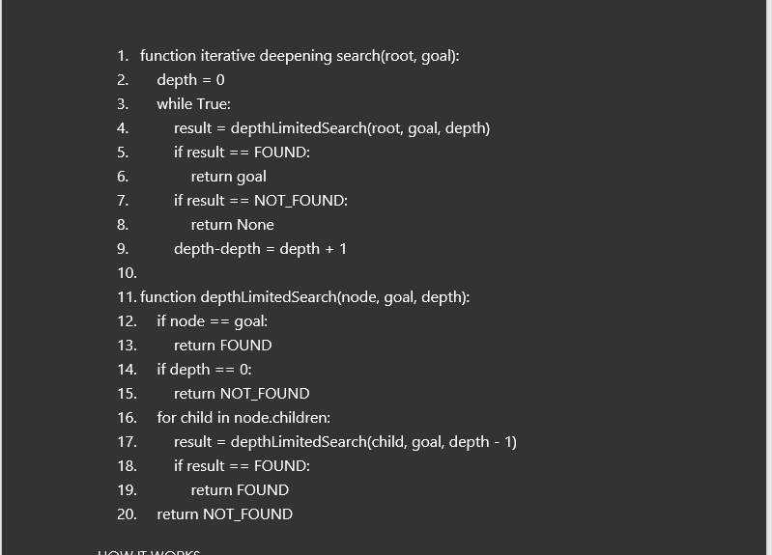
Pseudocode

Slide 8
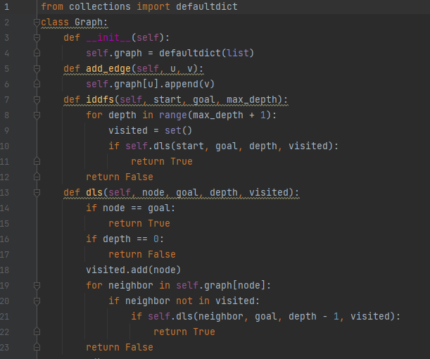
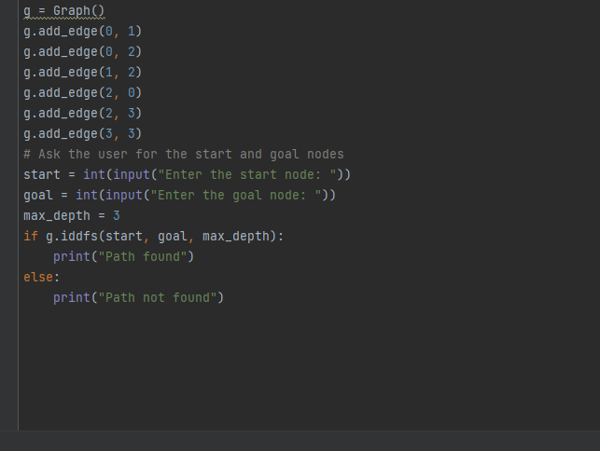
Python code

Slide 9
Time complexity
The time complexity of an algorithm quantifies the amount of time taken by an algorithm to run as a function of the length of the input.
The time complexity of IDS is O(b^d), where b is the branching factor and d is the depth of the shallowest goal node
In the previous example the time complexity will be 2^2.

Slide 10
Space Complexity
The space complexity of an algorithm quantifies the amount of space taken by an algorithm to run as a function of the length of the input.
The space complexity is the maximum space used by DFS in any iteration which is O(bd), where b is the branching factor and d is the depth of the shallowest goal
In the previous the space complexity will be (2X2) = 4 this means we need to store at least four nodes
The space complexity of IDS is O(bd), which is linear because it only needs to record the route it currently searching on

Slide 11
Advantages of IDS
It is memory efficient because it decreases the algorithm’s memory needs by not storing every node In the search area memory. It stores the nodes up to the current depth limit.
(IDS) ability to be utilized for both tree and graph search is its third benefit. This is due to the fact that ids is a generic search algorithm that works on any search space including tree or graph.

Slide 12
Disadvantages of IDS
It has the potential of visiting node more than once which might slow the search. The benefits of completeness and optimality frequently exceed this disadvantage .

Slide 13
Real life applications
Application
Robotics
Video games
Natural language processing

Slide 14

Questions

Slide 15
Thank You. IDS GROUP
AI
GROUP PRESENTATION

