Slide 1
Project idea presentation – Vote Tracker App
Draft May 1st

Slide 2
Project idea presentation – Vote Tracker App
Draft May 1st
Our idea is to create a website where you can get an overview of how Danish political parties have voted in the past.
In our web application it will be possible to choose a specific party and a specific time period and then get a list of all the laws they have voted for and against.
Data on this is publicly available on https://oda.ft.dk/ but it is not easy to get an overview on how a given party has voted.
The data exists in the oda.ft.dk database in the same structure as indicated in the E/R diagram, except the weak entity ”Party_Votes” which is created from data parsed from a text field in the ”Vote” entity

Slide 3
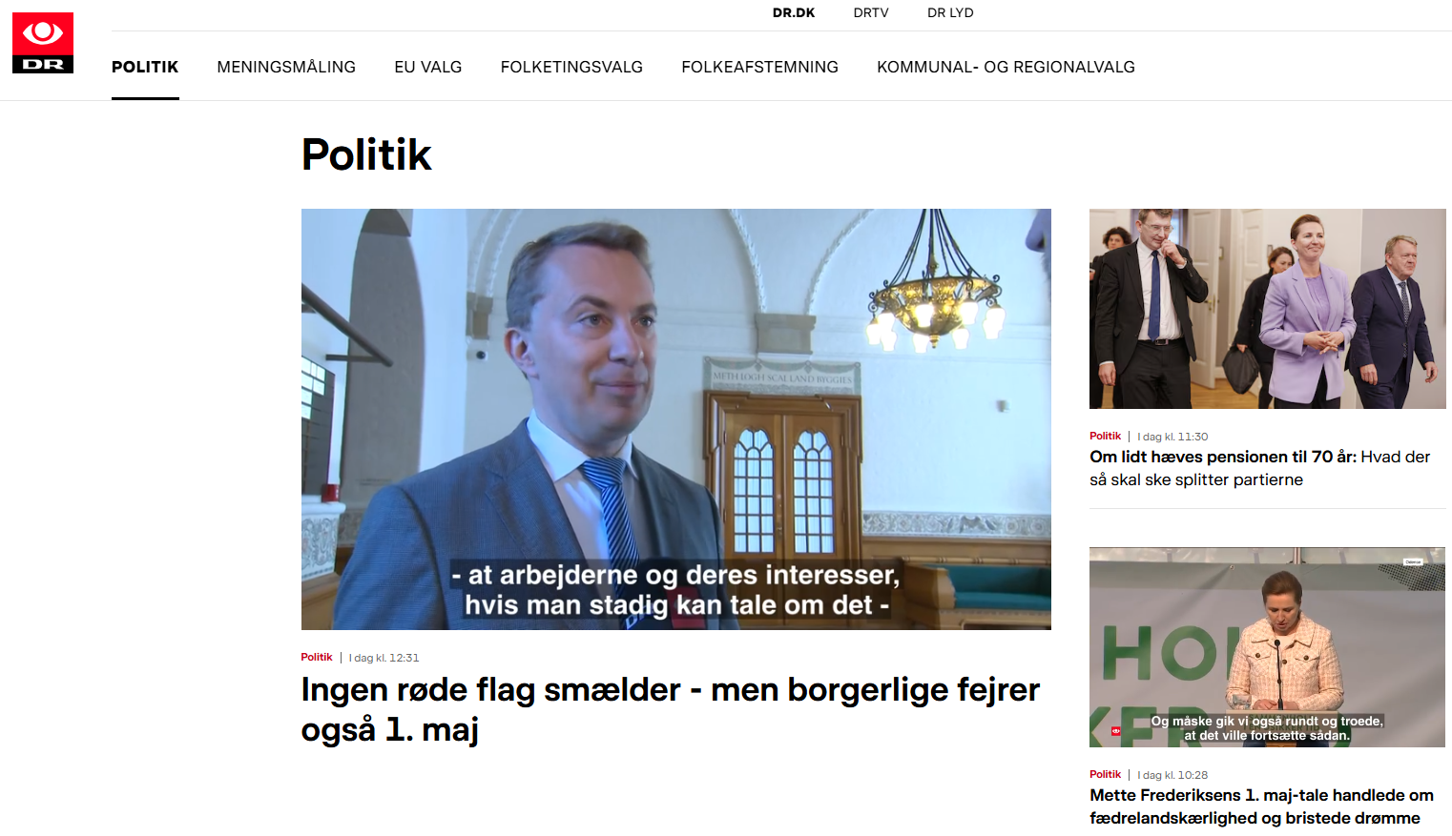
Interfaces for Getting Voting Information (I)
Search the News

Slide 4
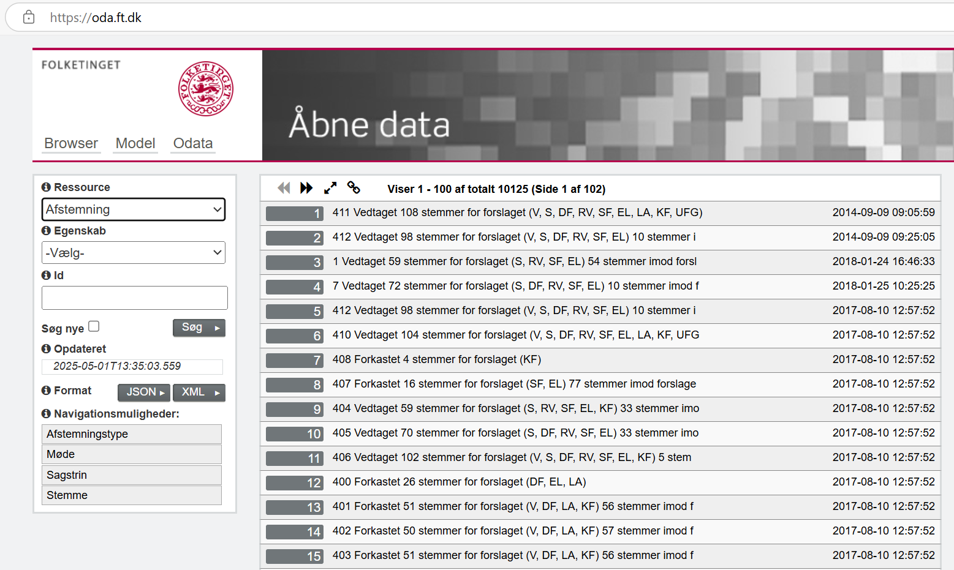
Interfaces for Getting Voting Information (II)
Search Folketinget’s Database Online

Slide 5
E/R Diagram – Vote Tracker App
Draft May 1st
Title_Short
Party
VoteCast
Case_ID
Case_Type
Cast at
Case
Party_Votes
Part of
Conclusion
Number
At
CaseStep
Meeting_ID
Adopted
CaseStep_ID
CaseStep_TYPE
Vote
Update_Date
Type_ID
At
Meeting
Vote_ID
CaseStep_ID
Meeting_ID
Meeting_Date
Attribute to be shown

