Slide 1

A computation of the Ninth Dedekind Number using FPGA Supercomputing
Patrick De Causmaecker
Lennart Van Hirtum

Slide 2

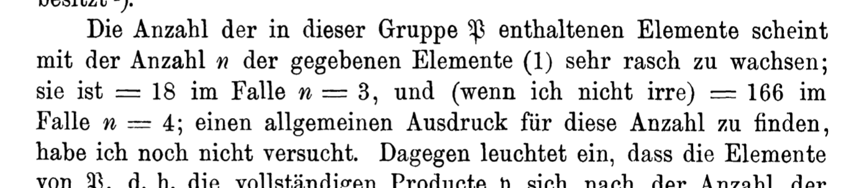
Richard Dedekind, 1897

Slide 3
a(0)-a(4) - Dedekind (1897)
a(5) - Church (1940)
a(6) - Ward (1946)
a(7) - Church (1965, verified by Berman and Kohler, 1976)
a(8) - Wiedemann (1991)
a(9) - Jäkel (2023)
a(9) - Van Hirtum, De Causmaecker, Goemaere, Kenter, Riebler, Lass, and Plessl (Independent Computation, 2023)
(https://oeis.org/A000372 )
n | D(n)
0 | 2
1 | 3
2 | 6
3 | 20
4 | 168
5 | 7581
6 | 7828354
7 | 2414682040998
8 | 56130437228687557907788
9 | 286386577668298411128469151667598498812366

Slide 4
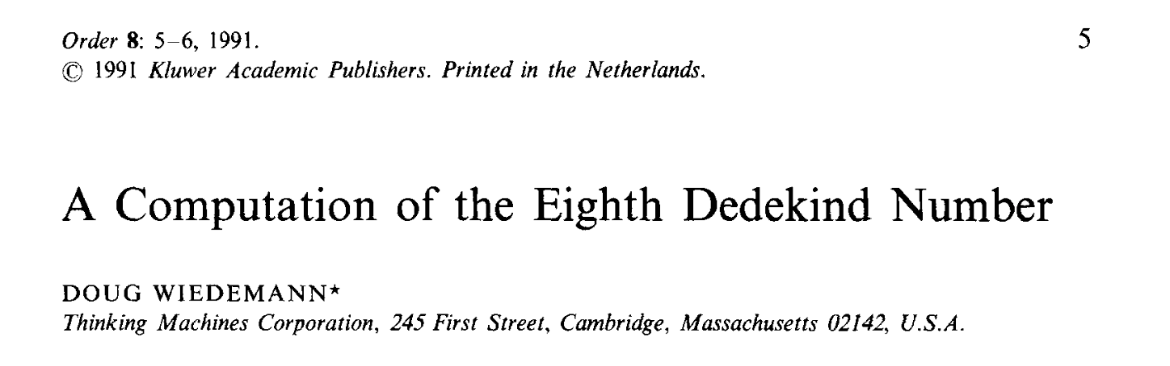
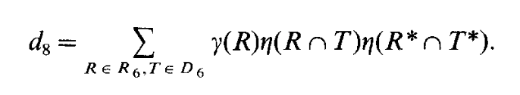
Doug Wiedemann, 1991

Slide 5
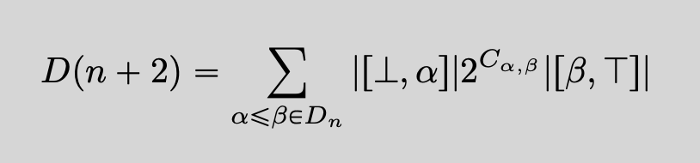
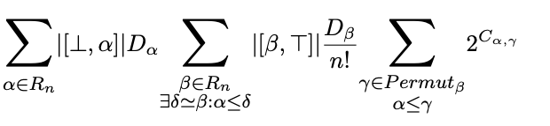
Lennart Van Hirtum, 2023

Slide 6
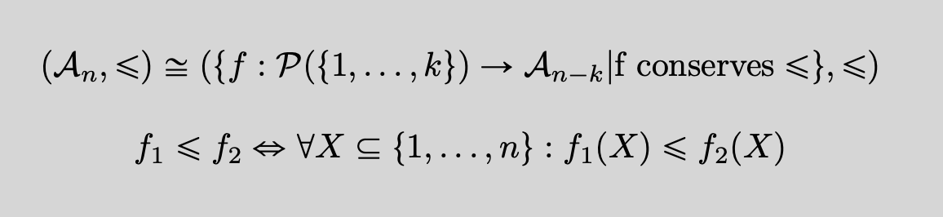

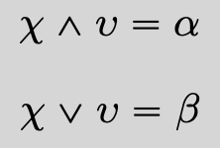




“P-Coefficient”

Slide 7

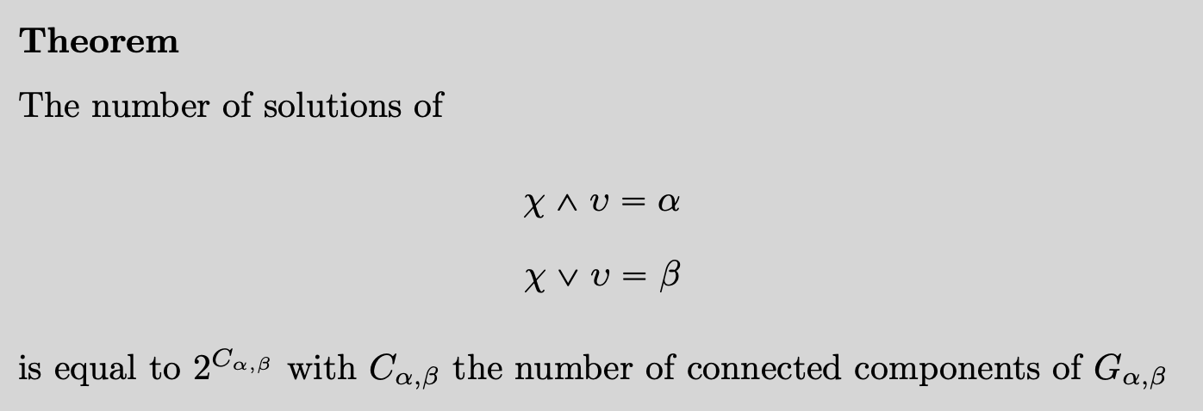
“P-Coefficient”

Slide 8
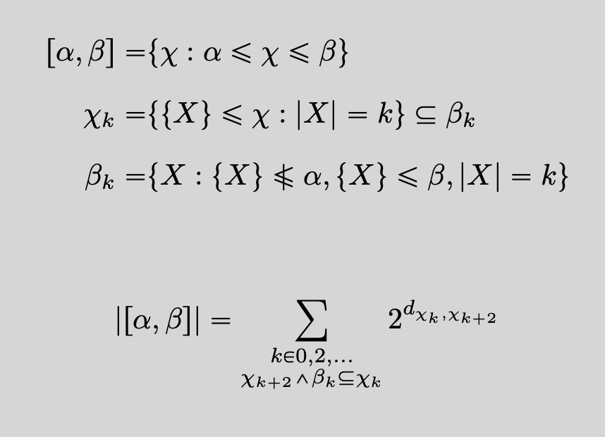
Intervals

Slide 9
Intervals
Our computation
Compute all non symmetric intervals in D₇
Compute the P-coefficients
Sum
Pawelski’s improvement for the intervals
A version of Wiedemann’s Formula

Slide 10
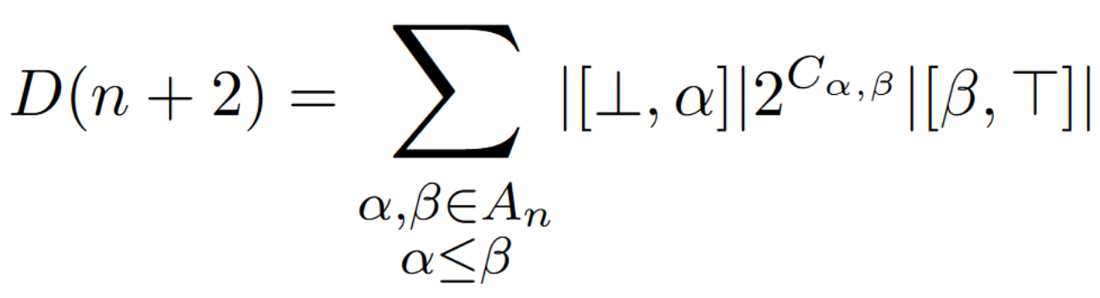
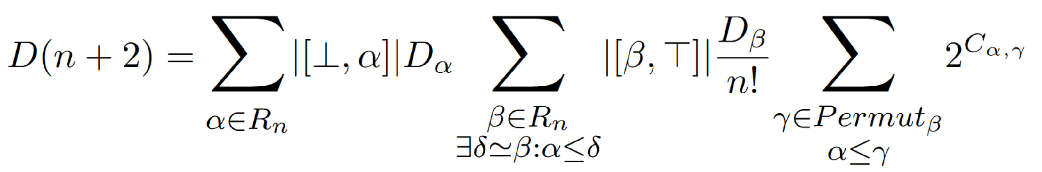
Expanded Pcoeff Formula

Slide 11
One Final Symmetry

Slide 12

Total work for D(9)
490M
*45M
*5040
$5.57∗{10}^{18} C_{α,γ}$ values in total!

Slide 13
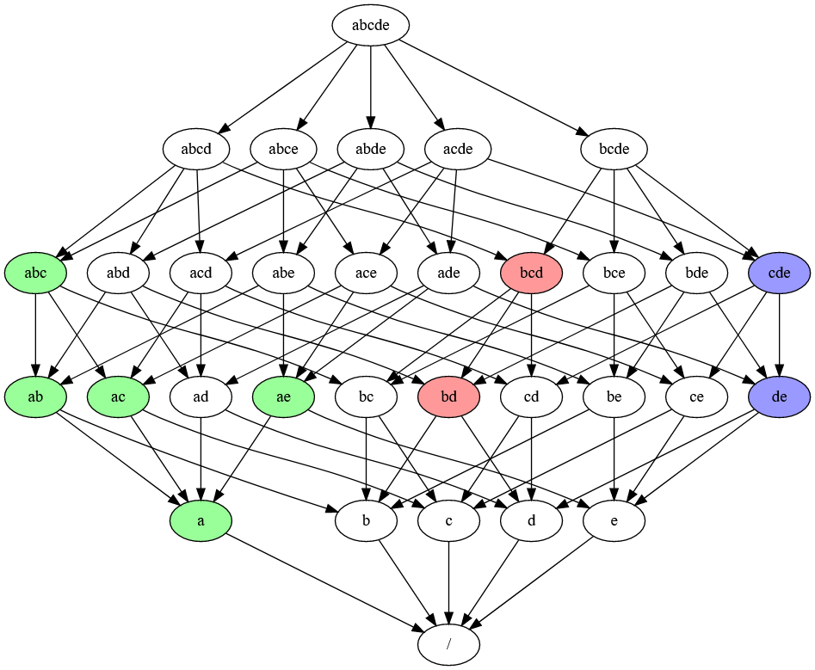

Connected Component Counting
$$C_{α,γ}=3$$

Slide 14
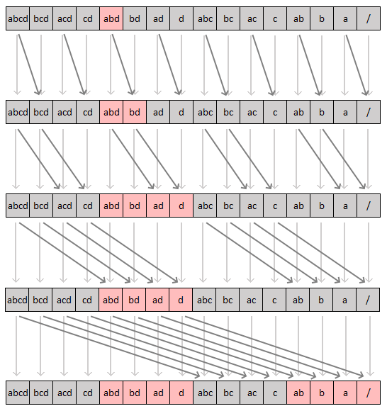
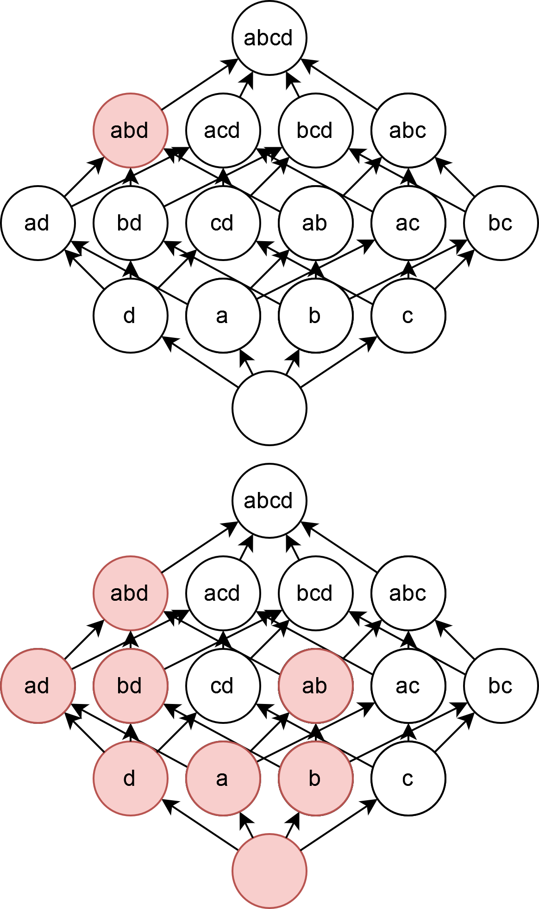
Prime Candidate for FPGA Impl

Slide 15
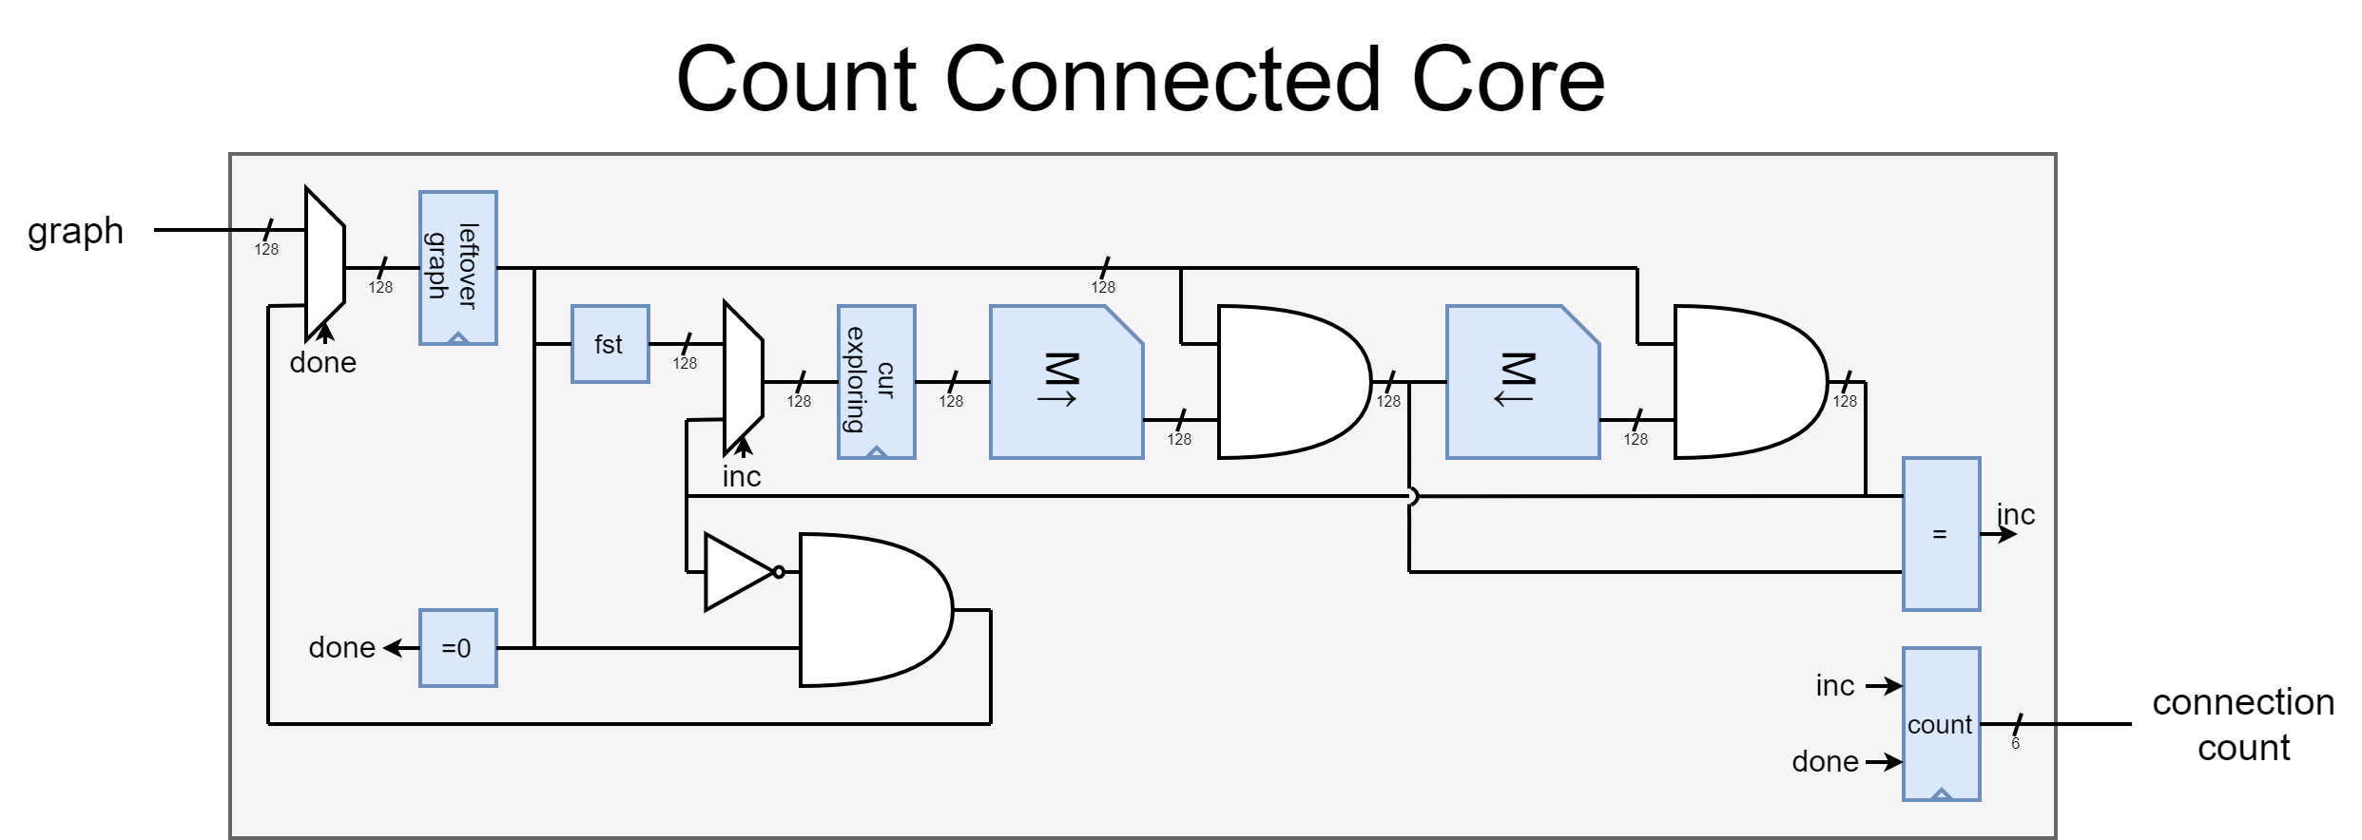
Count Connected Core

Slide 16
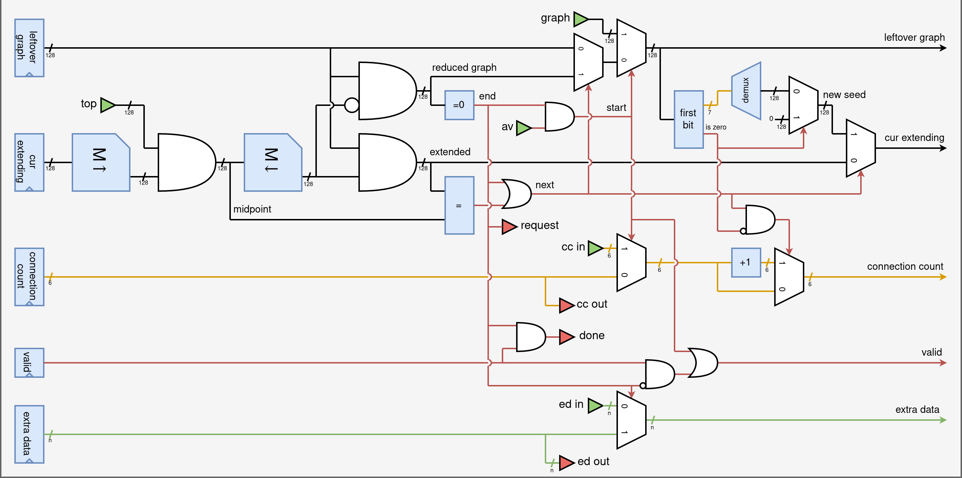
Expanded Pcoeff Formula
16

Slide 17
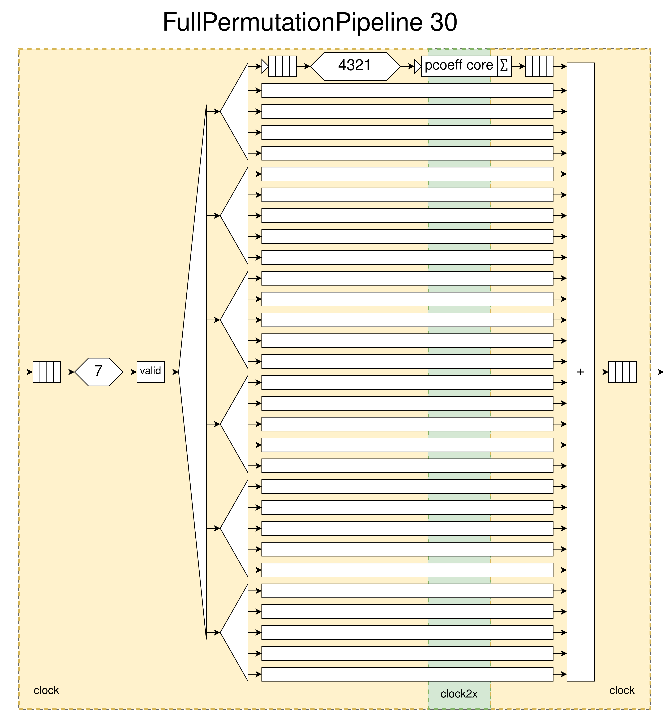
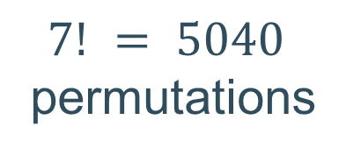
5040 Permutation splitter
$7! = 5040$
permutations

Slide 18
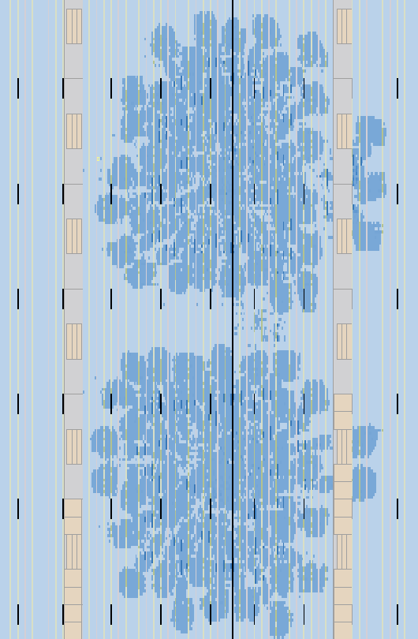
FPGA Die

Slide 19
2 Pipelines

Slide 20
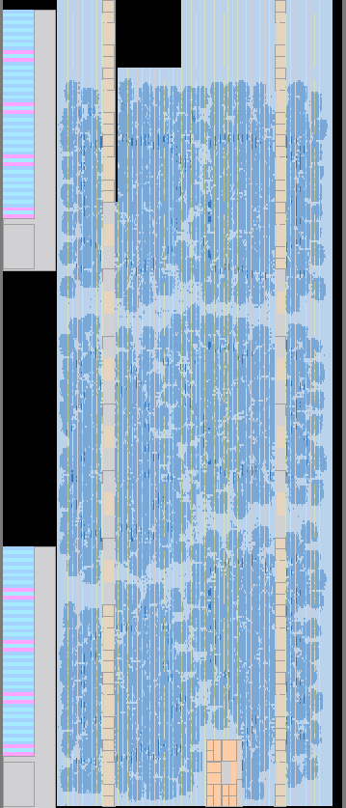
6 pipelines

Slide 21
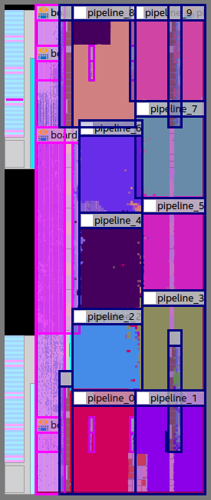
Full FPGA Design
450 MHz!
92% Logic Density
300 Mbots/s

Slide 22
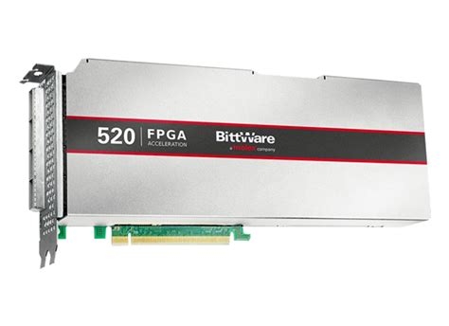
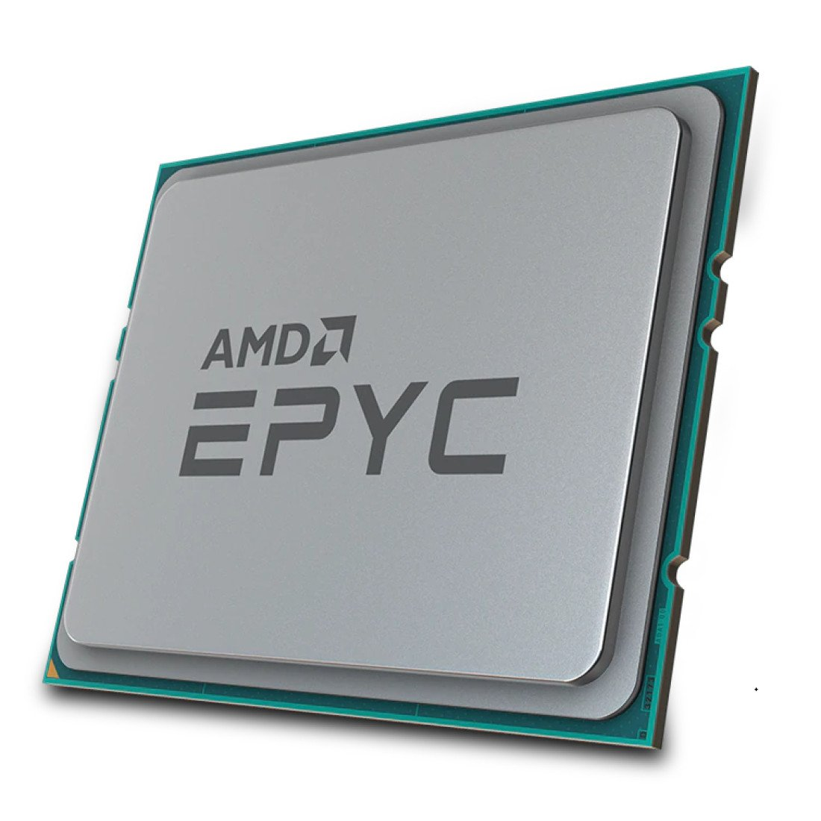
Performance Comparison
64 Cores
~0.6M bots/sec
300 P-Coëff Cores
300M bots/sec
500x
Faster!

Slide 23
Computation on Noctua 2
15’000 jobs
33’000 tops/job
100 mins / job
16 FPGA servers
Sporadic Undetected Bitflips
Bad synthesis for dense designs
Clock Speed Struggles
PCIE Transfer limits

Slide 24
Computation on Noctua 2
After 4 months on Noctua 2
47’000 FPGA hours in total
March 8th 2023, at 5pm:
286386577668298411128469151667598498812366
https://arxiv.org/abs/2304.03039
https://github.com/VonTum/Dedekind

Slide 25
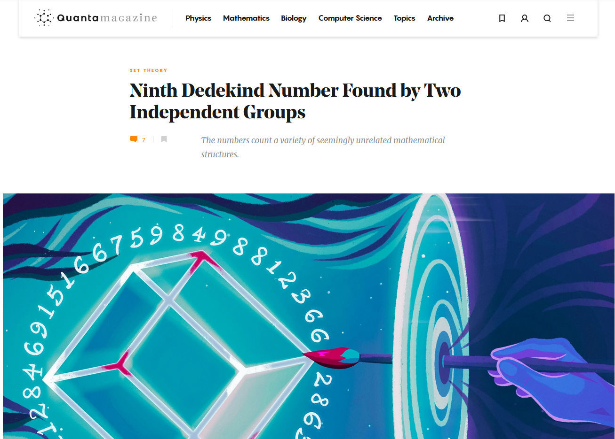
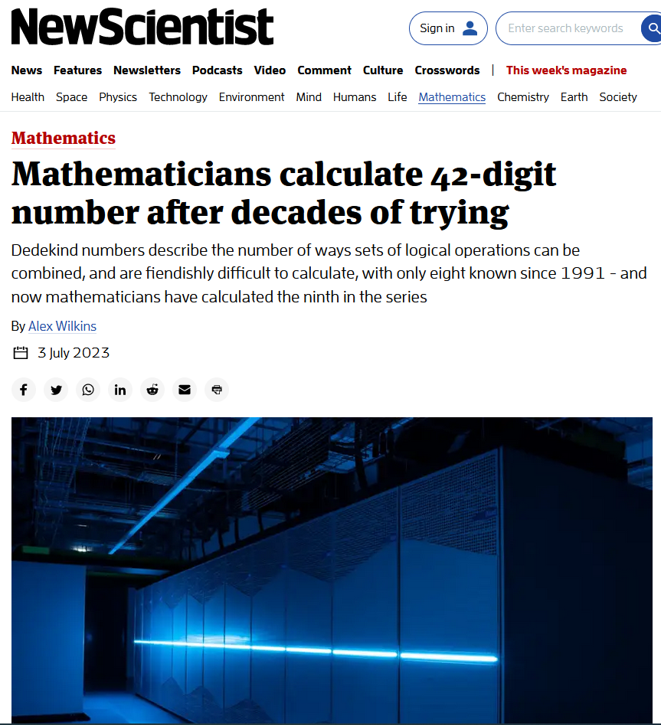

Media Attention

Slide 26
Problems Problems Problems
Sporadic Undetected Bitflips
Bad synthesis for dense designs
Clock Speed Struggles
PCIE Transfer limits

