Slide 1
9th Dedekind Progress

Slide 2
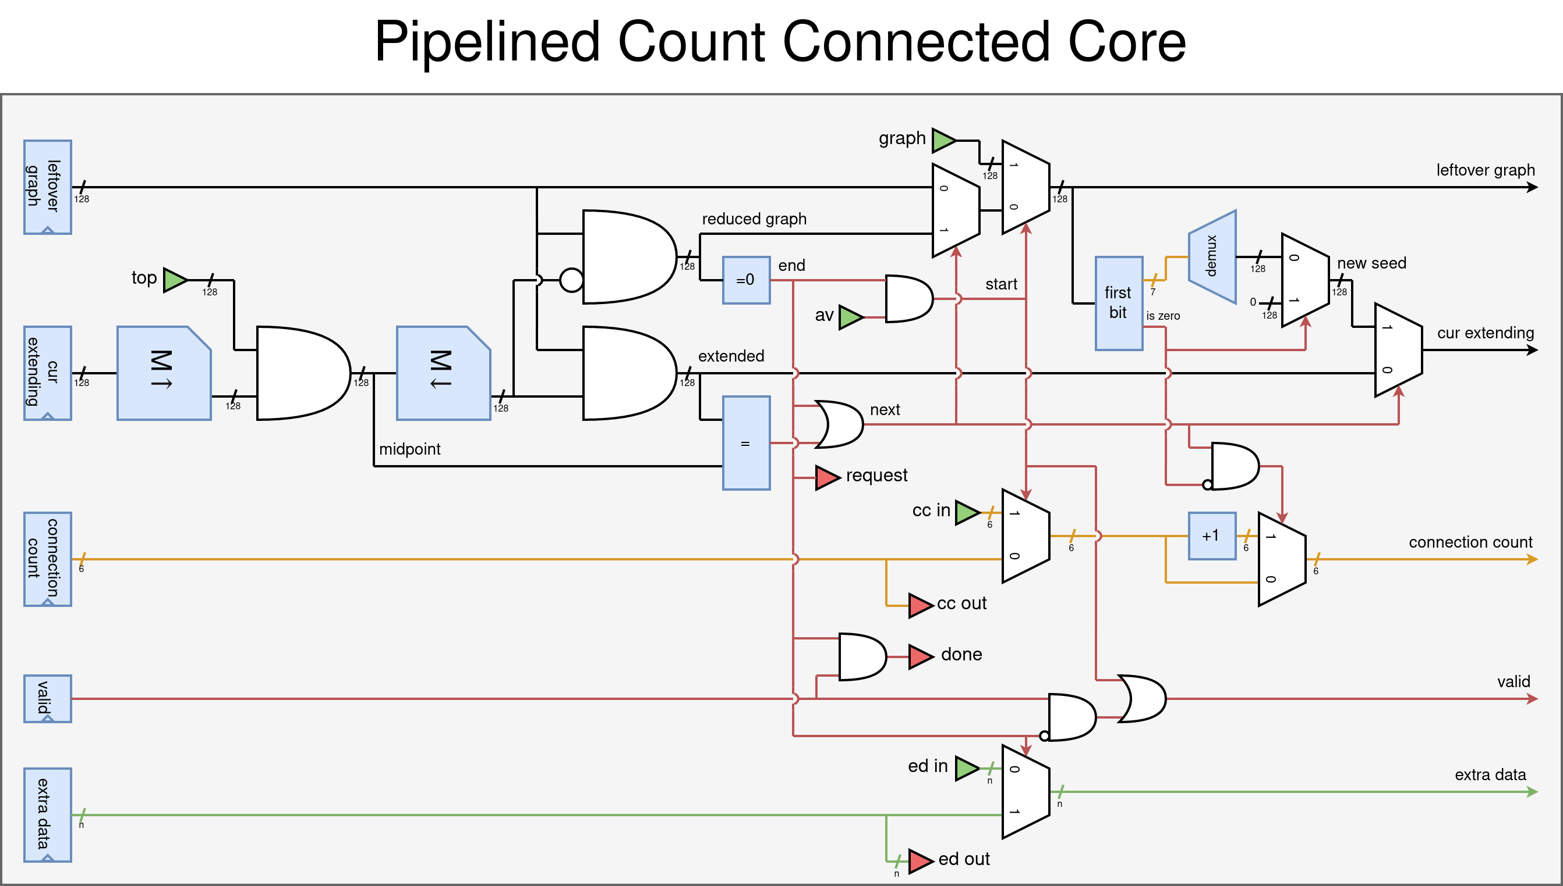
Pipelined CountConnected Core

Slide 3
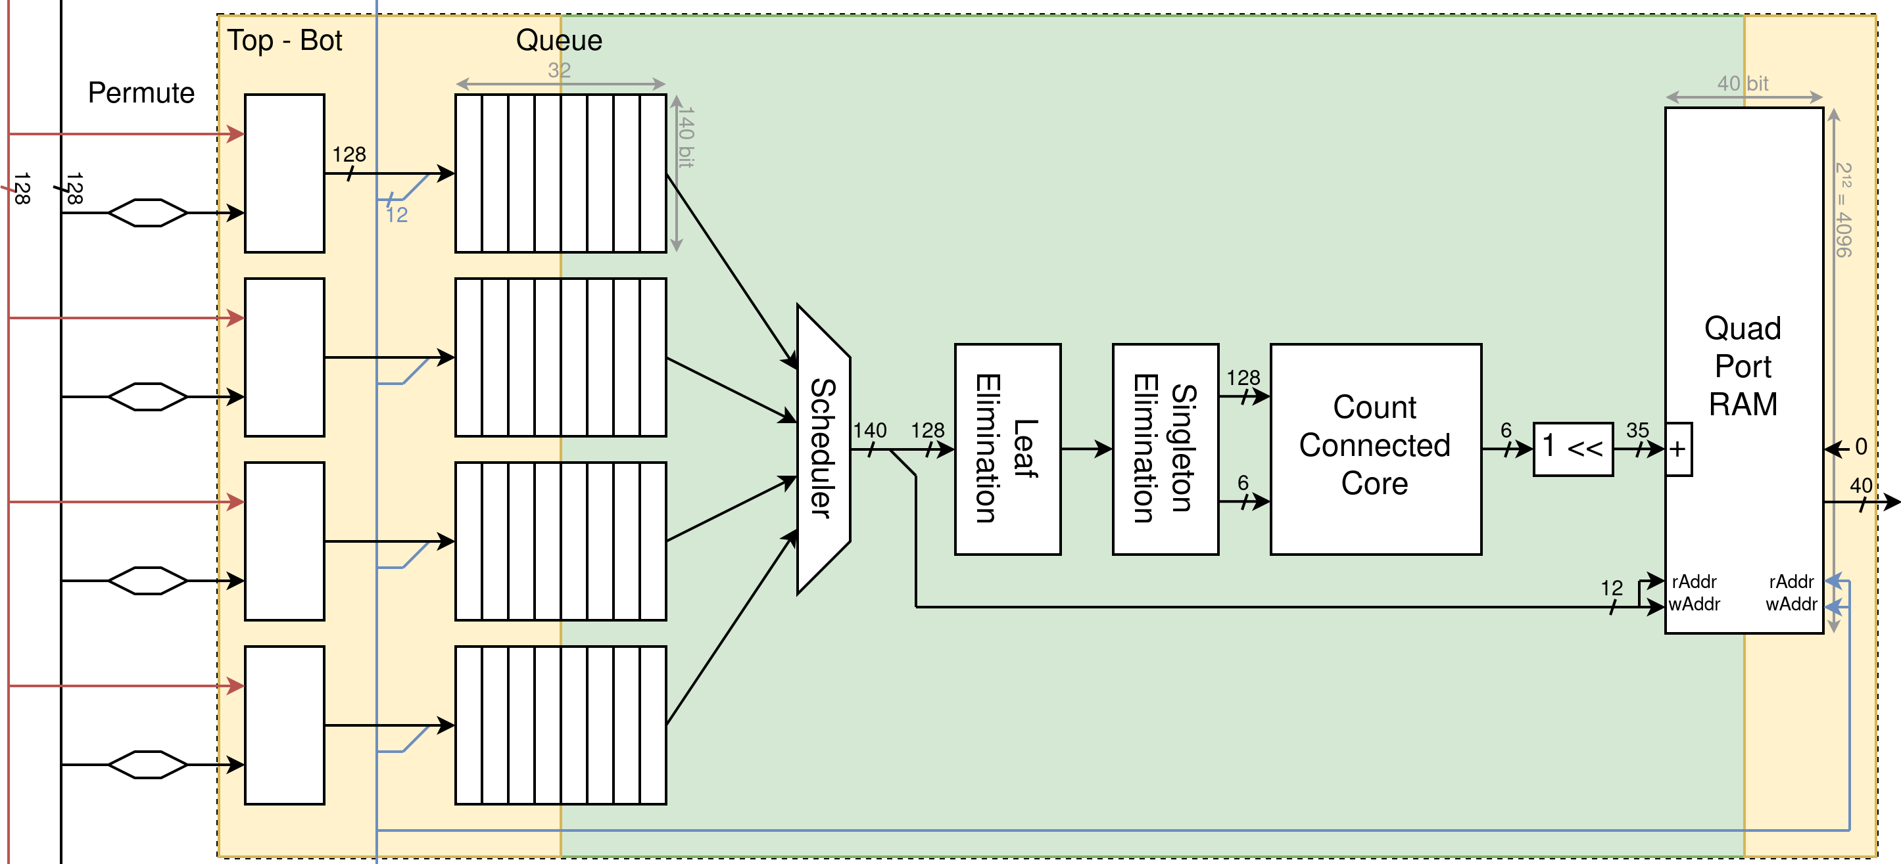
Full Pipeline

Slide 4
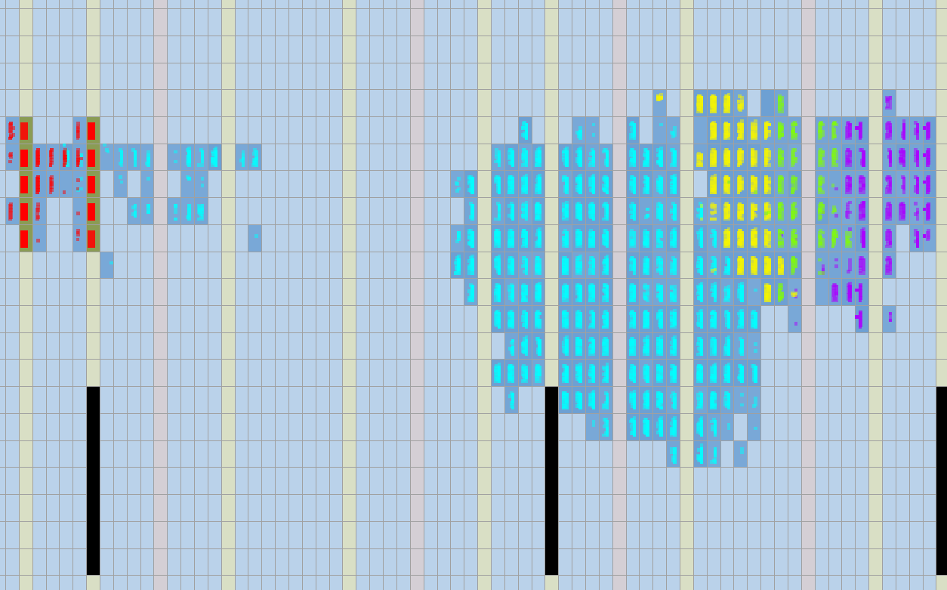
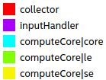
Full Pipeline implemented

Slide 5
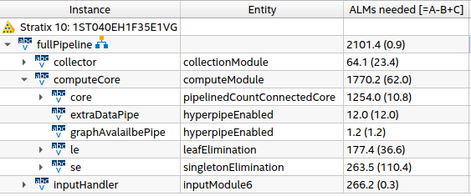
Resources and Fmax

Slide 6
Changes compared to predictions
 | Predicted | Implementation
ALMs/compute module | 700 | 2100
Pipelines synthesizeable in 900’000 ALMs | 1260 | 360
Fmax | 500MHz | 700MHz
Avg Cycles/Permutation | ~5.074 | ~4.05
betas/second | 493 million | 246 million
FPGA Hours Required | 25123 | 50354
FPGA Budget: 50000 hours!

Slide 7
Mathemathical Developments
Halving the total work:
  Deduplication of α-β, β’-α’ pairs.
  93 second D(8)
Proof of D(9) evenness.
  D(9) % 2 == 0

Slide 8
Where you come in
Guidance and Advice:
  How realistic is an Fmax of 800MHz?
    Support on 520N cards?
      Heat? Chip Speed Grade?
  Full chip synthesis (Synthesize on Noctua?)
    Pitfalls?
    FPGA Initialization time?
    FPGA Integrity checking after run?
  OpenCL integration

Slide 9
End
(Also I still need that Quartus Licence)

