Slide 1
9th Dedekind Project

Slide 2
Structure
Introduction to the problem
Core Formula
Implementation
Numbers

Slide 3
Dedekind Numbers
D(0) | 2 | Dedekind (1897)
D(1) | 3 | Dedekind (1897)
D(2) | 6 | Dedekind (1897)
D(3) | 20 | Dedekind (1897)
D(4) | 168 | Dedekind (1897)
D(5) | 7581 | Church (1940)
D(6) | 7828354 | Ward (1946)
D(7) | 2414682040998 | Church (1965)
D(8) | 56130437228687557907788 | Wiedemann (1991)
D(9) | ? | ?

Slide 4
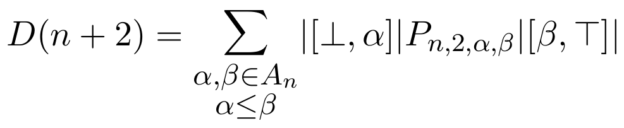
Core “Jump” Formula

Slide 5
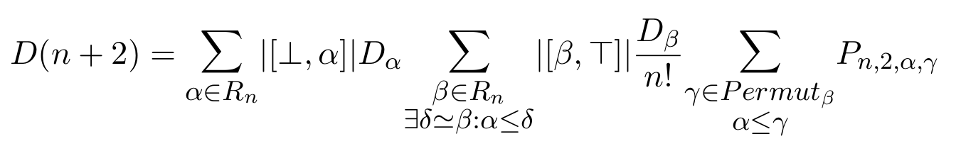
Modified Formula

Slide 6
Modified Formula
“Tops”
“Bottoms”
“Permutations”

Slide 7
Modified Formula
“Tops”
“Bottoms”
“Permutations”
For D(9): 490’013’148 tops ~91’000’000 bottoms/top ~250/5040 permutations/bottom

Slide 8
Modified Formula
“Tops”
“Bottoms”
“Permutations”
For D(9): 490’013’148 tops ~91’000’000 bottoms/top ~250/5040 permutations/bottom
Total bottoms: 4.59 * 10^16 Total terms: 11483553838459169213 ≈ 1.148 * 10^19

Slide 9
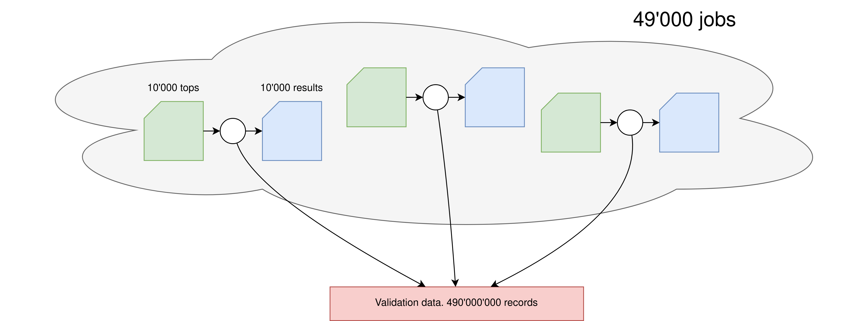
Jobs

Slide 10
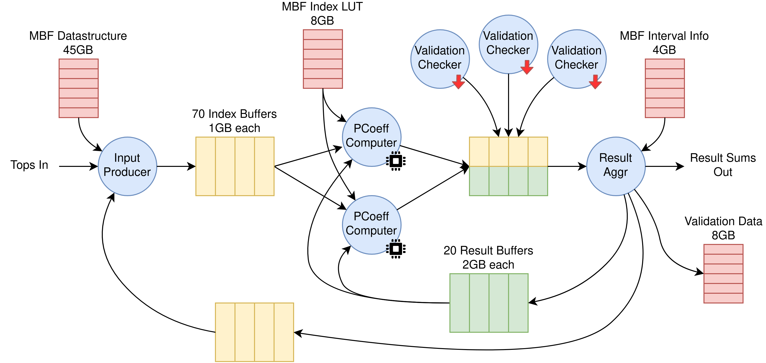
Threads

Slide 11
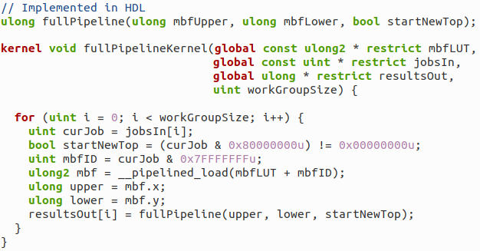
OpenCL

Slide 12
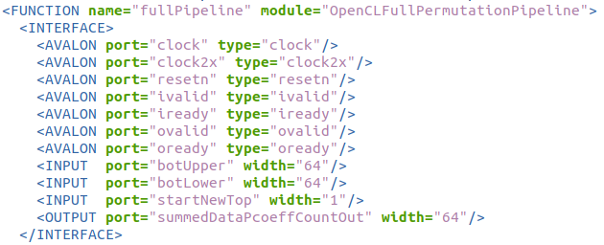
Kernel

Slide 13
Kernel
Not Documented!

Slide 14
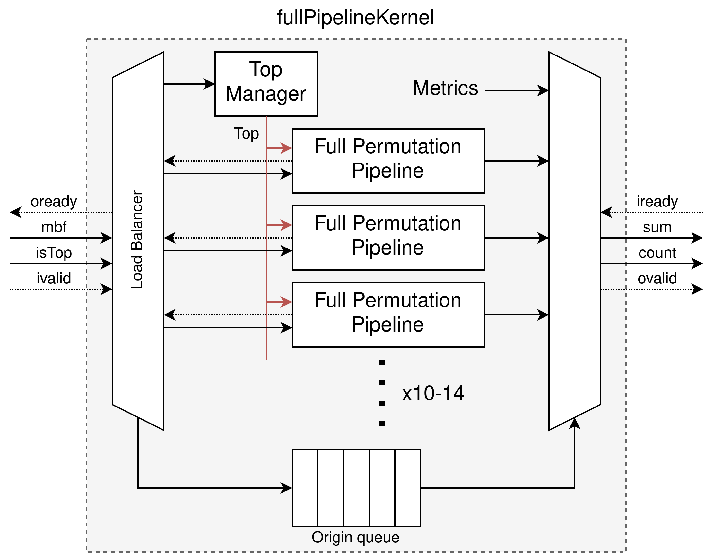
fullPipeline

Slide 15
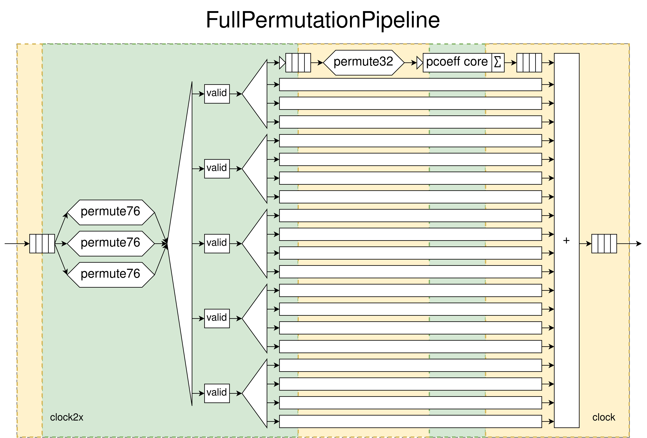
FullPermutationPipeline

Slide 16
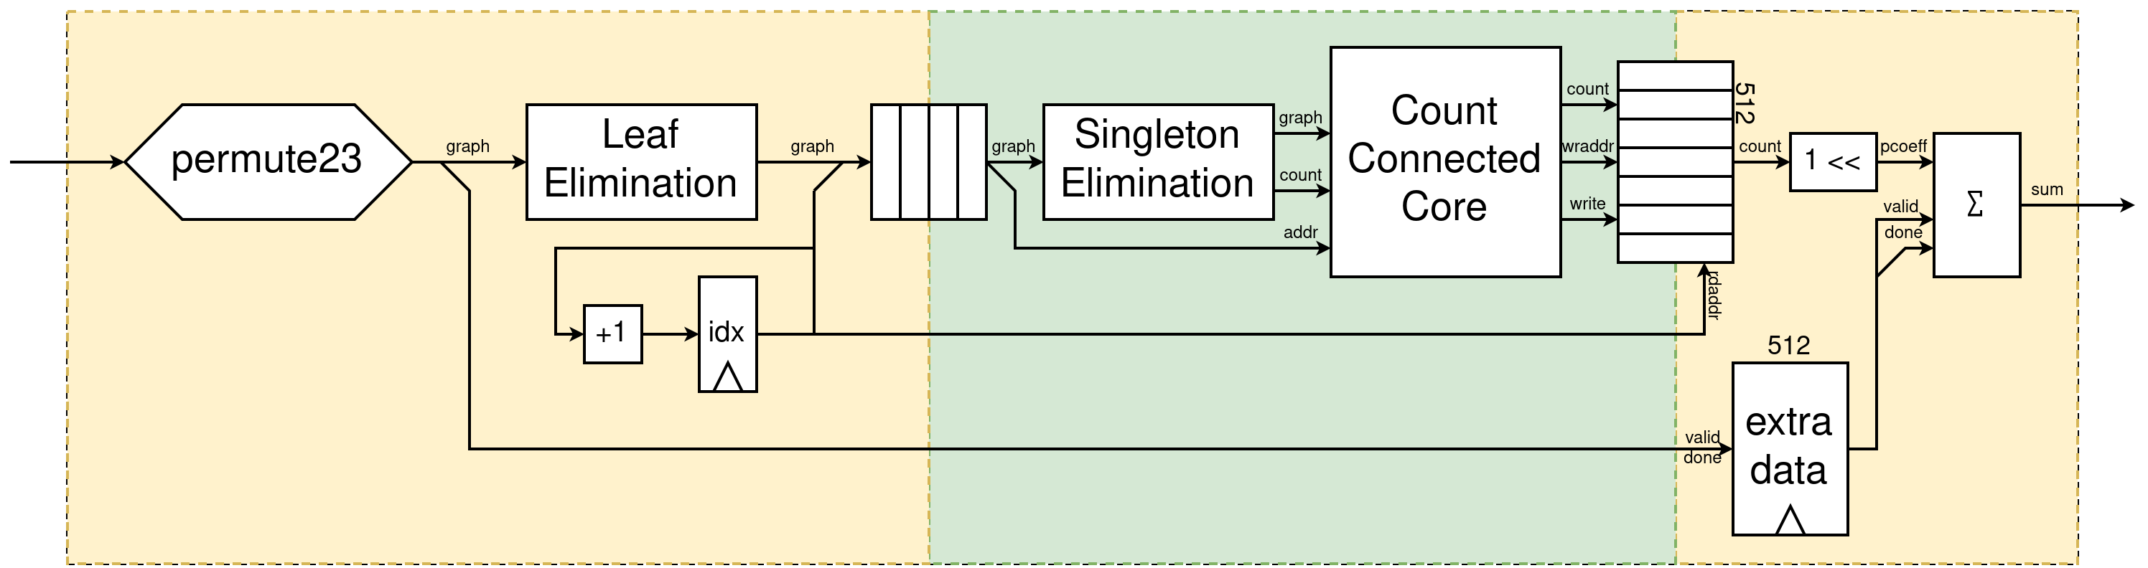
Pcoeff Core

Slide 17
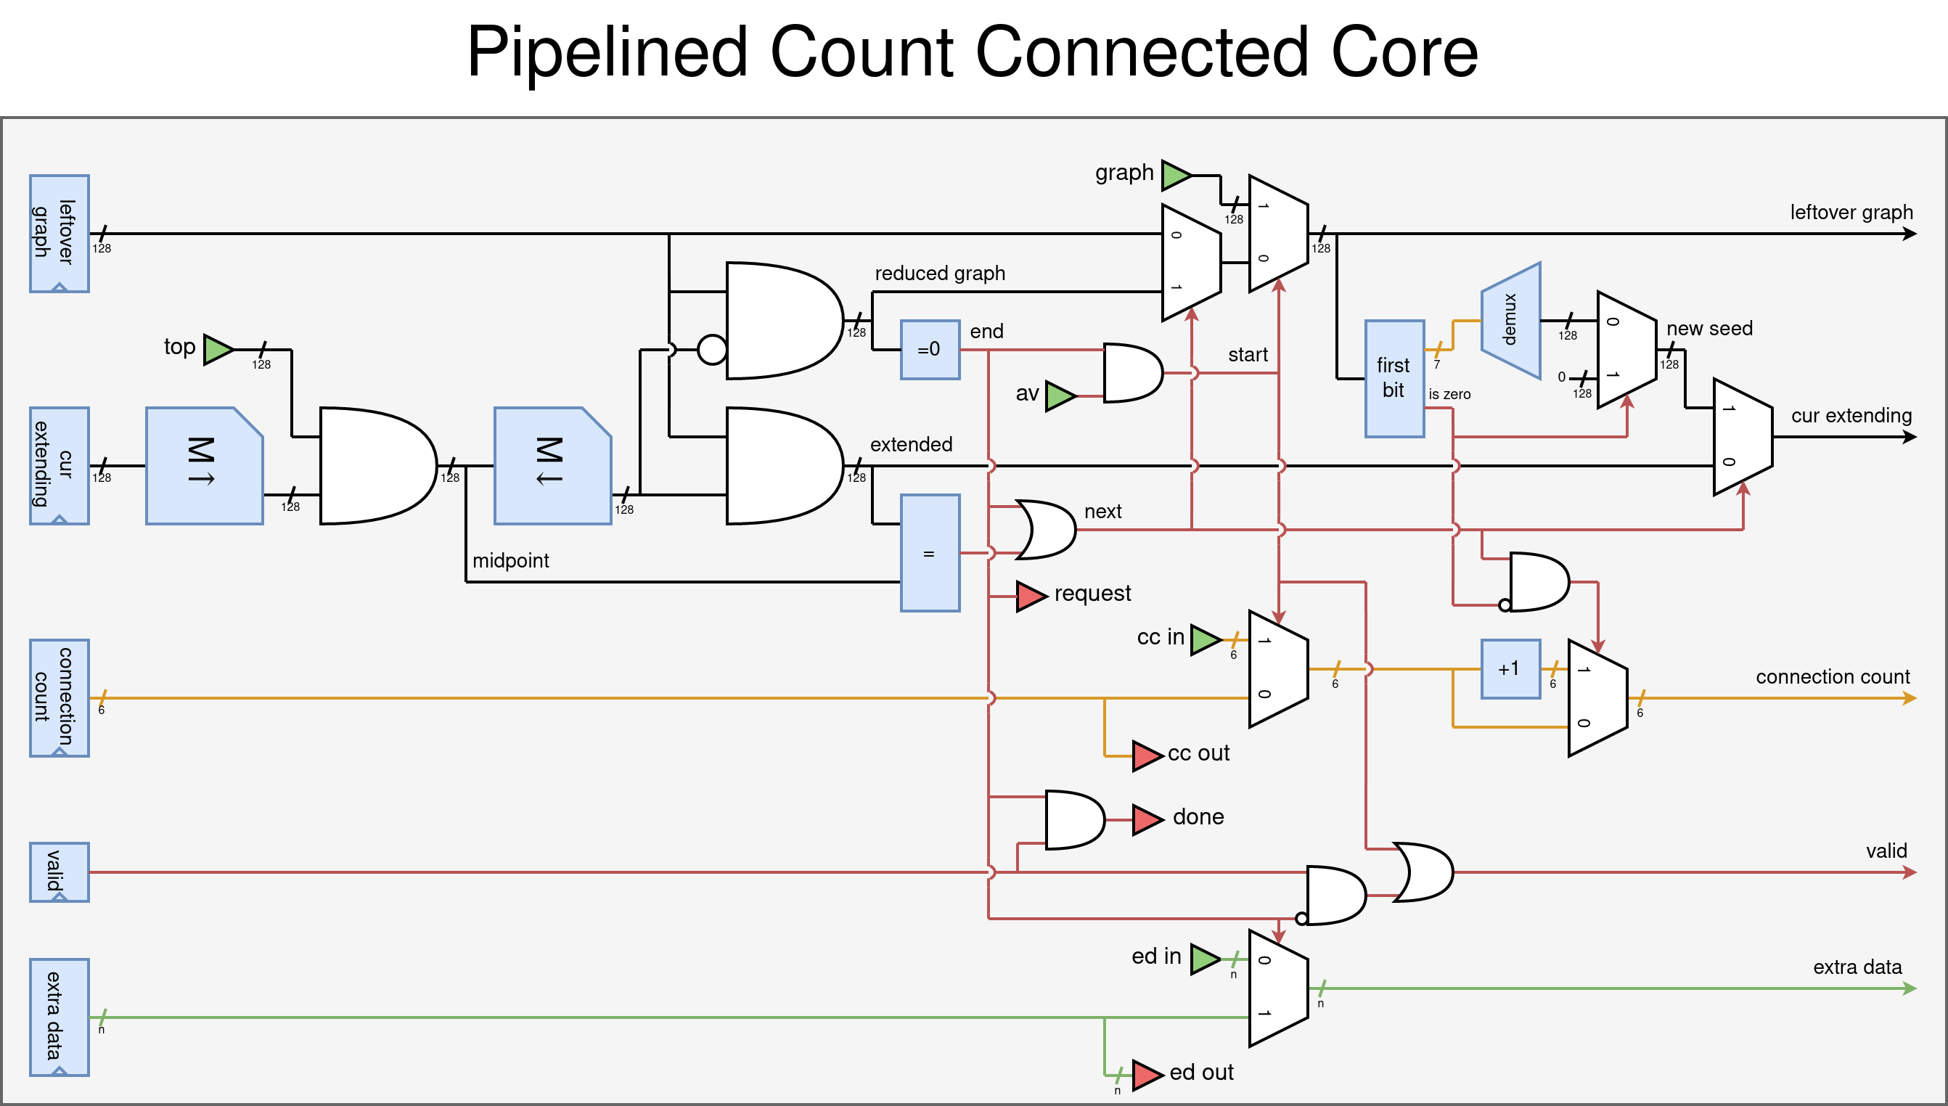
Pipelined Count Connected Core

Slide 18
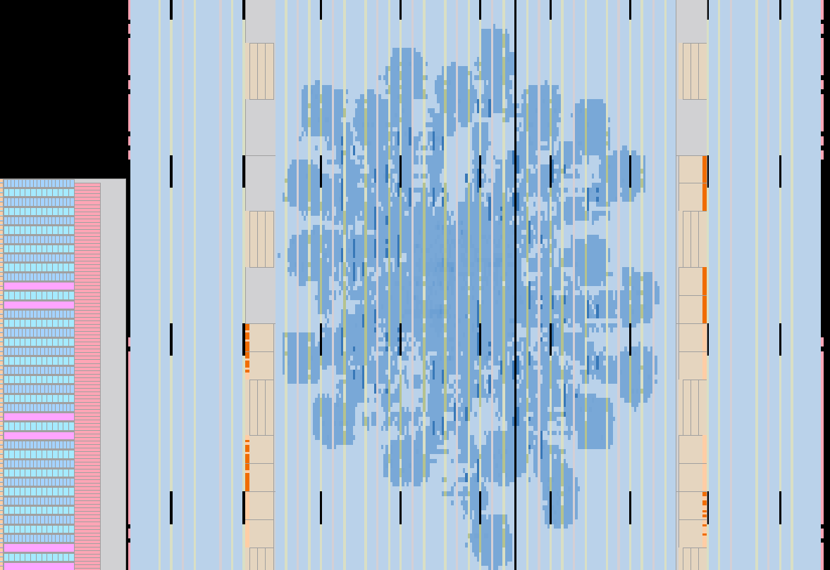
fullPipeline On Chip

Slide 19
The Numbers
2.3 * 10^16 bottoms (half due to deduplication)
5.74 * 10^18 total permutations
At 100% Efficiency:
  1 CCC processes 0.5 permutations/cycle.
  280 CCC: ~140 permutations/cycle
    = 35’000’000’000 permutations/s at 250MHz
    = 46000 FPGA Hours
    Budget 50000 FPGA Hours

Slide 20
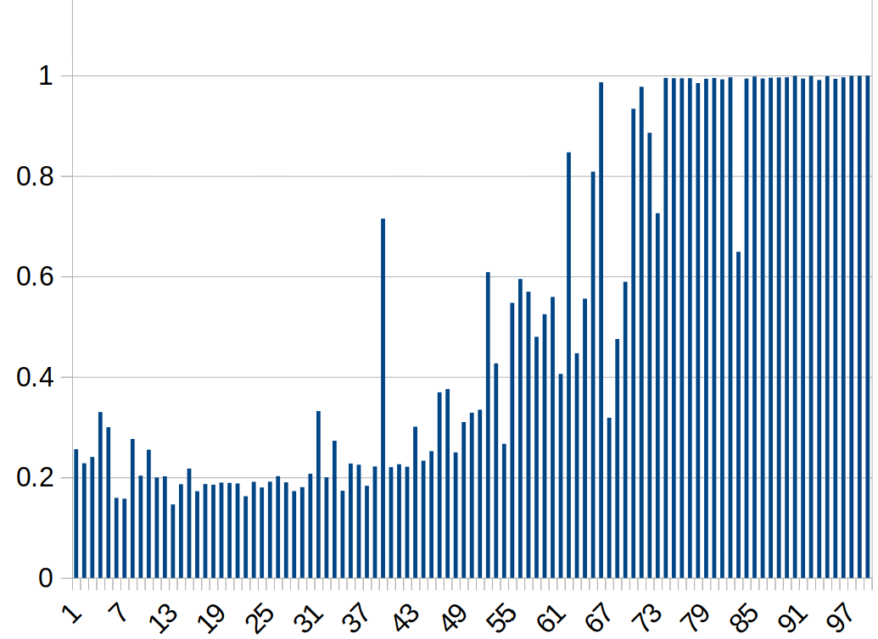
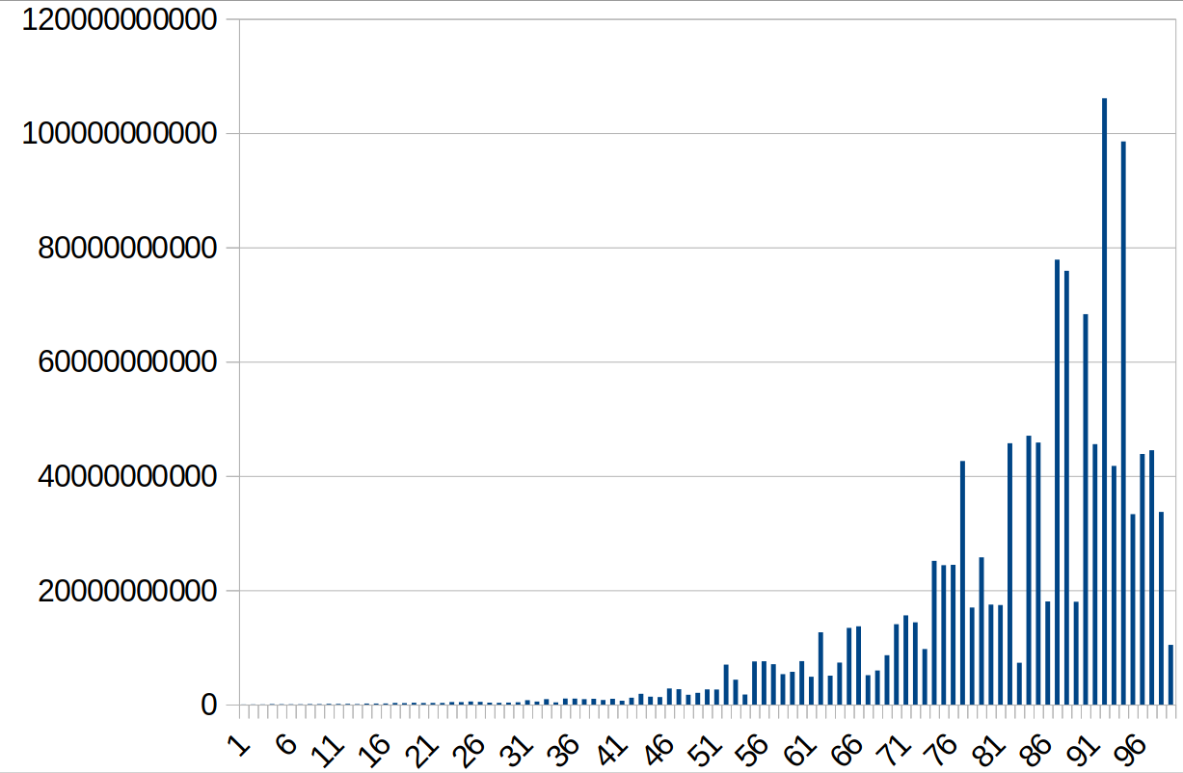
Plots

Slide 21
Questions to you
NDRangeKernel __global_id() ordered?
Best job size?
Submitting large (10’000) number of jobs?
Noctua2:
  Have a look at Xilinx FPGAs

