Slide 1
The 9th Dedekind Number
A case for FPGA Supercomputing
“The N^{th} Dedekind number is the number of Monotonic Boolean Functions in N variables”

Slide 2
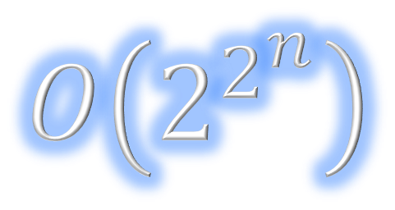
D(0) = | 2 | Dedekind (1897)
D(1) = | 3 | Dedekind (1897)
D(2) = | 6 | Dedekind (1897)
D(3) = | 20 | Dedekind (1897)
D(4) = | 168 | Dedekind (1897)
D(5) = | 7581 | Church (1940)
D(6) = | 7828354 | Ward (1946)
D(7) = | 2414682040998 | Church (1965)
D(8) = | 56130437228687557907788 | Wiedemann (1991)
D(9) = | ????

Slide 3
D(0) = | 2 | Dedekind (1897)
D(1) = | 3 | Dedekind (1897)
D(2) = | 6 | Dedekind (1897)
D(3) = | 20 | Dedekind (1897)
D(4) = | 168 | Dedekind (1897)
D(5) = | 7581 | Church (1940)
D(6) = | 7828354 | Ward (1946)
D(7) = | 2414682040998 | Church (1965)
D(8) = | 56130437228687557907788 | Wiedemann (1991)
D(9) = | 286386577668298411128469151667598498812366

Slide 4
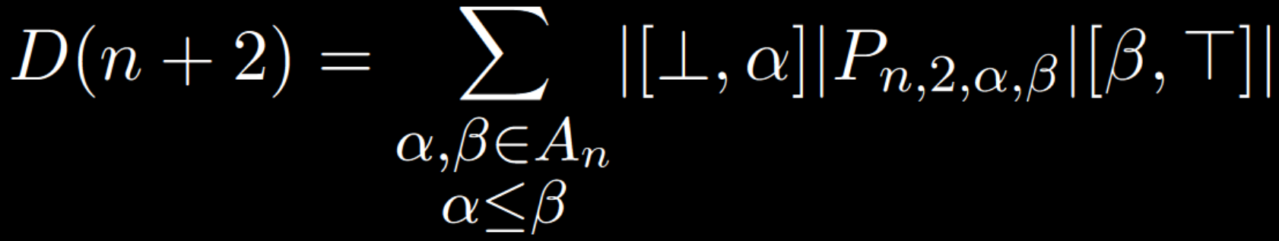
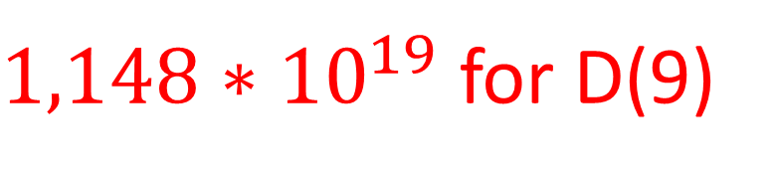

Slide 5
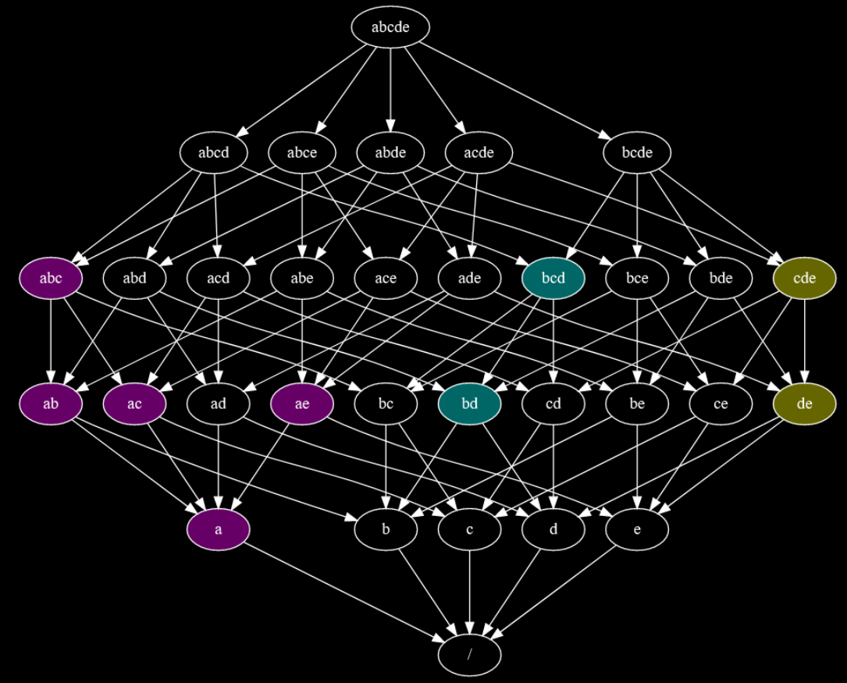
Computing P-Coëfficients
Boolean Operations
Fixed problem size
Very branchy
Bad fit for CPU
Can’t use SIMD
Very bad fit for GPU
Excellent for FPGA!

Slide 6
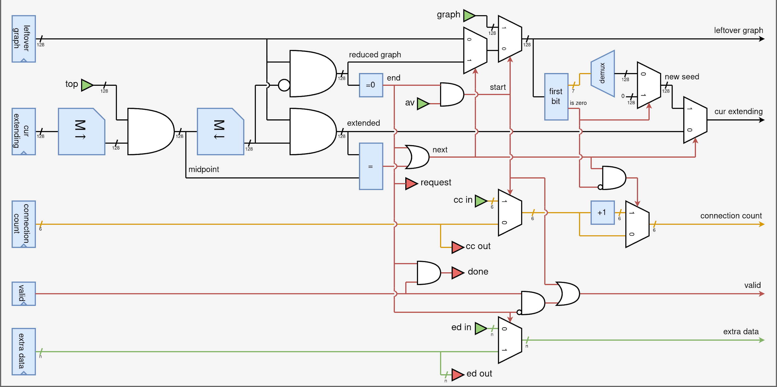

Slide 7
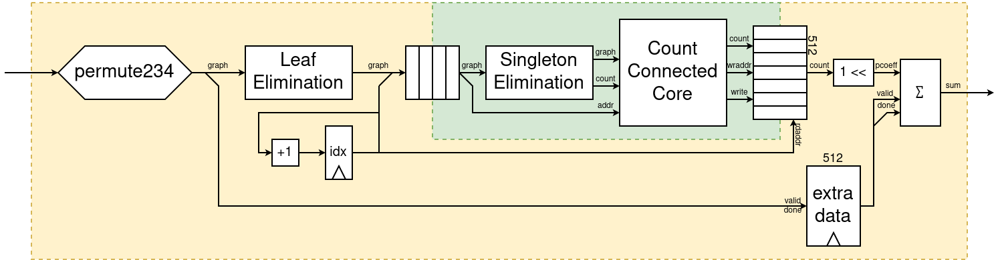

Slide 8
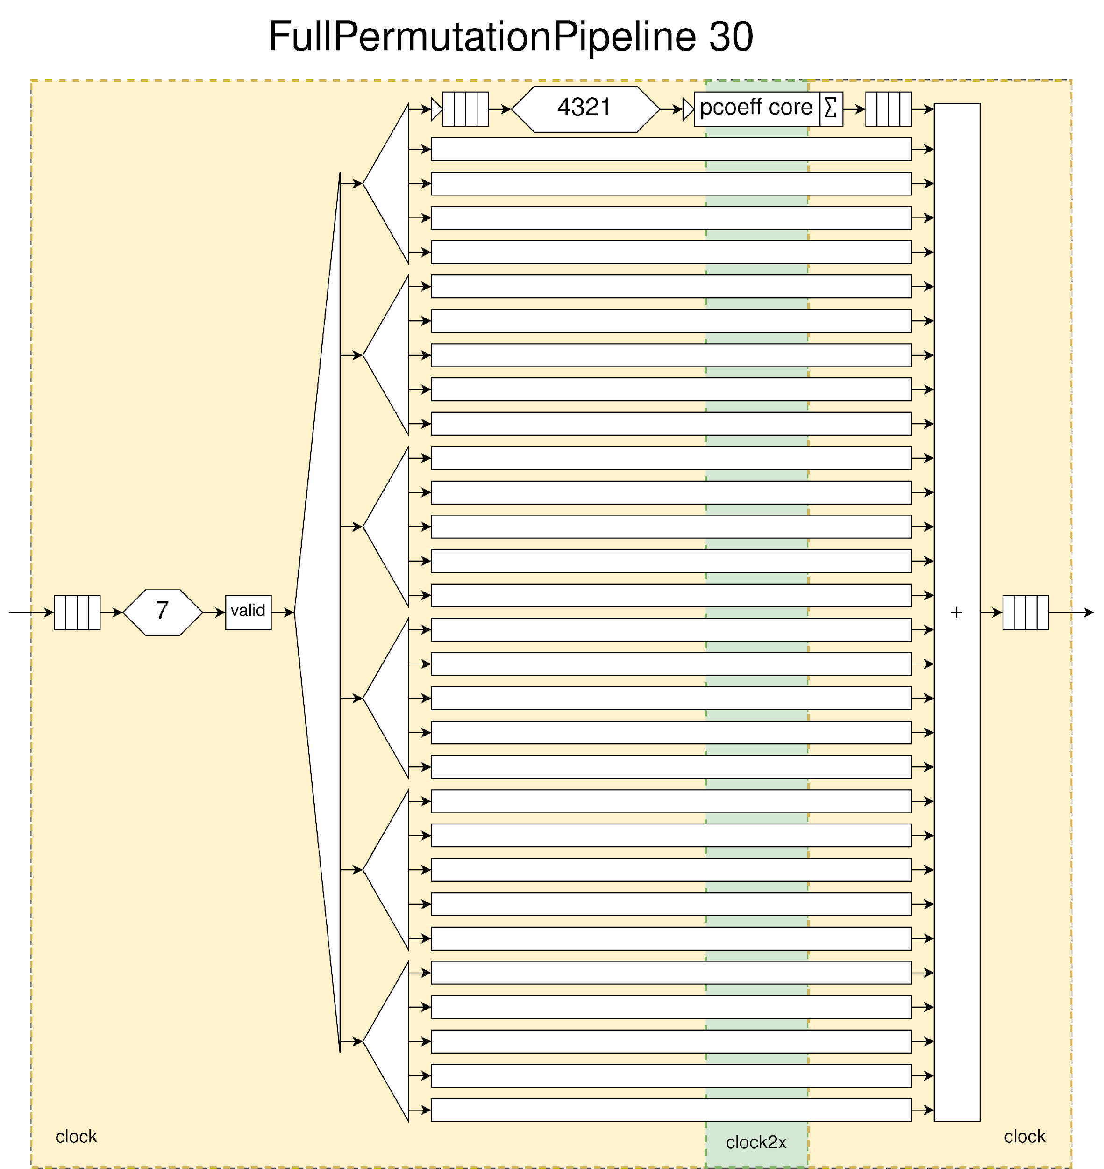

Slide 9
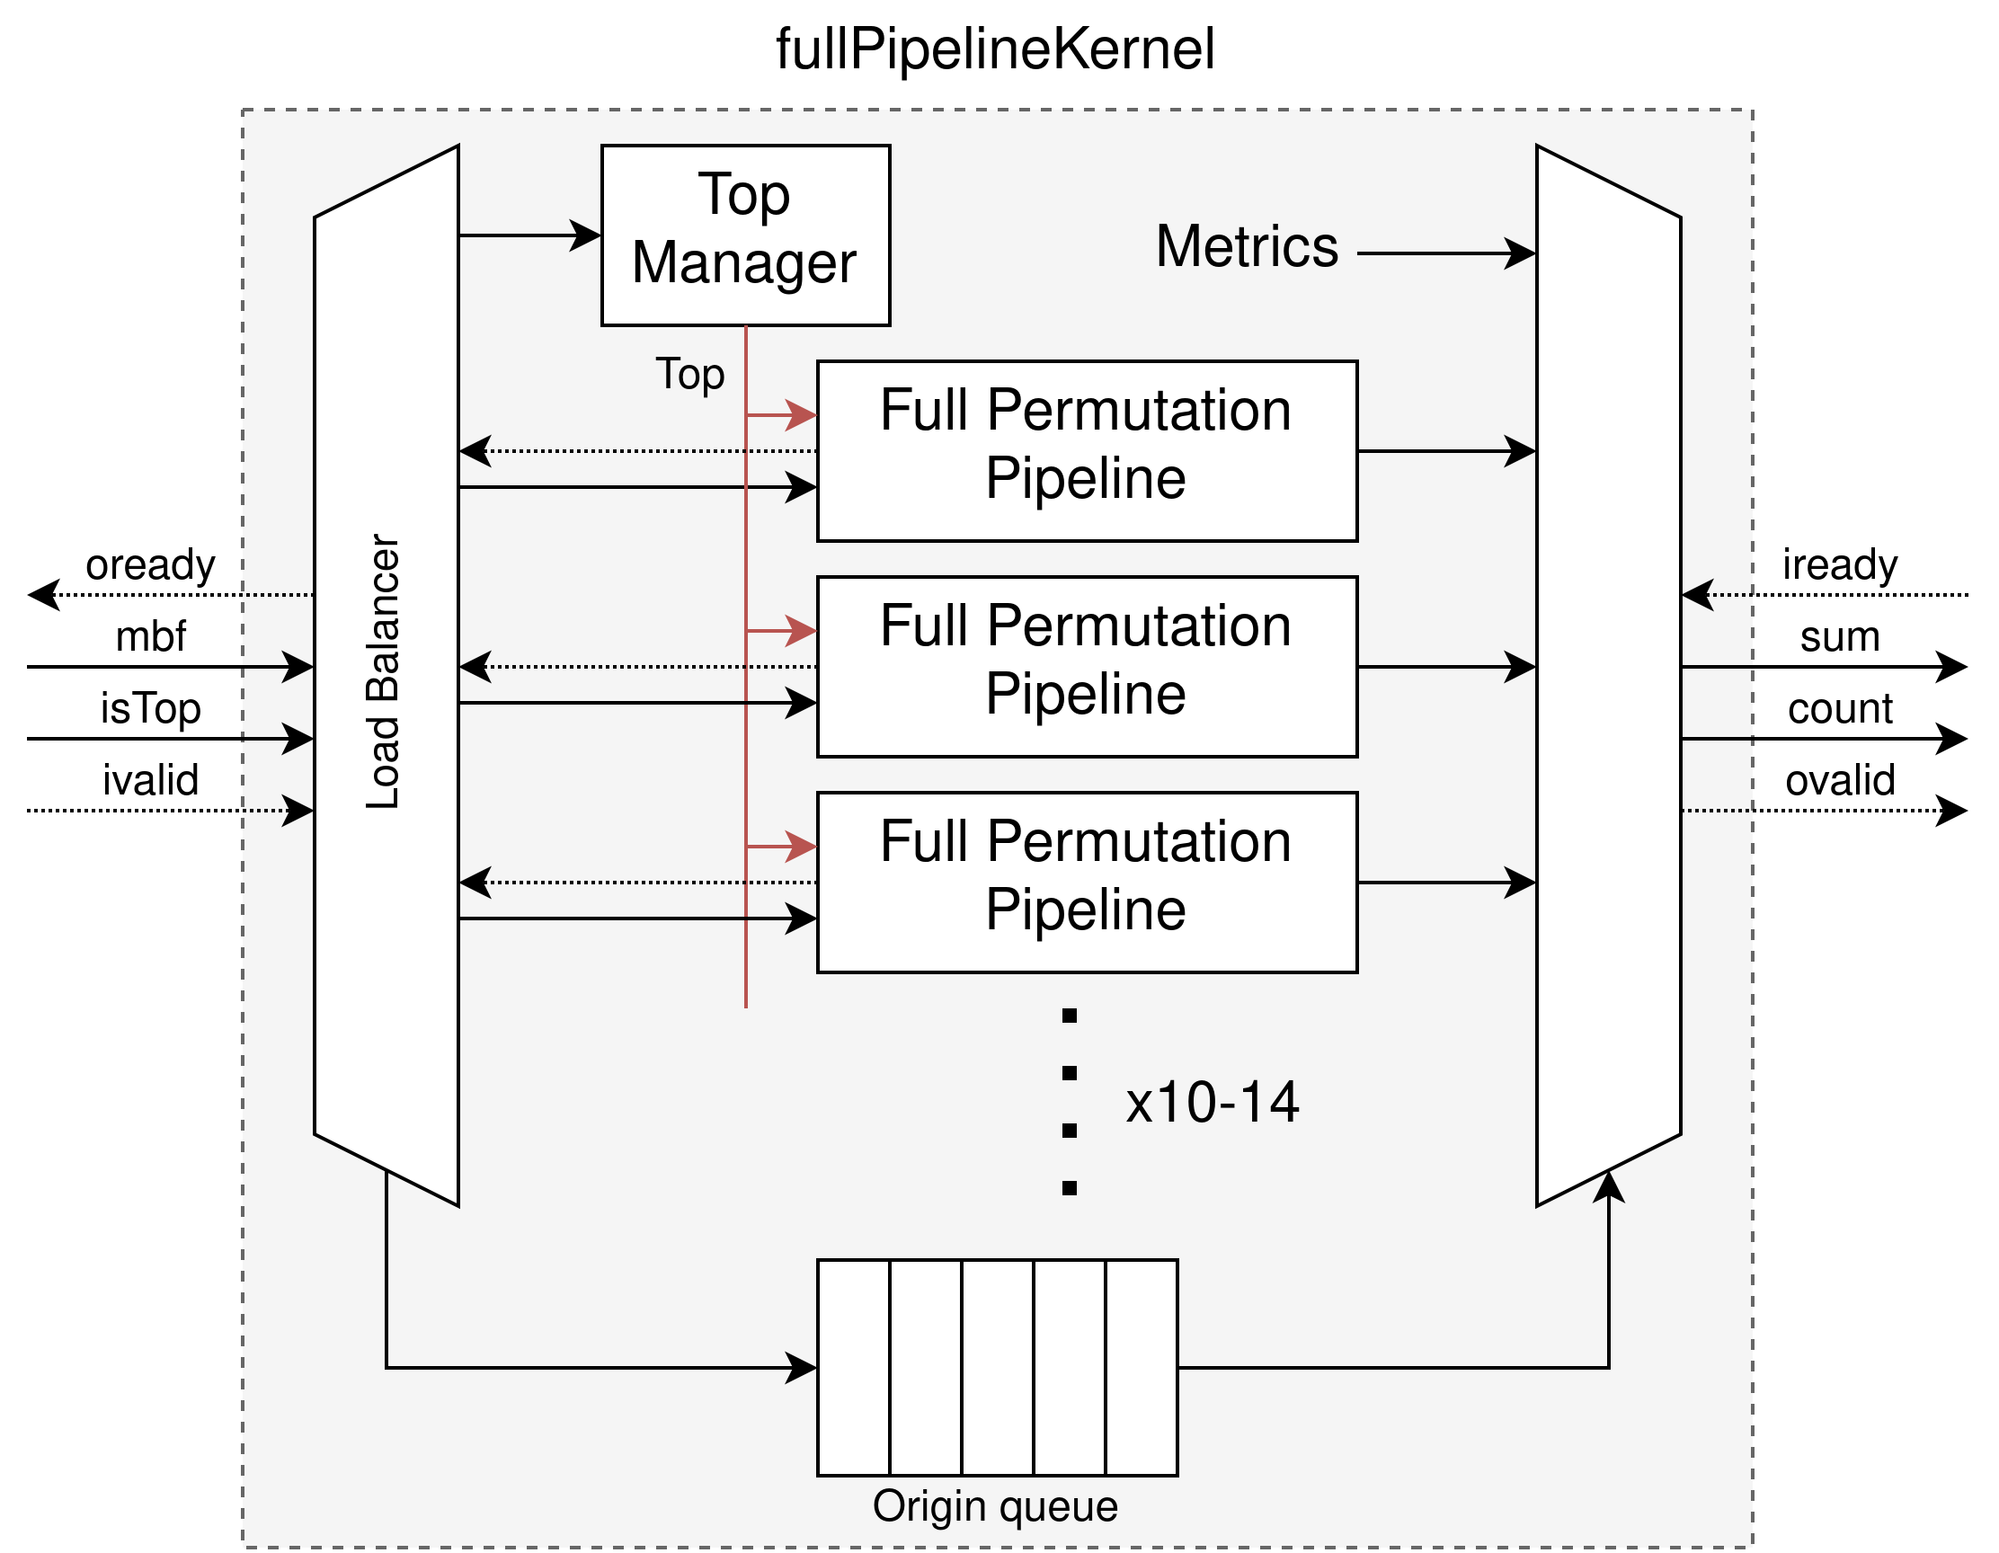

Slide 10
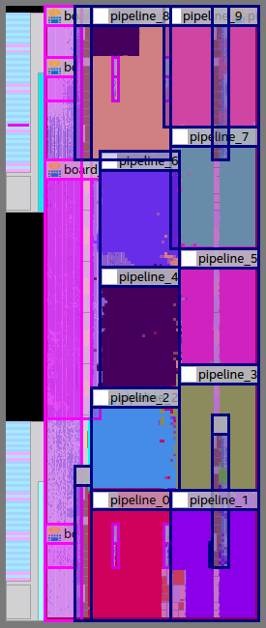
FPGA Implementation
300 Count-Connected-Cores
450MHz
ECC

Slide 11
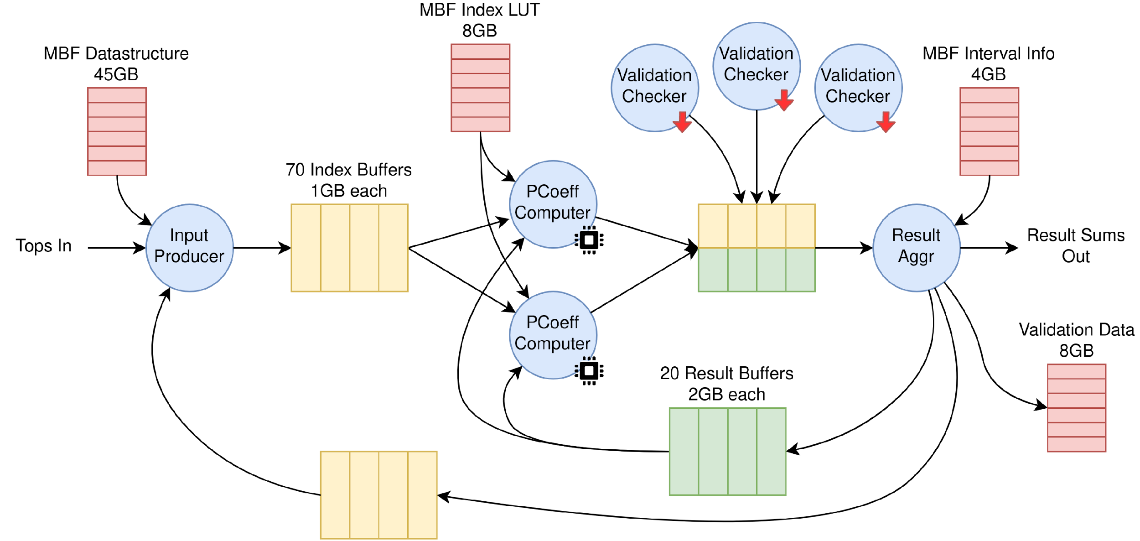

Slide 12
Total project runtime
FPGA 500x faster than AMD Milan CPU.
(usually ~40-60x)
15’000 100min jobs
4 months on Noctua 2

Slide 13
Should you use FPGAs for your project?
Huge development cost
Designing HW is difficult
Testing HW is more difficult
10-fold for native hardware!

Slide 14
hirtum.com/dedekind

