Slide 1
My most recent developments

Slide 2
Block-based methods
Mon | Tue | Wed | Thu | Fri | Sat | Sun | Mon | Tue | Wed | Thu | Fri | Sat | Sun
 |  |  |  |  |  | F
Compress sequence constraints into blocks
Convert to new inter-block constraints
1 | 1 | 1 | 0
0 | 1 | 1 | 0
0 | 0 | 0 | 1

Slide 3
Block-based methods
Full Blocks
Shift types included in block generation
+ Very few constraints
- Exponential #variables in shift types!
Day Blocks
Blocks represent works/doesn’t work days
+ Greatly reduced #blocks
- More complex model
Hybrid method?

Slide 4


Maximal BiClique Optimization
Merge large number of exclusive constraints
Tightens relaxation
Esp. Effective for:
Inter-block constraints
Shift Rotation constraints
1 | 1 | 1 | 0
0 | 1 | 1 | 0
0 | 0 | 0 | 1
1 | 1 | 1 | 0
0 | 1 | 1 | 0
0 | 0 | 0 | 1
$$x_{r}+x_{c}≤1$$
$$\sum_{r∈R}{x_{r}}+\sum_{c∈C}{x_{c}}≤1$$

Slide 5
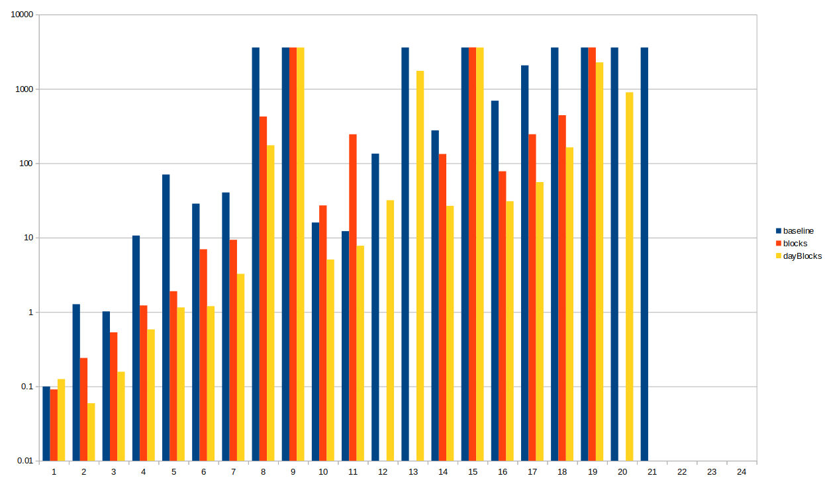
Results – Method comparison

Slide 6
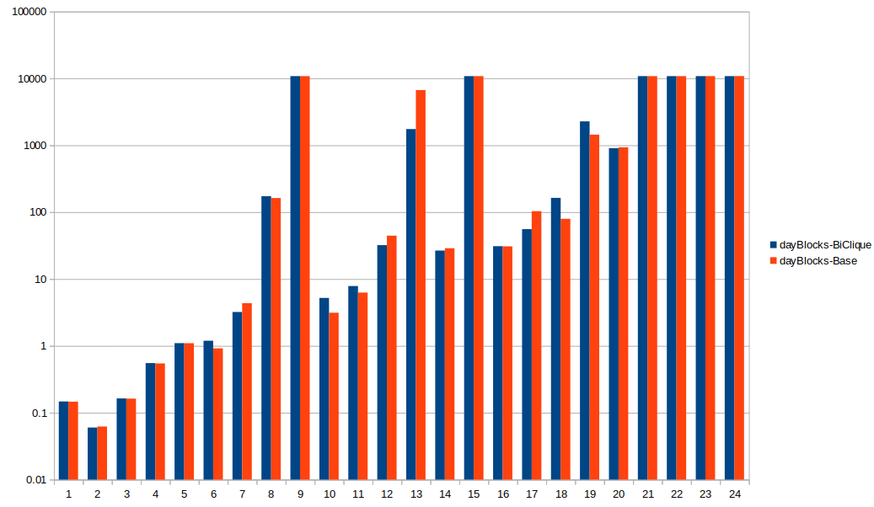
Results – Maximal BiClique optimization

Slide 7
Best Solutions
 | Baseline | blocks | dayBlocks | FlowBased IP
13 | 1471 |  | 1348
14 | 1278 |  | 1278
15 | 3899 |  | 3831
16 | 3225 |  | 3225
17 | 5746 |  | 5746
18 | 4471
19 | 3188
20 | 4773
21 | 89394
22 | -
23 | -
24 | -

