Slide 1



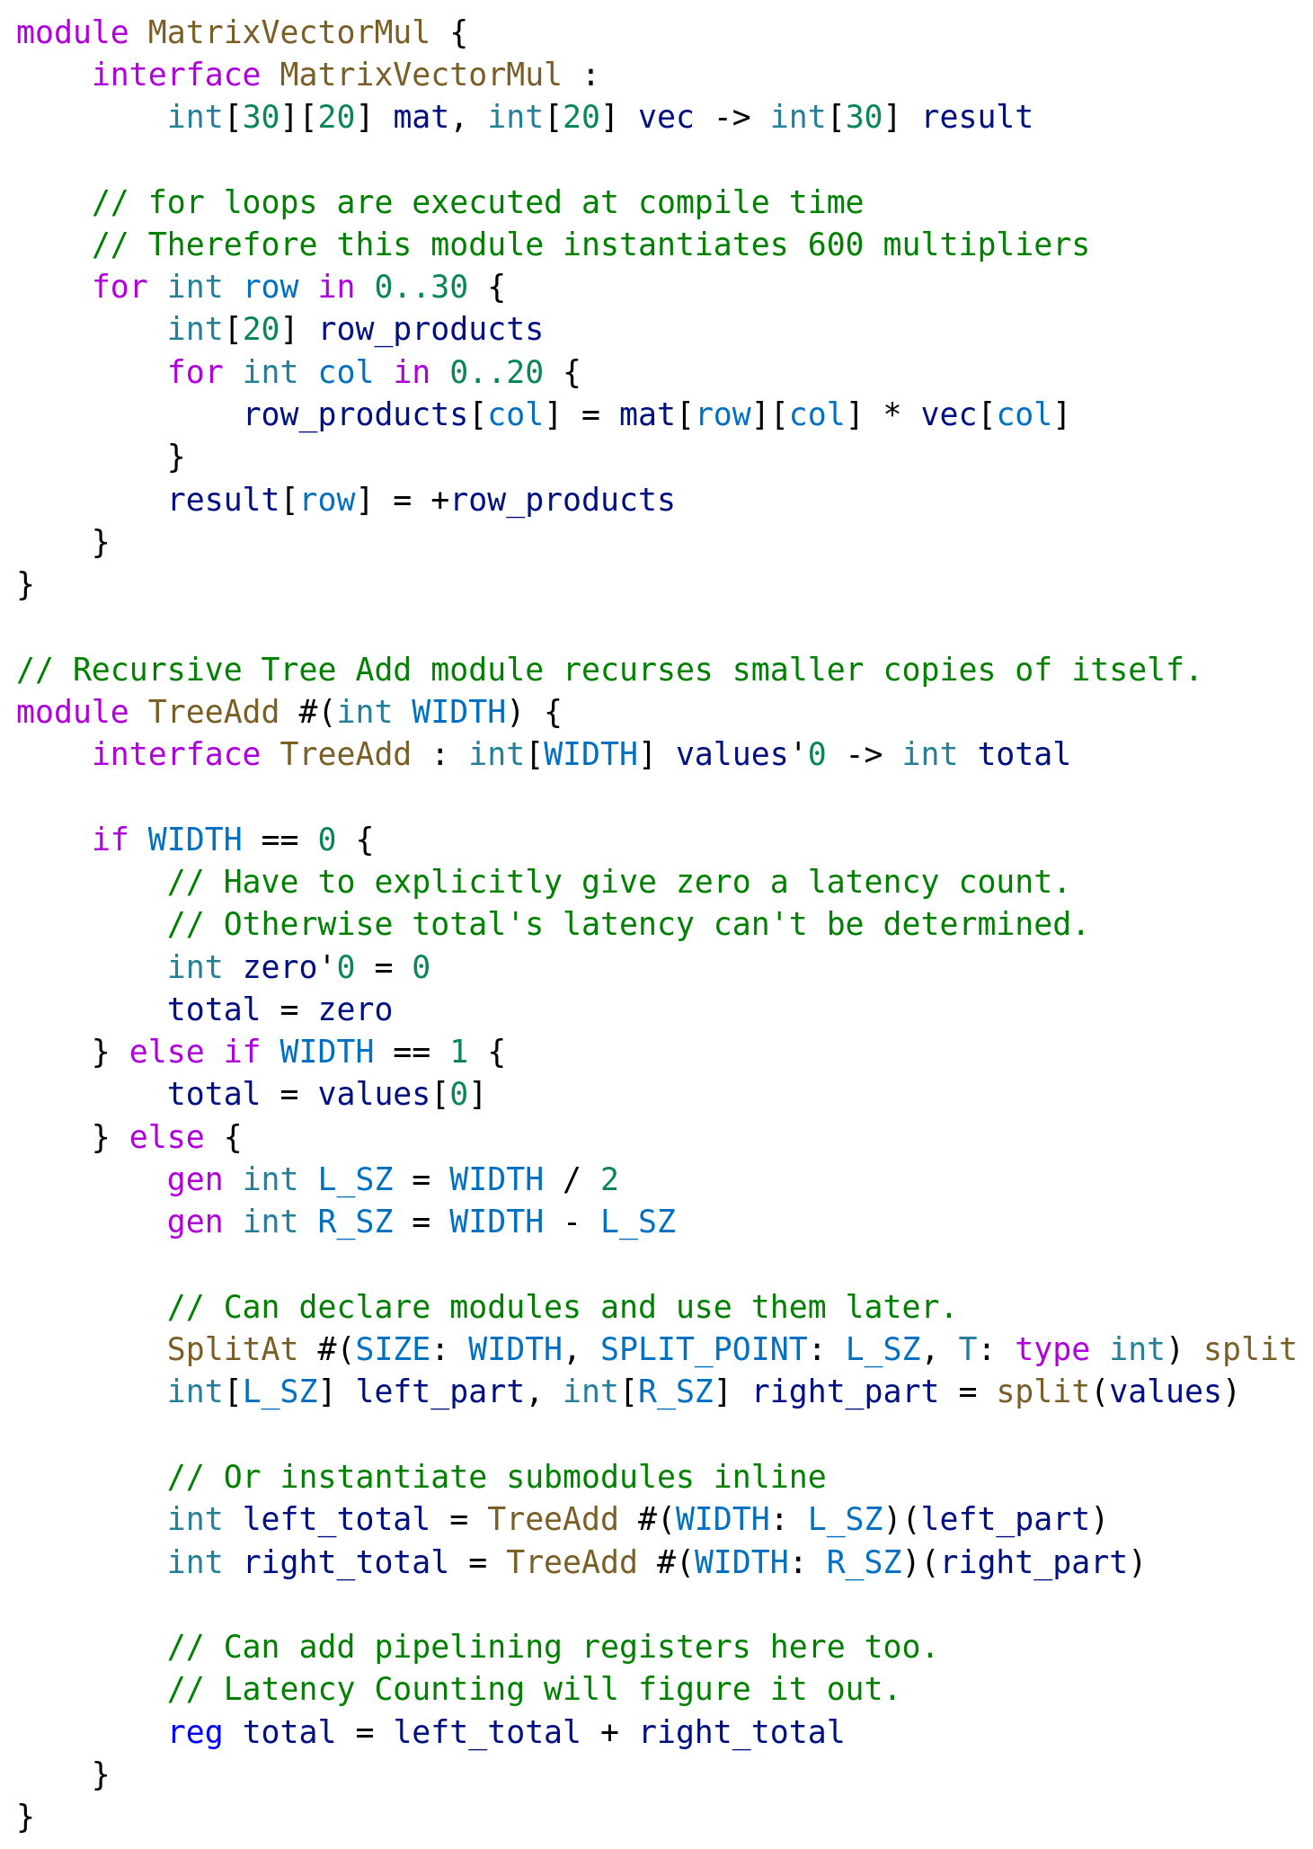
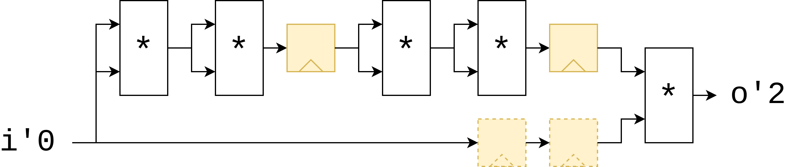
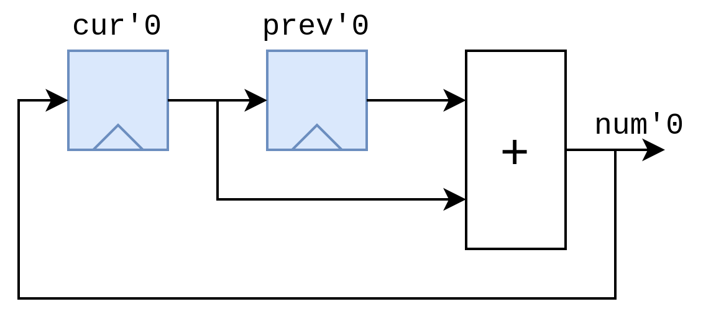
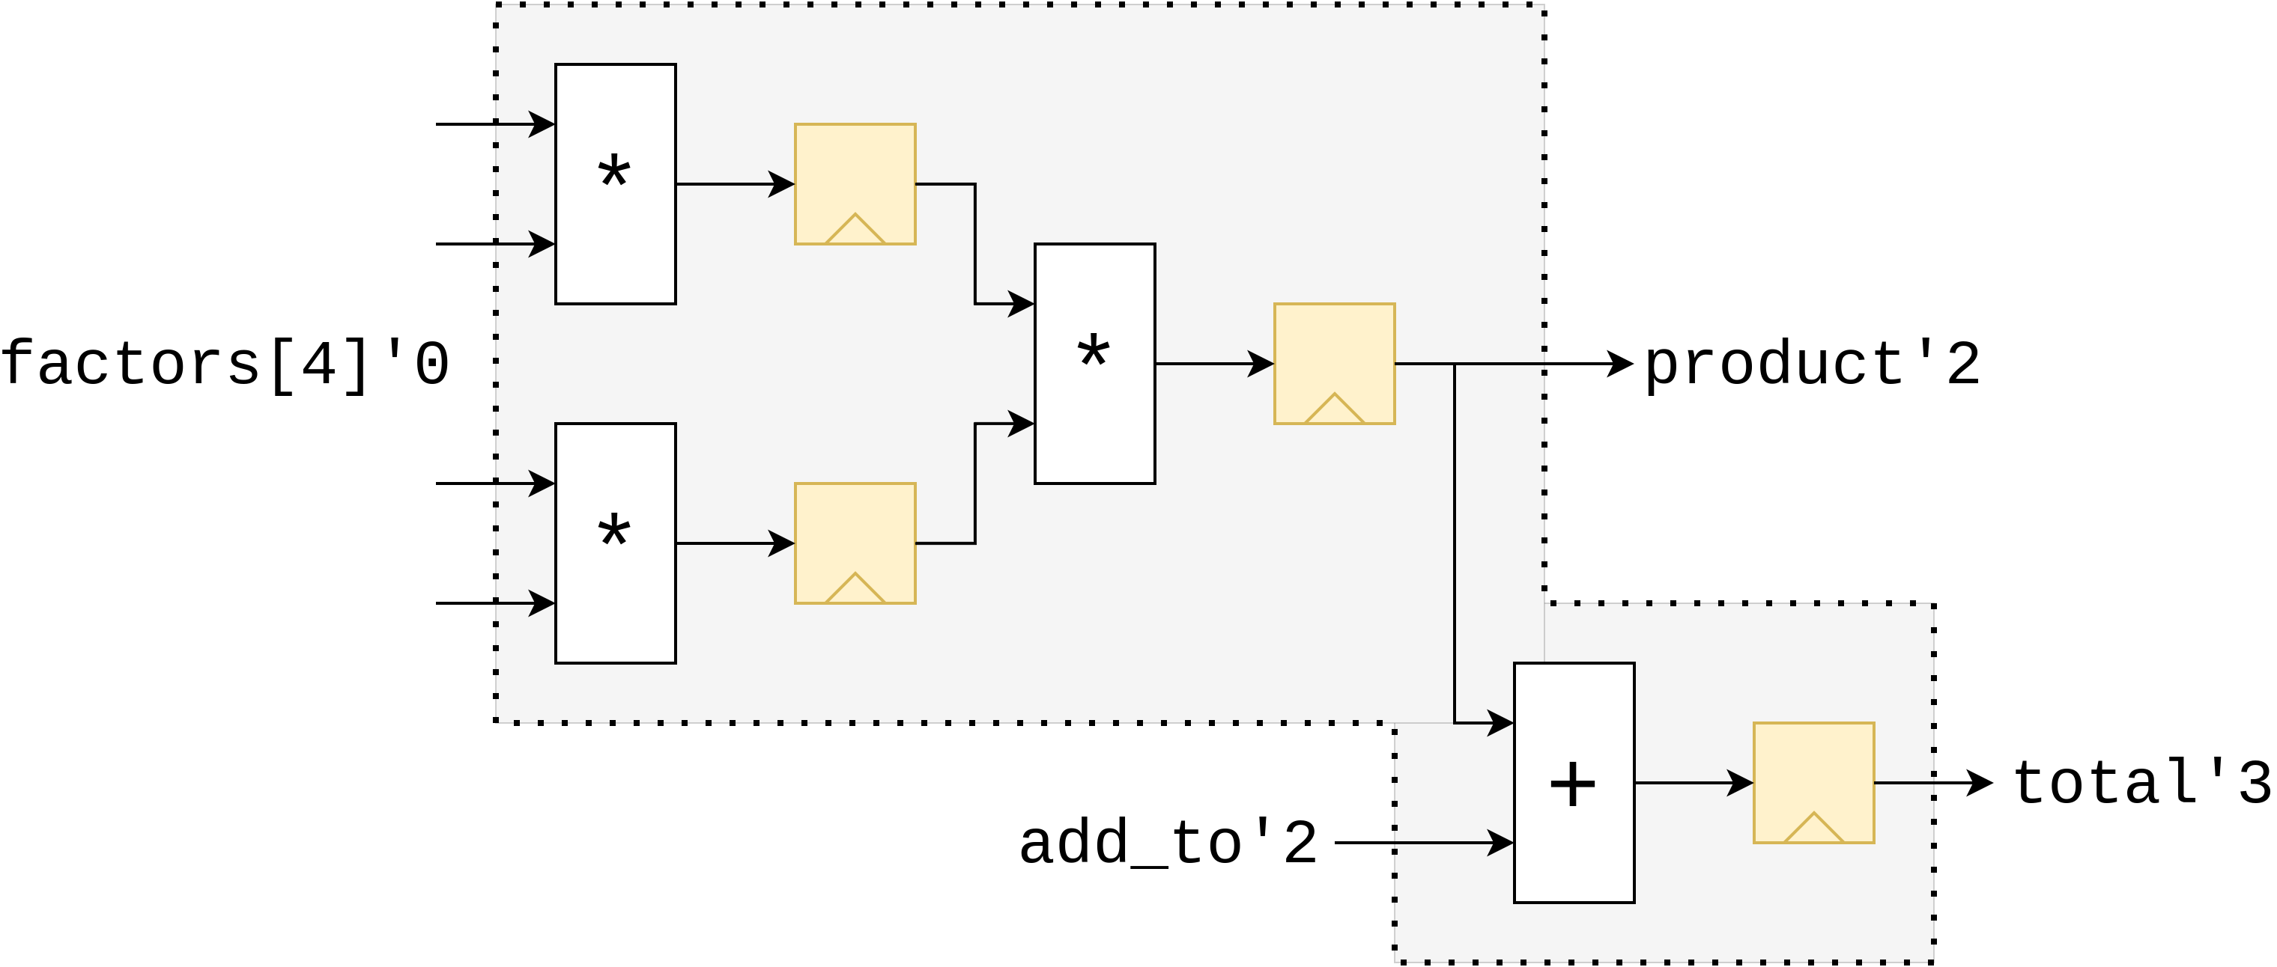


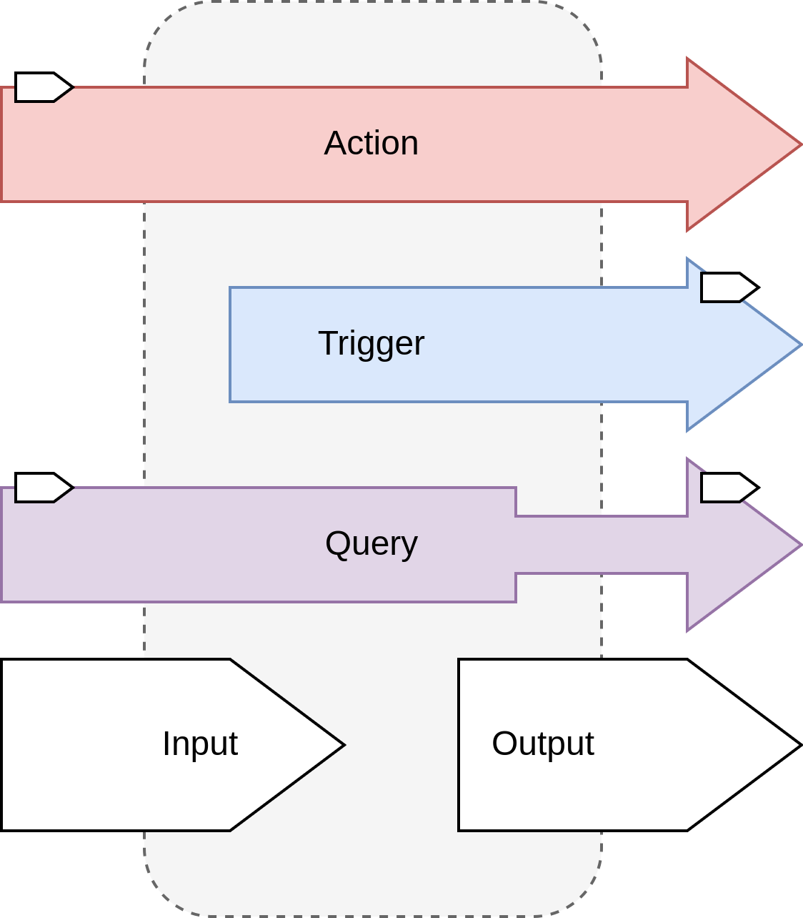
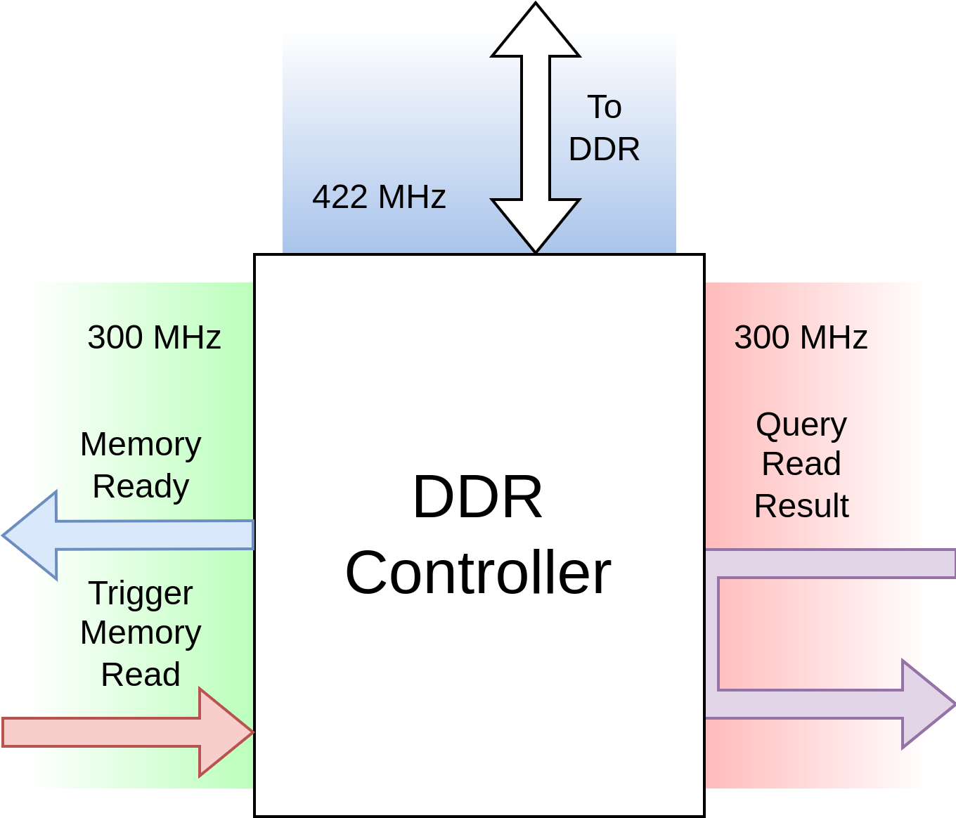
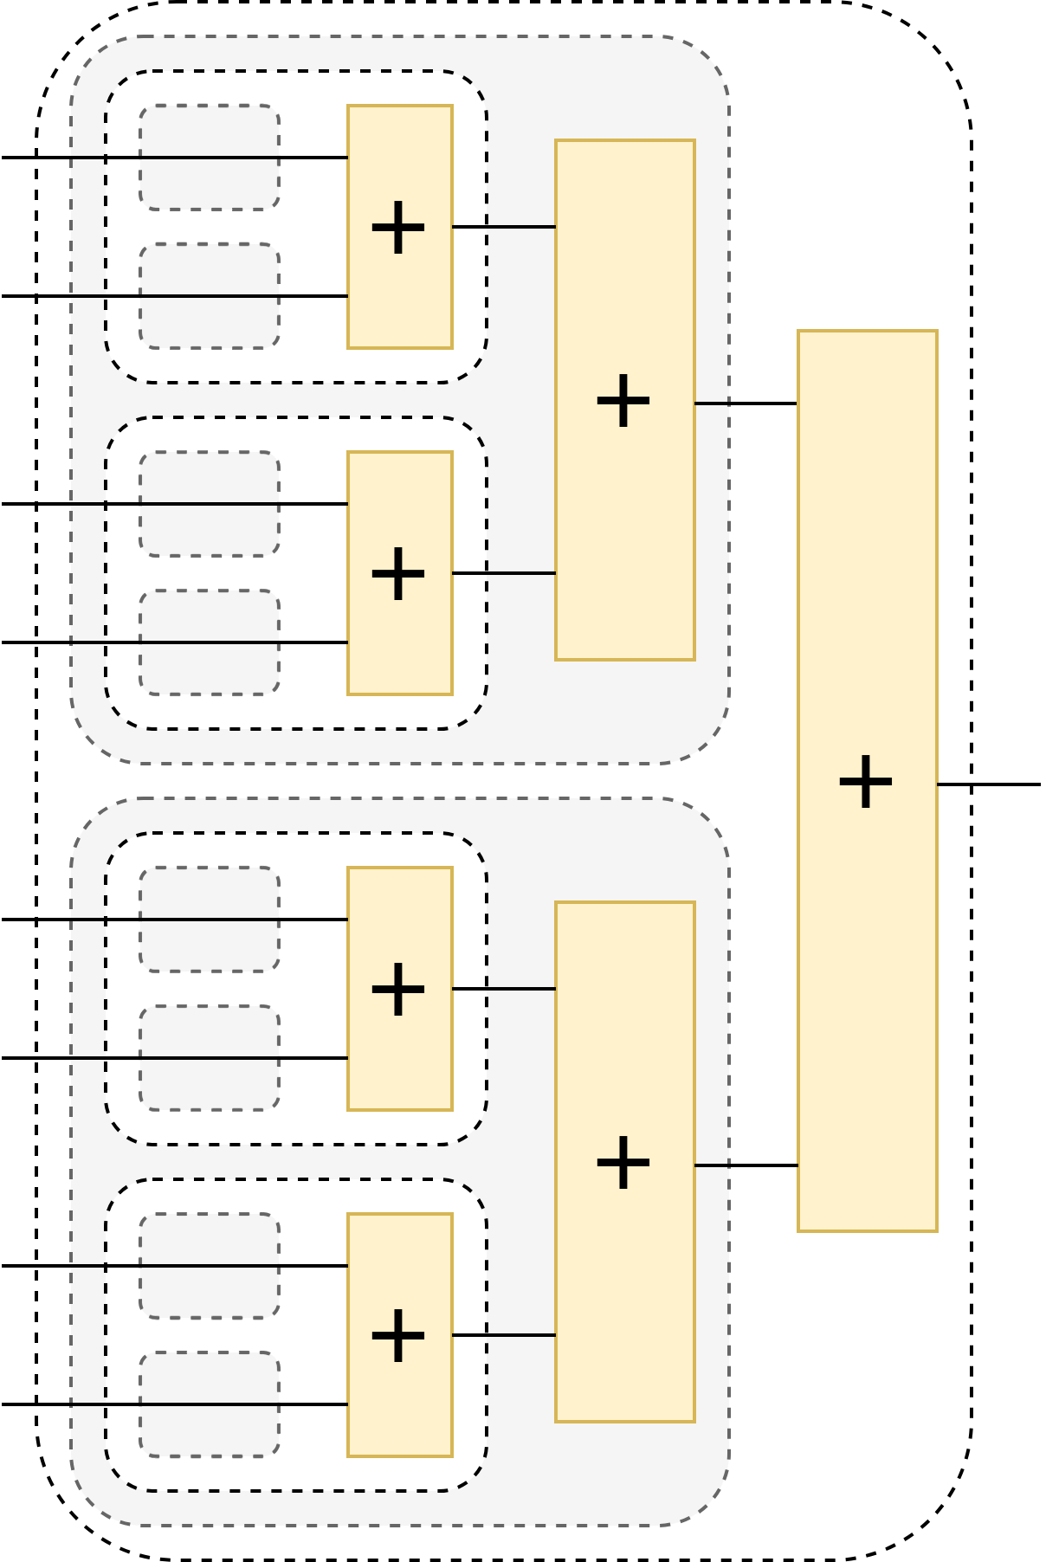
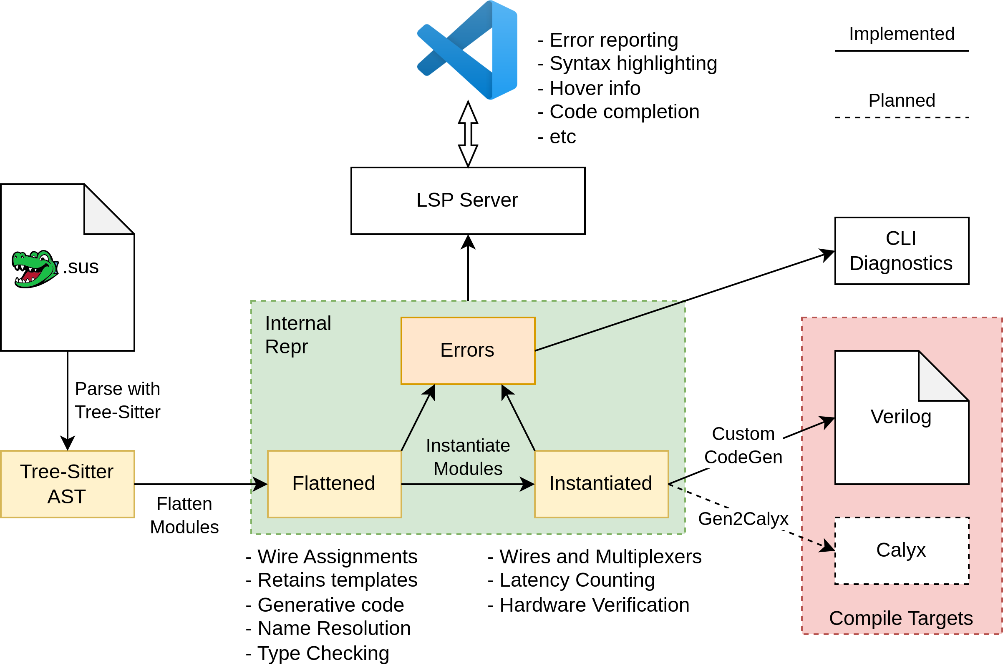




Lennart van hirtum
Simplifying Hardware design
Through semantic timing support
Example SUS Code
Pipelining through Latency Counting
Automatic Insertion of balancing pipeline registers
State registers do not get compensated
Input and output ports of modules have "absolute latencies" inferred
Semantic wire relations in interface
Actions, Triggers and Queries allow
Conditional presence of values to be expressed
Domains logically separate the wires of
Interfaces that aren't directly related in time
They also serve to support clock domains
Compiler Architecture
Links

