Slide 1
A new language for hardware design
Lennart Van Hirtum

Slide 2
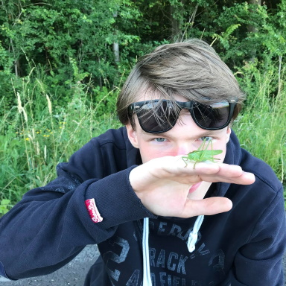
I am
Lennart Van Hirtum
Masters in CS at KU Leuven in Belgium
PhD program at Paderborn
Center for Parallel Computing
My fields
Hardware design
High-performance Computing
Discrete mathematics & Graph Theory
Programming Language Design

Slide 3
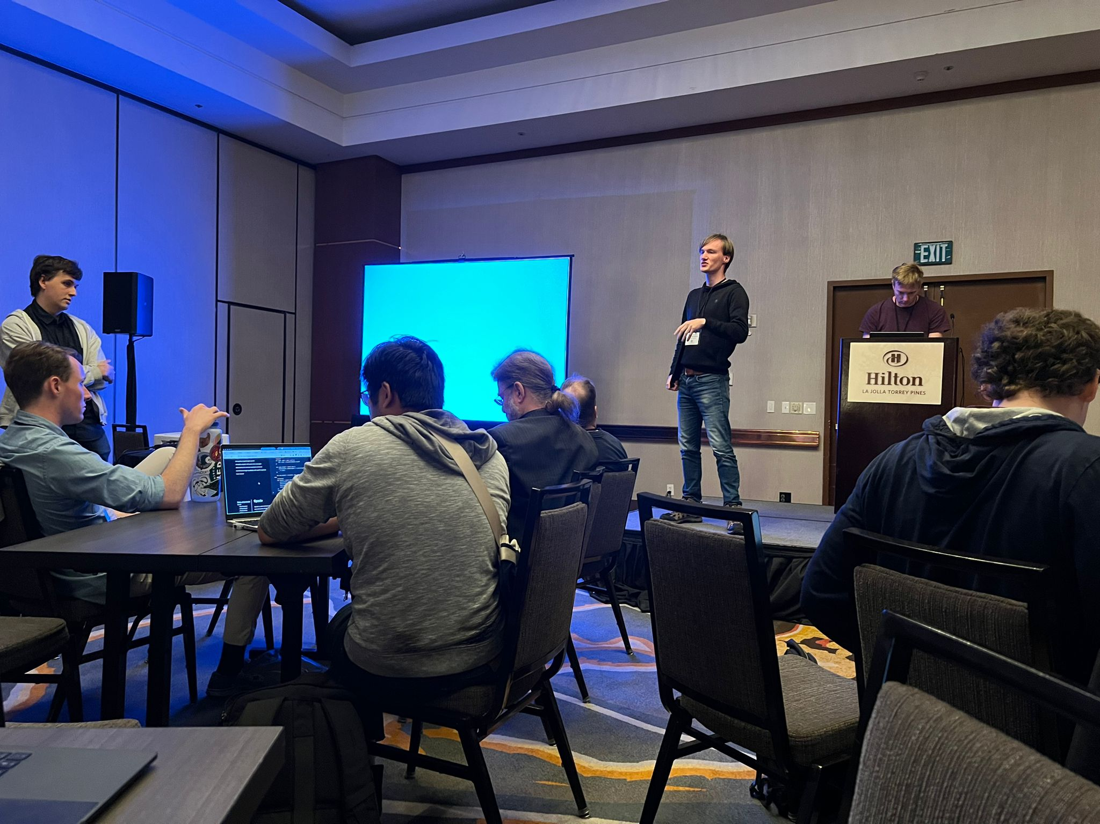
SUS Hardware Design Language
For directly designing hardware (No code synthesis)
Make timing easier to reason about
Abstractions for Pipelining
& Clock Domains
Good developer feedback -> LSP
Written in Rust
LATTE’24 short talk in San Diego

Slide 4
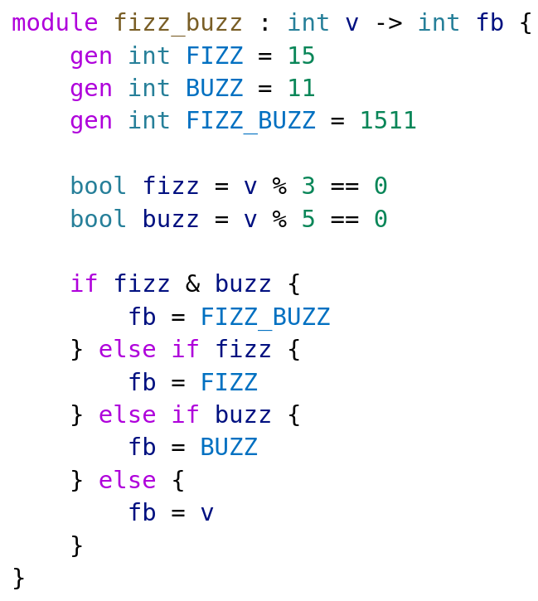
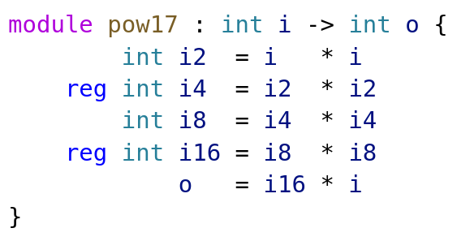
SUS Examples

Slide 5

github.com/pc2/sus-compiler

