Slide 1
SUS Compiler

Slide 2
Goals
Retain low-level control over generated hardware
Individual Statements should map onto hardware as directly as possible
But more compact than VHDL/(System) Verilog
Compile-Time Verification
No Guessing, no trusting the compiler to do The Right Thing™
Common modifications should be easy
Reduce “State” as much as possible.
Can yell at programmer more often

Slide 3
Why not HLS?
Hardware != Imperative
Fiddly
Rely on compiler optimization for decent hardware
Why is my pipeline only having 50% throughput?
Cannot express exact timing requirements
Intel & Xilinx proprietary monopolies.

Slide 4
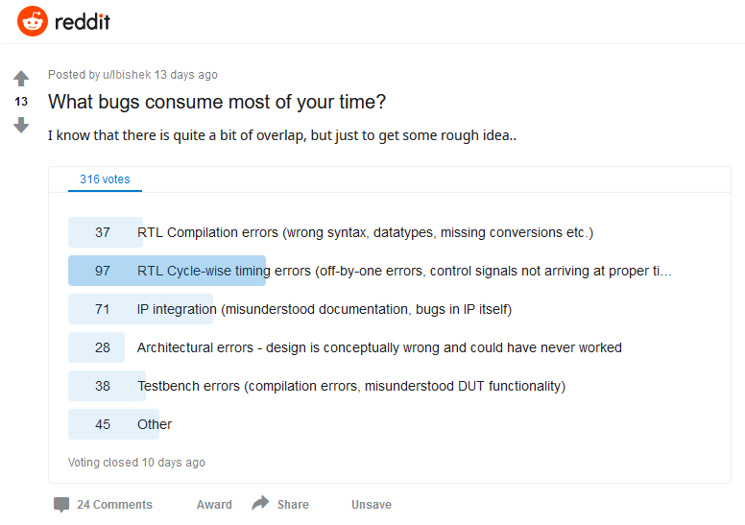

Slide 5
From speaking with people in industry
Clock Domain Crossings are VERY difficult
Proper timing constraints also difficult

Slide 6
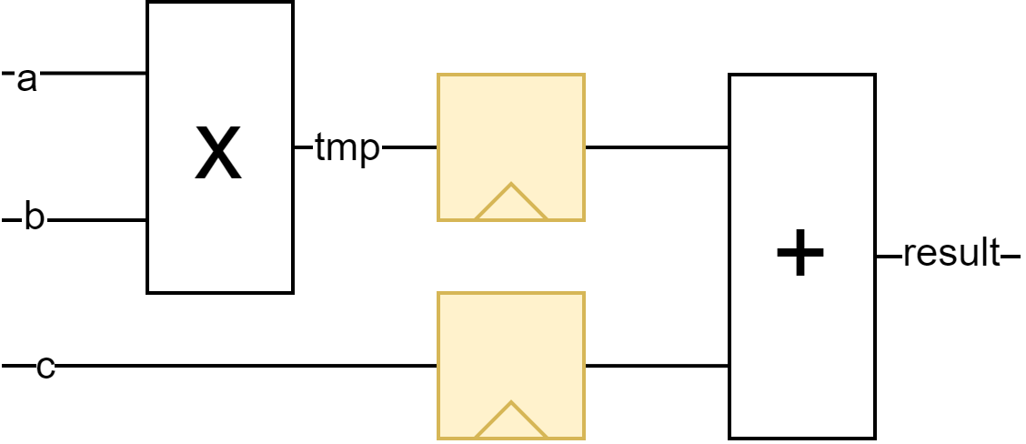
Easy Pipelining
module multiply_add :
int a,
int b,
int c
-> int result
{ int tmp = a * b;
@
result = tmp + c; }
module multiply_add(
input clk,
input[31:0] a,
input[31:0] b,
input[31:0] c,
output[31:0] result_D
) {
reg[31:0] tmp_D;
reg[31:0] c_D;
always @(posedge clk) begin
tmp_D <= a * b;
c_D <= c;
end
assign result_D = tmp_D + c_D;
}

Slide 7
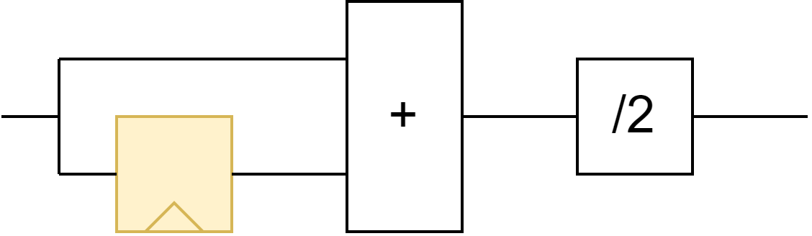
Stream Processors
// Explicitly state when valid
timeline (v->/) .. (v->v)*
module blur2 :
int data -> int blurred
{ state int prev = data;
#
loop {
blurred = prev + data / 2; prev = data;
#
} }
module blur2(
input clk,
input[31:0] data,
output[31:0] blurred
) {
reg[31:0] prev;
always @(posedge clk) begin
prev <= data;
end
assign blurred = prev + data / 2;
// when is blurred valid?
}

Slide 8
Pipe and Time combination
module multiply_aggregate(
input clk,
input start,
input done,
input[31:0] data,
output reg[31:0] sum,
output sumValid
) { always @(posedge clk) begin
if(start) {
sum <= 0;
} else if(done) {
}
prev <= data;
end
assign blurred = prev + data / 2;
}

Slide 9
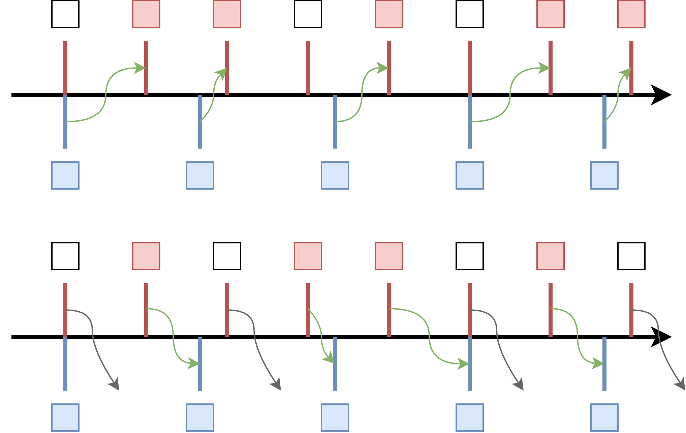
Rhythms for Clock Domain Crossings

Slide 10
True Stateful modules
FIFOs
Memory
Control Circuits

Slide 11
Neat safety features
Automate FIFO sizing
Automate reset duration sizing
Integer min-max sizing instead of bit-widths
Rhythms for Clock Domain Crossings
Generated hardware can make extensive use of “Don’t care”
Aids in Simulation

Slide 12
Open Questions
Safety for stream ordering?
CPU and Cache Safety by state invalidation?
How extensive should timeline protocol specs be?
Dealing with constants?
“Compute Modes”?
Generating timing constraints?
Generic vs Concrete conflict
What about stream modules that require unpredictable input stalls?
Resource saving on long register chains?

