Slide 1

Classification of arteries and veins
in retinal images
Authors: Bc. Yana Kamar, Bc. Nahumanov Andrii, Bc. Nataliia Kolesnyk
Consultant: Ing. Tomáš Vičar
Brno, 01 May 2022

Slide 2
Project’s task and data
The main task of the project:
Creation of an algorithm for automatic classification of arteries and veins.
Using of masks of segmented blood vessels to automatically split vessels according to their branches. Then classification of these areas into arteries and veins.
Evaluation of the quality of the classification using appropriate metrics.
Project’s data
As data set we got 4 folders:
1.Folder “Images” – 45 images of fundus of human eye
2.Folder “mask” – 45 binary masks
3.Folder “manual” – 45 masks of manually segmented blood vessels
4.Folder “Classified” – 6 images of already classified veins an arteries

Slide 3
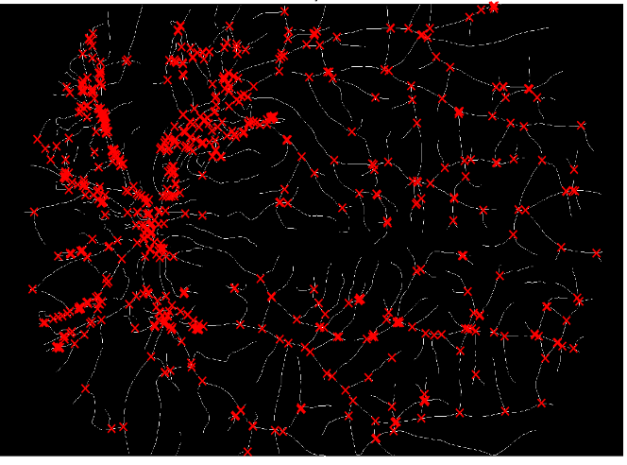
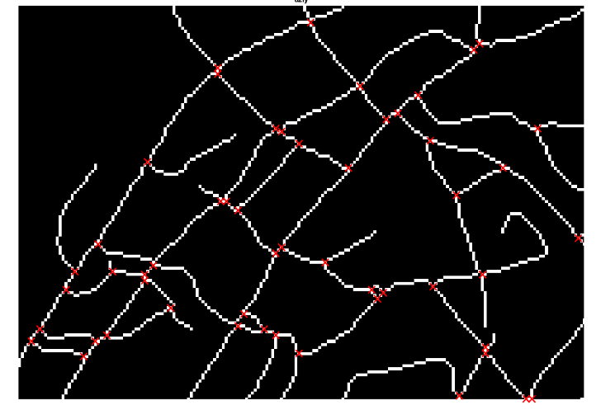
Blood vessels’ nodes (all)
Defining of nodes and pieces of blood vessels
Blood vessels’ nodes (closer)

Slide 4
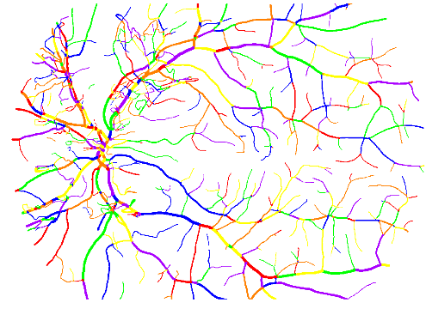
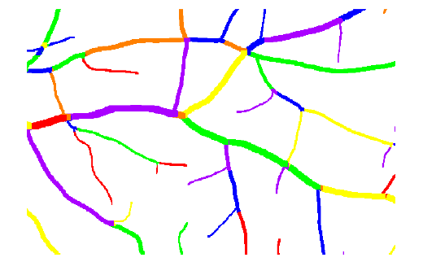
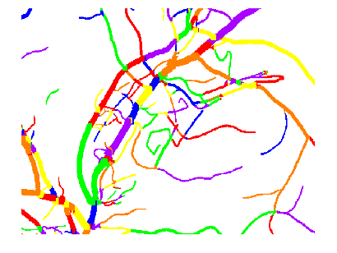
Defining of nodes and pieces of blood vessels
Blood vessels pieces(all)
Blood vessels’ nodes (close)

Slide 5
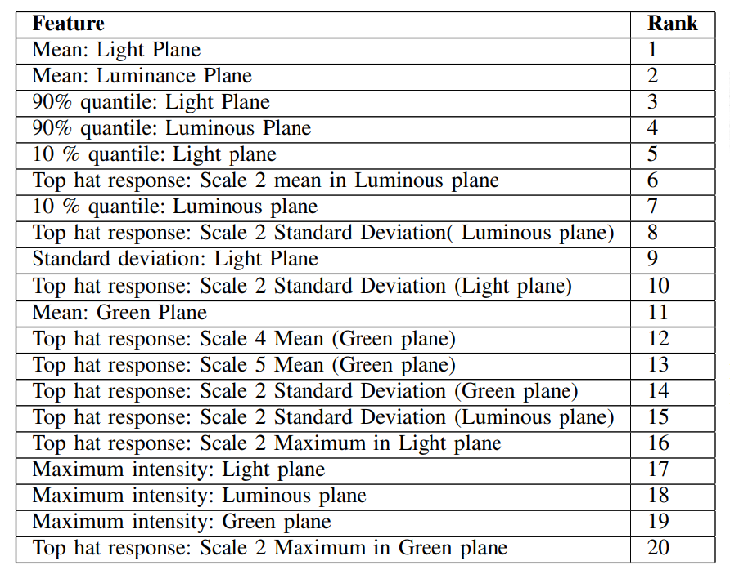
Table of features from [1]
[1] Vijayakumar V, Koozekanani DD, White R, Kohler J, Roychowdhury S, Parhi KK. Artery/vein classification of retinal blood vessels using feature selection. Annu Int Conf IEEE Eng Med Biol Soc. 2016 Aug;2016:1320-1323. doi: 10.1109/EMBC.2016.7590950. PMID: 28268568.

Slide 6
Color spaces
LAB color space expresses color as three values: L* for perceptual lightness, and a* and b* for the four unique colors of human vision: red, green, blue, and yellow.
The difference between YCbCr and RGB is that YCbCr represents color as brightness and two color difference signals, while RGB represents color as red, green and blue. In YCbCr, the Y is the brightness (luma), Cb is blue minus luma (B-Y) and Cr is red minus luma (R-Y).

Slide 7
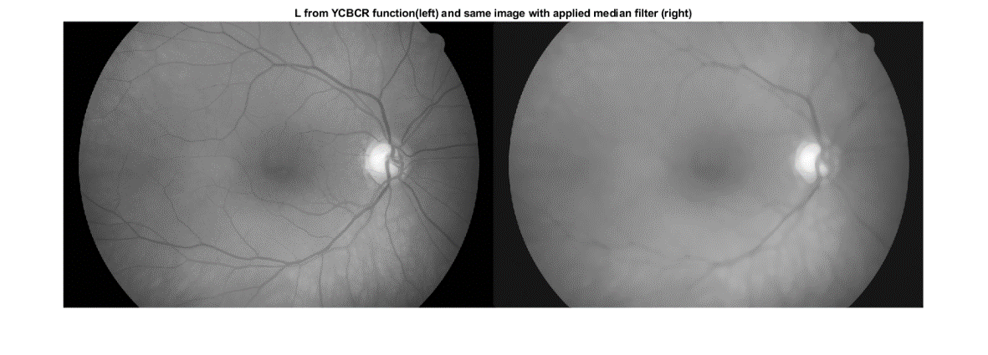
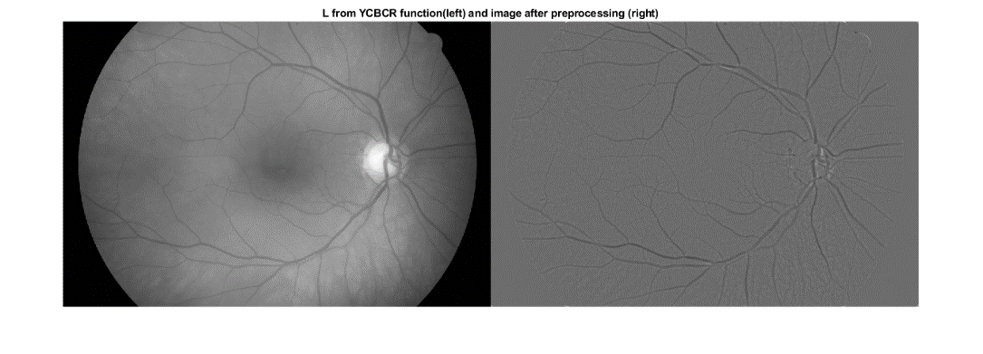
Defining of the median

Slide 8
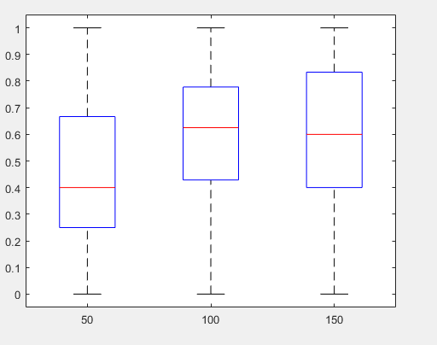
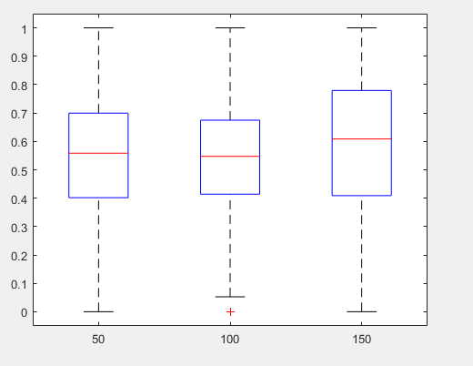
Features box plots
STD of a luminance
Thickness of vessel

Slide 9
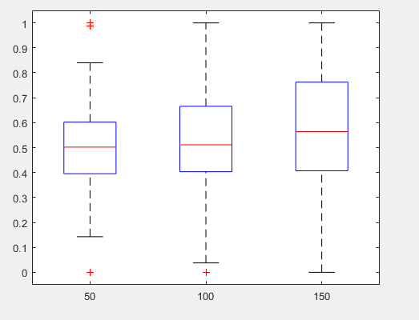
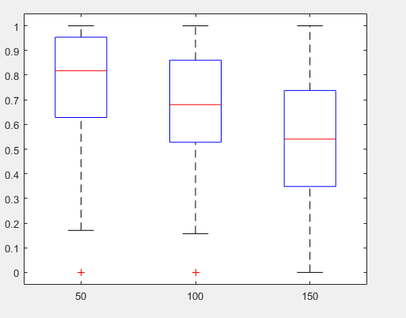
Features box plots
Median of luminance
STD of lightness

Slide 10
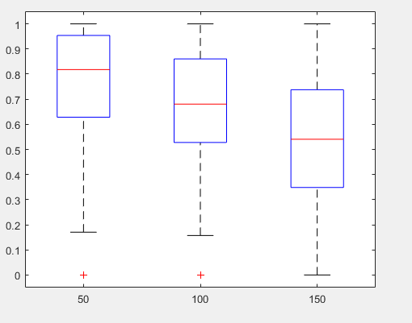
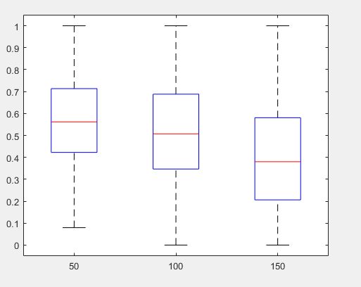
Features box plots
Mean of lightness
Mean of luminance

Slide 11
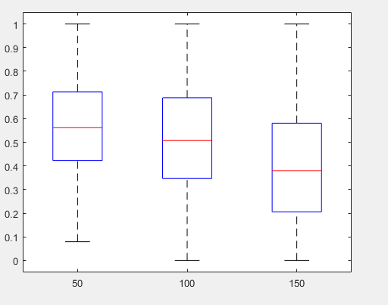
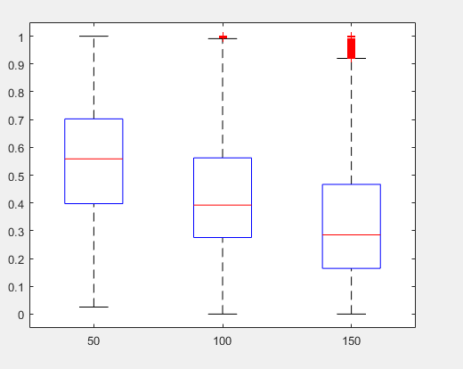
Features box plots
Luminance 90%
Luminance

Slide 12
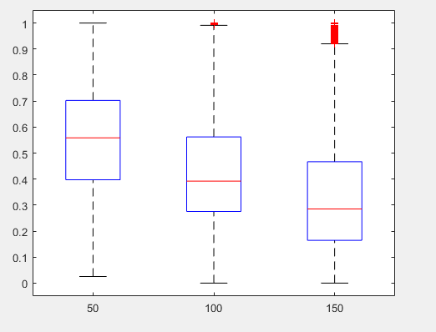
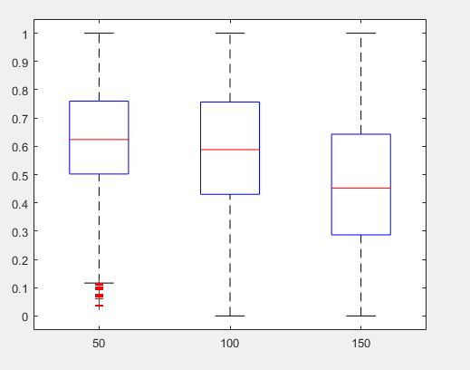
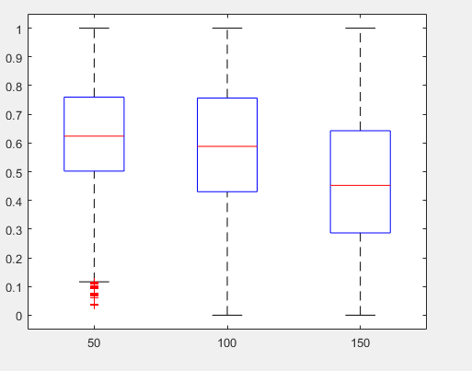
Features box plots
Lightness
Lightness 10%
Luminance 10%

Slide 13
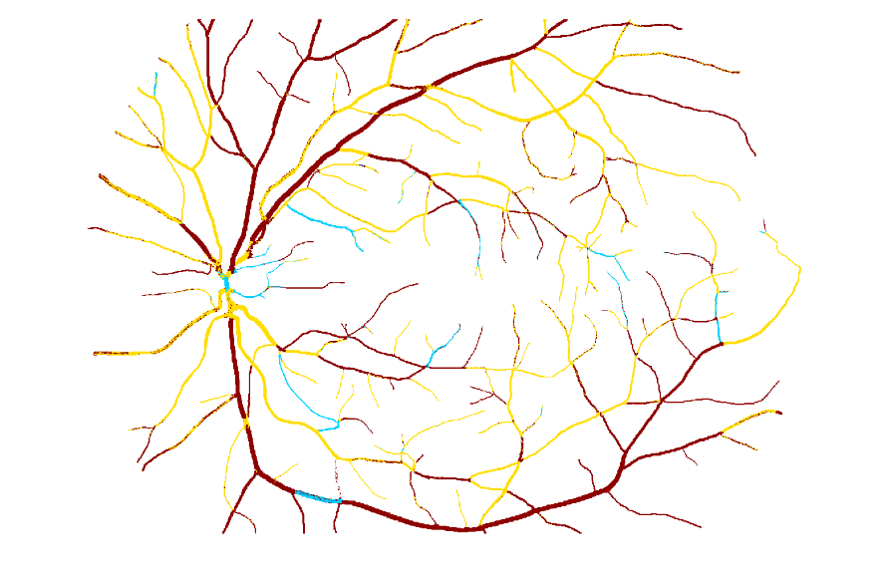
Results of pixel classification
Pixels after classification before mode

Slide 14
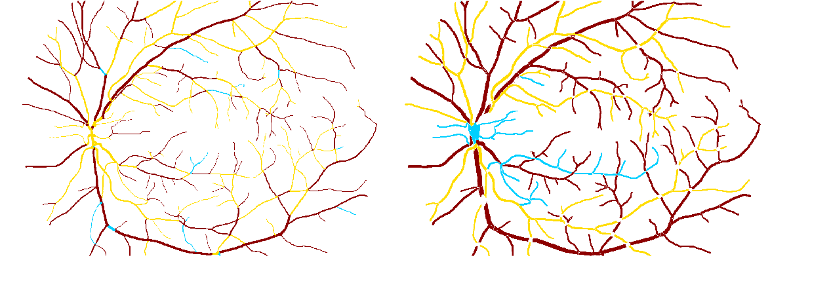
Results of pixel classification
Pixels after classification after mode function

Slide 15

Conclusions
In this project we preprocessed image and extract the most useful features for the future applying of ML classifier
We tried to implement Machine Learning classifier Random Forest for automatic classification of arteries and veins
Our results is:

Slide 16
Thank you for your attention!

