Slide 1

Classification of arteries and veins
in retinal images
Authors: Bc. Jana Kamar, Bc. Nahumanov Andrii, Bc. Nataliia Kolesnyk
Consultant: Eng. Tomáš Vičar
Brno, 01 May 2022

Slide 2
Summary
Project’s task and data
Defining of nodes and pieces of the blood vessels
Color spaces, Table of features
Defining of vessels’ median
Feature’s box plot
Pixels’ result
Results

Slide 3
Project’s task and data
The main task of the project:
Creation of an algorithm for automatic classification of arteries and veins.
Using of masks of segmented blood vessels to automatically split vessels according to their branches. Then classification of these areas into arteries and veins.
Evaluation of the quality of the classification using appropriate metrics.
Project’s data
As data set we got 4 folders:
1.Folder “Images” – 45 images of fundus of human eye
2.Folder “mask” – 45 binary masks
3.Folder “manual” – 45 masks of manually segmented blood vessels
4.Folder “Classified” – 6 images of already classified veins an arteries

Slide 4
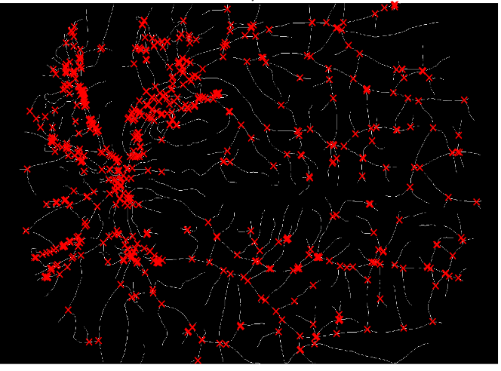
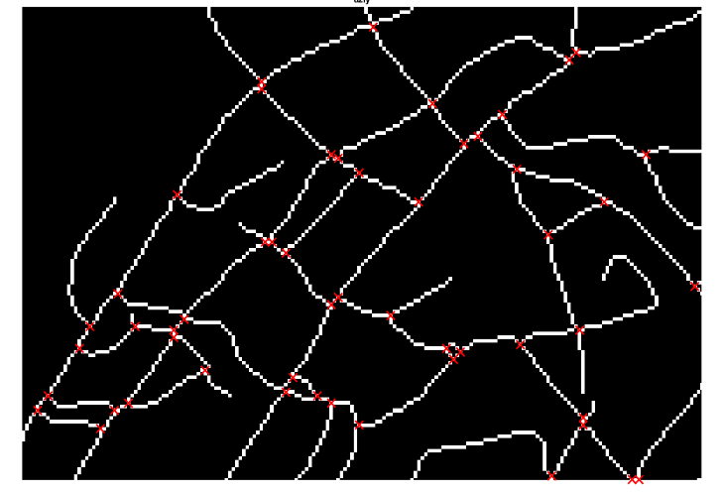
Blood vessels’ nodes (all)
Defining of nodes and pieces of blood vessels
Blood vessels’ nodes (closer)

Slide 5
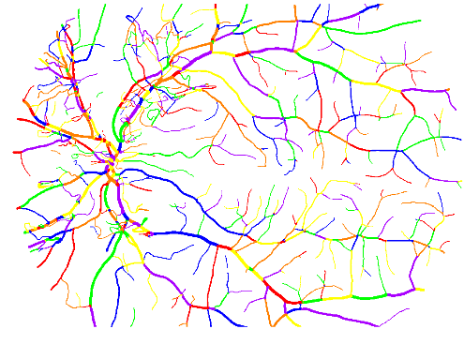
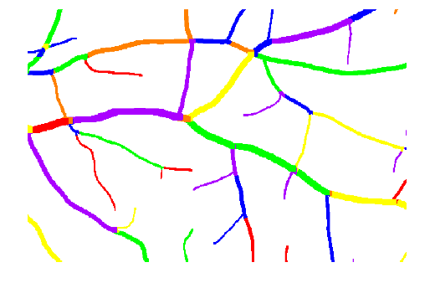
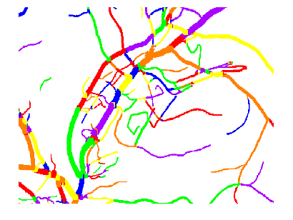
Defining of nodes and pieces of blood vessels
Blood vessels pieces(all)
Blood vessels’ nodes (close)

Slide 6
Color spaces, Table of features
LAB color space expresses color as three values: L* for perceptual lightness, and a* and b* for the four unique colors of human vision: red, green, blue, and yellow.
The difference between YCbCr and RGB is that YCbCr represents color as brightness and two color difference signals, while RGB represents color as red, green and blue. In YCbCr, the Y is the brightness (luma), Cb is blue minus luma (B-Y) and Cr is red minus luma (R-Y).

Slide 7
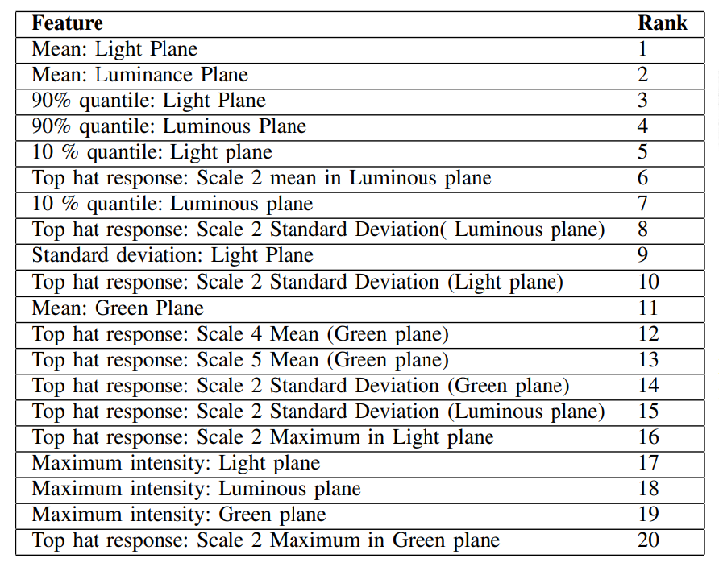
Table of features

Slide 8
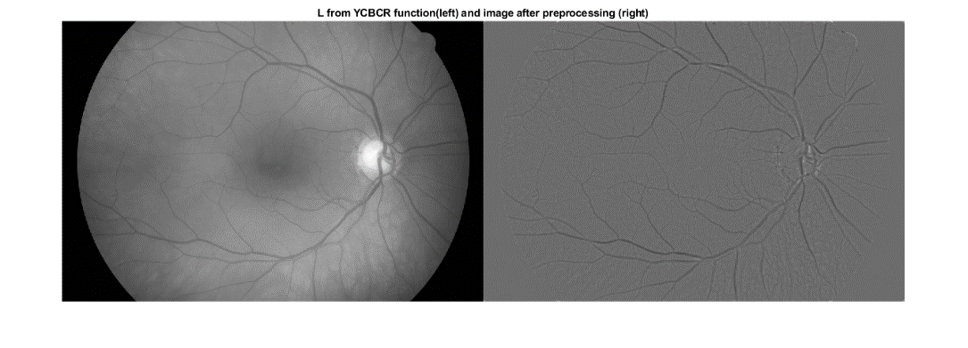
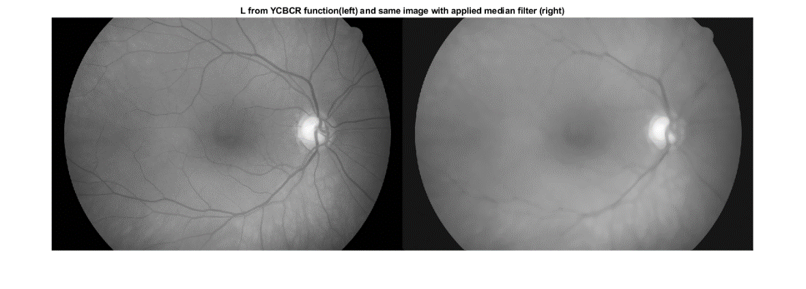
Defining of the median

Slide 9
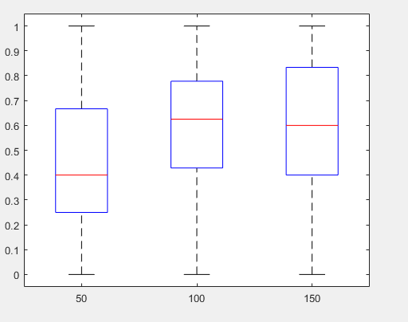
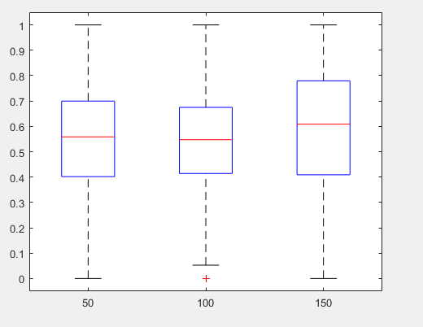
Features box plots
STD of a luminance
Thickness of vessel

Slide 10
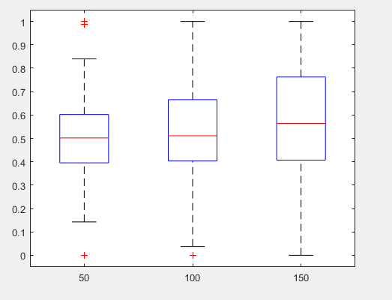
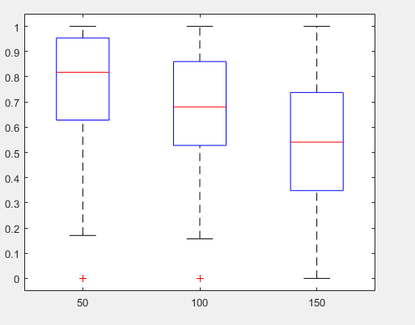
Features box plots
Median of luminance
STD of lightness

Slide 11
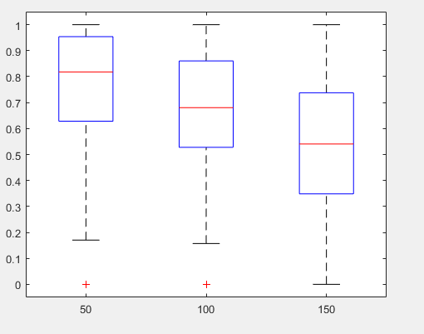
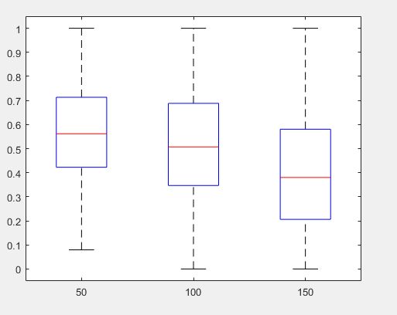
Features box plots
Mean of lightness
Mean of luminance

Slide 12
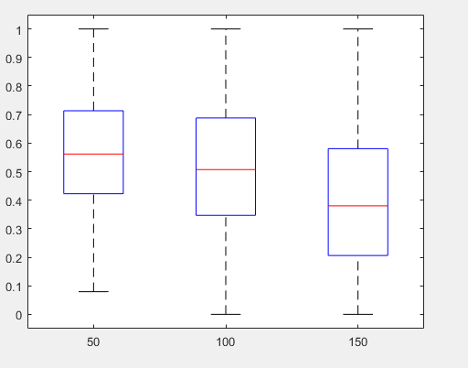
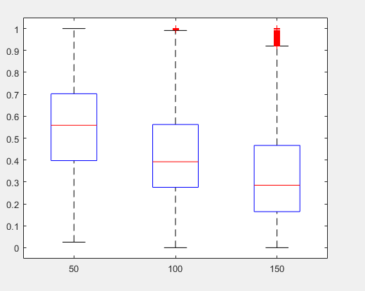
Features box plots
Luminance 90%
Luminance

Slide 13
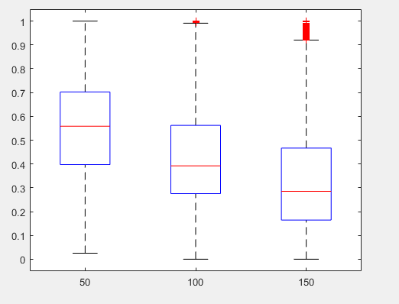
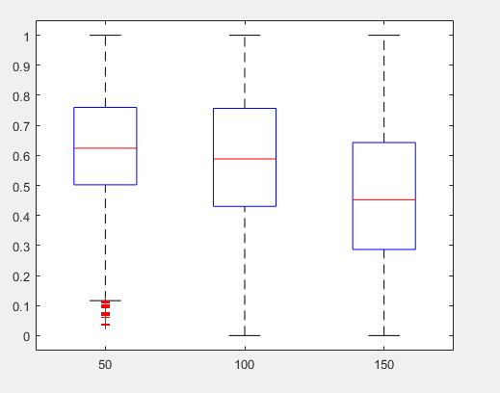
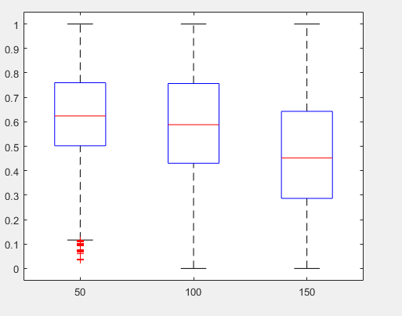
Features box plots
Lightness
Lightness 10%
Luminance 10%

Slide 14
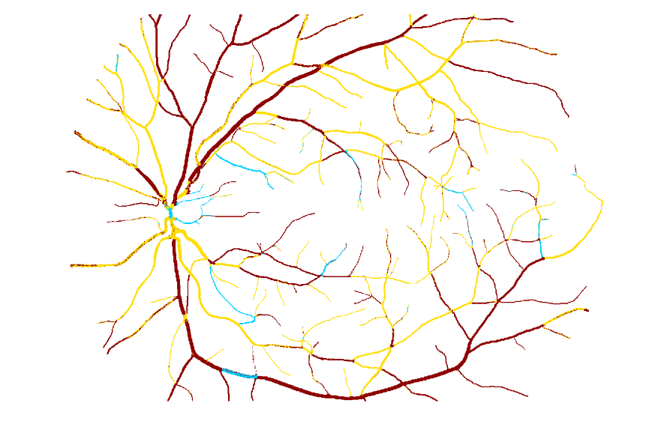

Results
Pixels after classification

Slide 15
Conclusions
In this project we preprocessed image and extract the most useful features for the future applying of ML classifier
We tried to implement Machine Learning classifier Random Forest for automatic classification of arteries and veins
Our results is:

Slide 16
Thank you for your attention!

