Slide 1

AI Shared Services @ DTSE CZ
Python Crashcourse
Štěpán Vondráček
SHARED SERVICES

Slide 2

Why are we here?

Slide 3
Agenda
WHAT do we do at the AI Shared Services (AIS)?
HOW do we do it?
WHY do you might want to learn it?
Crash Course Introduction

Slide 4
What Do We Do at AI Shared Services (AIS)

Slide 5
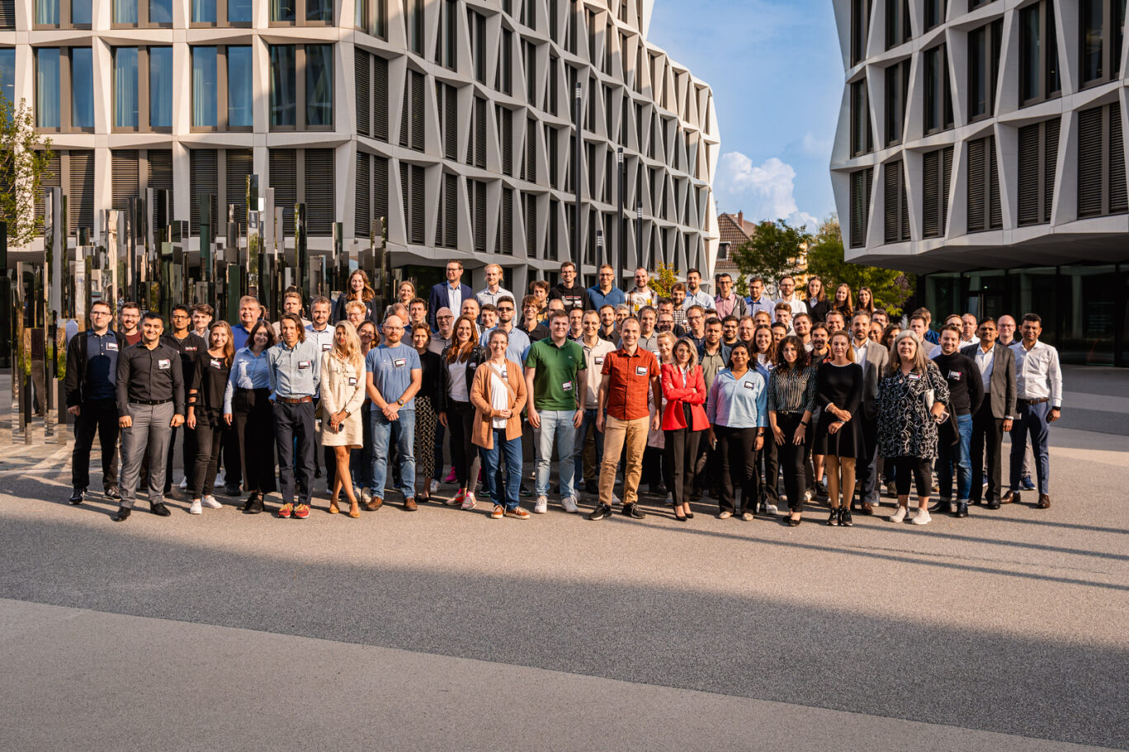
AI Shared Services (AIS)
Started as AI Incubator in 2019 (4 employees including Brno’s very own Pišta Kosztolányi)
50 data scientists, developers, project managers etc. located in Bonn, Brno, Bratislava, Bucharest and Košice (hired perhaps just to spoil the B symbolic)
Provider of AI and ML driven solutions across the DT Group (From Macedonia to Germany, from Group Controling to HR)

Slide 6



Product portfolio
TIME SERIES ANALYTICS
TEXT PROCESSING / NLP
OTHER SERVICES/PRODUCTS
Delphi Forecasting
time series predictions for financials & non-financials
to be used to simplify and improve forecasting & planning processes
complementary visualization & planning interface “Delphi Studio”
Guided Reporting
time series analysis to detect anomalies in data and provide early warnings
to be used to analyze reported data & identify most important points for action
Early Warning System
special case of multivariate time series predictions based on a leading indicator generated from external factors (inflation, etc)
to be used for time series heavily influenced by DT_external factors
Chatbots
chatbots based on Natural Language Processing (NLP) models, deployed on mobile or desktop application
to be used to browse DT-internal data or other information
Semantic Search Engine “Athena”
NLP-based search engine supporting all kinds of text files
to be used for finding information in DT-internal, possibly confidential data
Automated Commenting
automated production of qualitative comments on data (rule-based or using LLMs)
to be used to comment the output of dashboards and data cockpits
Web-based planning tool IRIS
web frontend for entering, adjusting and visualizing data, connected to a database
to be used for data collection and planning processes
Data Science as a service
on-demand flexible data science services, also for short-term engagements
to be employed when there is a shortage/absence of data science resources and need for ad-hoc support

Slide 7

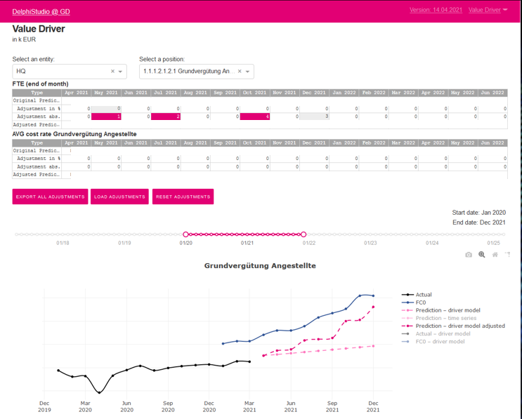
Delphi | Live demo

Slide 8
How Do We Do It?

Slide 9

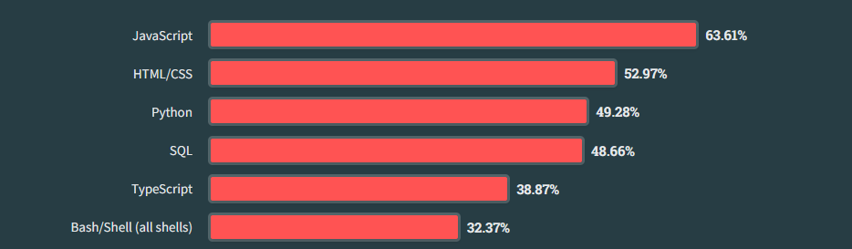
Many others, but foremost Python
The “oil” of the AIS
Introductory programming language as well as third most used one by professionals (as of 2023)
N. 1 Choice in Machine Learning, AI etc.
Easily readable, user-friendly, steep learning curve
Vibrant open-source community
ML/AI, web pages etc.

Slide 10
Why Do You Might Want To Learn It?

Slide 11
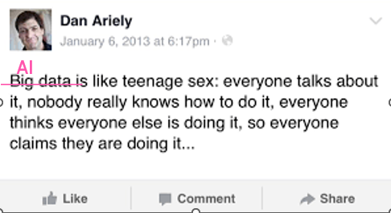
Everybody Talks AI
AI has become widely accessible, yet few really understand the guts (and also perceive the limits)
The art of “prompting” is not very different from coding

Slide 12
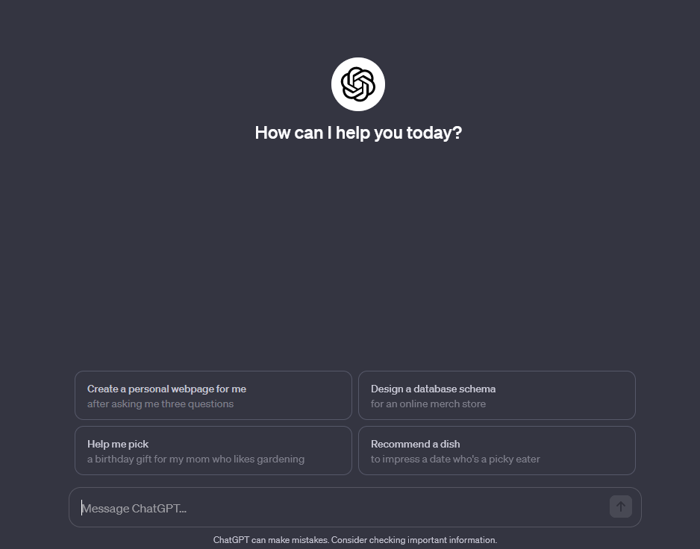
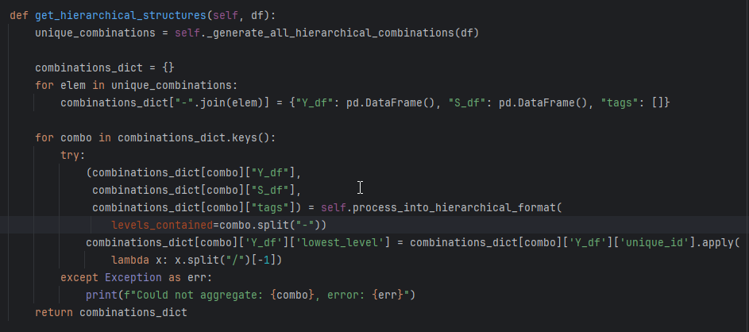
Algorithmic Way of Thinking
Have you ever been scared off by an immense task to tackle?
Programming can teach you how to define atomic tasks which are
less frightening and more doable
How else could you build something like THIS:
From THIS:

Slide 13

Boring Routine Automation
Do you have an appetite for moving 1000 files matching specific pattern from one directory to another?
Deleting specifically named files in a directory?
Removing characters polluting otherwise normally readable text?

Slide 14
DTSE CZ Python Crash Course!

Slide 15
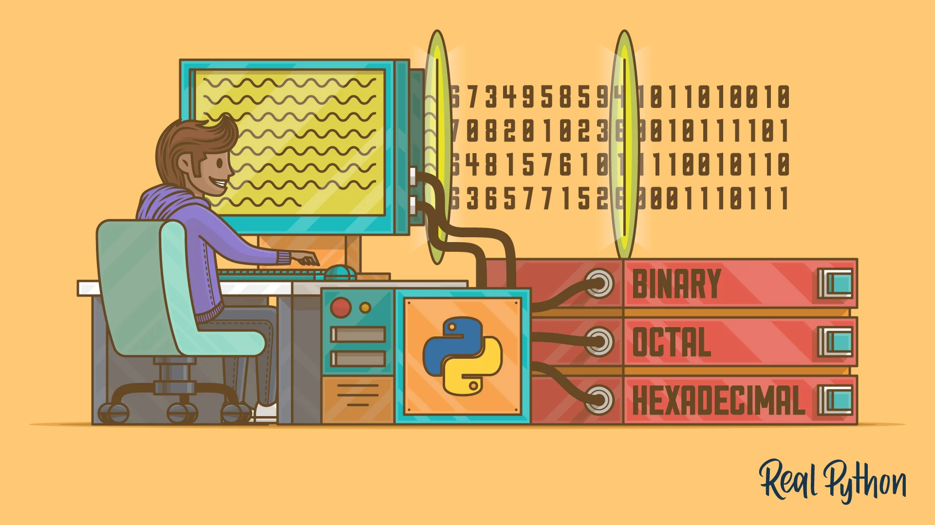
What will you learn?
Concrete Data Types – characteristics and usage
Basic numeric and string (character) operations
Abstract Data Types – characteristics and operations
Iterating and Writing Reusable Components
Working with folders and text – real world examples

Slide 16
How Will You Learn
No installation of anything needed
Only Google Account
Code is running in prepared python notebooks
Automated evaluation of your exercises
Further readings, materials

Slide 17

Let’s get going!

Slide 18
Google Colab Interface

Slide 20
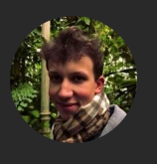



Contact
We are part of Deutsche Telekom Services Europe (DTSE).
As the group’s shared service center, we deliver excellent AI solutions to our customers all over the DT world.
Štěpán Vondráček
Data Scientist @ Delphi TDG
Also, check out our pages on the internet/intranet! (click on the icons)
YAM United
Linkedin

