Slide 1

Explainer Dashboard Demo Štěpán Vondráček
296359464
296359464
278555704
0
AIS Knowledge Exchange
SHARED SERVICES

Slide 2
Why Explainable AI?
91% of AI models degrade in production (Nature)
Legislative requirements: bank institutions are required to use explainable models to prevent bias (e.g. against minorities)
Model Diagnostics

Slide 3
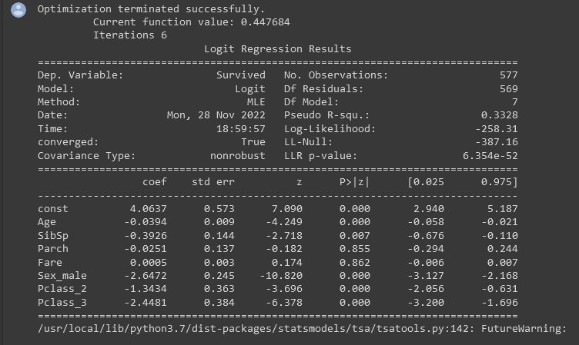

Curse of Explainability
Multiple linear regression?
Only average effect (no local effects)
Problem of differently scaled covariates (dummy vars?)
Assumption of monotonous effect, linear relationships
Adding interactions can be computationally costly
How about complex models?

Slide 4

SHAP values
“SHapley Additive exPlanations”
Generally used approach towards explainability (even of supposedly “black box” models)
Concept introduced by Lloyd Shapley in his work on Game Theory
“How much does a particular member of coalition contribute to the outcome?”
Lundberg et al. 2017 → SHAP

Slide 5
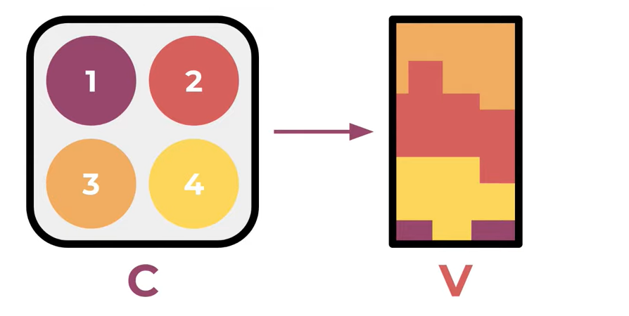
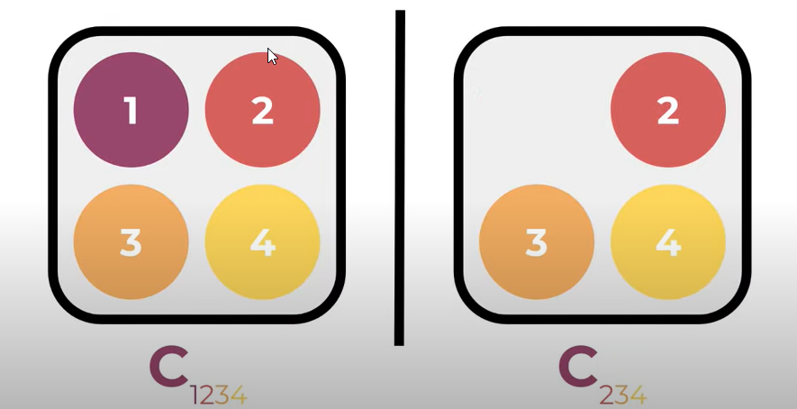
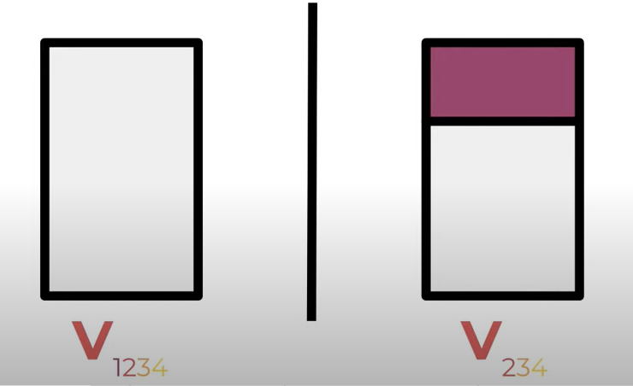
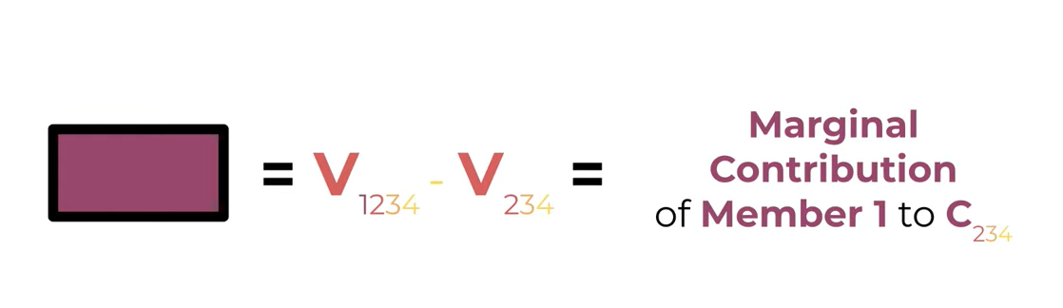
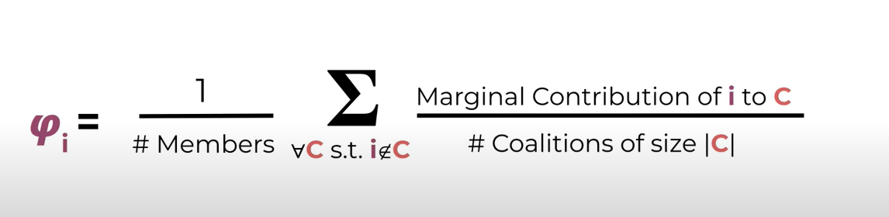
Shapley values – original concept Suppose you want to evaluate, how much did 4 workers contribute to the outcome to fairly distribute their compensation:

Slide 6
SHAP Explainer Algorithms
KernelExplainer: all models, actually a SHAP’s own specification of another algorithm - LIME
TreeExplainer: tree-based methods; uses averaging over missing features of all models trained in the process
DeepExplainer: deep-learning; back-propagation of SHAP values analytically calculated for many NN components using DeepLIFT
SHAP values satisfy 3 important conditions:
Local Accuracy: asymptotically the effect of an estimated local effect should be equal to the actual one
Missingness: the SHAP value of a 0 contribution is 0
Consistency: feature effect moves in the same direction as the change of feature contribution

Slide 7
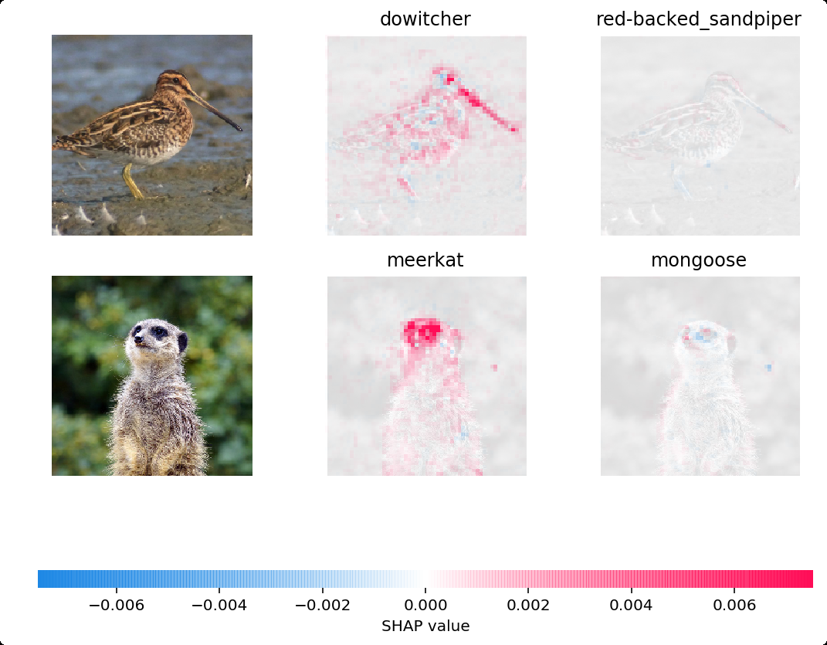
Benefits of SHAP
Reverse engineering (once you have the BEST model, you can start explain, no need to sacrifice predictive ability)
Marginal contributions are normalized and easily comparable (however no real-word metric is used)
Allows for non-linear effects
Computable even for complex models
Requires to train 2^{n features} models → Approximations
Uses resampling -> not applicable for autocorrelated data sets

Slide 8


Explainer Dashboards
Easy-to-Build frontend to explore the models’ interpretability
Employs SHAP values and standard metrics for multiple “sklearn-type” models

Slide 9
DEMO TIME!

