Slide 1

Explainer Dashboard Demo Štěpán Vondráček
296359464
296359464
278555704
0
AIS Knowledge Exchange
SHARED SERVICES

Slide 2
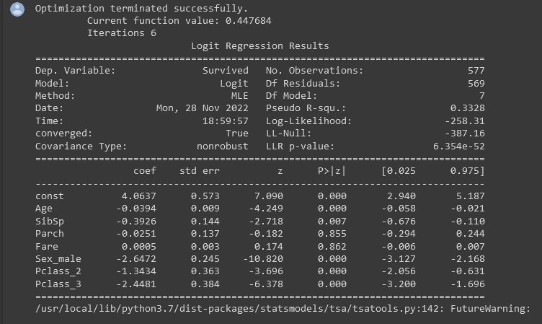

Curse of Explainability
Multiple linear regression?
Only average effect (no local effects)
Problem of differently scaled covariates
How about dummies if covariates are standardized?
Assumption of monotonous effect, linear relationships
Adding interactions can be computationally costly
How about complex models?

Slide 3
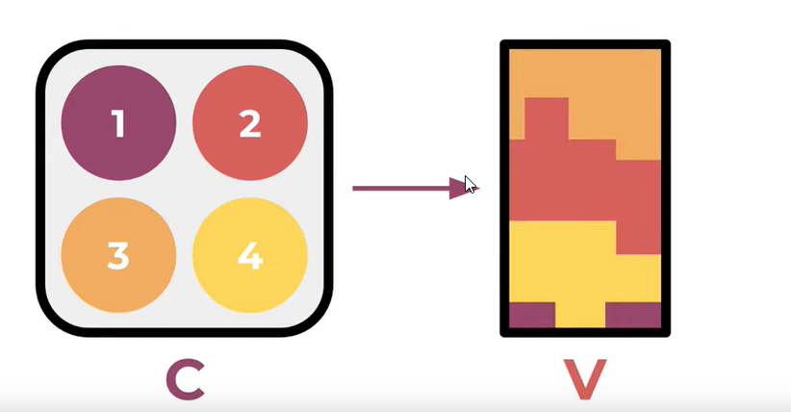
SHAP values
“SHapley Additive exPlanations”
Standard approach towards explainability of complex models
Based on “resampling” techniques over the whole sample given the observation
characteristics
Concept introduced by Lloyd Shapley in his work on Game Theory
“How much does a particular member of coalition contribute to the outcome?”
Lundberg et al. 2017 → SHAP

Slide 4
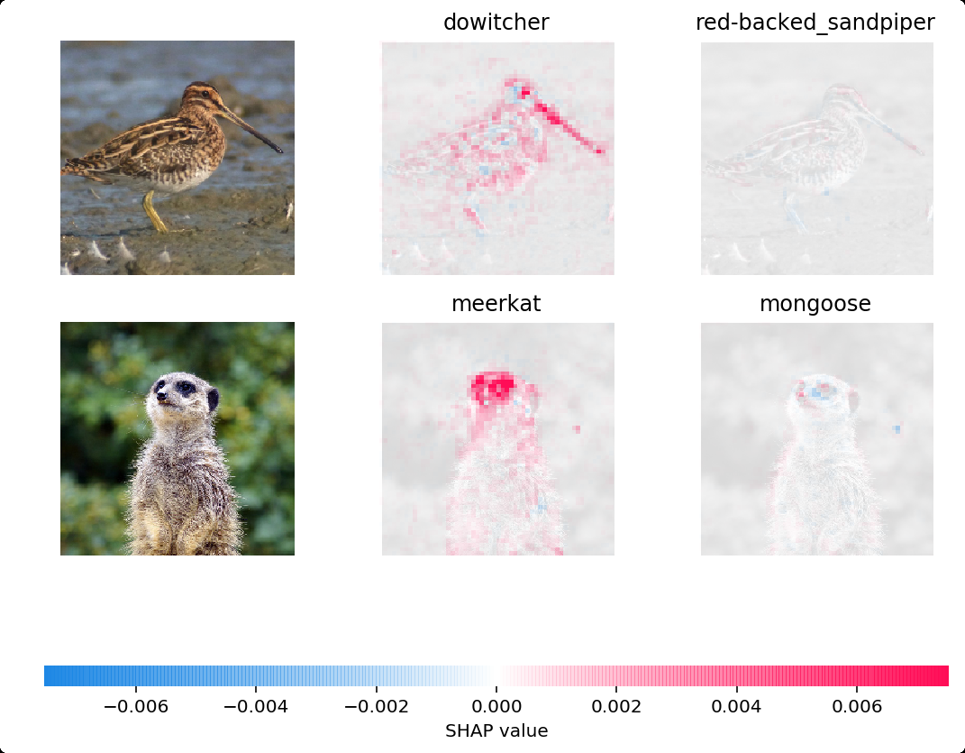
Benefits of SHAP
Reverse engineering (once you have the BEST model, you can start explain, no need to sacrifice predictive ability)
Marginal contributions are normalized and easily comparable (however no real-word metric is used)
Allows non-linear effects
Possible even for complex models
Requires to train 2^n_FEATURES models → Approximations
Non applicable under autocorrelation (please correct me if I’m wrong)

Slide 5


Explainer Dashboards
Easy-to-Build frontend to explore the models’ interpretability
Employs SHAP values and standard metrics for multiple sklearn-type models

Slide 6
Further resources

