Slide 1
AI Group Project
Group 8 Presenter: MATSUNAGA TAKEHIRO 518030990028
Other group members: EDUARDO WANG ZHENG 518030990025,
KAR CHUN TEONG 518030990014(currently in Malaysia)

Slide 2
Model architectures
Deep fully connected neural networks with Merge-and-Run mappings (DMRNets)
Long-term short memory (LSTM)
Bidirectional Long-term short memory (biLSTM)

Slide 3
Model Overview
DMRNets
*Analysed by KAR CHUN TEONG
Implemented by KAR CHUN TEONG and EDUARDO WANG ZHENG

Slide 4
What is DMRNets
A variation of Deep convolutional neural networks with Merge-and-Run mappings (coincidentally has the same short-form DMRNets, to differentiate, DMRNets(CNN) and DMRNets(FCN))
DMRNets(CNN) itself is a variation of Residual Neural Network (ResNet)

Slide 5
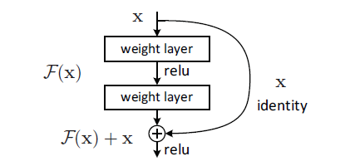
Starting from ResNet, what is ResNet?
Deep CNN: is stacking more conv layers(increase depth) = better performance?
Problem: Degradation
as depth increasing, accuracy get saturated then degrades rapidly
Not caused by overfitting
More layers = higher training error
Solution: Residual Learning
H(x) = F(x) + x (desired underlying mapping)
F(x) = H(x) – x
x = shortcut connection(identity mapping)
Image source: Deep Residual Learning for Image Recognition

Slide 6
Based on ResNet: DMRNets(CNN)
Assembles the residual branches in parallel through a merge-and run mapping.
Merge: average the inputs of these residual branches.
Run: add the average to the output of each residual branch as the input of the subsequent residual branch.

Slide 7
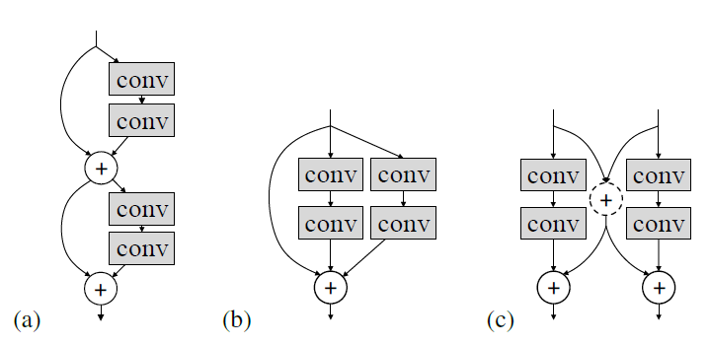
Comparison
Image source: Deep Convolutional Neural Networks with Merge-and-Run Mappings

Slide 8
Finally: DMRNets(FCN)
Variation of DMRNets(CNN): change the conv layers(CNN) into fully connected layers(FCN).
Model Structure:
fc_block (dense -> batch normalization -> leaky ReLU -> dropout)
Merge-and-Run (two branches)
Branch a (fc_block)
Branch b (identity map)
Average branch a and b
Leaky ReLU

Slide 9
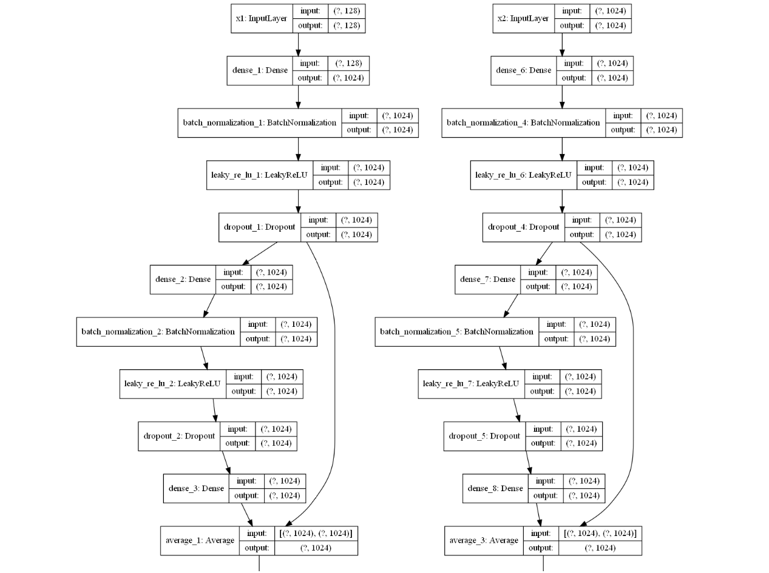

Slide 10
Performance
First 200 training shards MAP@10:
First 100 validation shards MAP@10:
Whole datasets MAP@10:

Slide 11
Model Overview
LSTM
*Analysed and implemented by TAKEHIRO MATSUNAGA

Slide 12
What is LSTM?
A type of recurrent neural network (RNN) architecture.
A common LSTM unit is composed of:
a cell: remembers values over time intervals
3 gates to regulate the flow of information into and out of the cell.
forget gate: decides to forget which information.
input gate: decides to update which value, and update cell states.
output gate: output filtered cell states.
TL;DR: use past context to predict the output.
Example: trying to predict next word based on given sentence
“he went to pool to …”

Slide 13
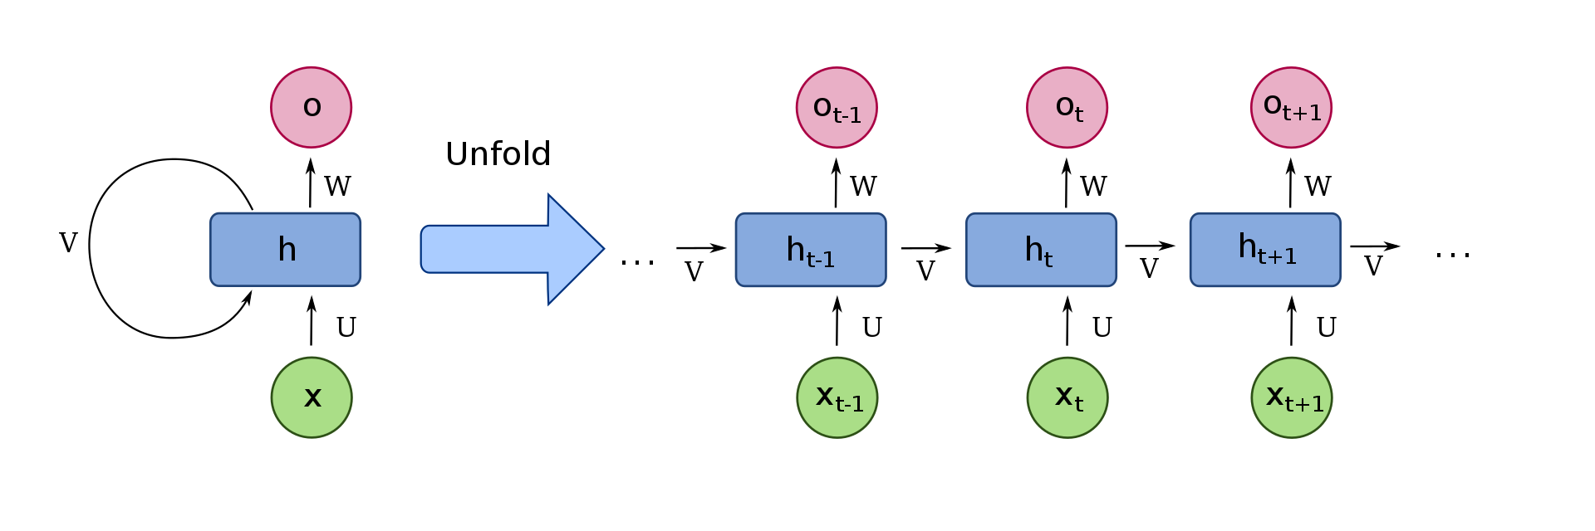
RNN structure
RNN can derive some parameters from its forward node,

Slide 14
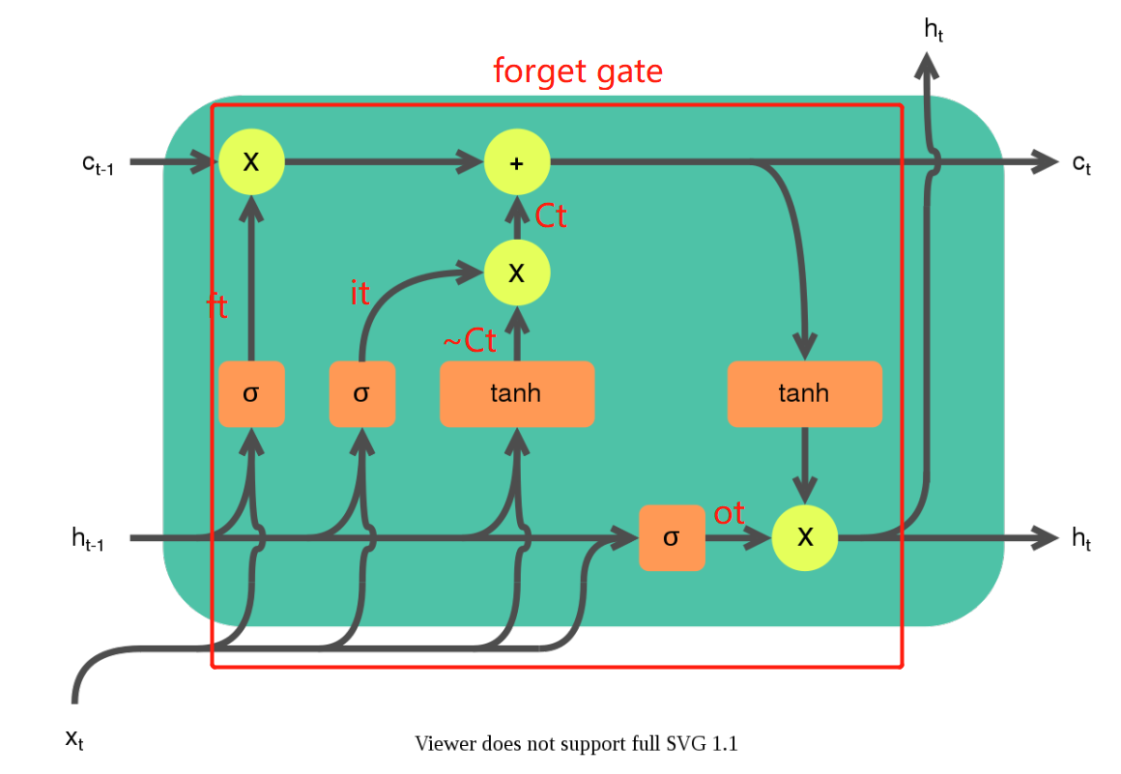
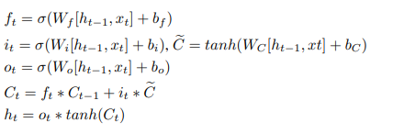
A Cell of LSTM

Slide 15
Performance
First 200 training shards MAP@10:
First 100 validation shards MAP@10:
Whole datasets MAP@10: 0.759

Slide 16
Model Overview
biLSTM
*Analysed and implemented by TAKEHIRO MATSUNAGA

Slide 17
What is biLSTM?
LSTM but in two directions.
LSTM uses past context only
biLSTM uses past and future context
biLSTM generally provided more context -> better performance
Example: trying to predict next word based on given sentence
Forward LSTM: “he went to … ”
Backward LSTM: “… to take a shower.”

Slide 18
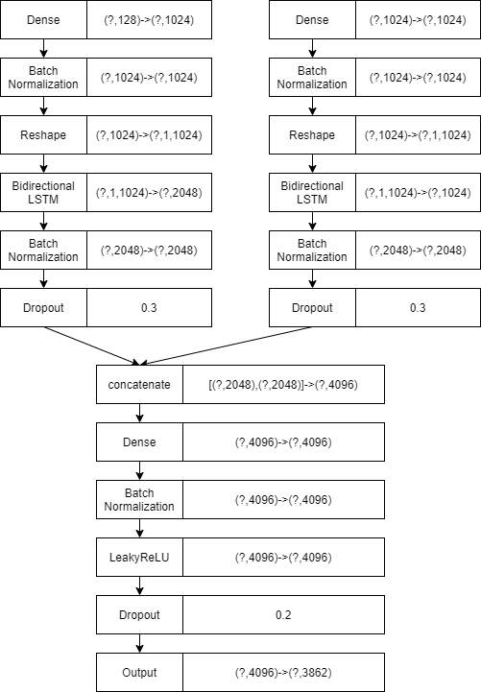
Our structure
The model first using Bidirectional LSTM for each feature, then merging them to get the output

Slide 19
Performance
First 200 training shards MAP@10:
First 100 validation shards MAP@10:
Whole datasets MAP@10: 0.763

Slide 20
Experiments and Analysis
Tested by TAKEHIRO MATSUNAGA and Analysed by KAR CHUN TEONG

Slide 21
Training
Cloud platforms: expensive (GCP offers free trial but needs credit card)
At the end, use our own computers: can only train with small subsets (first 200 training shards and the first 100 validation shards.)

Slide 22
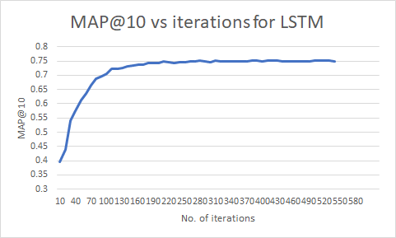
LSTM training curve

Slide 23
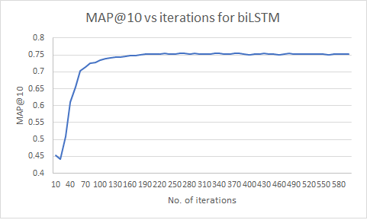
biLSTM training curve

Slide 24
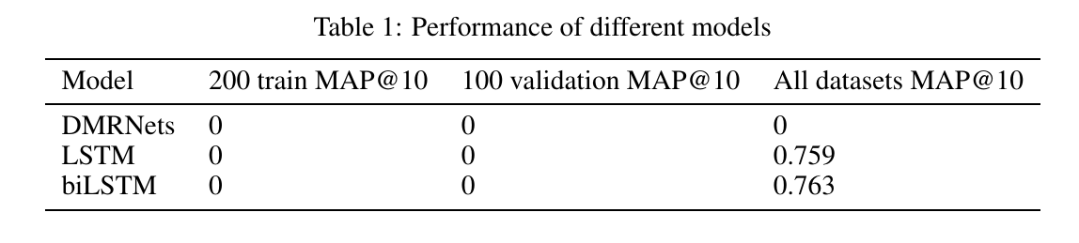
Comparison of all models
MAP@10 for 200 train and 100 validation always > MAP@10 for all datasets
We train with 200 train and 100 validation, possible overfit
However, LSTM and biLSTM still > 0.75 with only small subsets of training data
Hypothesis: the MAP@10 could be higher with more training data.
Don’t have enough computing power to prove that.

Slide 25
Contributions
KAR CHUN TEONG
Production management(organization and distribution of workload, arrangement of meeting schedule, etc.)
Research and implementation of DMRNets(FCN) model
Design, creation, and compilation of final report and PPT
MATSUNAGA TAKEHIRO
Implementation of LSTM model
Training and testing of LSTM model
EDUARDO WANG ZHENG
Implementation of DMRNets(FCN) model
Training and testing of DMRNets(FCN) model

Slide 26
Conclusion

Slide 27
Thank you for listening!
This presentation is made and designed by KAR CHUN TEONG.

