Slide 1
AI Group Project
Group 8 Presenter: MATSUNAGA TAKEHIRO 518030990028
Other group members: EDUARDO WANG ZHENG,
KAR CHUN TEONG 518030990014(currently in Malaysia)

Slide 2
Model architectures
Deep fully connected neural networks with Merge-and-Run mappings (DMRNets)
Long-term short memory (LSTM)
Bidirectional Long-term short memory (biLSTM)

Slide 3
Model Overview
DMRNets
*Analysed by KAR CHUN TEONG

Slide 4
What is DMRNets
A variation of Deep convolutional neural networks with Merge-and-Run mappings (coincidentally has the same short-form DMRNets, to differentiate, DMRNets(CNN) and DMRNets(FCN))
DMRNets(CNN) itself is a variation of Residual Neural Network (ResNet)

Slide 5
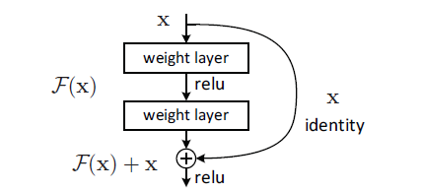
Starting from ResNet, what is ResNet?
Deep CNN: is stacking more conv layers(increase depth) = better performance?
Problem: Degradation
as depth increasing, accuracy get saturated then degrades rapidly
Not caused by overfitting
More layers = higher training error
Solution: Residual Learning
H(x) = F(x) + x (desired underlying mapping)
F(x) = H(x) – x
x = shortcut connection(identity mapping)
Image source: Deep Residual Learning for Image Recognition

Slide 6
Based on ResNet: DMRNets(CNN)
Assembles the residual branches in parallel through a merge-and run mapping.
Merge: average the inputs of these residual branches.
Run: add the average to the output of each residual branch as the input of the subsequent residual branch.

Slide 7
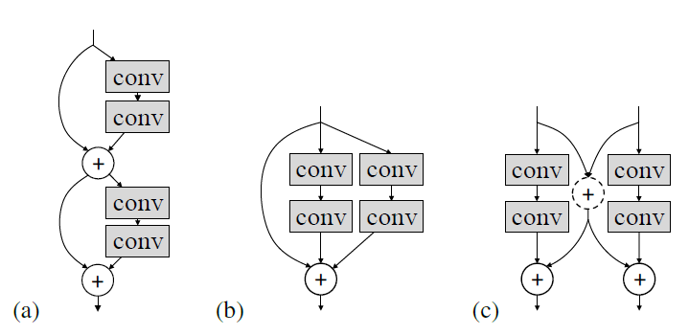
Comparison
Image source: Deep Convolutional Neural Networks with Merge-and-Run Mappings

Slide 8
Finally: DMRNets(FCN)
Variation of DMRNets(CNN): change the conv layers(CNN) into fully connected layers(FCN).
Model Structure:
fc_block (dense -> batch normalization -> leaky ReLU -> dropout)
Merge-and-Run (two branches)
Branch a (fc_block)
Branch b (identity map)
Average branch a and b
Leaky ReLU

Slide 9
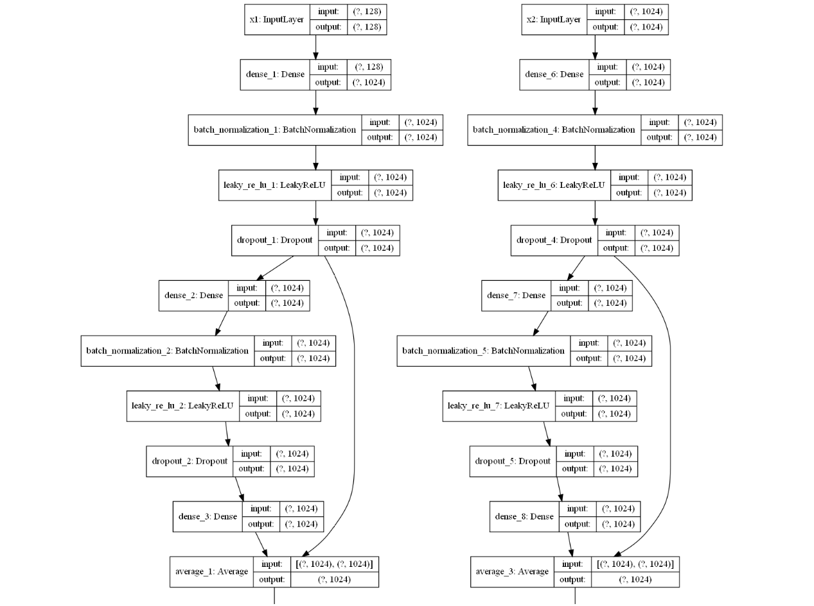

Slide 10
Contributions
KAR CHUN TEONG
Production management(organization and distribution of workload, arrangement of meeting schedule, etc.)
Research and implementation of DMRNets(FCN) model
Design, creation, and compilation of final report and PPT
MATSUNAGA TAKEHIRO
Implementation of LSTM model
Training and testing of LSTM model
EDUARDO WANG ZHENG
Implementation of DMRNets(FCN) model
Training and testing of DMRNets(FCN) model

Slide 11
Thank you for listening!
This presentation is made, designed and brought to you by KAR CHUN TEONG.

