Slide 1
Detecting TCP ACK storm attack: a state transition modelling approach Author: Neminath Hubballi, Jonathan Santini
Team Members: KAR CHUN TEONG, 李洪旭, 胡天益, 黄中钰

Slide 2
What is TCP ACK storm attack?
3 Stages:
Pick up (at least) one packet from a TCP connection between a client and a server
Generate two packets, each addressed to one party and with sender address of the other party. The packets should have content (at least one byte of data).
Send the packets to the client and the server at the same time. The connection will then enter an infinite loop of sending ACK packets back and forth between both parties.

Slide 3
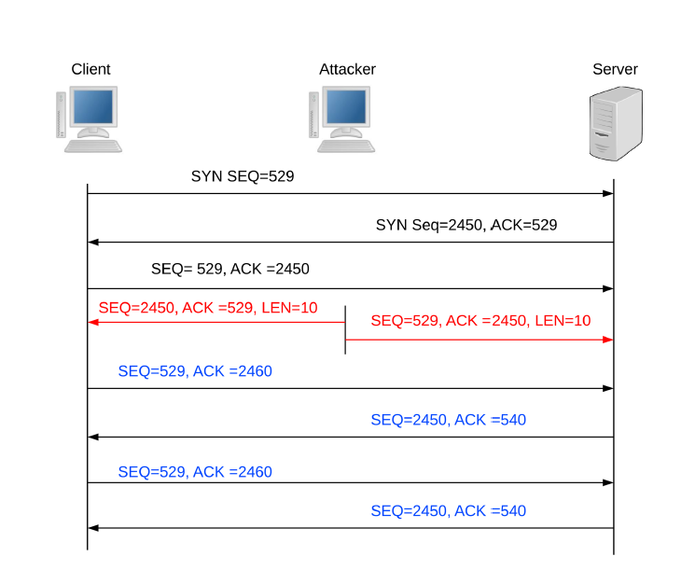

Slide 4
Possible Defenses
Fixing TCP implementation/standard
When receiving a packet containing ACK higher then the receiver’s SEQ, the packet must be discarded, and no response should be sent. That will guarantee that upon such an attack, no traffic will be generated.
Use encrypted wireless network and/or IPSec-protected connections
prevent eavesdropping
Filtering traffic using a stateful firewall
limiting maximum number of connections per IP address, limiting number of packets per time frame

Slide 5
Use State Transition Machine(CCA) to detect ACK storm attack

Slide 6
States
q0: there are no unacknowledged bytes in the TCP connection
q1: there are bytes to be acknowledged in the TCP connection
q2: abnormal acknowledgement packet received
Storm: acknowledgement storm detected

Slide 7
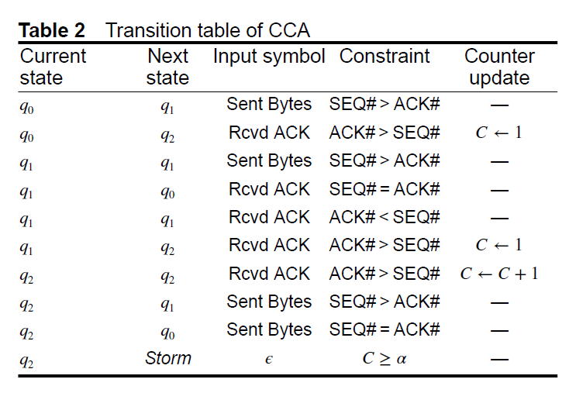

Slide 8
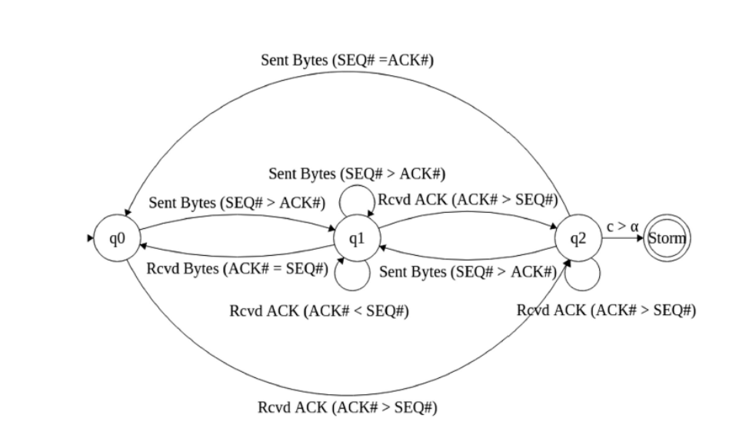

Slide 9
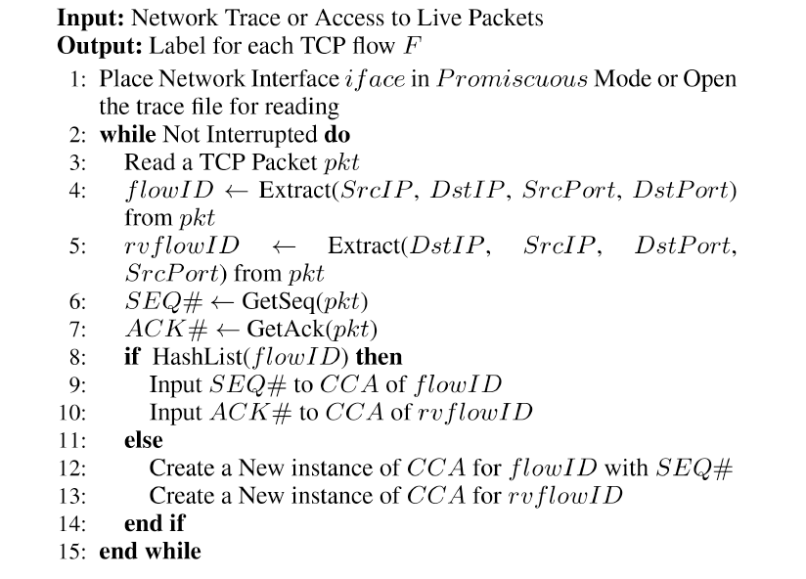

Slide 10
Complexity
Hosts communicates with fixed no. of peers
CCA has fixed no. of states: constant memory
Searching flowID in hash list: constant or linear time
Select appropriate transitions on CCA: constant time
Space and Time Complexity: Linear in terms of no. of TCP connections

