Slide 1


PETROVSKIY COLLEGE
Virtual Private Networks (VPN)
Modern methods for ensuring security and privacy in global networks
Student: Timofeev Ivan
Group: 53-02
Teacher: Latysheva Victoria
2026

Slide 2

Presentation Outline
1.
Definition and Purpose of VPN
2.
Mechanisms: Encryption and Tunneling
3.
Classification of VPN Architectures
4.
Modern Protocols Overview (Vless, WireGuard, IKEv2/IPsec)
5.
Analysis of Benefits and Limitations
6.
Sources and Conclusion
2

Slide 3

VPN — A Secure Bridge in the Internet
Virtuality
The network is created programmatically on top of existing physical internet infrastructure.
Privacy
Hiding the real IP address protects the user from profiling and surveillance.
Security
Using cryptographic methods guarantees the integrity and confidentiality of transmitted traffic.
3

Slide 4




How VPN Protects Your Data
Data Encryption
Tunneling
Authentication
Converting information into unreadable code that cannot be decrypted without a specific cryptographic key.
Encapsulating data packets in a secure shell for their safe transportation through open networks.
Verifying the identity of the user and the server to prevent unauthorized access and MITM attacks.
4

Slide 5




VPN Types for Various Tasks
Remote Access
Site-to-Site
Personal Protection
Allows employees to securely connect to internal company resources from anywhere, creating a presence effect in the office.
Connects geographically distributed offices into a single secure corporate network through public communication channels.
Used by individuals to ensure anonymity, bypass censorship, and protect data in insecure public Wi-Fi networks.
5

Slide 6






Why VPN Became a Security Standard
Online Anonymity
Global Access
Secure Wi-Fi
Economic Benefit
Masking the digital footprint and protecting browsing history from internet service providers.
Connecting to servers in different countries to access regional entertainment content.
Preventing theft of passwords and personal data when using open hotspots.
Protection against price discrimination based on your geographic location.

Slide 7
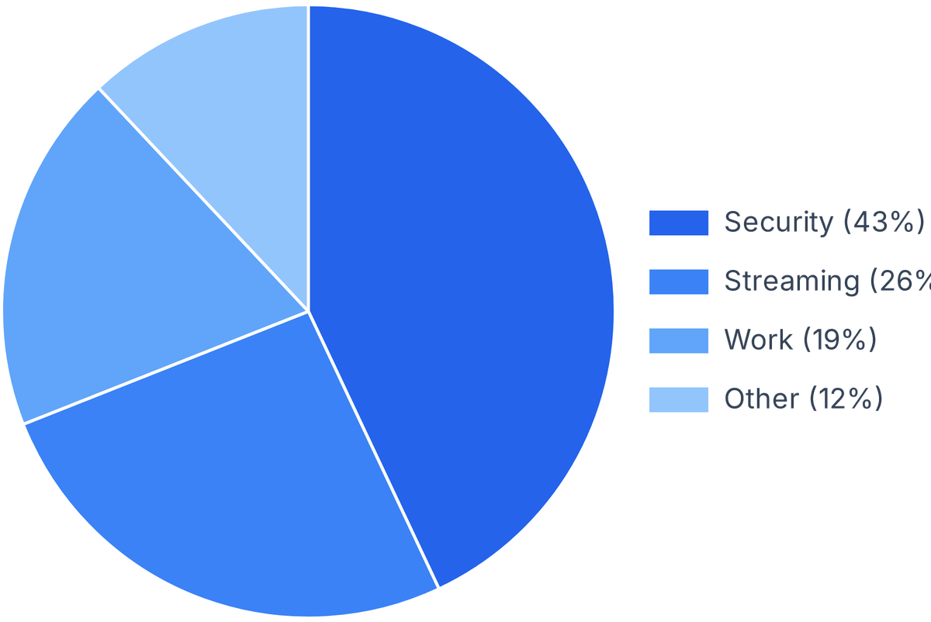
VPN Popularity Dynamics Worldwide
Over 1.5 billion people regularly use VPN services.
Security remains the top priority for 43% of users worldwide.
7

Slide 8



Choosing a Protocol: Speed vs. Reliability
Vless
WireGuard
IKEv2/IPsec
The industry gold standard with open-source code. Provides maximum configuration flexibility and the highest security level for all network types.
A revolutionary protocol with minimalistic code. Ensures record-breaking connection speeds and instant connection with minimal CPU overhead.
The optimal solution for mobile devices. Features exceptional stability and the ability to instantly restore connections when switching networks.
8

Slide 9




What Should You Pay Attention To?
Performance Drop
Encryption overhead and server distance can lead to a 10-20% loss in internet speed during active connection.
Logging Policy
Free services often trade user data. Choosing a provider with a strict «no-logs» policy is vital for true privacy.
Power Consumption
Constant cryptographic operations create additional load and drain mobile device batteries faster than usual.
9

Slide 10
Sources
1.
Kaspersky Lab: Cybersecurity Encyclopedia
kaspersky.com
2.
Habr: Technical Review of WireGuard Protocol
habr.com
3.
Cisco Documentation: Building Secure Corporate Networks
cisco.com
4.
Selectel Portal: Comparison of Tunneling Methods
selectel.com
10

Slide 11

Thank You for Your Attention!
Virtual Private Networks (VPN): Reliable Protection in the Digital World
Do you have any questions?

Slide 12
PETROVSKIY COLLEGE
Virtual Private Networks (VPN)
Modern methods for ensuring security and privacy in global networks
Student: Timofeev Ivan
Group: 53-02
Teacher: Latysheva Victoria
2026

