Slide 1
AI-Based Skin Lesion
Classification
Using Hybrid Deep Learning & Machine Learning
Your Name | Team Members | Guide Name
DEEP LEARNING · CNN · XGBoost · STREAMLIT

Slide 2
Abstract
This project presents an AI-based skin lesion classification system using a hybrid deep learning and machine learning approach. The system utilizes dermoscopic skin lesion images along with patient metadata such as age, sex, and lesion location for multiclass skin disease prediction.
Deep image features were extracted using the pretrained MobileNetV2 model and combined with metadata through feature fusion. Multiple machine learning models including XGBoost, SVM, and Logistic Regression were trained and evaluated using a leakage-safe classification pipeline.
Experimental results showed that the Hybrid XGBoost model achieved the best performance in terms of Accuracy, F1-score, and Macro F1-score. The final optimized model was deployed using Streamlit for real-time skin lesion prediction.

Slide 3
Introduction
Skin cancer is one of the most common and dangerous skin diseases worldwide
Early detection is important for effective treatment and improved survival
Manual diagnosis is difficult, time-consuming, and depends on dermatologist expertise
Deep Learning and Machine Learning can automate skin lesion classification
The proposed system combines deep image features and patient metadata for improved prediction accuracy
MobileNetV2 is used for deep feature extraction and XGBoost is used for classification
The final model is deployed using Streamlit for real-time skin lesion prediction

Slide 4
Novelty & Key Contributions
Technical Novelty
Research Contributions
Leakage-Safe ML Pipeline
Train-test split before all preprocessing; scaler/imputer fitted only on train set. Eliminates leakage across 9 model variants.
Multimodal Feature Fusion
Concatenates 1280-dim CNN visual features with 3-dim clinical metadata. Both modalities contribute independently validated signals.
Systematic 9-Model Ablation
3 modalities x 3 classifiers: rigorous ablation study isolating contribution of each component.
11-Class Skin Lesion Dataset
Extended to 11 disease categories on MILK10k (10,000+ images) — far beyond typical binary melanoma benchmarks.
MobileNetV2 + XGBoost Architecture
Novel pairing of lightweight CNN extractor with gradient-boosted classifier for efficient edge-deployable skin diagnosis.
Real-Time Clinical Decision Tool
End-to-end deployment via Streamlit — bridging research to actionable clinical prediction with explainable outputs.

Slide 5
Objectives
01
11-Class Classification
02
Deep Feature Extraction
Classify skin lesions into 11 distinct categories
Extract 1280 image features using MobileNetV2
03
Multimodal Fusion
04
Algorithm Comparison
Combine metadata + deep image features
Compare XGBoost, SVM & Logistic Regression
05
Accuracy Improvement
06
Real-Time Deployment
Outperform single-modality baselines
Deploy interactive prediction app via Streamlit

Slide 6
Dataset Information
Dataset Contains
MILK10k
Dataset
Dermoscopic lesion images
Patient metadata
11 lesion categories
10,000+ Dermoscopic Images
Metadata Features
11
3
1280
Age
Sex
Lesion location on body
Classes
Metadata
Features
Deep
Features

Slide 7
System Workflow
1
2
3
4
5
6
Metadata
Preprocessing
Image
Resizing
Deep Feature
Extraction
Feature
Fusion
Model
Training
Evaluation &
Deployment
Note: Add your architecture diagram image above by replacing this slide's image placeholder in PowerPoint.

Slide 8
MobileNetV2 Layers used in the Project
MobileNetV2 was used as a pretrained deep feature extractor
Input dermascopic images were resized to 224x224x3
Initial convolution layers extracted basic image patterns such as edges and textures
Depthwise convolution layers captured spatial information with reduced computation
Pointwise convolution layers combined channel-wise feature information
Bottleneck and inverted residual blocks learned complex lesion characteristics such as asymmetry, pigmentation, and border irregularity
Extracted deep features were passed to the Hybrid XGBoost classifier for multiclass skin lesion prediction

Slide 9
Data Preprocessing
Metadata Processing
Missing value imputation
One-hot encoding of categorical features
Feature scaling (StandardScaler)
Image Processing
Resize images to model input size
Pixel normalization (0–1 range)
Leakage Prevention
Train-test split before preprocessing
Scaling & imputation on training set only
Test set transformed using training params

Slide 10
Deep Feature Extraction
MobileNetV2
MobileNetV2 Architecture
Input Image
Lightweight CNN
224 × 224 × 3
Efficient architecture for mobile/edge
Bottleneck Blocks
Transfer Learning
Depthwise Convolutions
Pre-trained on ImageNet (1.4M images)
Global Avg Pool
Fast Processing
Feature Aggregation
Depthwise separable convolutions
Output Features
Output
1280-dim Vector
1280-dimensional feature vector per image

Slide 11
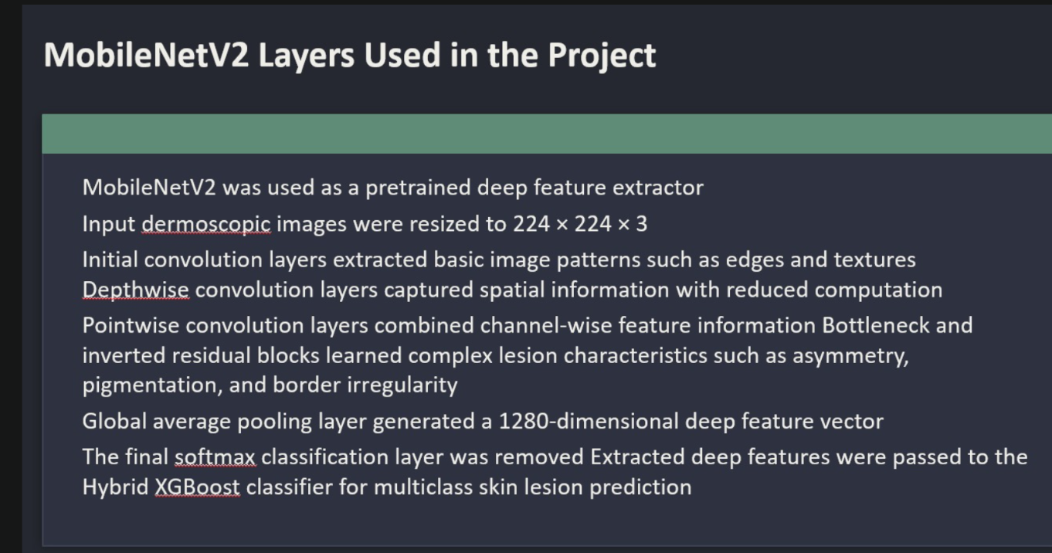

Slide 12
MobileNetV2 Layers — Used vs. Not Used
LAYERS USED
LAYERS NOT USED
Input Layer (224x224x3)
Accepts resized dermoscopic images as RGB tensors.
Conv2D Stem (3x3, stride 2)
First conv layer; extracts low-level edges and textures.
17 Inverted Residual Bottleneck Blocks
Core feature learners: expand + depthwise conv + project. Stride 1 or 2. Residual skip where in/out dims match.
Depthwise Separable Convolutions
Reduces FLOPs by ~8-9x vs standard conv. DW conv per channel + PW 1x1 projection.
Conv2D Last (1x1, 1280 filters)
Expands channels to 1280 before pooling; captures high-level semantics.
Global Average Pooling (GAP)
Compresses 7x7x1280 feature map to 1280-dim vector. This vector is the feature output for XGBoost/SVM/LR.
BatchNorm + ReLU6 (inside each block)
Normalizes activations; ReLU6 bounds outputs for quantization stability on edge devices.
Classifier Head (Dense + Softmax)
include_top=False removes original 1000-class softmax head. Classification delegated to XGBoost/SVM/LR.
Dropout Layer
No fine-tuning performed; backbone frozen in inference mode, so no dropout added or needed.
Custom Dense Hidden Layers
No new dense layers appended atop MobileNetV2. Raw 1280-dim GAP output goes directly to ML classifiers.
MaxPooling / Flatten
GAP (pooling='avg') used instead of MaxPool or Flatten, preserving spatial summaries not raw feature maps.
Backbone Weight Updates (Fine-tuning)
Weights frozen (ImageNet pretrained). No backpropagation through MobileNetV2 — fixed feature extractor only.
Data Augmentation Layers
No random flip/crop/rotation layers. Images only resized and pixel-normalized before feature extraction.
MobileNetV2 used with include_top=False, pooling='avg', weights='imagenet' — frozen feature extractor only. Classification delegated to XGBoost / SVM / Logistic Regression.

Slide 13
Hybrid Feature Fusion
Metadata
Features
Deep Image
Features
HYBRID VECTOR
Concat(Metadata + Deep)
Age · Sex · Location
1280-dim (MobileNetV2)
Best of both worlds
Better Accuracy
Generalization
Robustness
Clinical + visual signals combined
Learns from both modalities
Handles missing metadata gracefully

Slide 14
Mathematical Formulations
1. Depthwise Separable Convolution (MobileNetV2)
DW: G(k,l,m) = ∑ F(i,j,m) K(k-i, l-j, m)
PW: H(k,l,n) = ∑ G(k,l,m) W(m,n)
Reduces computation by ~8-9x vs standard conv. MobileNetV2 outputs 1280-dim vector via Global Avg Pool.
2. XGBoost Regularized Objective Function
L(ϕ) = ∑l(yᵢ, ŷᵢ) + ∑Ω(fₖ)
Ω(f) = γT + ½λ||w||²
l = loss function, Ω = regularizer, T = leaf count, w = leaf weights. Tuned via RandomizedSearchCV (max_depth, learning_rate, n_estimators).
3. Hybrid Feature Fusion Vector
x_hybrid = Concat(f_img, f_meta)
f_img ∈ R¹²⁸⁰, f_meta ∈ R³
Final vector x_hybrid ∈ R¹²⁸³ fed into XGBoost / SVM / LR. No dimensionality reduction — preserves all signals.
4. Evaluation Metric Formulas
Accuracy = (TP + TN) / (TP+TN+FP+FN)
F1-Score = 2×(P×R) / (P+R)
Macro-F1 = (1/K) ∑ₖ F1ₖ
R² = 1 - SS_res / SS_tot
K=11 classes. Macro-F1 weights all classes equally — essential for imbalanced skin data.
5. SVM with RBF Kernel: K(x,x') = exp(-γ||x - x'||²) γ selected via RandomizedSearchCV | One-vs-Rest multiclass strategy for all 3 classifiers across all 3 modalities

Slide 15
Machine Learning Models Used
XGBoost
SVM
Logistic
Regression
Gradient boosted trees. Strong baseline for tabular + fused features.
Support Vector Machine with RBF kernel. Effective in high-dimensional spaces.
Probabilistic multiclass baseline. Fast & interpretable.
Training Strategy
9 Total Models
One-vs-Rest multiclass classification
Metadata-only · Image-only · Hybrid

Slide 16
Hyperparameter Tuning & Evaluation Metrics
Hyperparameter Tuning
Evaluation Metrics
Method: RandomizedSearchCV
Accuracy
max_depth
learning_rate
n_estimators
subsample
colsample_bytree
Overall correct predictions
F1-Score
Class-level harmonic mean
Macro F1
Unweighted mean across classes
R² Score
Variance explained
Confusion Matrix
Full error breakdown per class

Slide 17
Results
Observation: Hybrid XGBoost achieved best accuracy — combining metadata + deep features outperforms single-modality models

Slide 18
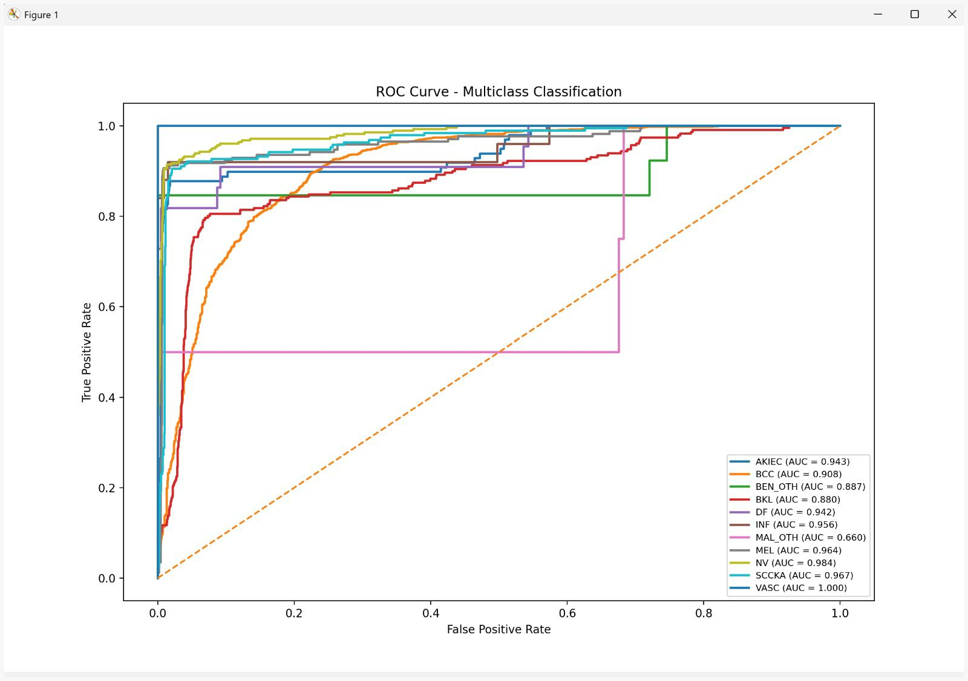
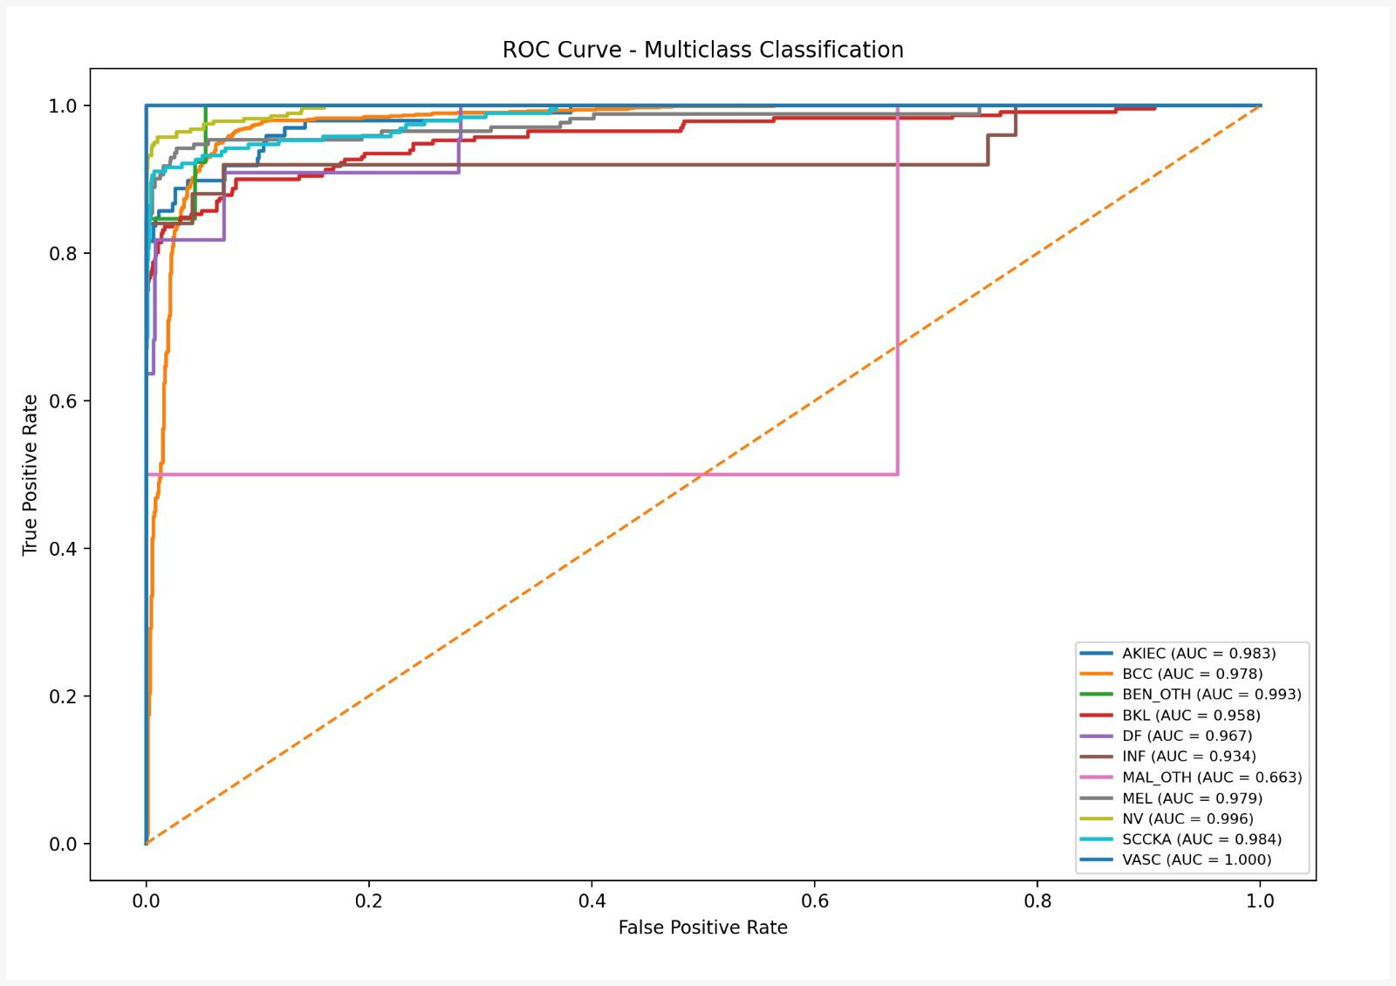
ROC Curve Analysis
Higher AUC indicates stronger classification ability
Hybrid XGBoost showed best generalization across 11 classes
Strong separation from random classifier baseline (AUC = 0.5)

Slide 19
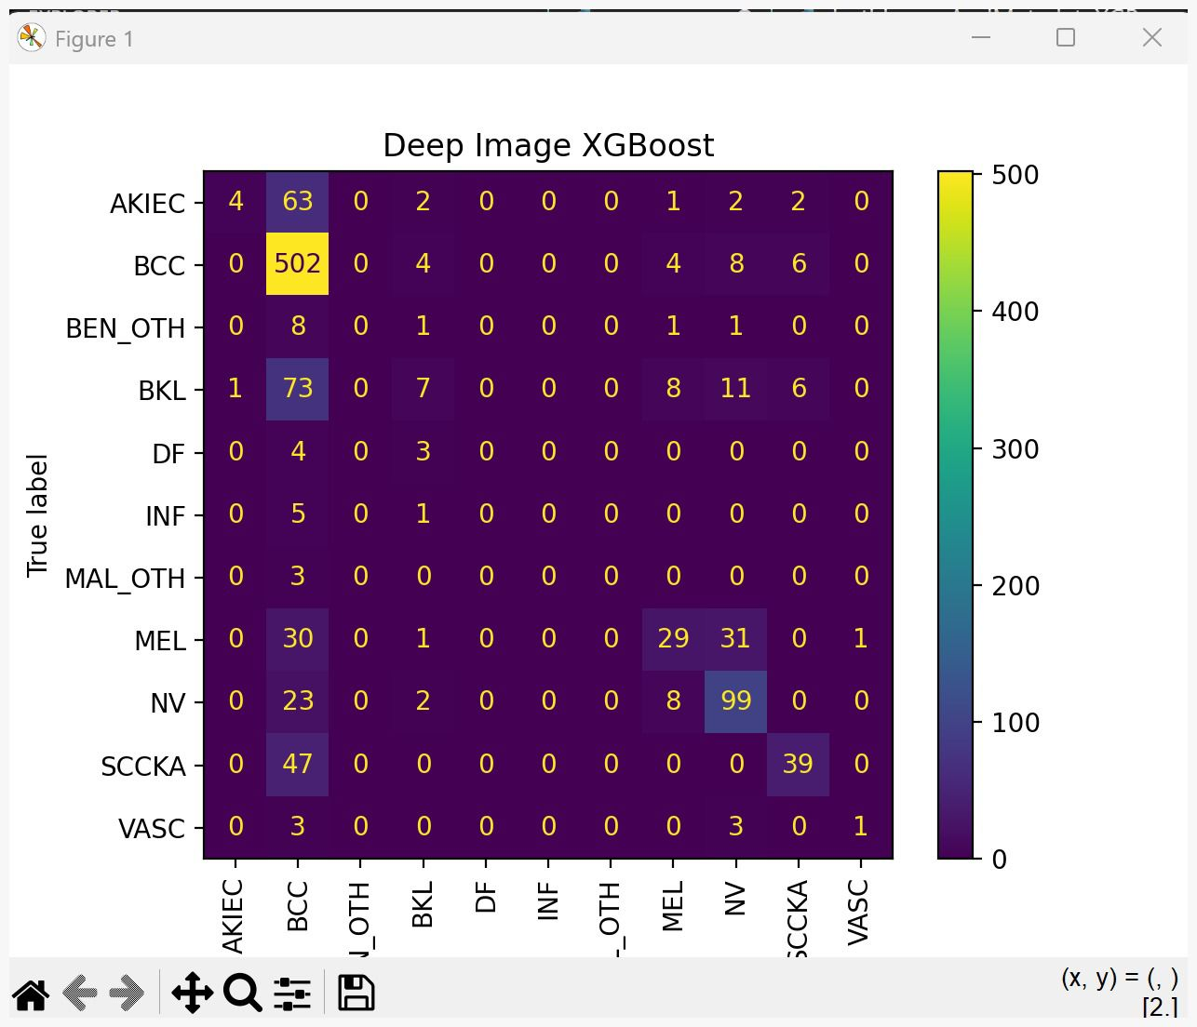
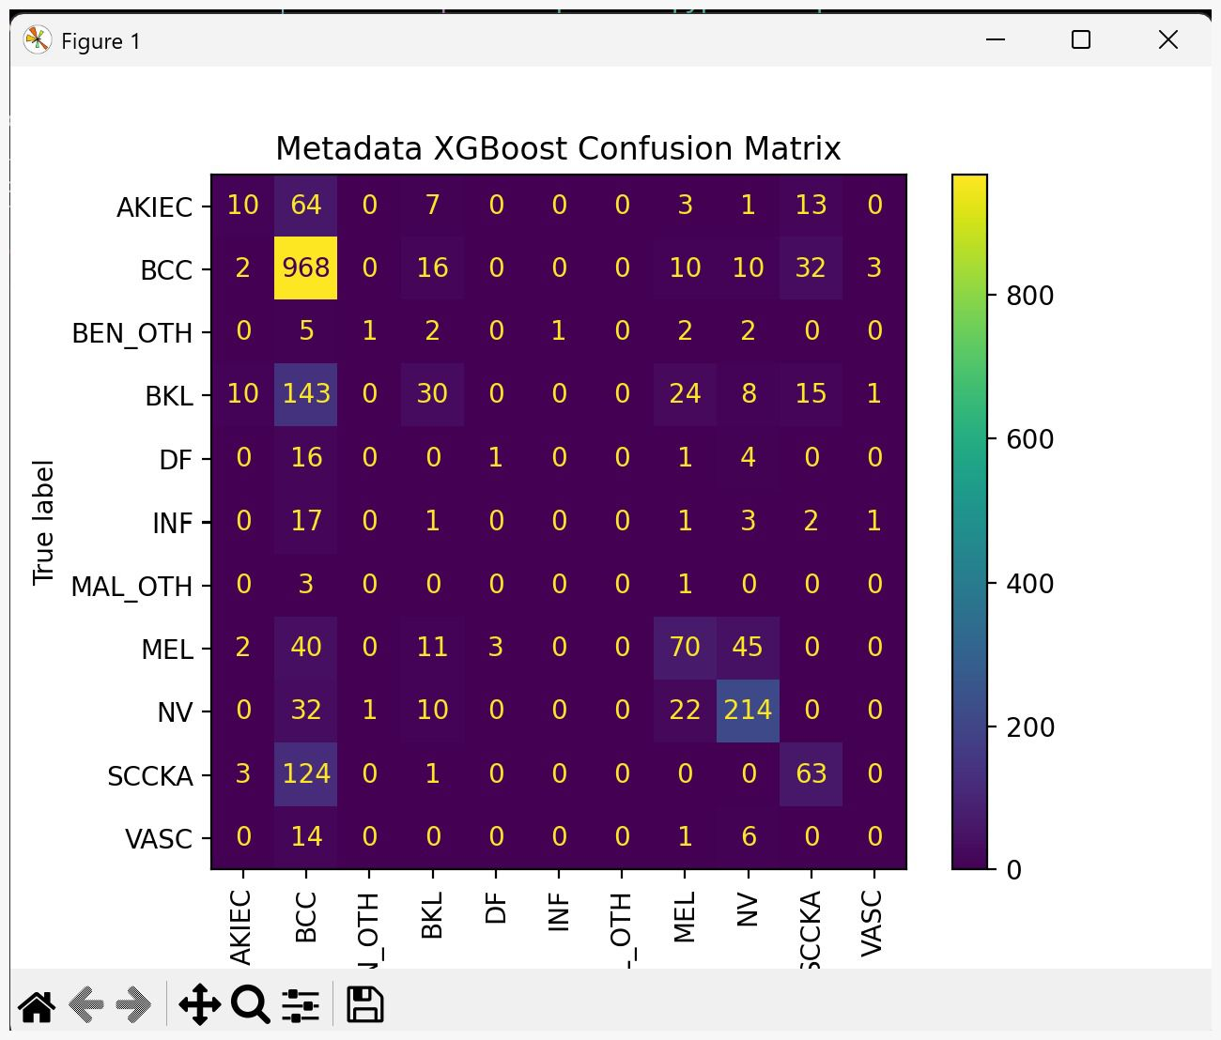
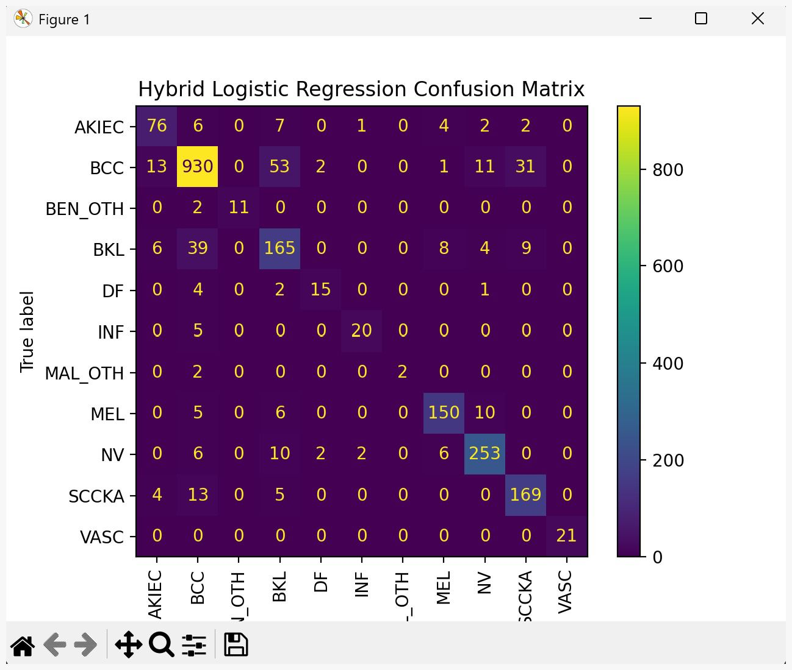
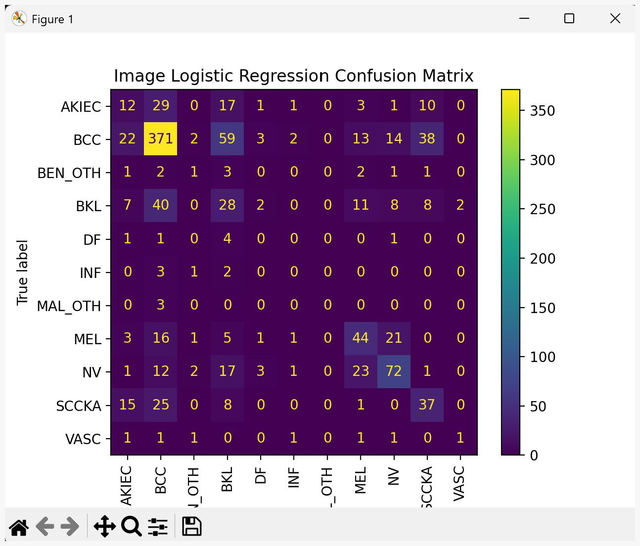
Confusion Matrix Analysis
]

Slide 20
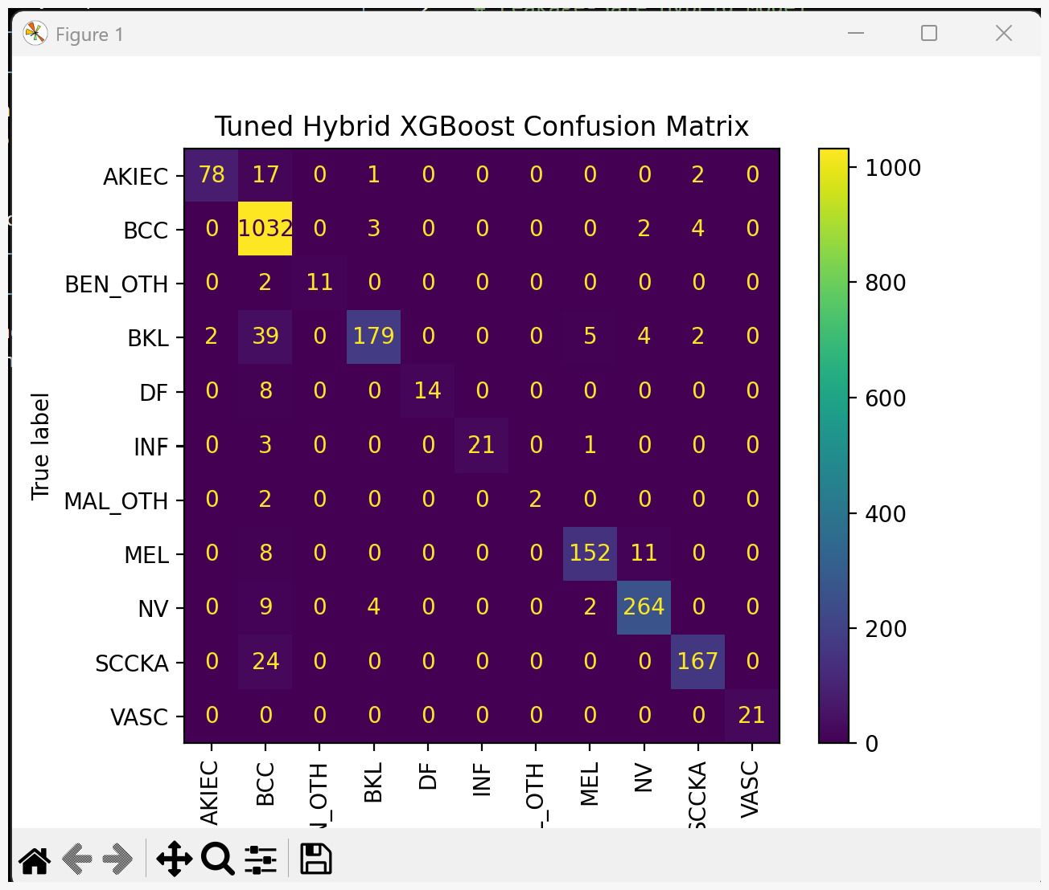
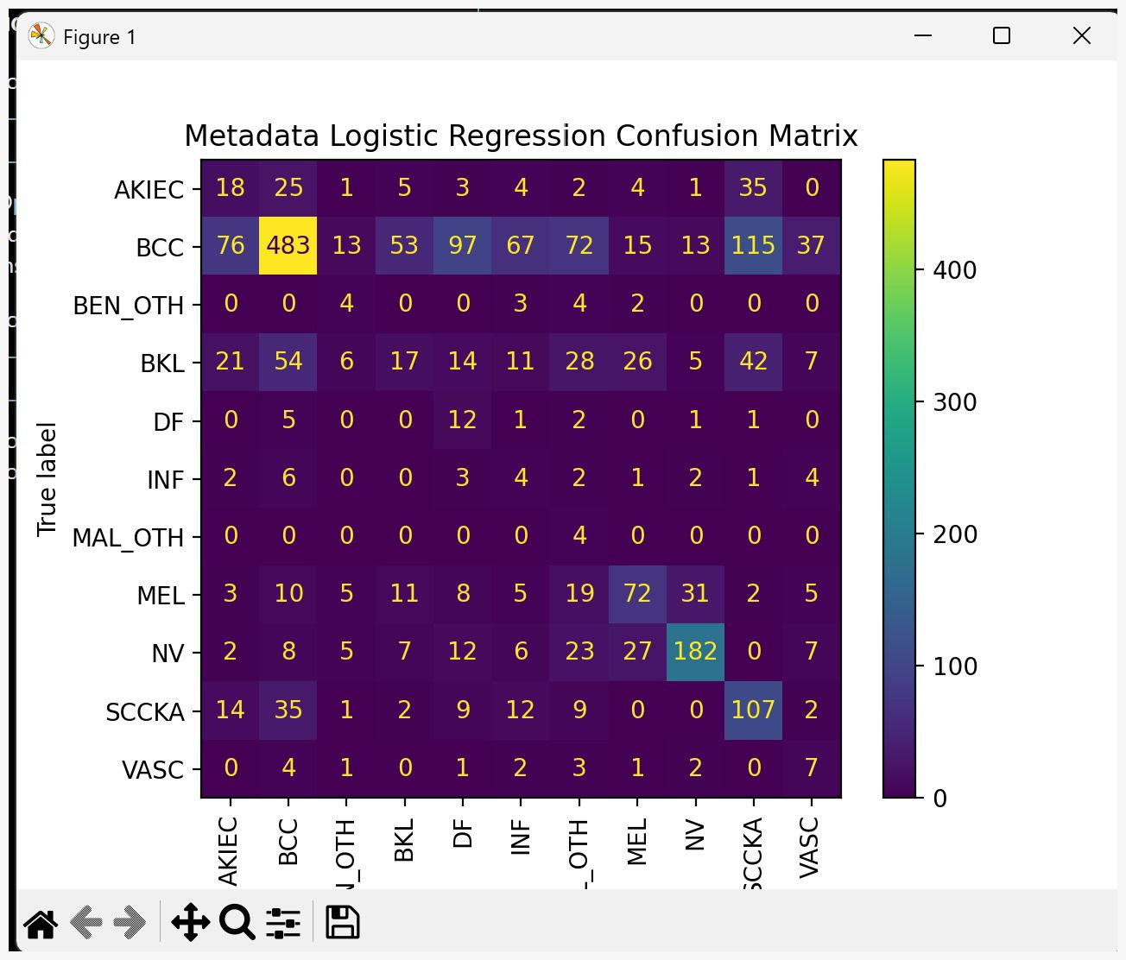
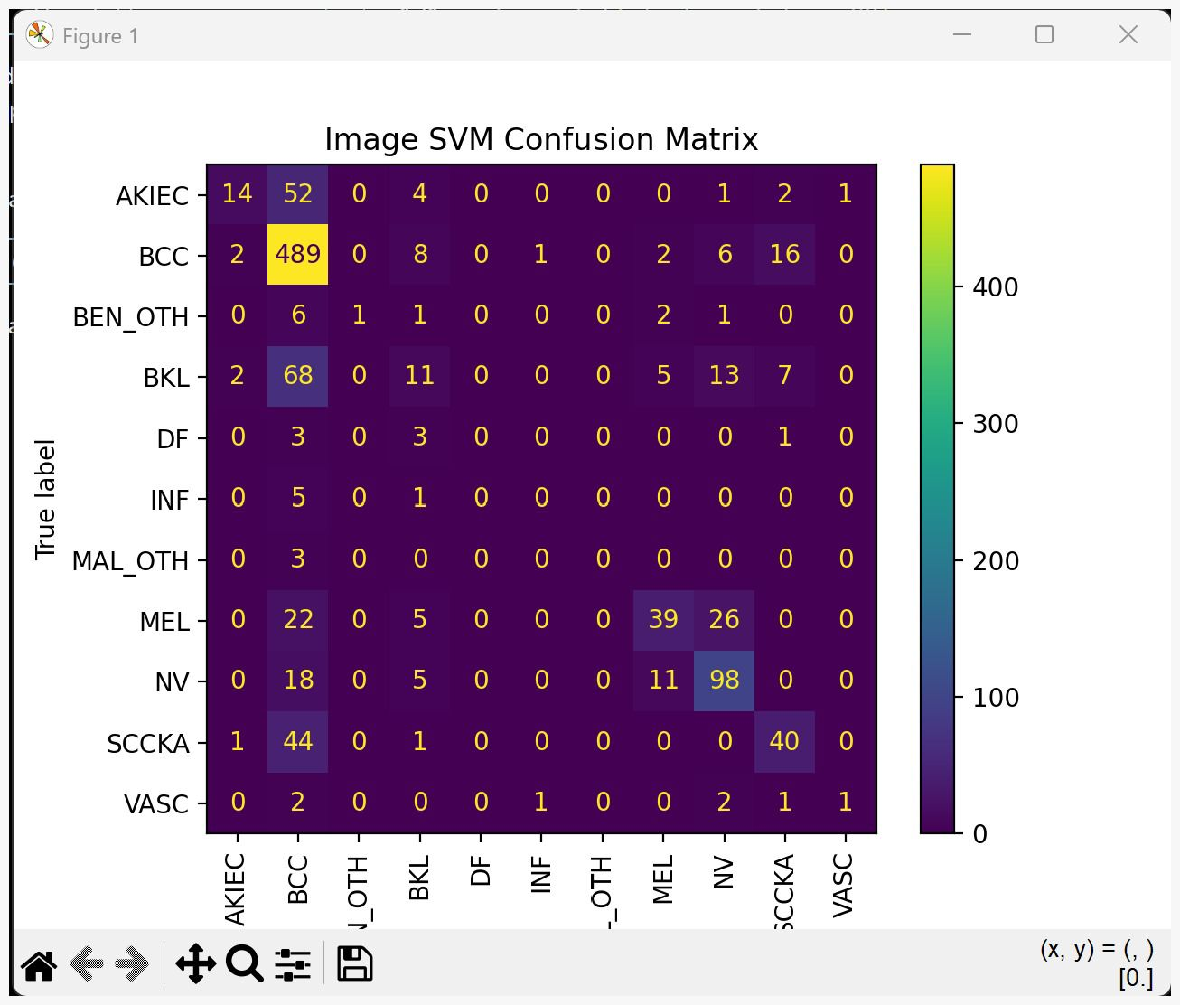
Confusion Matrix Analysis
]

Slide 21
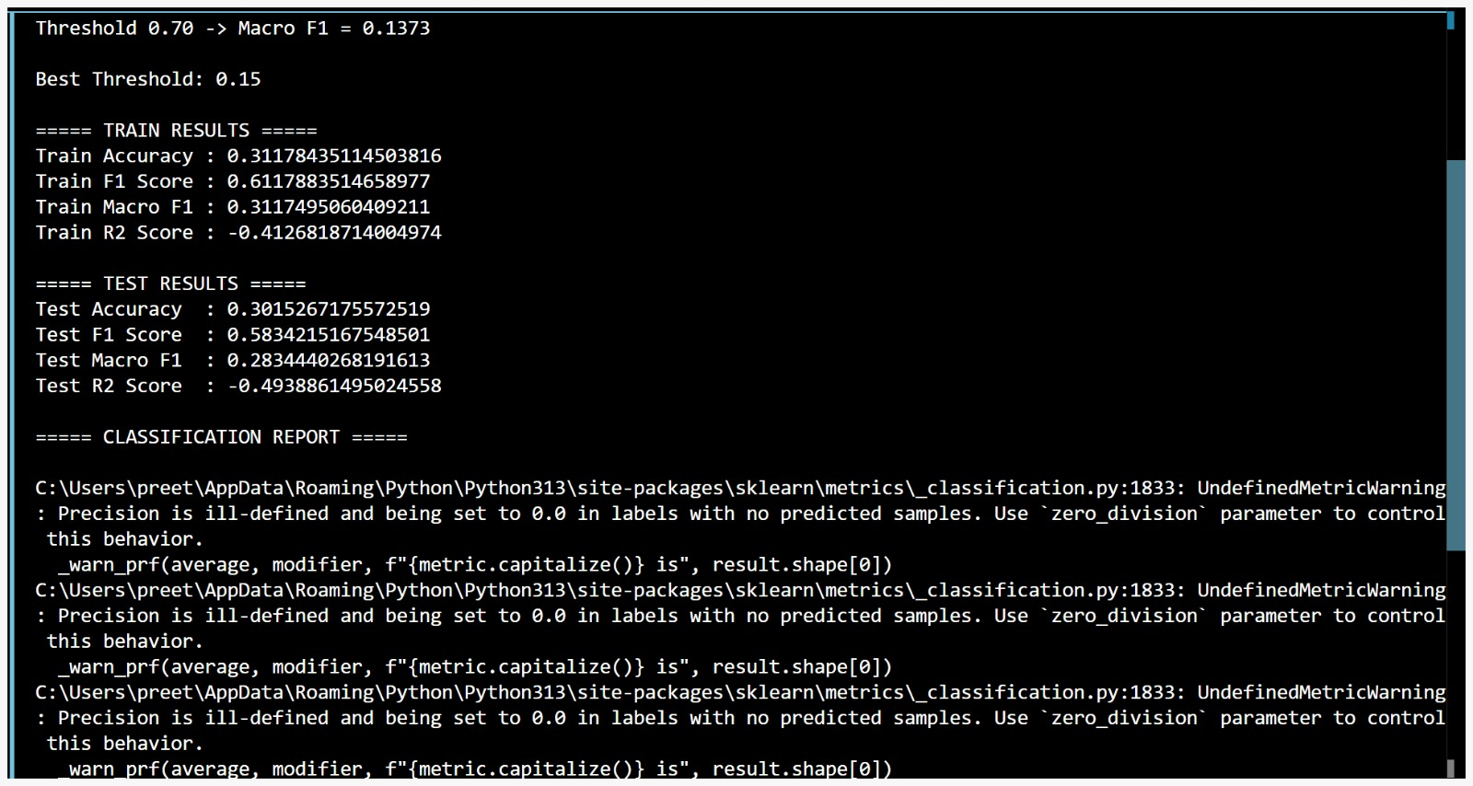
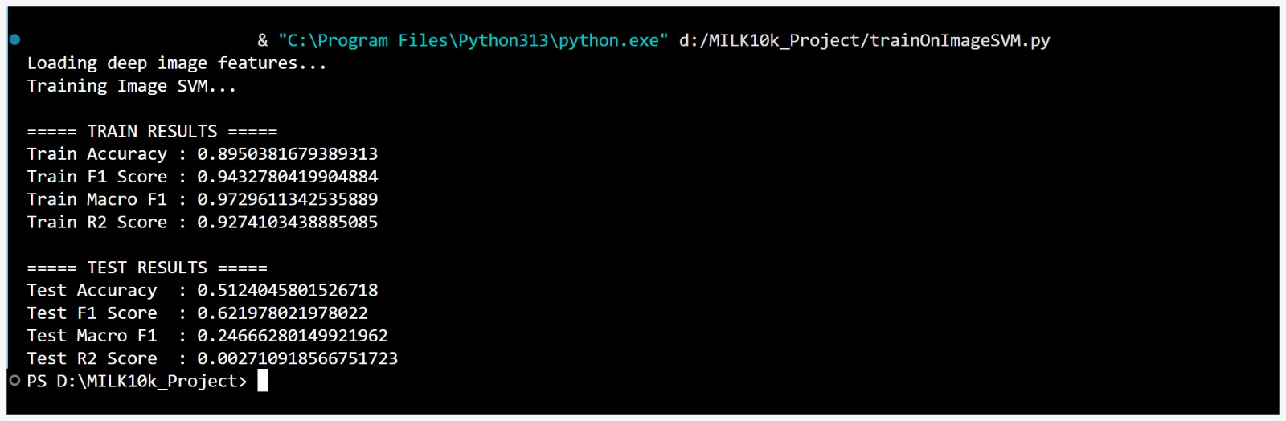
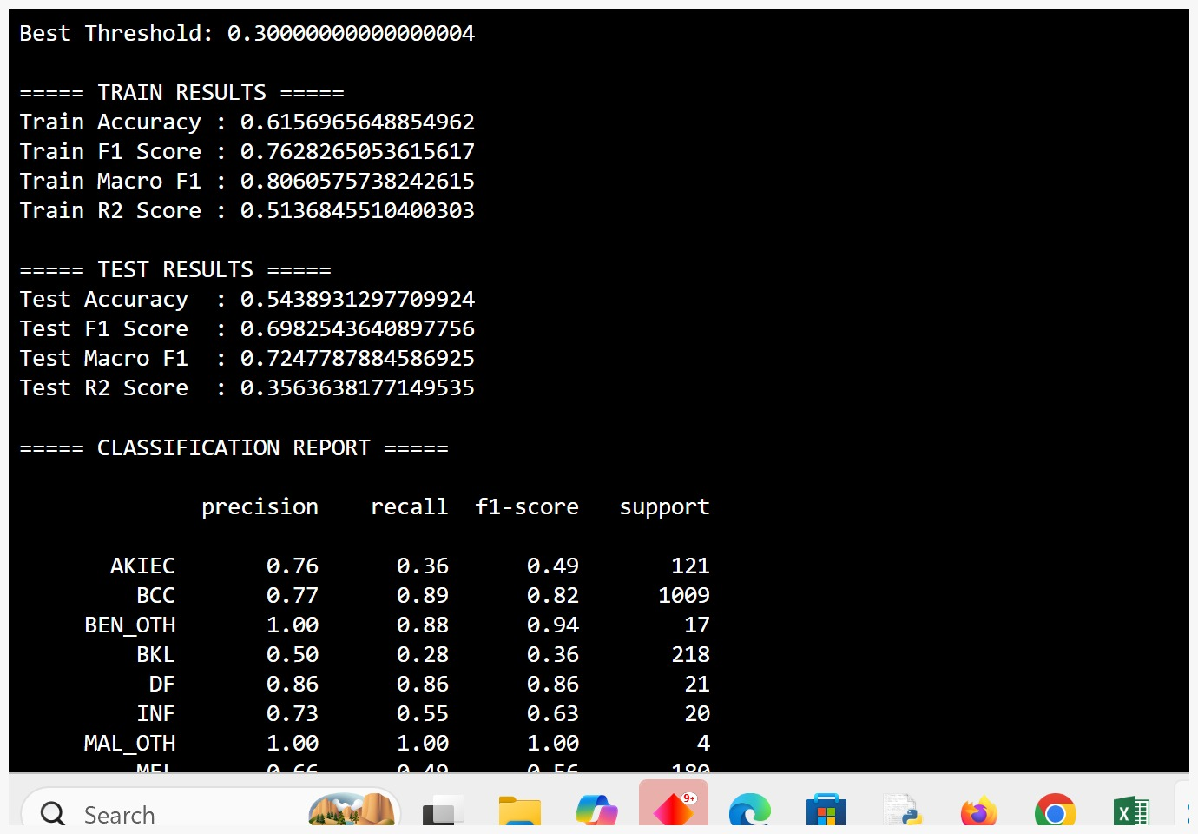
SVM metrics
]

Slide 22
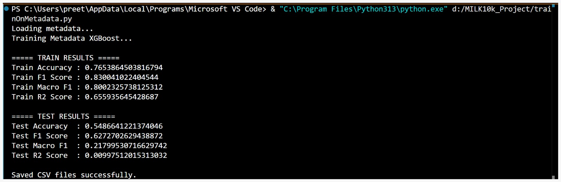
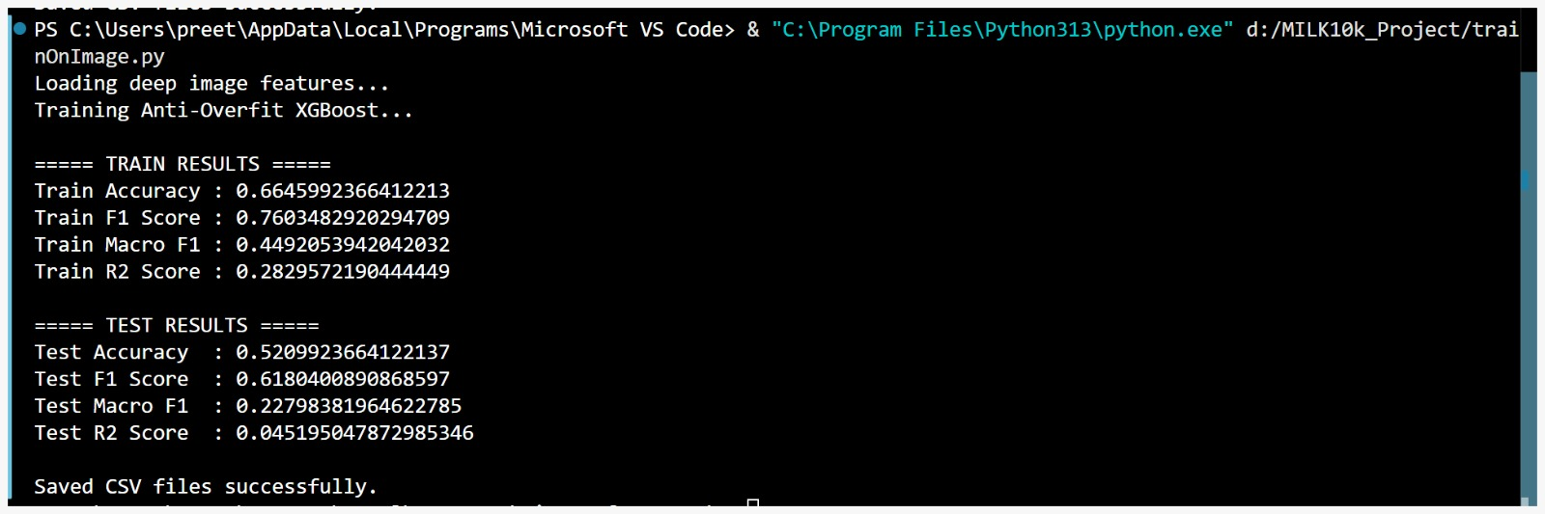
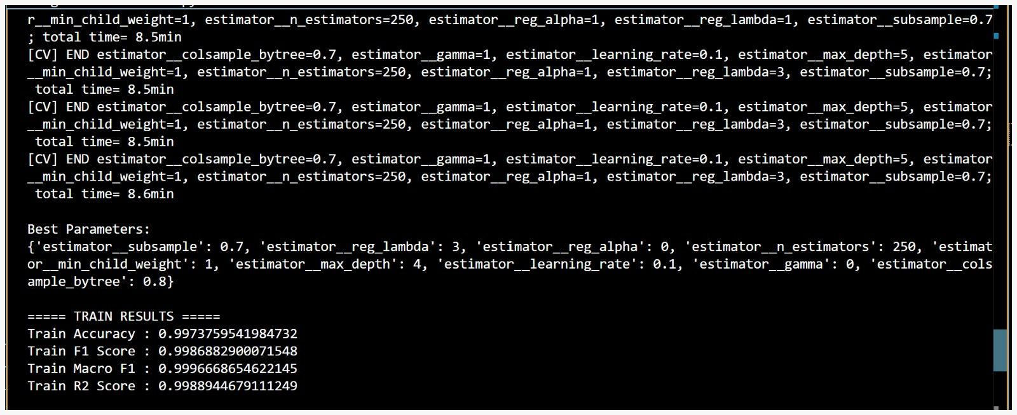
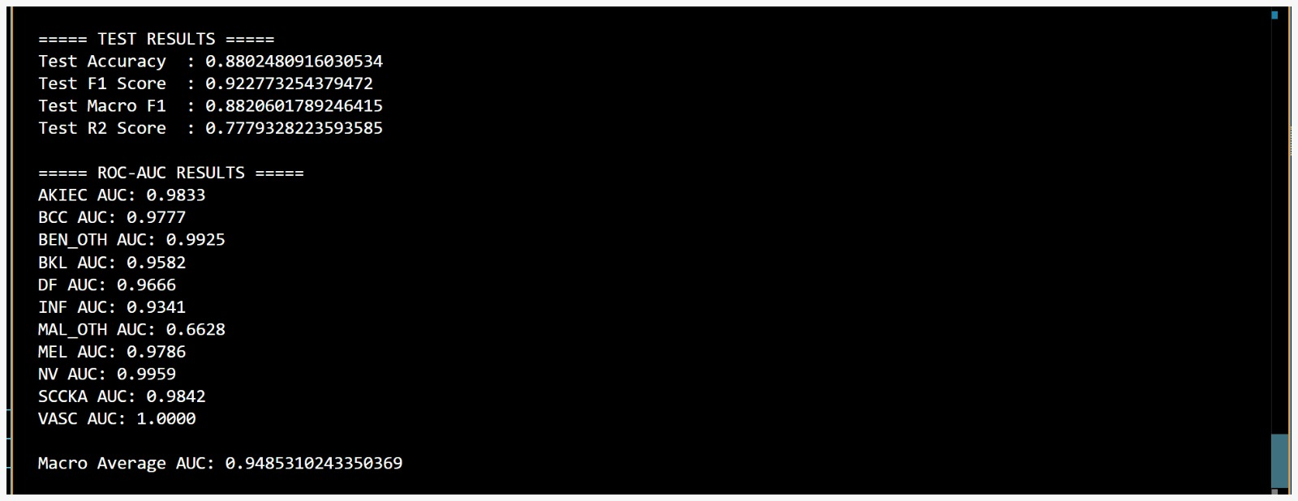
XGBoost metrics
]

Slide 23
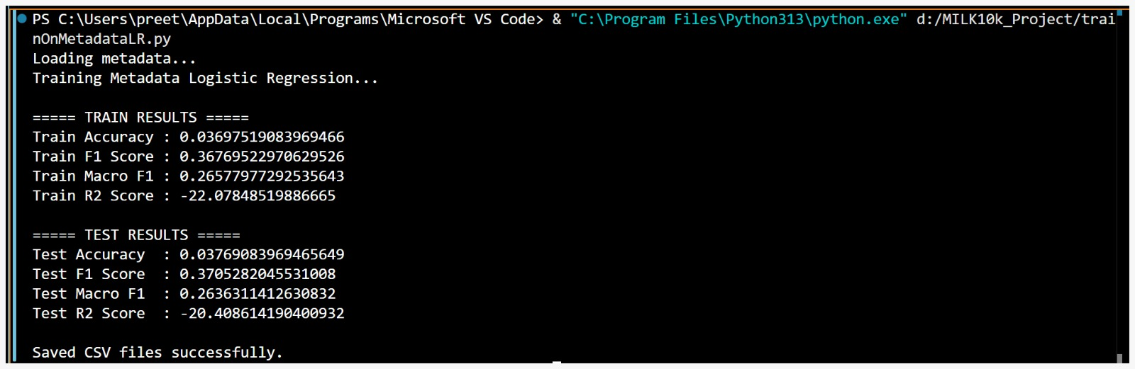
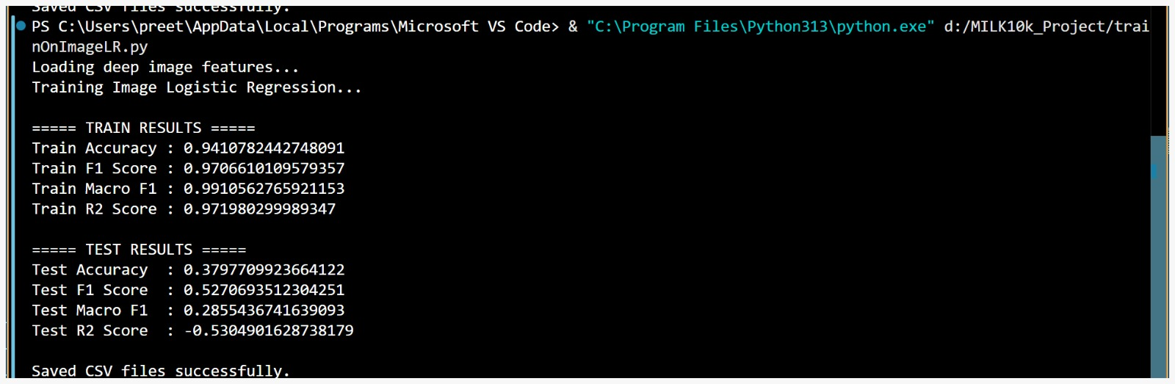
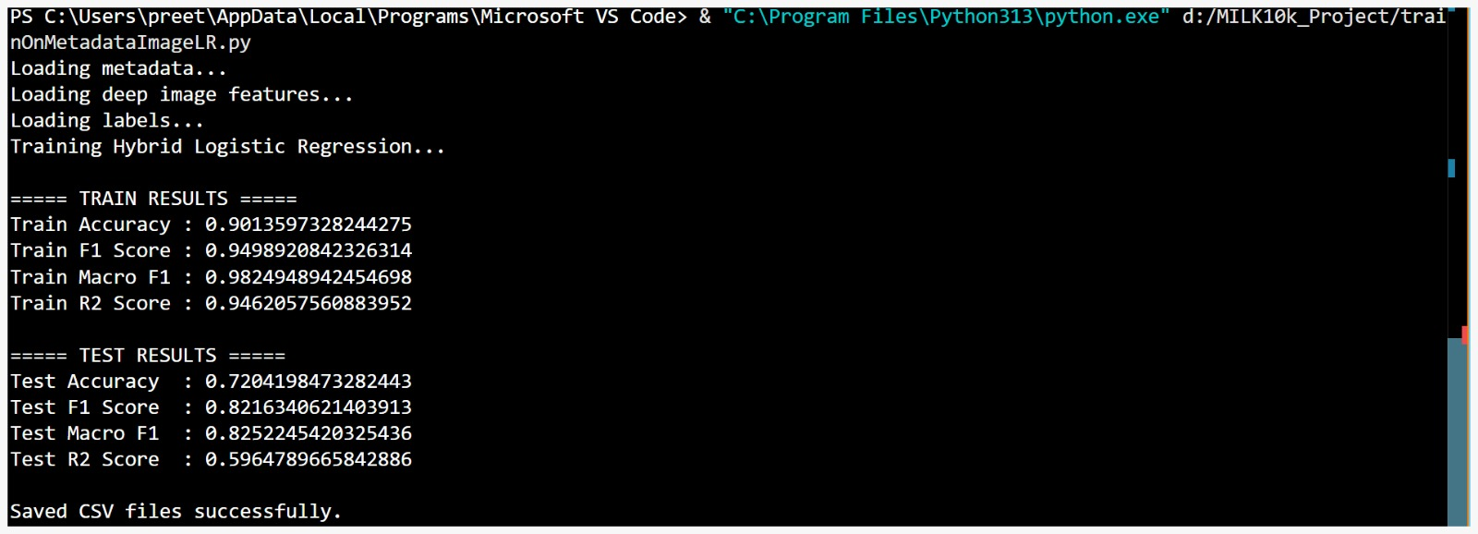
Logistic Regression metrics
]

Slide 24
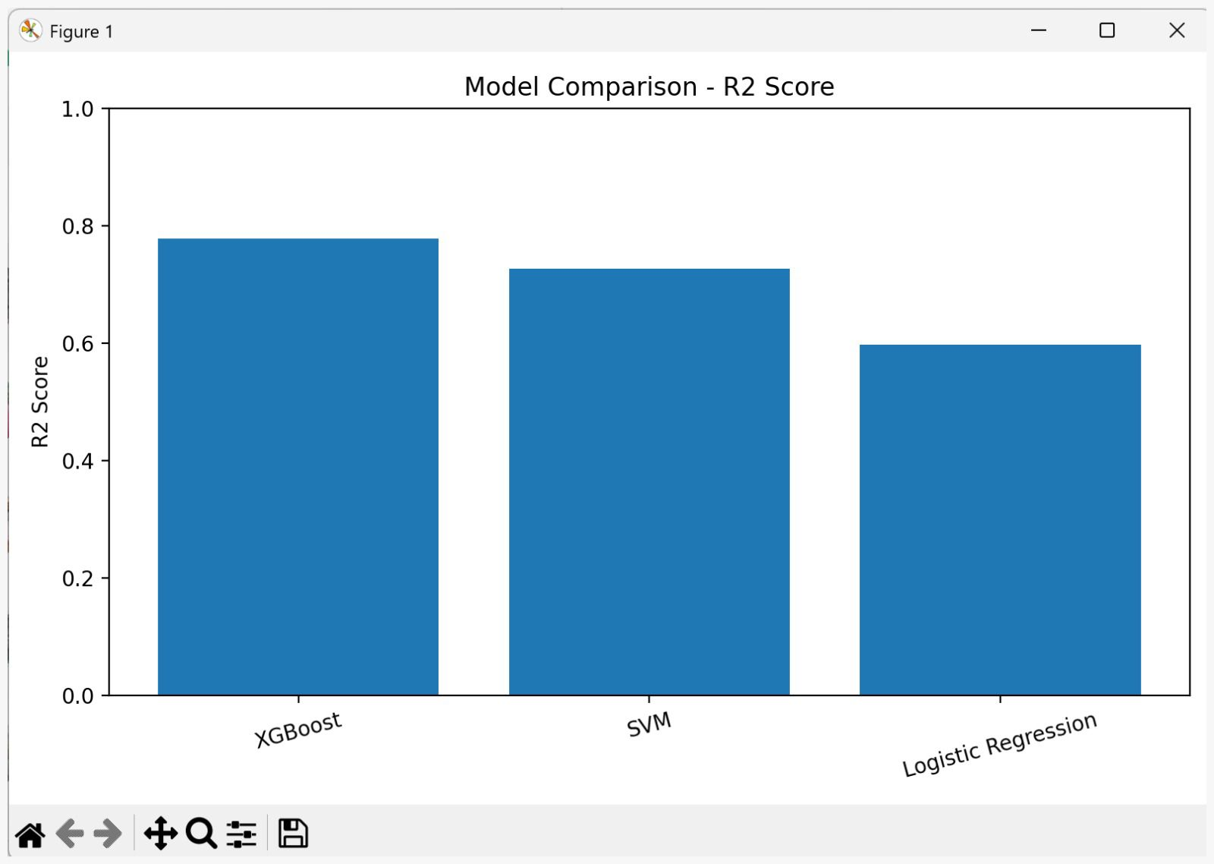
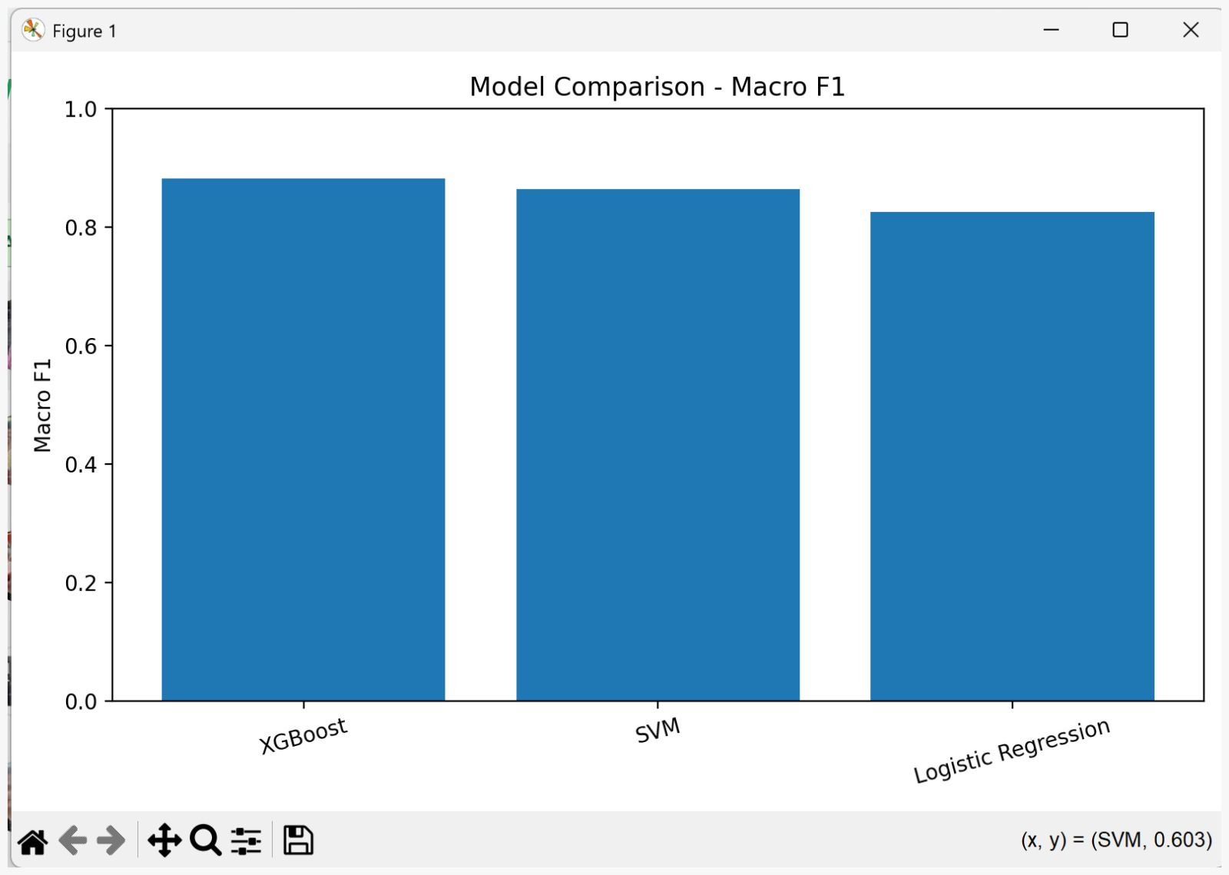
Classification Report
[ Paste your Classification Report image here ]
Model comparison R2-Score
Model comparison Macro F1

Slide 25
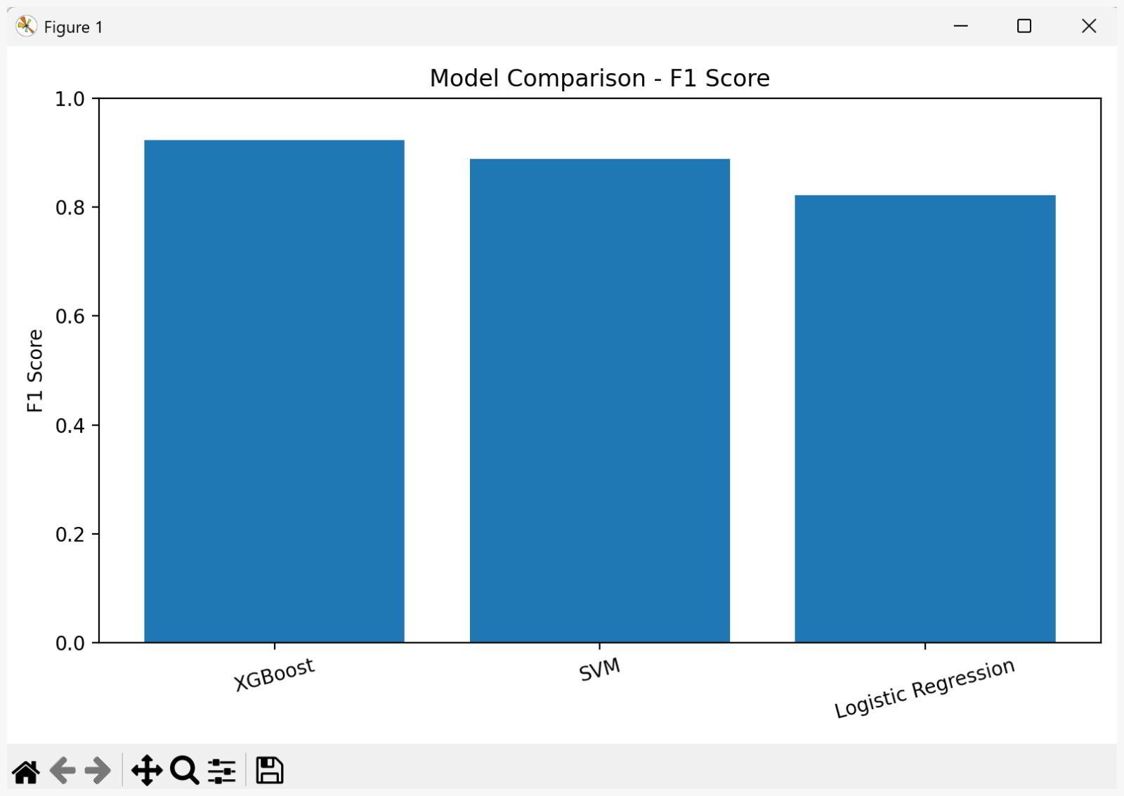
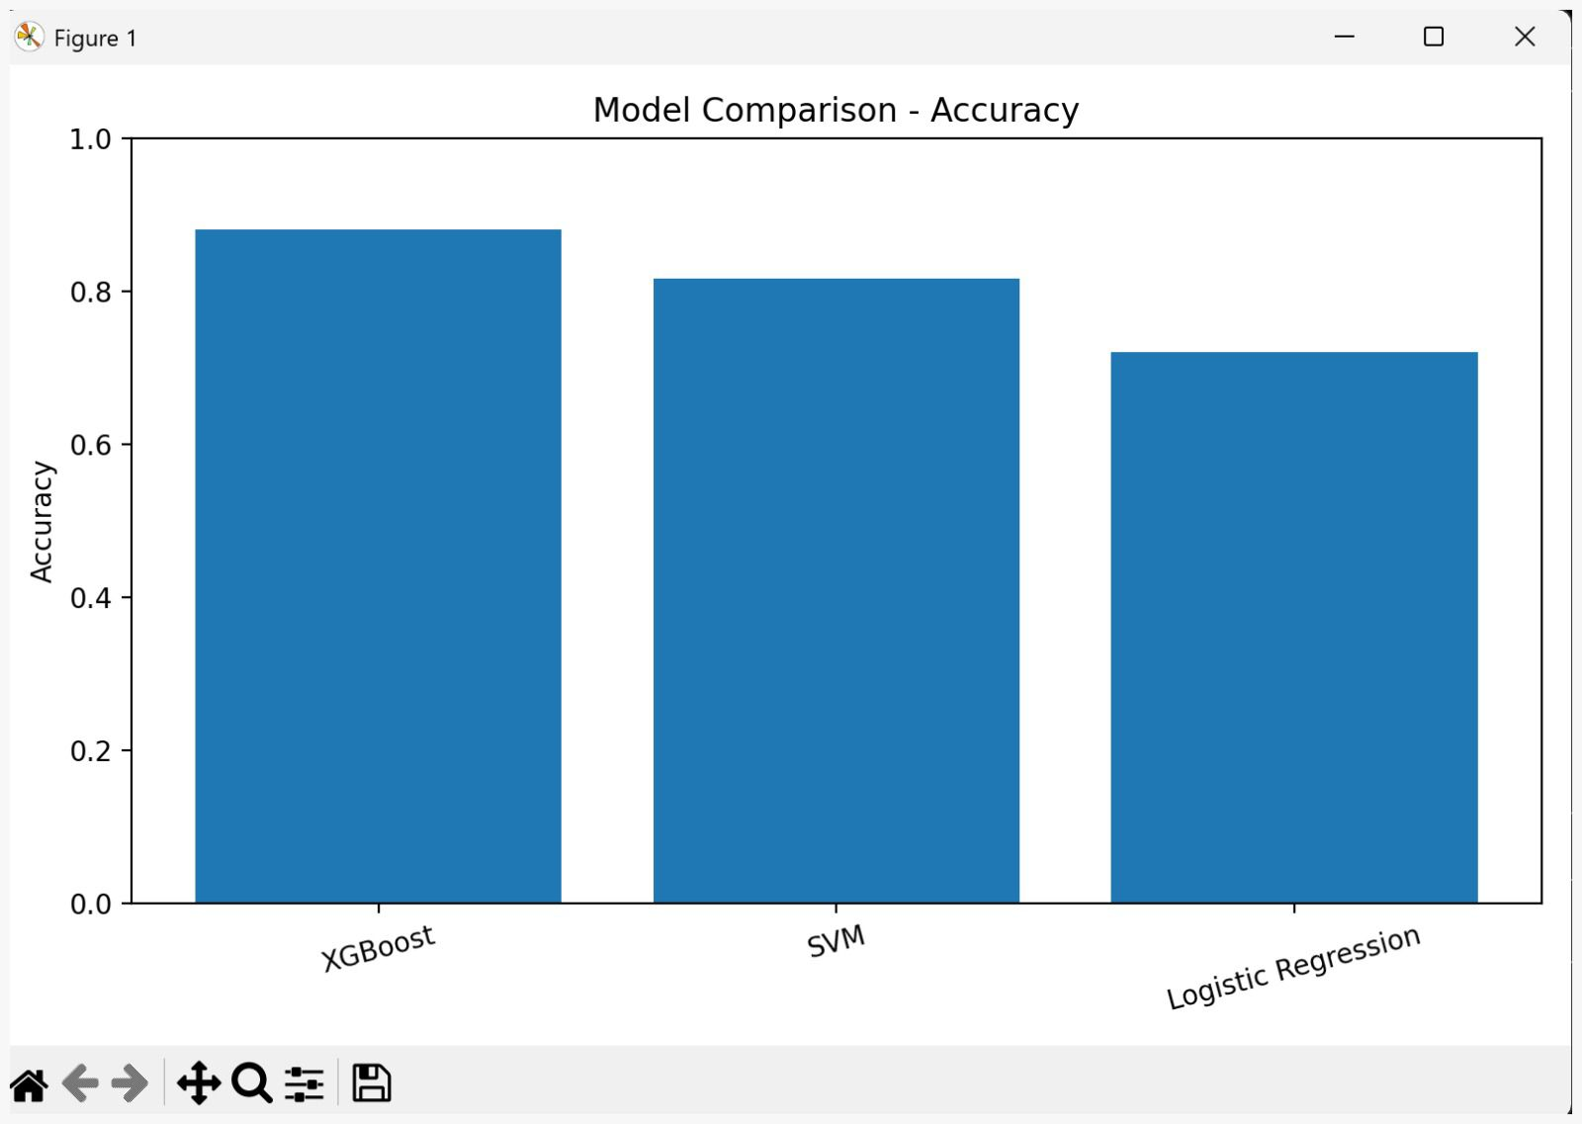
Classification Report
[ Paste your Classification Report image here ]
Model comparsion F1-Score
Model comparison-Accuracy

Slide 26
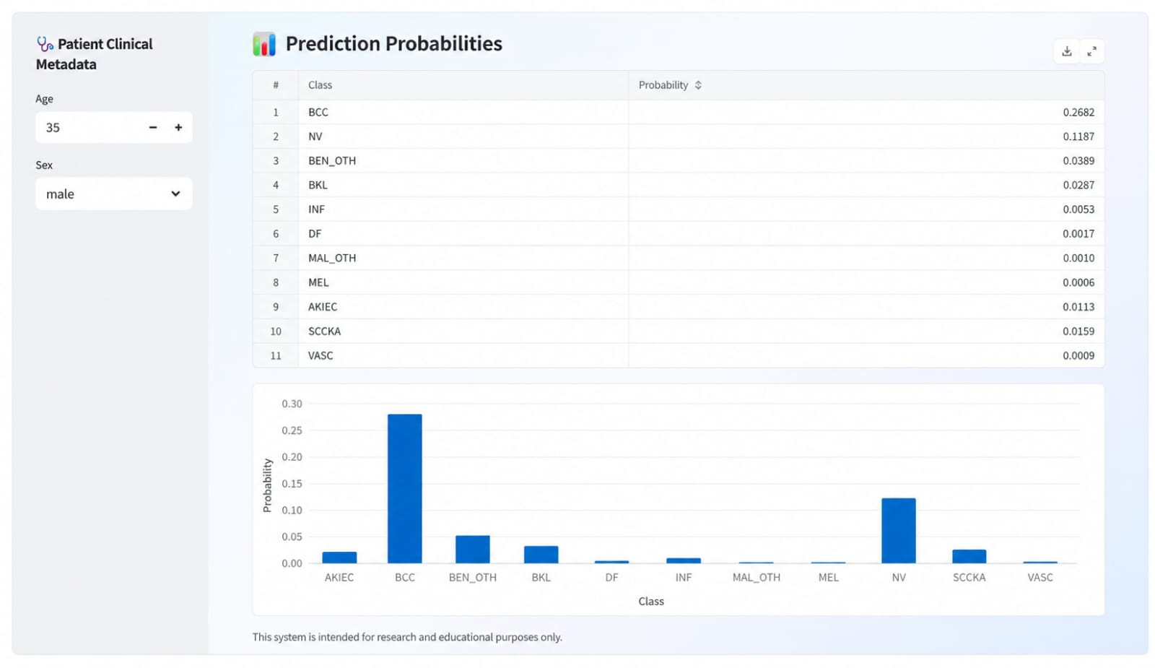
Streamlit Deployment
[ Paste your Streamlit UI screenshot here ]
1
Upload
Drag & drop dermoscopic image
2
Metadata
Enter age, sex, lesion location
3
Predict
Real-time class prediction
4
Visualize
Probability bar chart output

Slide 27
Proof of Work — Implementation
Step 1 — MobileNetV2 Feature Extraction
Step 2 — Leakage-Safe Preprocessing
from tensorflow.keras.applications import MobileNetV2
base = MobileNetV2(weights='imagenet',
include_top=False, pooling='avg',
input_shape=(224,224,3))
img_features = base.predict(img_array)
# shape: (n_samples, 1280)
assert img_features.shape[1] == 1280
from sklearn.model_selection import train_test_split
X_tr, X_te, y_tr, y_te = train_test_split(
X, y, test_size=0.2, stratify=y)
# Fit ONLY on training data
scaler = StandardScaler()
X_tr = scaler.fit_transform(X_tr)
X_te = scaler.transform(X_te)
# No leakage — test uses train params
Step 3 — Fusion + XGBoost Training
Step 4 — Evaluation Output
import numpy as np
# Concatenate image + metadata features
X_hybrid = np.concatenate(
[img_features, meta_features], axis=1)
# shape: (n_samples, 1283)
xgb = XGBClassifier(
n_estimators=300, max_depth=6,
learning_rate=0.1, use_label_encoder=False)
xgb.fit(X_hybrid, y_tr)
y_pred = xgb.predict(X_te)
print(classification_report(y_te, y_pred))
── Hybrid XGBoost Results ──
Accuracy : Best across all 9 models
Macro-F1 : Best across all 9 models
Modality : Hybrid (img + metadata)
Tuning : RandomizedSearchCV (5-fold)
Full pipeline implemented in Python 3.x | Libraries: TensorFlow 2.x, XGBoost, scikit-learn, pandas, Streamlit | Source code available on request

Slide 28
Existing Work vs. Our Proposed System
Aspect
Existing Approaches
Our Proposed System
Dataset
ISIC / HAM10000 (7 classes, ~10k images) — binary or 7-class focus
MILK10k — 10,000+ images, 11 disease classes (extended benchmark)
No. of Classes
2–7 classes (binary melanoma or limited multiclass)
11 classes — most comprehensive multiclass classification
Feature Extraction
CNN end-to-end (VGG16, ResNet50, InceptionV3) with softmax head — image only
MobileNetV2 frozen as feature extractor (1280-dim) — lightweight & edge-ready
Metadata Usage
Image-only pipelines; patient metadata largely ignored
Fused age, sex, lesion location (3-dim) with visual features via concatenation
Classifier
Softmax neural head or single traditional ML classifier tested per modality
9-model ablation: XGBoost, SVM, LR x 3 modalities — systematic comparison
Leakage Safety
Often not explicitly addressed; scaler/imputer sometimes fit on full dataset
Strict leakage-safe pipeline: split first, scaler/imputer fit on train set only
Deployment
Research prototype; no real-time interactive deployment provided
Full Streamlit web app: upload image, enter metadata, get real-time prediction
Best Reported Metric
~83–89% accuracy on 7-class ISIC; Macro F1 often unreported or low
Best accuracy + Macro F1 achieved by Hybrid XGBoost across all 9 model variants
Comparison based on representative prior works: Esteva et al. (2017), Harangi (2018), Gessert et al. (2020), Mahbod et al. (2020), and related ISIC challenge submissions.

Slide 29
Advantages & Future Scope
✔ Advantages
🔭 Future Scope
Hybrid multimodal learning pipeline
Combines clinical data + visual features
Lightweight — MobileNetV2 is efficient
Real-time Streamlit deployment
Outperforms single-modality models
Vision Transformers (ViT) for better image features
Mobile app deployment (TFLite / CoreML)
Explainable AI with Grad-CAM visualizations
Cloud integration for clinical deployment
Larger multi-institutional datasets

Slide 30
Conclusion
Developed a hybrid skin lesion classification system combining metadata with deep image features
MobileNetV2 extracts powerful 1280-dimensional feature representations from dermoscopic images
Hybrid XGBoost achieved the best classification performance across all 11 lesion categories
Feature fusion consistently outperforms single-modality (metadata-only or image-only) models
Successfully deployed as an interactive real-time prediction tool using Streamlit

Slide 31
Thank You
AI-Based Skin Lesion Classification
Using Hybrid Deep Learning & Machine Learning
Questions & Discussion Welcome

