Slide 1

Real Estate Price Prediction
CS-418 –Project
Group -18

Slide 2

Team Members
Uday Bhaskar Voora (uvoor@uic.edu)
Anuraag Reddy Kommareddy (akomm@uic.edu)
Sujay Dahagam (sdahag2@uic.edu)
Nirmal Kumar Varma Vegesna (nveges3@uic.edu)
Om Naga Sai Mani Pavan Chamarthi (ochama2@uic.edu)
Github Repository - https://github.com/VooraUdayBhaskar/RealEstate_Price_Prediction

Slide 3
Objective
The goal is to develop a robust and data-driven solution that leverages historical price data from Zillow to provide accurate property valuations. The solution should address the challenges faced by sellers, buyers, real estate professionals, and tenants, ultimately fostering a more transparent and efficient real estate ecosystem.

Slide 4

Problem Statement
In the dynamic and competitive real estate market, stakeholders, including buyers, sellers, real estate professionals, and tenants, face significant challenges in accurately assessing the value of residential properties. Mispricing can have adverse consequences, leading to extended time on the market, lost opportunities, and financial losses. Reliable and precise property valuation is crucial for informed decision-making, effective negotiations, and optimizing outcomes for all parties involved.
Determine what are the 5 best zip codes to invest in and what are the forecasted 10 year average home values for each of these zip codes.

Slide 5
Changes in dataset
The original dataset contains prices of houses around different areas over the united states for around 12 years range. [Published by Zillow].
In addition to this dataset we have added one more dataset from St.Louis Federal Reserve portal for additional information like mortgage value and etc.,

Slide 6
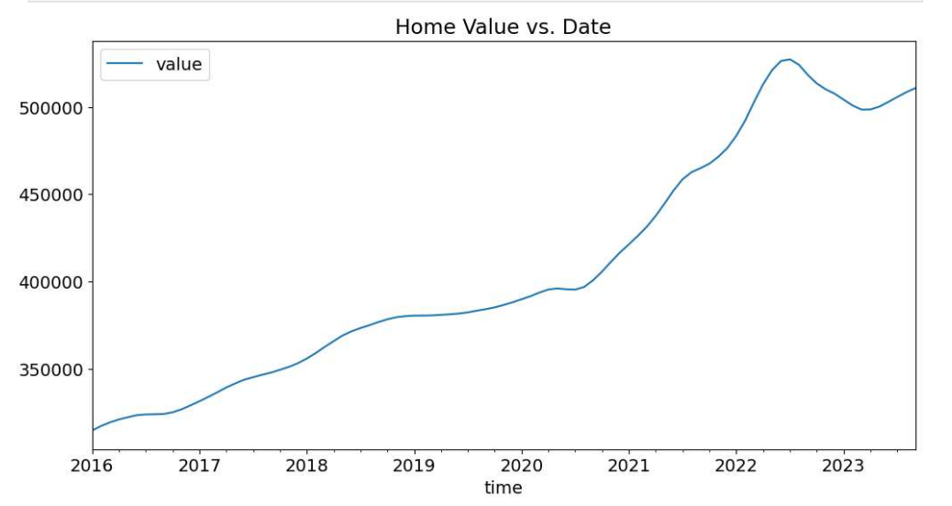
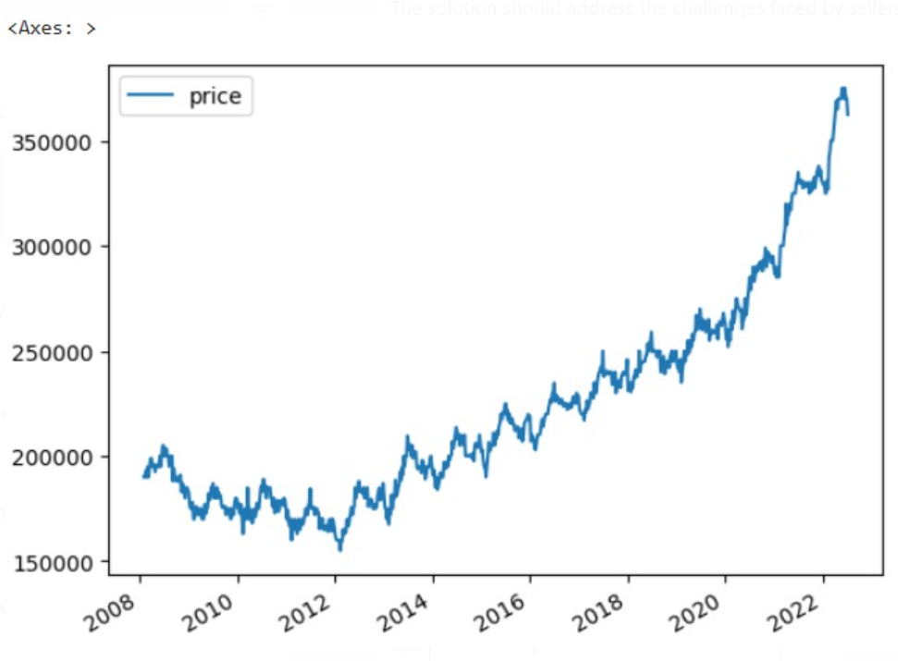
This depicts home value around 2016-2023
This contains the new dataset which covers the 1st part of our project where the dataset is a combination of the official Zillow data set and the dataset from the St.Louis Federal Reserve portal.

Slide 7
Preprocessing data
Cleaning is the first step of the process as part of this we have cleared the Null values that are present in the dataset for columns Metro.
And changed the format of time in a convenient way to compute mathematical analysis on the time dataframe.
Replacing null values in the dataset with the mean of the dataset for future models for training models and making predictions.

Slide 8

Visualizations

Slide 9
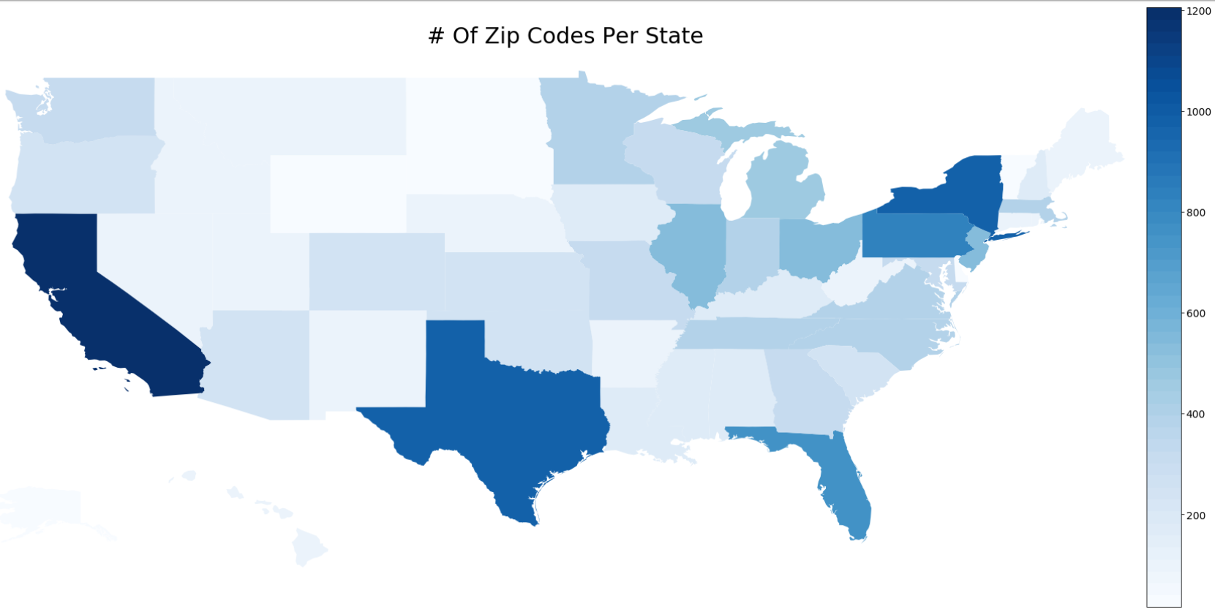
This reperesents the information of the Zillow dataset in a geographical manner which clearly displays the amount of data that Zillow has in different states around the states.[Colour intensity has significance] [High intensity → more number of zip codes in that state/area ] [Lesse intensity → less number of zip codes in that state/area]
Geographical plot

Slide 10
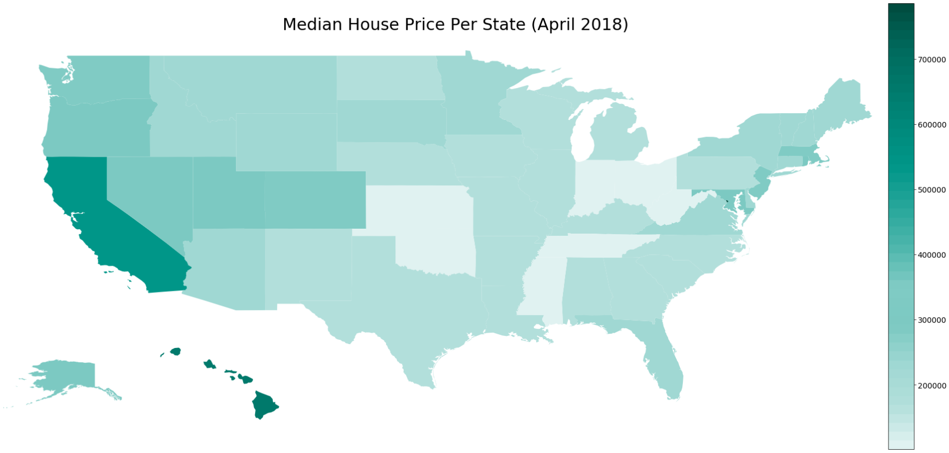
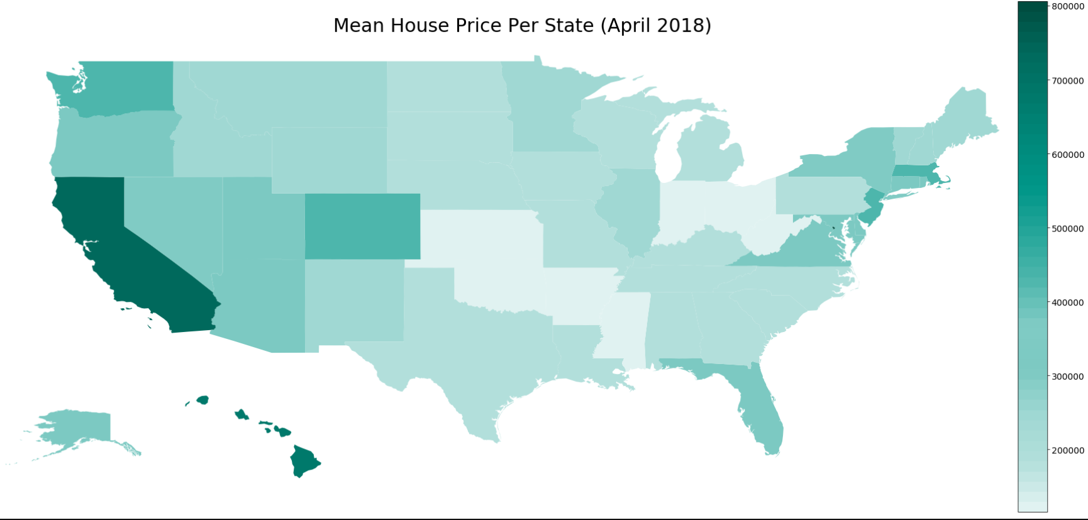
This depicts median house price of data around the year 2018
Geographical plot
This depicts mean house price of data around the year 2018
This is a sample so we considered year 2018

Slide 11
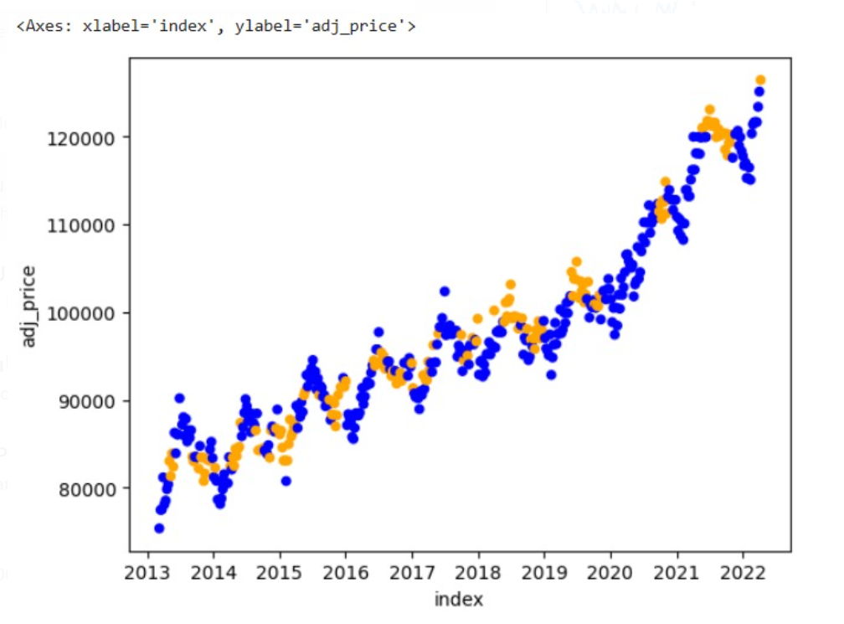
Scatter Plot
This diagnostic helps in knowing how to make the model better with the help of adjusted price.
To remove the inflation cause we use adjusted price column.

Slide 12
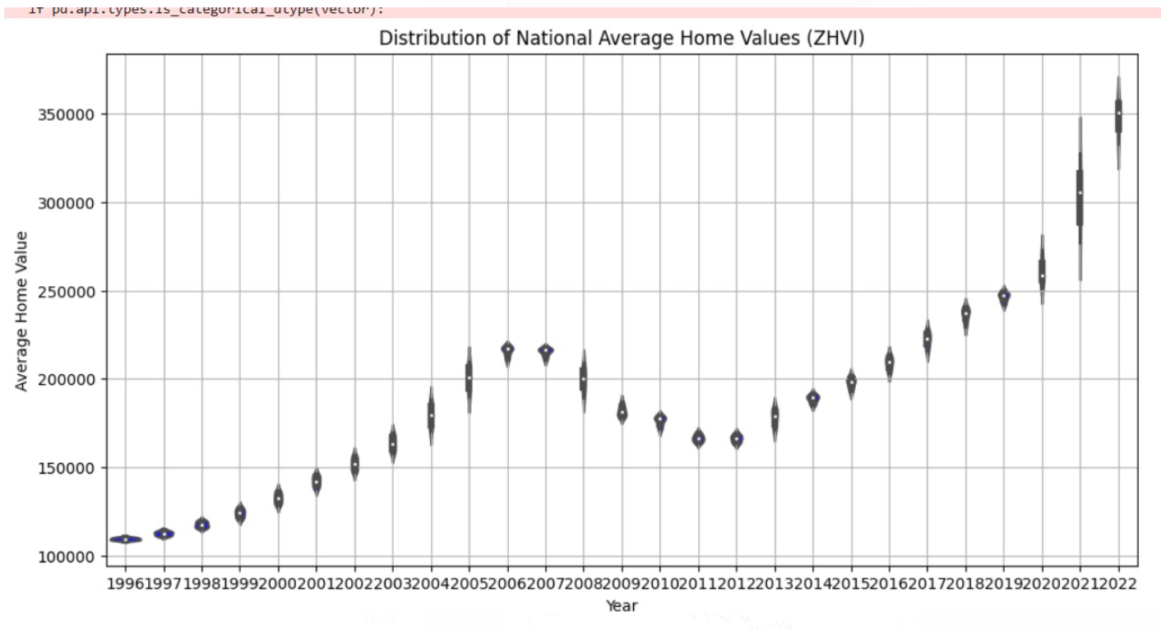
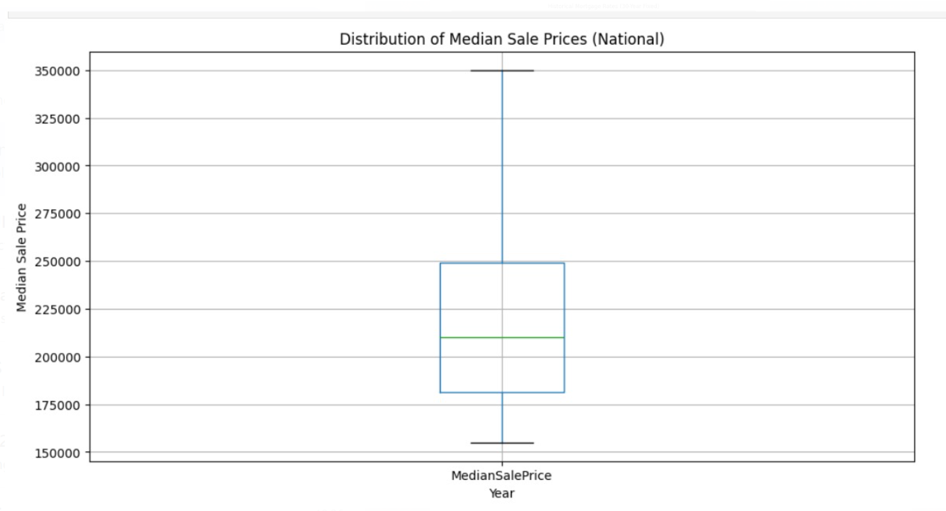
Box Plot
Violin Plot
The above plot shows the trend in the national median sale price of properties over time
This plot shows the trend in national average home values over time, based on the Zillow Home Value Index (ZHVI) data

Slide 13
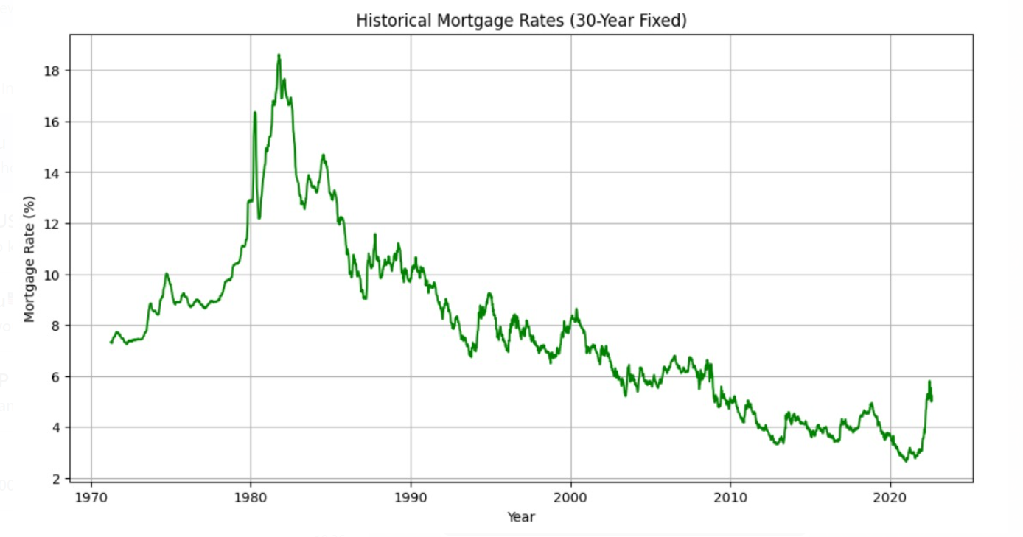
Line Plot
This visualization displays the historical trends in 30-year fixed mortgage rates. It represents the fluctuations in mortgage rates which crucial factor in this model.

Slide 14
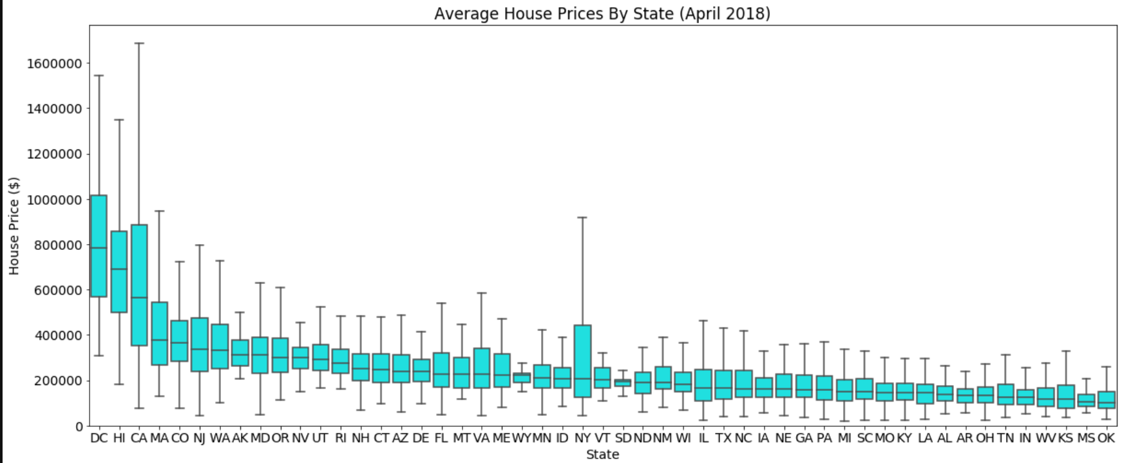
Box Plot
This shows the distribution of prices around different states of united states around the year 2018

Slide 15
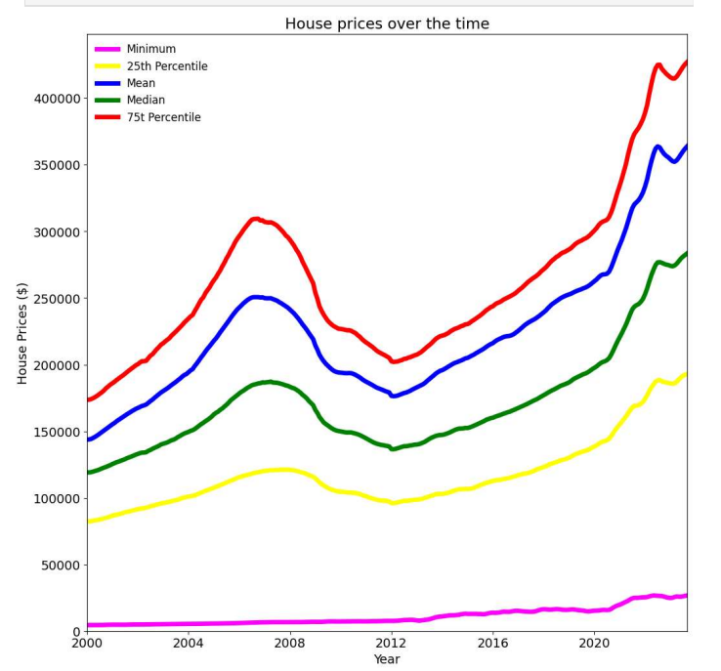
Statistical analysis of house prices over 20 years data.
* The next thing is we want to look at is which regions had the best average annual growth rate. It is important to look at how much prices have typically grown each year rather than just looking at the final value of a home so that we can incorporate the true potential of the homes based on both their starting value and ending value. We will calculate the growth rate between 2000 and 2007 (when the housing market crashed), 2007 and 2012 (time period when housing market was down), 2012 and 2018 (when housing market recovered to most recent data) and 1996 to 2018 (full range of our data).

Slide 16
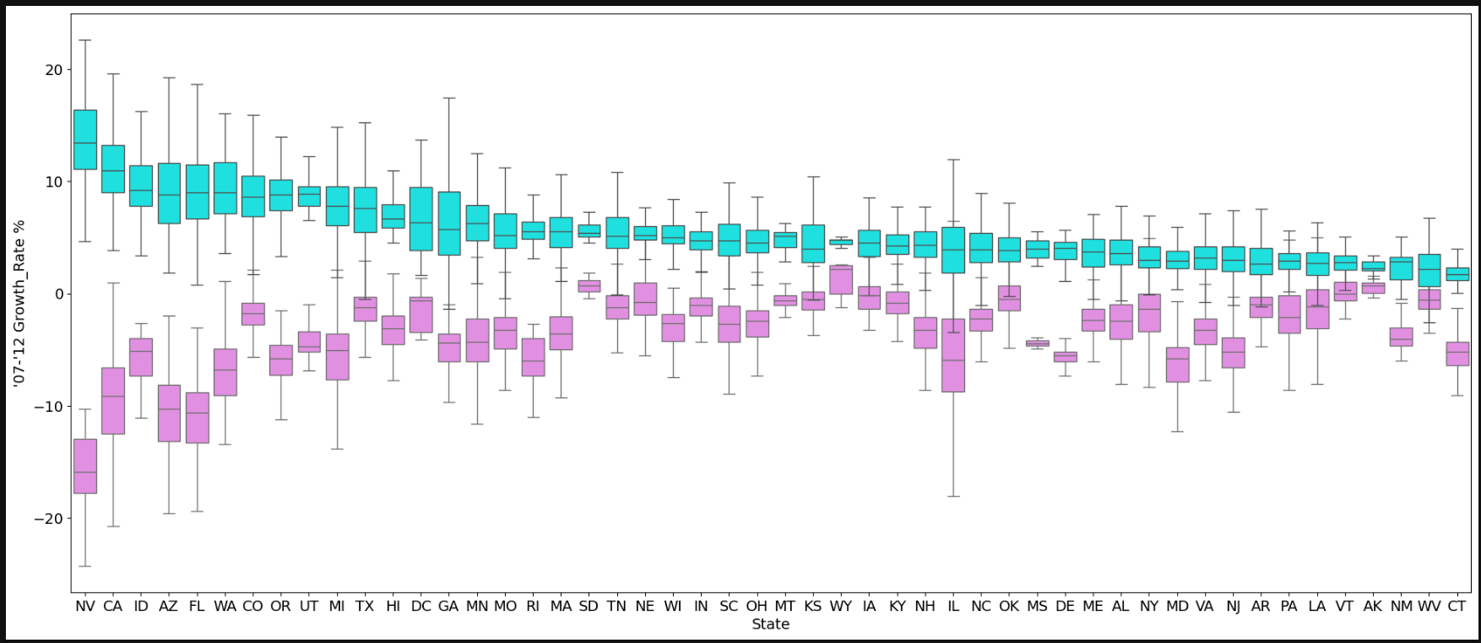
It looks like many of the states with the highest growth rates in recent years actually had some of the worst growth rates during the housing crisis. [Green colour box plot shows variation pf prices during the price drop which is 2007-2012 ] [Pink colour box plot represents the growing phase of house prices which is 2012-2023]

Slide 17
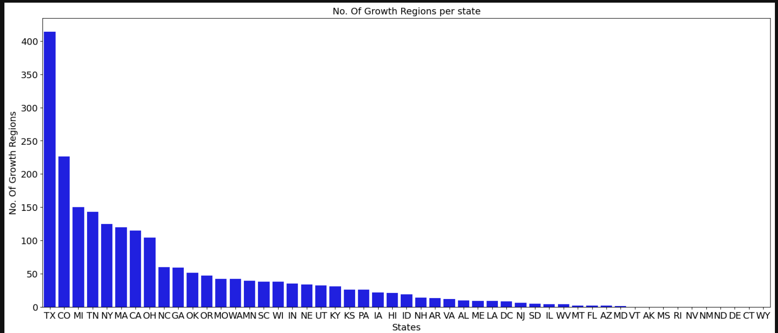
Bar graph for checking growth around different states in U.S.A On a total level, Texas has the most growth regions, followed by Colorado and Miami. Let's now see which states have the most growth regions compared to the total number of regions in each state.

Slide 18
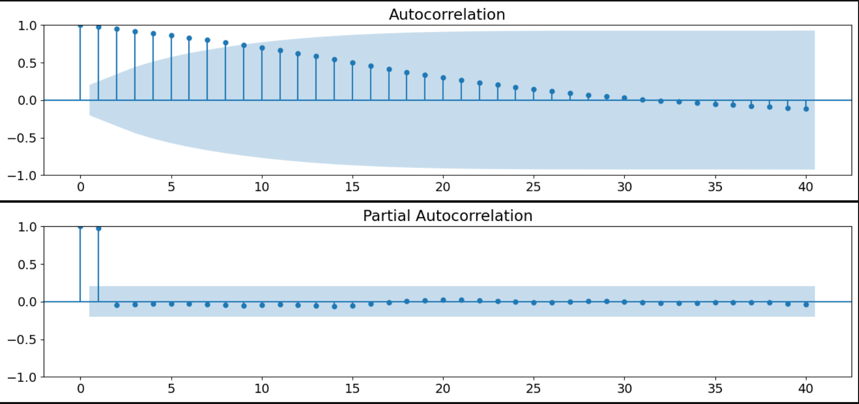
Correlation This will be helpful later for checking if there are any relations between variables across time series

Slide 19
Models for price prediction
We have used several machine learning classifiers/models to predict the price. Linear regression, Random forest, Arima and Sarima, Rnadom forest regressor.
We used ARIMA model to train the data for predicting the top 5 zip codes to invest in based on some conditions.
Models are trained by splitting the dataset into different ratios for each model and predicted the outputs.

Slide 20
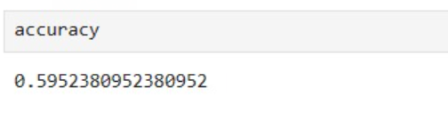
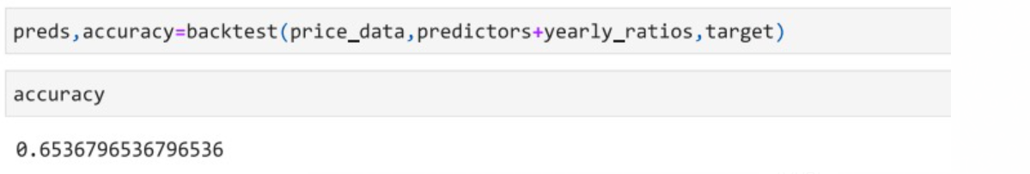
Random Forest Classifier
The backtest function iterates over the data in chunks defined by START and STEP.For each iteration, it creates a training set (train) using the data up to the current index (i) and a test set (test) using the subsequent chunk of data.It uses the predict function to train a RandomForestClassifier on the training set and make predictions on the test set.The predictions are collected in the all_preds list.
On adding few more variables to the model,specifically variables those based on recent trend in house prices, On considering the ratio between current sales price,current interest rates and the average during the last year. Training the model again will improve the accuracy of the model and the improved model accuracy is given here.

Slide 21
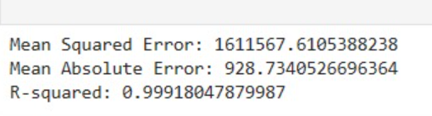
Random Forest Regressor
first we load our dataset, preprocess it, and then train and evaluate the RandomForestRegressor.The model predicts future house prices based on the current average prices.The performance is evaluated using Mean Squared Error, Mean Absolute Error, and R-squared.

Slide 22
Linear Regression Model
The script prints the evaluation metrics for the Linear Regression model, including Mean Squared Error, Mean Absolute Error, and R-squared.In summary, this code uses a Linear Regression model to predict housing prices based on region information, and it evaluates the model's performance using standard regression metrics. The predictions (predictions_lr) are generated on the test set, and the evaluation metrics are printed to assess how well the model is performing on unseen data.

Slide 23
ARIMA MODEL for predicting best zip code to invest money in * Determine what are the 5 best zip codes to invest in and what are the forecasted 10 year average home values for each of these zip codes. * These predictions are done on training the model. * For zip code being best it should be following the below conditions. * Have above average annual growth rate since the housing market recovered from the crisis (2012), and also have above average annual growth rate during the crisis (2007-2012) * Needs to have a 5yr average annual growth rate in the top 25% of the dataset * Needs to also have a 10 yr average annual growth rate in the top 25% of the dataset * Needs a narrow predicted interval width to ensure a more accurate forecasted value ( interval width must be within 25% of the smallest interval widths * The maximum p-value must be less than alpha=.05 to ensure we are statistically significant and therefore a better performing region.

Slide 24

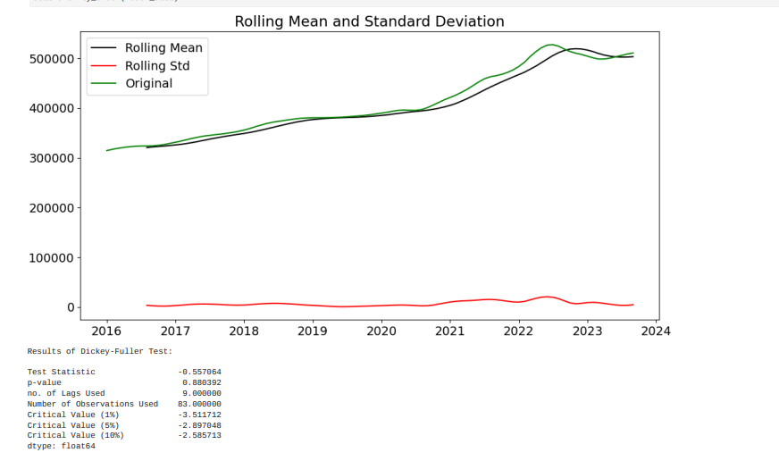
Modifying data
Conversion of data into appropriate format in columns format to rows format so that compuatation will be easy and converting the time dataframe to tappropriate format so that computing will be easy.
Getting stats of data.

Slide 25
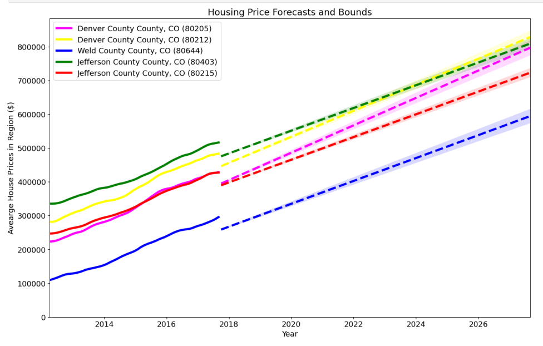
Here you can see the price prediction
Here you can see the price prediction which is best for 5 counties [zip codes].

Slide 26
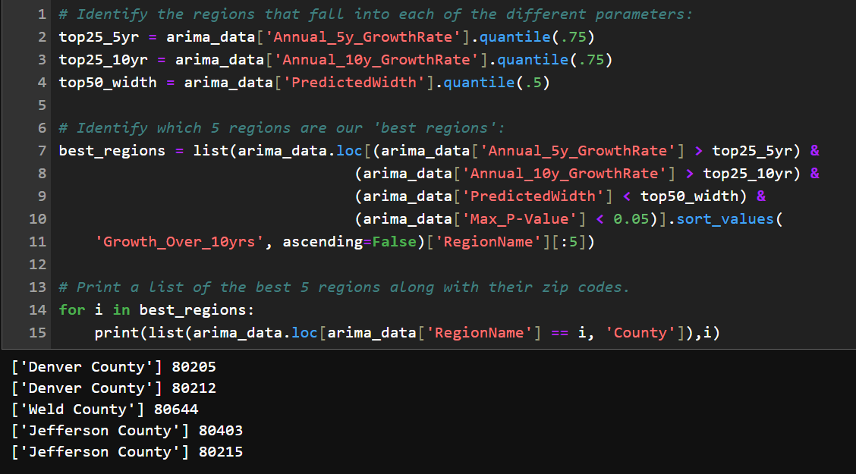
Prediction Here you can see the predictions based on the functions implemented which takes care of the 5 conditions to be best pace to invest .

Slide 27
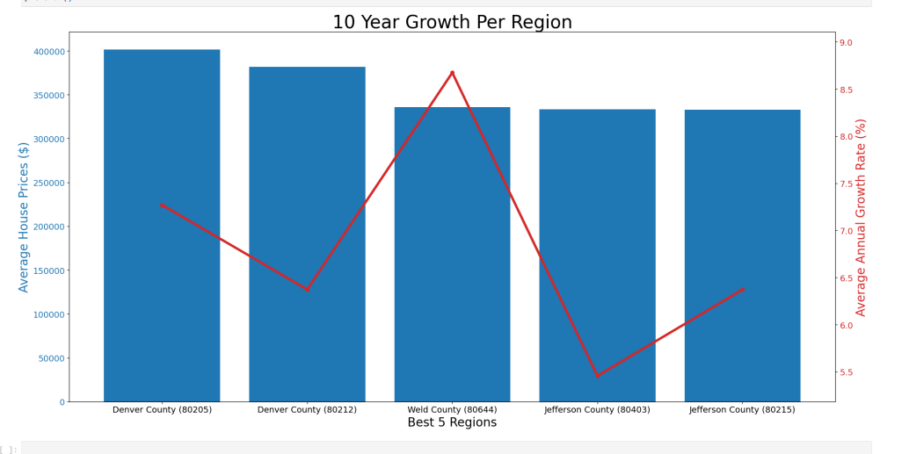
We see some pretty strong potential in these regions! Particularly, Denver County has an estimated increase in average home value of over 0.4 million dollars! There also are 2 zip codes in Denver County with similar forecasted home values to each other, followed by 2 zip codes in Jefferson County.
Analysis

Slide 28
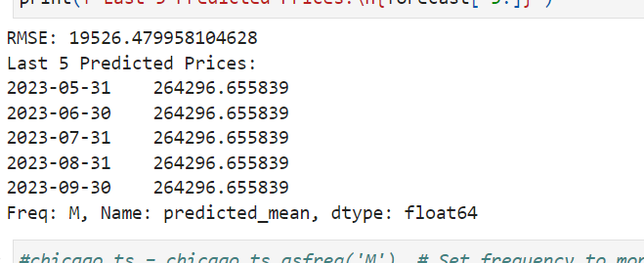
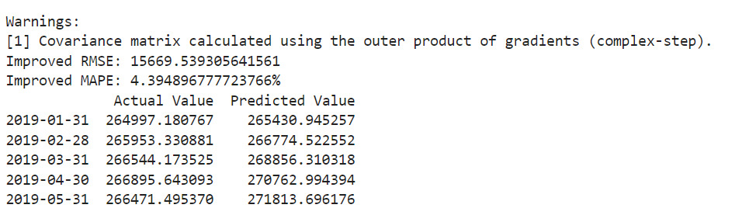
Arima n Sarima(Advanced)
On using arima model these are the predictions of price to improve this we use sarimax
On using sarimax model these are the predictions of price and the improved rmse.

Slide 29
Conclusions
One part of the problem is solved. What are the top 5 best zip codes for us to invest in?
To qualify as one of the 'best' regions, the region must meet the following qualifications:
Have above average annual growth rate since the housing market recovered from the crisis (2012), and also have above average annual growth rate during the crisis (2007-2012)
Needs to have a 5yr average annual growth rate in the top 25% of the dataset
Needs to also have a 10 yr average annual growth rate in the top 25% of the dataset
Needs a narrow predicted interval width to ensure a more accurate forecasted value (interval width must be within 25% of the smallest interval widths
The maximum p-value must be less than alpha=.05 to ensure we are statistically significant and therefore a better performing region.
we combine zillow and st.louis datasets and obtain a merged dataset ,the merged data set is then trained with different machine learning models to obtain the accuracy .we perform this models to find the estimate value of house for the next quarter

Slide 30
Contributions
Contributions are clearly mentioned in the Jupyter notebook file and have given access to the github repository for verification.

Slide 31

Thank You

