Slide 1
AUTO Image Captioning
Harsh Vora - A20445400
Ninad Parikh - A20427382

Slide 2
PROBLEM STATEMENT
Image Captioning can find its use in different scenarios of life, giving a boost to self-driving cars, aiding the blind and cctv camera for scenario detection and also for image search. This requires computer vision and language processing to work together. This can be achieved through utilizing the pretrained CNN models and a language encoder to generate captions for images.
In this paper, a generative model is presented based on a deep recurrent architecture that combines recent advances in computer vision and machine translation and that can be used to generate natural sentences describing an image. The model is trained to maximize the likelihood of the target description sentence given the training image.

Slide 3
PROPOSED SOLUTION
To create an end-to-end system for the Neural Image Captioning problem. We use a pretrained CNN model (Inception v3) which is already pretrained on the ImageNet dataset. Using transfer learning, we use the last hidden layer for the input to the RNN model to decode and generate sentences.
DATASET USED:
We use the Flicker8k Dataset for the implementation.
Flickr8k_Dataset.zip
Contains 8000 images. These images are bifurcated as follows:
Training Set – 6000 images
Dev Set – 1000 images
Test Set – 1000 images
Flicker8k_text.zip
Contains 8 files from which the most important file is “Flickr8k.token.txt”.
The file contains the name of each image along with its 5 captions.

Slide 4
IMPLEMENTATION DETAILS
Data Preprocessing:
Data Cleaning: Lowercase All words, removed Punctuations and special token and words with numbers.
Creating a Vocabulary: In this, all the unique words from data file is used to create a vocabulary file.
Wrap Descriptions in tokens: We add the words startseq and endseq to the start and end of the caption from the file descriptions.txt.
Caption data-preprocessing: We create indexes for each unique word in the vocabulary. We then convert each caption into a list of tokens
Image Data-preprocessing: Convert image to (299,299,3) for using it as input for Inception v3.
Data generation: We also calculate the maximum length of a caption. The maximum length of a caption is 32. We will then pad the captions in case the length is less than 32, so that all the captions will have equal length.

Slide 5
IMPLEMENTATION DETAILS
Feature Extraction:
We will use the Inception v3 model extracting the feature of the images.
The model will provide us with a 2048 feature vector for each image.
We will store the image file names and the feature vector in a pickle file named “encoded_train_images.pkl”.
We will map every word in the vocabulary to a 200 long vector using a pretrained GLOVE model to create an embedding matrix to load into the model before training.
Each sequence in the caption will now have 32 by 200 long vector which will then be used with the 2048 length vector of the image.

Slide 6
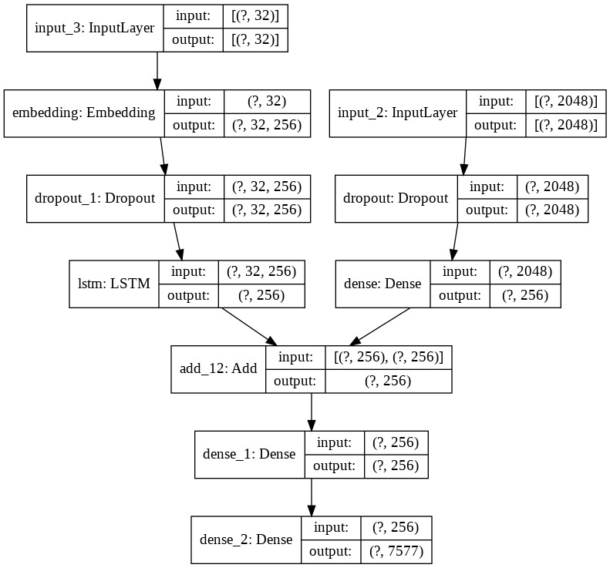
IMPLEMENTATION DETAILS
MODEL BUILD & TRAINING:
We use the following parameters for the model:
Loss = categorical_crossentropy
Optimizer = adam
Epochs = 20
Number of pics per bath = 3
Steps: len(training_descriptions)//number_pics_per_bath
Hyper-parameter tuning after 20 epochs:
Learning rate = 0.0001
Epoch = 10
Number of pics per bath = 3
Steps: len(training_descriptions)//number_pics_per_bath

Slide 7
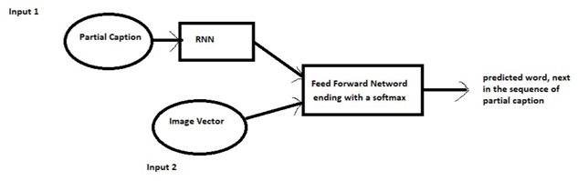
IMPLEMENTATION DETAILS
MODEL PREDICTIONS:
During prediction, the model takes the image vector and the partial caption, the as input and predicts a word, next in the sequence of partial of caption.
The next word prediction is done greedily, selecting the maximum probability given the feature vector and partial caption.
This is also called maximum likelihood estimation, and this is done until the model generates a vector of size 12 or when the model comes across an endseq token.

Slide 8
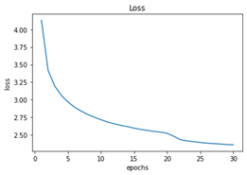
RESULTS AND DISCUSSION
After training the model, we get the below loss for each epoch.
We see that at epoch 20, there is sudden drop in the loss, this is because we changed the hyper-parameters after 20 epochs.
We lowered the learning rate and increased the batch size which led to a decrease in the loss at the 20th epoch.

Slide 9
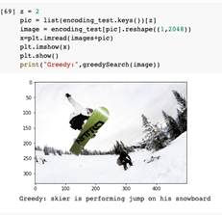
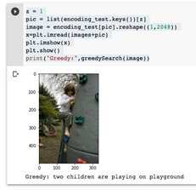
RESULTS AND DISCUSSION
Correct Prediction:
C
Incorrect Prediction:

Slide 10
CONCLUSION
The model performs well for the given test images and as we can see the from the generated captions, the captions are semantically correct and make sense with respect to the picture.
After evaluating the predictions on the test image, we find that the captions generated may not always be similar to the intended image and there may be incorrect predictions.
This solution is basic and can be improved upon with different methods. Having a larger dataset would definitely be helpful given more time and infrastructure.
Also, hyper-parameter tuning would also improve the results.

Slide 11
REFERENCES
https://arxiv.org/pdf/1609.06647v1.pdf
https://ieeexplore.ieee.org/abstract/document/8990998
https://papers.nips.cc/paper/2019/file/680390c55bbd9ce416d1d69a9ab4760d-Paper.pdf
https://cloud.google.com/tpu/docs/inception-v3-advanced

Slide 12
Link to Video
https://drive.google.com/file/d/18hgDMtJQ7QDgjG46FQ_70T27HYJVFS6W/view?usp=sharing

