Slide 1




Admin portal to track agents

Slide 2

Our Team
PANDHI RENUKA –(Emp ID 6167)
SUSHMA SURESH –(Emp ID 6165)
HARIPRIYA KUMAR –(Emp ID 6156)
VORADI SAIVANI –(Emp ID 6164)
ARUNKUMAR CHOWDAPPA –(Emp ID 6134)
BALA SUBRAMANIAN –(Emp ID 6161)
SHIVA RAM GILLEPALLY -(Emp ID 6152)
ANUDEEP SURAGALA –(Emp ID 6148)
AKIRI ANIL KUMAR --(Emp ID 6147)
<number>

Slide 3


CONTENTS
<number>
Problem Statement
Introduction
Technology
Results
Future Enhancement

Slide 4
PROBLEM STATEMNT
We are developing an admin portal where we can handle agent details like- adding new agent, updating agent details, tracking the agent location and deleting agent details.
<number>

Slide 5

INTRODUCTION
This application is developed for admin who have complete rights of agents.
Here admin can add, update, delete agents and track the agent location using latitude and longitude.
And we can see the agent details which are stored in the database.

Slide 6



Technologies
Android Studio
XML
Java
API
Database(SQL lite)
<number>

Slide 7
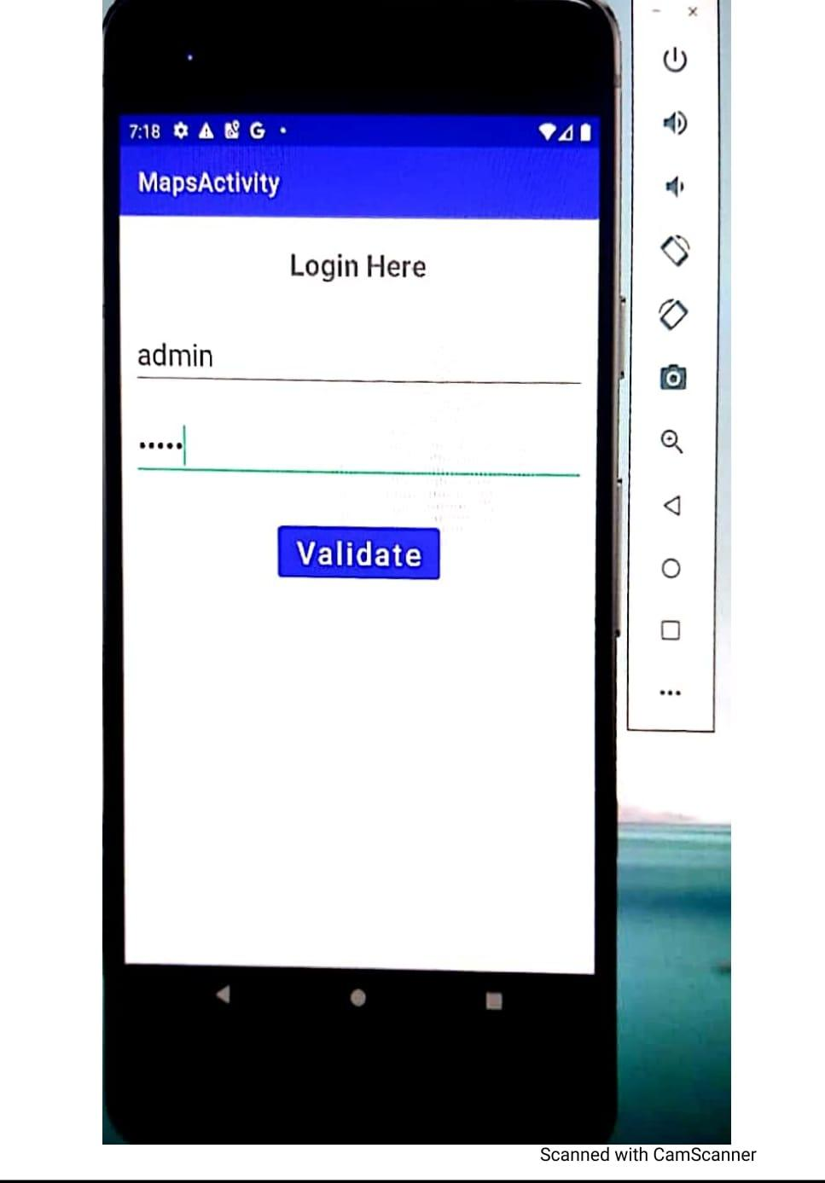
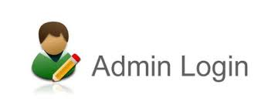
Result
<number>

Slide 8
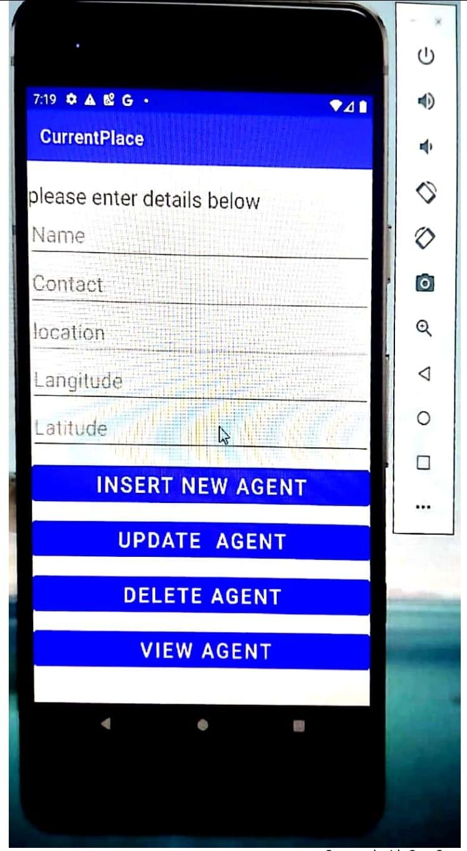
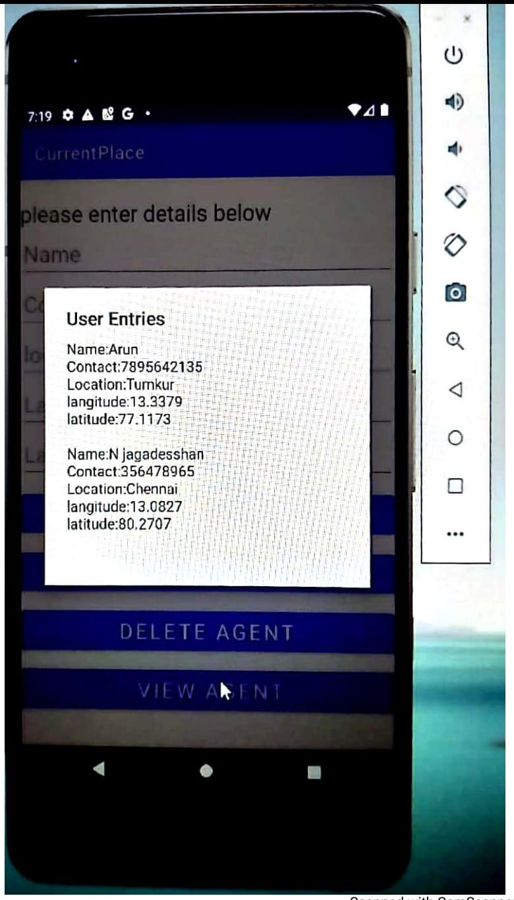

About agent page
<number>

Slide 9
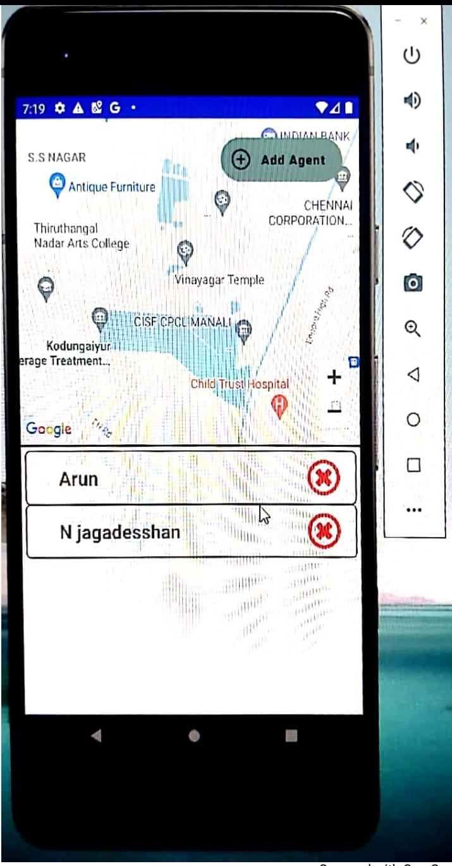
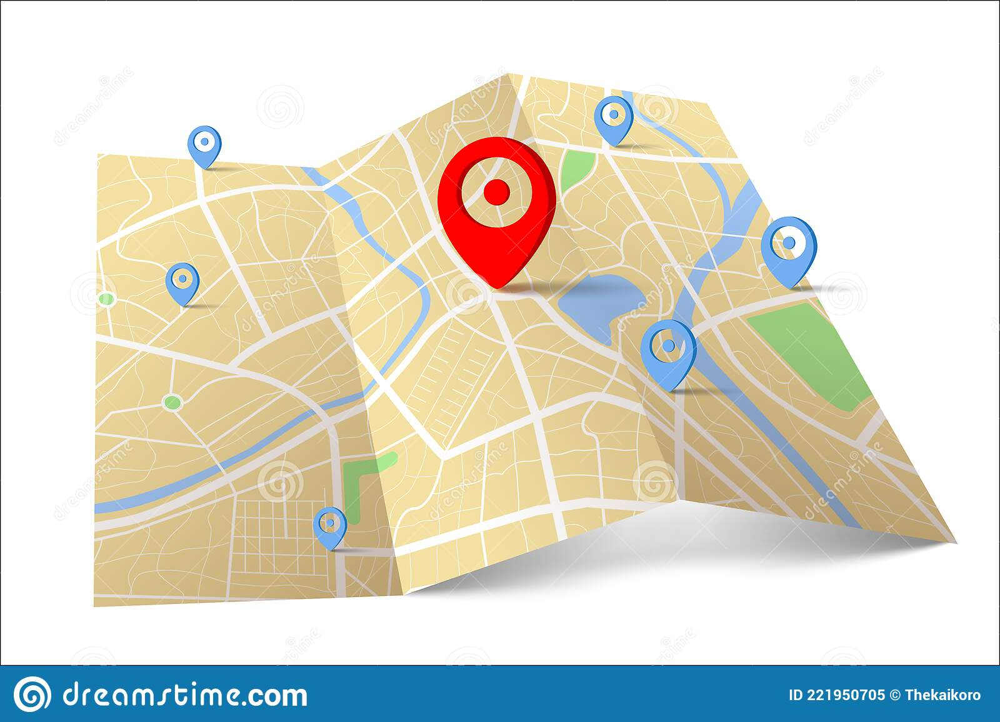
Mapping of agent
<number>

Slide 10
Future Enhancement
We will implement notification section
Gift voucher sending for agent based on the performance

Slide 11
THANK YOU
<number>

