Slide 1
Web services
Presenting by:
Mugdha
Shiva
Bala
Haripriya
Saivani

Slide 2
The term Web service (WS) is either:
a service offered by an electronic device to another electronic device, communicating with each other via the World Wide web(www), or
a server running on a computer device, listening for requests at a particular port over a network, serving web documents (HTML, JSON, XML, images).
In a Web service a Web technology such as HTTP is used for transferring machine-readable file formats such as XML and JSON.

Slide 3
A Web Service is can be defined by following ways:
It is a client-server application or application component for communication.
The method of communication between two devices over the network.
It is a software system for the interoperable machine to machine communication.
It is a collection of standards or protocols for exchanging information between two devices or application.

Slide 4
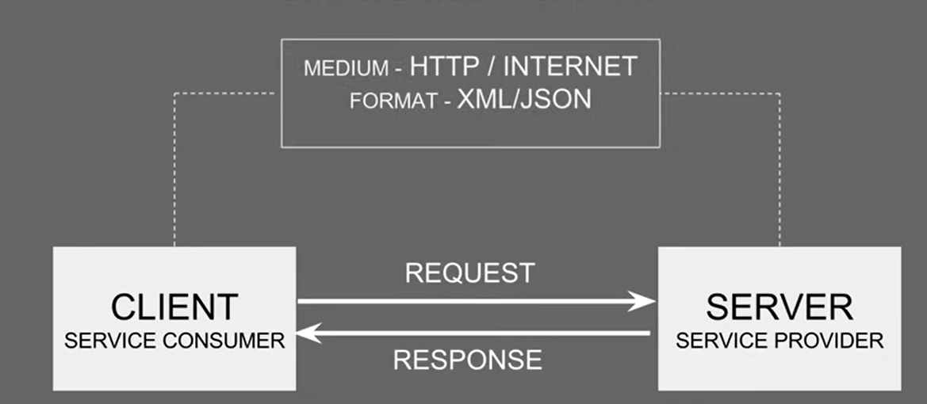
t

Slide 5
l
Why we use it: - platform independent communication - using web services two different applications (implementation) can talk to each other and exchange data/information.
Web services allow various applications to talk to each other and share data and services among themselves. Other applications can also use the web services. For example, a VB or .NET application can talk to Java web services and vice versa. Web services are used to make the application platform and technology independent.

Slide 6
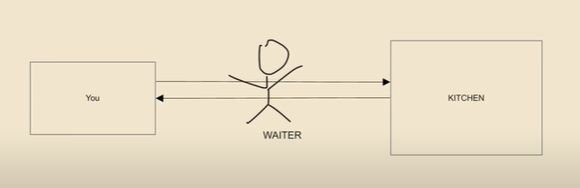
Real time example:
Here as shown in picture the waiter is acts as medium between the customer and the kitchen.
Communication between the customer, waiter and waiter, kitchen is the format

Slide 7
Standardized Protocol
Web services use standardized industry standard protocol for the communication. All the four layers (Service Transport, XML Messaging, Service Description, and Service Discovery layers) use well-defined protocols in the web services protocol stack. This standardization of protocol stack gives the business many advantages such as a wide range of choices, reduction in the cost due to competition, and increase in the quality

Slide 8
Low Cost Communication
Web services use SOAP over HTTP protocol, so you can use your existing low-cost internet for implementing web services. This solution is much less costly compared to proprietary solutions like EDI/B2B. Besides SOAP over HTTP, web services can also be implemented on other reliable transport mechanisms like FTP.

Slide 9
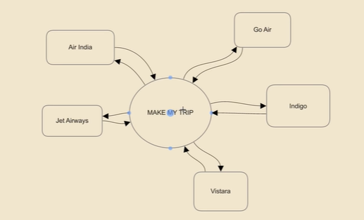
Make my trip example:
Here all the data of all flights are connected to one site.
If any changes are done at any of flight it will updated to the site

Slide 10
Advantages of web service:
1. Revealing the Existing Function on Framework
2. Interoperability (the ability of systems or software to exchange information)
3. Ordered Protocol (timestamps)
4. Ease of Use
5. Re-Ease of Use
6. Send Capacity
7. Agility (ability to move quickly and easily)
8. Quality
9. Cost
10. Minimal Effort Communication(XML-Based)

Slide 11
Disadvantages of web services
Although web services are simple to use but there are some flaws of using it. One of the disadvantage is over Matching Requirements. Any time one create a service to handle a variety of customers, need specialized machine requirements.
Second disadvantage of web services is availability. Every user or client who uses web services know that it is not available hundred percent all the time.
Third Disadvantage of web services is security. Web services are available to public through http-based protocol. So everyone can access web services and use it. This flaw can be avoided using authentication mechanisms.
Guaranteed Execution is a major problem of web services because HTTP which is hypertext transport protocol is not a reliable protocol that is it does'nt provide any guarantee of delivery of response.

Slide 12
Thank you

