Slide 1

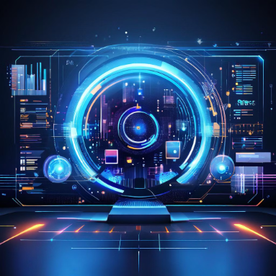

NAMED ENTITY RECOGNITION
BY
PRANAV MUDAM (160121733116)
HRUSHI KIRAN VOREM (160121733132)

Slide 2
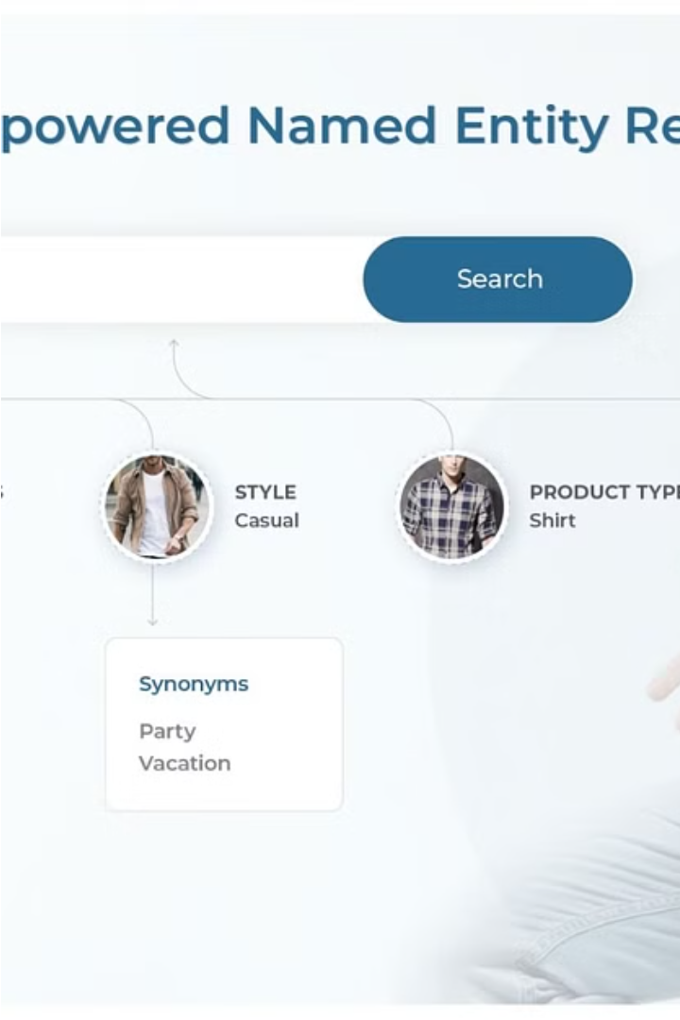
Introduction to Named Entity Recognition (NER)
Named Entity Recognition (NER) is a fundamental task in natural language processing (NLP) that involves identifying and classifying named entities, such as people, organizations, locations, and events, within unstructured text. It involves extracting these meaningful elements from the text and categorizing them into predefined entity types. NER is a crucial building block in natural language processing, enabling systems to better understand the context and meaning of textual data. This introductory section provides an overview of the key concepts and importance of NER.

Slide 3
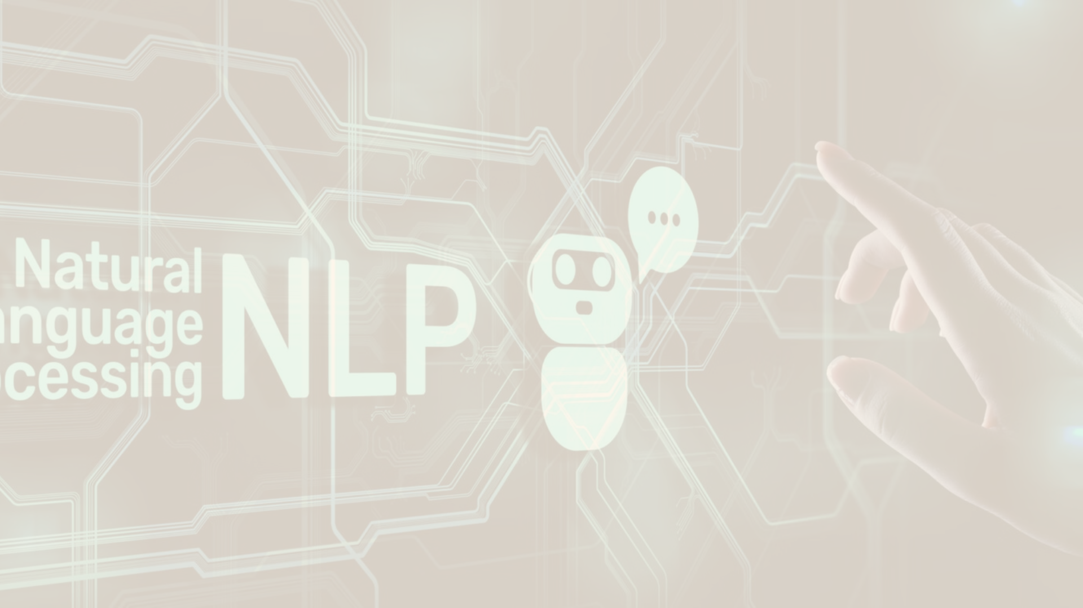
Importance of NER in Natural Language Processing
Information Extraction: Converts unstructured text into structured data by identifying key entities, facilitating tasks like data mining and knowledge base creation.
Question Answering Systems: Enhances response accuracy by extracting entities relevant to user queries.
Search and Information Retrieval: Improves precision in search engines through entity-based indexing and query matching.
Customer Support and Chatbots: Enables chatbots to understand and process user queries by recognizing named entities, leading to better interactions.
Anonymization and Data Protection: Helps in data privacy by identifying sensitive information, allowing for masking or redaction to meet privacy regulations.

Slide 4




Common Named Entities: Types and Examples
People
Organizations
Locations
Dates and Times
Named entities for people include personal names, such as "John Doe", and professional titles like "CEO" or "Dr.".
Organizations like companies, government agencies, and nonprofits are identified as named entities, e.g. "Apple Inc." or "United Nations".
Named entities for locations encompass geographic places such as cities, countries, rivers, and landmarks, for example "Machu Picchu" or "Amazon River".
NER can also detect named entities for specific dates, times, and time periods, like "June 15, 2023" or "the 19th century".
Libraries Used
pandas:
spaCy:
displacy:
A powerful data manipulation library in Python. In this code, its import could be for potential data handling or visualization tasks.
A popular NLP library used for Named Entity Recognition, among other tasks. Key features are Tokenization, POS tagging, Named Entity Recognition, Lemmatization etc..
A visualization tool within spaCy for displaying entities and their relationships. Key features are Dependency Parsing Visualization, Named Entity Recognition, Interactive Visualization etc..
collections:
numpy:
A module that provides specialized container datatypes. Here, Counter could be used for counting elements.
A fundamental package for numerical computations in Python. It might be used for advanced calculations, although it's not heavily featured in this snippet.

Slide 5
Approaches to NER: Rule-based, Machine Learning, and Deep Learning
Rule-based NER
Machine Learning NER
Deep Learning NER
Hybrid Approaches
Rule-based NER relies on a set of predefined linguistic rules and patterns to identify named entities. This approach is transparent and easy to understand, but requires significant domain expertise and manual effort to develop the rules.
Machine learning-based NER models are trained on large annotated datasets to learn the patterns and features that distinguish named entities. These models can generalize better to new data, but require extensive training and feature engineering.
Deep learning approaches, such as recurrent neural networks and transformer models, have revolutionized NER by automatically learning contextual features and representations from text. These models can achieve state-of-the-art performance with minimal feature engineering.
Many modern NER systems combine rule-based and machine/deep learning techniques to leverage the strengths of both, achieving improved accuracy and robustness across diverse domains and languages.

Slide 6
Evaluation Metrics for NER: Precision, Recall, and F1-score
Precision
The proportion of named entities that the model correctly identified out of all the entities it predicted.
Recall
The proportion of named entities that the model correctly identified out of all the true named entities in the data.
F1-score
The harmonic mean of precision and recall, providing a balanced metric that considers both accuracy and coverage.
These metrics help evaluate the performance of NER models, allowing developers to understand their strengths, weaknesses, and opportunities for improvement. Optimizing for a balance between precision and recall is crucial for building effective named entity recognition systems.

Slide 7
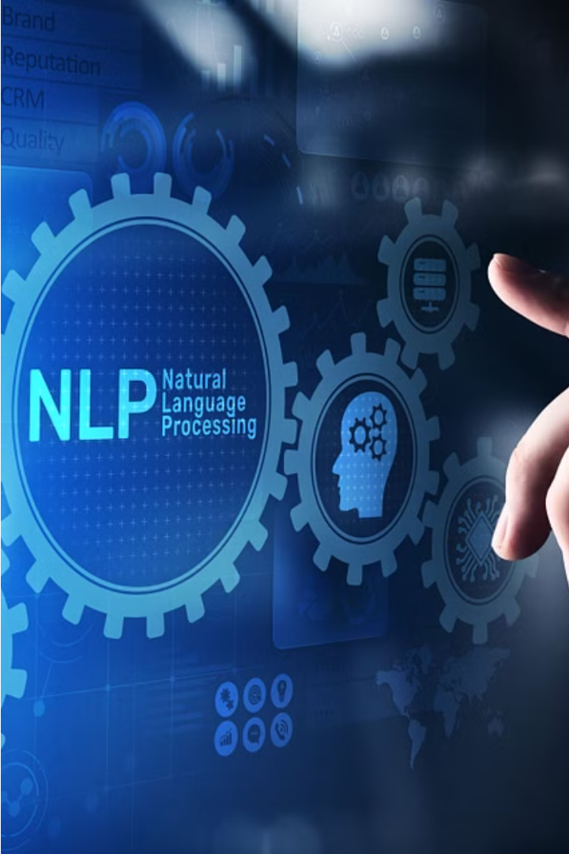
Challenges and Limitations of NER
Named Entity Recognition faces several challenges, including ambiguity, entity boundary detection, handling of nested entities, domain-specific terminology, and lack of annotated data for some languages and domains.
Additionally, NER models can struggle with rare or unseen entities, slang, and evolving language usage. Robust NER systems require continuous adaptation and improvement to overcome these limitations.

Slide 8




Real-world Applications of NER
Search and Information Retrieval
Conversational AI
News and Media Monitoring
Financial and Business Intelligence
NER is a crucial component of chatbots and virtual assistants, helping them understand user intents and extract relevant details to provide accurate responses.
NER is used to automatically extract and categorize named entities from news articles, social media posts, and other textual data, enabling better content analysis and tracking.
NER powers the entity-based search capabilities of leading search engines, enabling users to find relevant information about people, places, and organizations.
NER is applied to financial reports, earnings calls, and other business documents to identify key entities like companies, products, and executives, supporting data-driven decision-making.

Slide 9
Future Scope
Improved Accuracy and Context Awareness
Multilingual and Cross-Lingual NER
Domain-Specific NER
Handling Noisy Data and Social Media
Integration with Knowledge Graphs
Real-Time Applications and Streaming Data
Privacy and Ethical Considerations
Improved Labeling and Annotation
Transfer Learning and Adaptability

