Slide 1
TRAFFIC ACCIDENT SEVERITY
Traffic Accident
Severity Prediction
Final deployment presentation · Local web app demo · INFO 442 Data Science Project
Team 16
Team Members
Haoye Chen · 320230941721 Fangzhou Liu · 320230942161 Xiuru Li · 320230942091 Shaoyi Zong · 320230942831 Yukun Su · 320230942311
INFO 442 · Traffic Accident Severity Prediction
01 / 11
Notes:
【约30秒】开场说明：本项目是交通事故严重程度预测，答辩重点是最终部署和演示，而不是只展示训练结果。 核心句：我们把训练好的模型变成一个可交互、可解释的本地原型，用户能输入事故条件并看到预测和概率。

Slide 2
AGENDA
What this presentation covers
01
Problem & goal
05
Model performance
What decision the model is trying to support.
What the trained model can and cannot detect.
02
Data and preprocessing
06
Deployment workflow
How inputs are cleaned, encoded, and kept consistent.
How the web app, API, and saved metadata work together.
03
EDA findings
Why the task is imbalanced and context-dependent.
07
Limitations and next steps
04
Model architecture & selection
Where the prototype should not be overclaimed.
Why FT-Transformer was selected for deployment.
INFO 442 · Traffic Accident Severity Prediction
02 / 11
Notes:
【约25秒】这页作为正式目录。把听众预期建立起来：问题、数据、EDA、模型架构与选择、模型表现、部署、限制。
这套结构更像正式答辩，不像按作业阶段编号逐项汇报。

Slide 3
PROBLEM & GOAL
Predict injury severity from crash context
The system estimates a severity class and shows uncertainty through class probabilities.
Inputs
Prediction task
Output classes
•
traffic control, lighting
Given observed crash conditions, which injury severity class is most likely?
NO_INJURY
•
weather and road surface
No indication of injury
•
first crash type and cause
MINOR_INJURY
The deployment returns a label, a confidence value, and class probabilities for transparent interpretation.
Reported or non-incapacitating injury
•
intersection and unit count
SEVERE_INJURY
•
hour, day, and month
Incapacitating or fatal injury
INFO 442 · Traffic Accident Severity Prediction
03 / 11
Notes:
【约40秒】先把问题定义清楚。我们不是预测事故是否发生，而是在事故上下文已知时估计伤害严重程度。 输入包括交通控制、天气、光照、碰撞类型、路面情况、是否在路口、车辆数量和时间信息。 输出整理成三个类别：无伤、轻伤、重伤。界面不只给类别，还给概率，这对解释不确定性很重要。

Slide 4
DATA AND PREPROCESSING
Make prediction inputs consistent with training
The backend uses saved preprocessing metadata so the web form and the trained model remain aligned.
209k+
17
3
Metadata-driven form
records shown in app summary
columns after final cleaning
prediction labels
Categorical options, numeric ranges, target labels, and medians are read from saved files rather than copied by hand into the interface.
Normalize
Fill missing
Validate ranges
Engineer time
Scale + encode
Predict
INFO 442 · Traffic Accident Severity Prediction
04 / 11
Notes:
【约45秒】这一页讲数据和预处理。部署中最容易出错的一点，是训练时的处理方式和预测时不一致。 所以我们让后端读取保存好的预处理元数据，包括类别映射、数值范围、缺失填充值和标签。 底部是一次预测的处理流程：文本标准化、缺失处理、范围验证、时间特征构造、缩放和编码，最后进入训练好的模型。

Slide 5
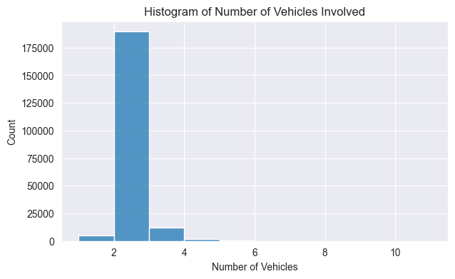
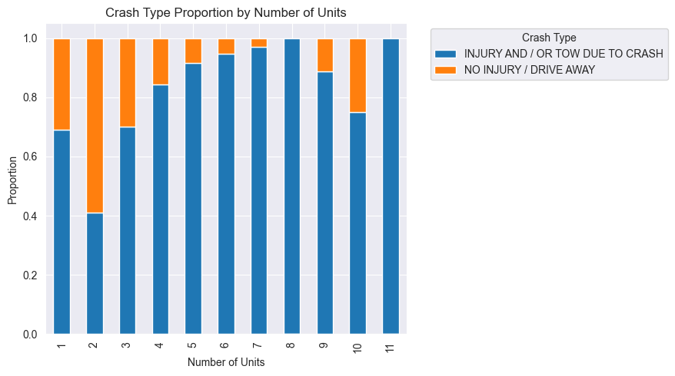
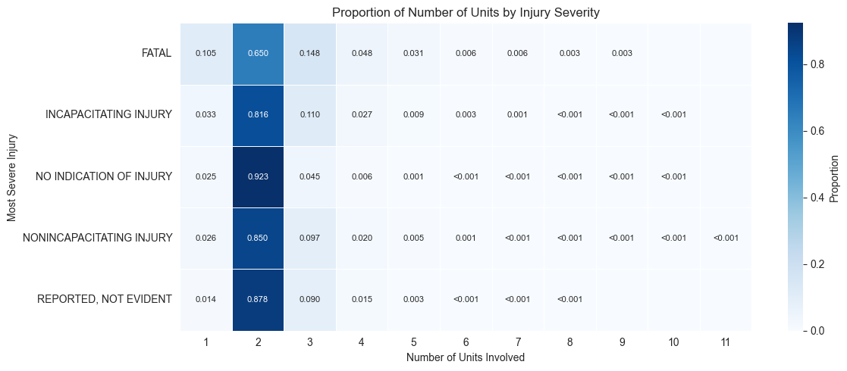
EDA FINDINGS
The dataset is imbalanced and context-dependent
These charts explain why balanced metrics and careful interpretation are necessary.
Vehicle count: two-unit crashes dominate.
Rain and cloudy conditions show higher injury/tow rates.
Unit count interacts with weather context.
Interpretation
Most records are routine crashes, while severe outcomes are sparse. A useful model must be judged with balanced accuracy, macro F1, class-level recall, and probability behavior.
INFO 442 · Traffic Accident Severity Prediction
05 / 11
Notes:
【约50秒】EDA 的作用是解释为什么这个建模问题并不简单。 第一张图显示车辆数量高度集中在两辆车；第二张图显示不同天气下受伤或拖车比例不同；第三张图说明车辆数量和天气条件之间还有交互。 这些发现说明模型不能只依赖一个简单规则，也不能只看准确率。因为严重伤害样本很少，准确率可能掩盖少数类表现。

Slide 6
MODEL ARCHITECTURE & SELECTION
Compare candidates before reading the score page
The final deployment uses the validation Macro F1 winner, not the highest-accuracy shortcut.
Crash features
Model-specific encoding
Selected architecture
Model output
categorical context + numeric time / unit features
CatBoost: raw categories XGBoost: one-hot features FT: embeddings + numeric tokens
FT-Transformer 64-d tokens · 8 heads 3 attention layers · dropout 0.15
NO_INJURY MINOR_INJURY SEVERE_INJURY probabilities
Selection rule
Validation Macro F1 was the primary criterion; FT-Transformer was selected after comparing CatBoost and XGBoost.
Imbalance handling
Three-class target, rare-level grouping, stratified split, class-weight search, and focal loss for the neural model.
INFO 442 · Traffic Accident Severity Prediction
06 / 11

Slide 7
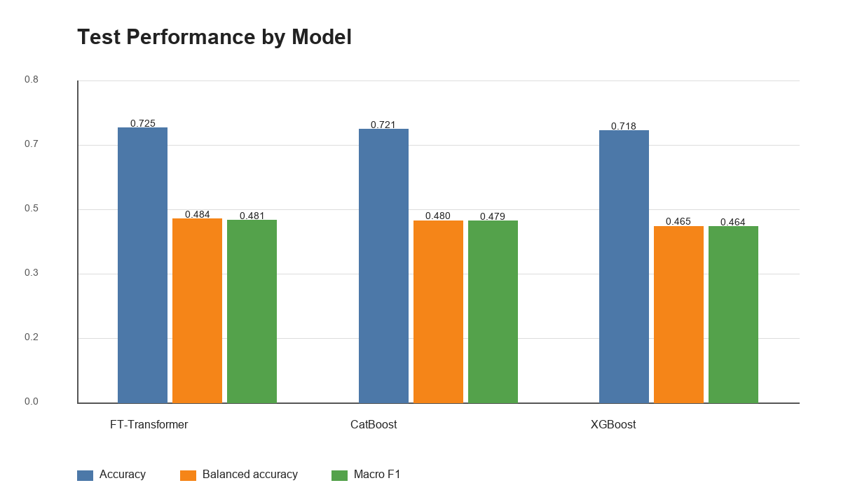
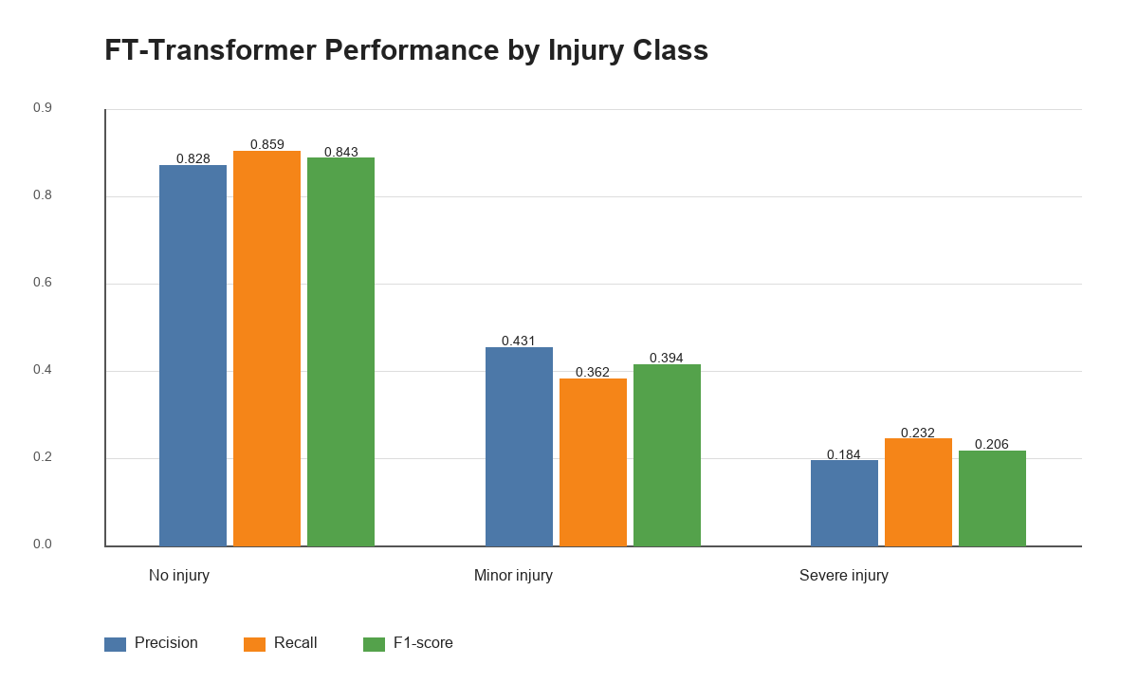
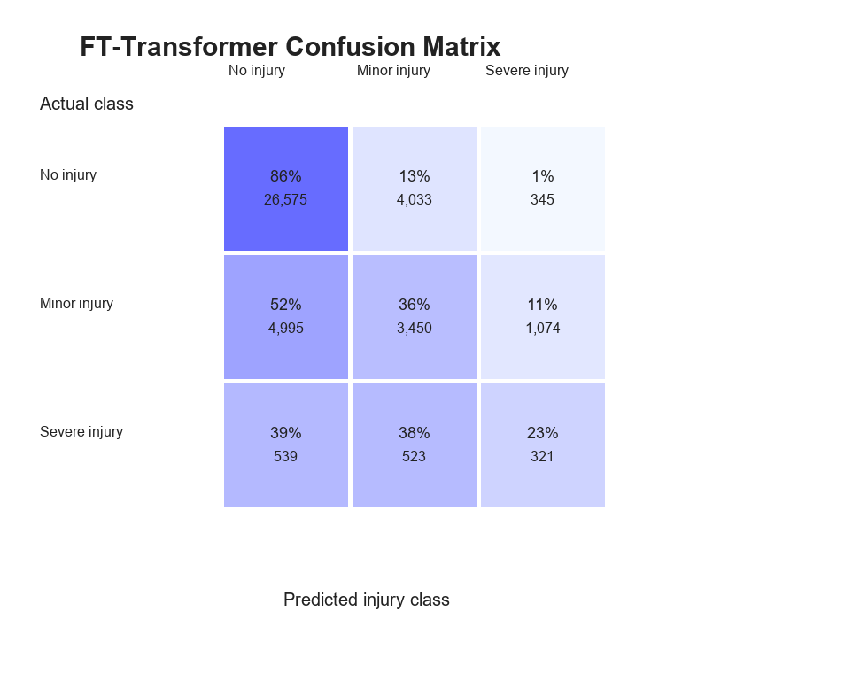
MODEL PERFORMANCE
FT-Transformer is strongest overall, but severe cases remain difficult
The performance page should be read at both model level and class level.
Model reading
Overall accuracy is about 0.725, but severe-injury F1 is only about 0.206 and severe recall is about 0.232. This is the main reason the app is presented as a decision-support prototype, not a triage tool.
INFO 442 · Traffic Accident Severity Prediction
07 / 11
Notes:
【约60秒】这里是模型表现页，是内容上最关键的一页之一。 左边对比显示 FT-Transformer 整体表现最好，准确率约 0.725，balanced accuracy 和 macro F1 略高于其他模型。 但中间和右边说明了更重要的问题：严重类表现仍然弱，F1 大约 0.206，召回大约 0.232。 所以我们不能把它包装成急救分诊系统。它更适合作为课堂原型和风险提示工具。

Slide 8
PREDICTION WORKFLOW
From browser input to model-backed response
The web app uses a lightweight local server with schema, status, and prediction endpoints.
Crash form
Local API
Preprocessor
Response
user-selected context
status · schema · predict
saved metadata + scaler
label + confidence + probabilities
Real-time defaults
Current hour, day, month, and optional weather data prefill fields, while manual edits are preserved.
Transparency
The request JSON panel lets reviewers see exactly what the model received.
INFO 442 · Traffic Accident Severity Prediction
08 / 11
Notes:
【约45秒】这一页讲系统流程。前端表单提交事故上下文到本地服务器，服务器提供三个接口：状态、输入 schema 和预测。 后端先用保存的预处理元数据处理输入，再把特征送入训练好的模型，返回类别、置信度和概率分布。 这里还可以顺带讲实时默认值：小时、星期、月份来自浏览器时间，天气可以来自外部天气服务；但用户能手动改，系统不会强制覆盖。

Slide 9
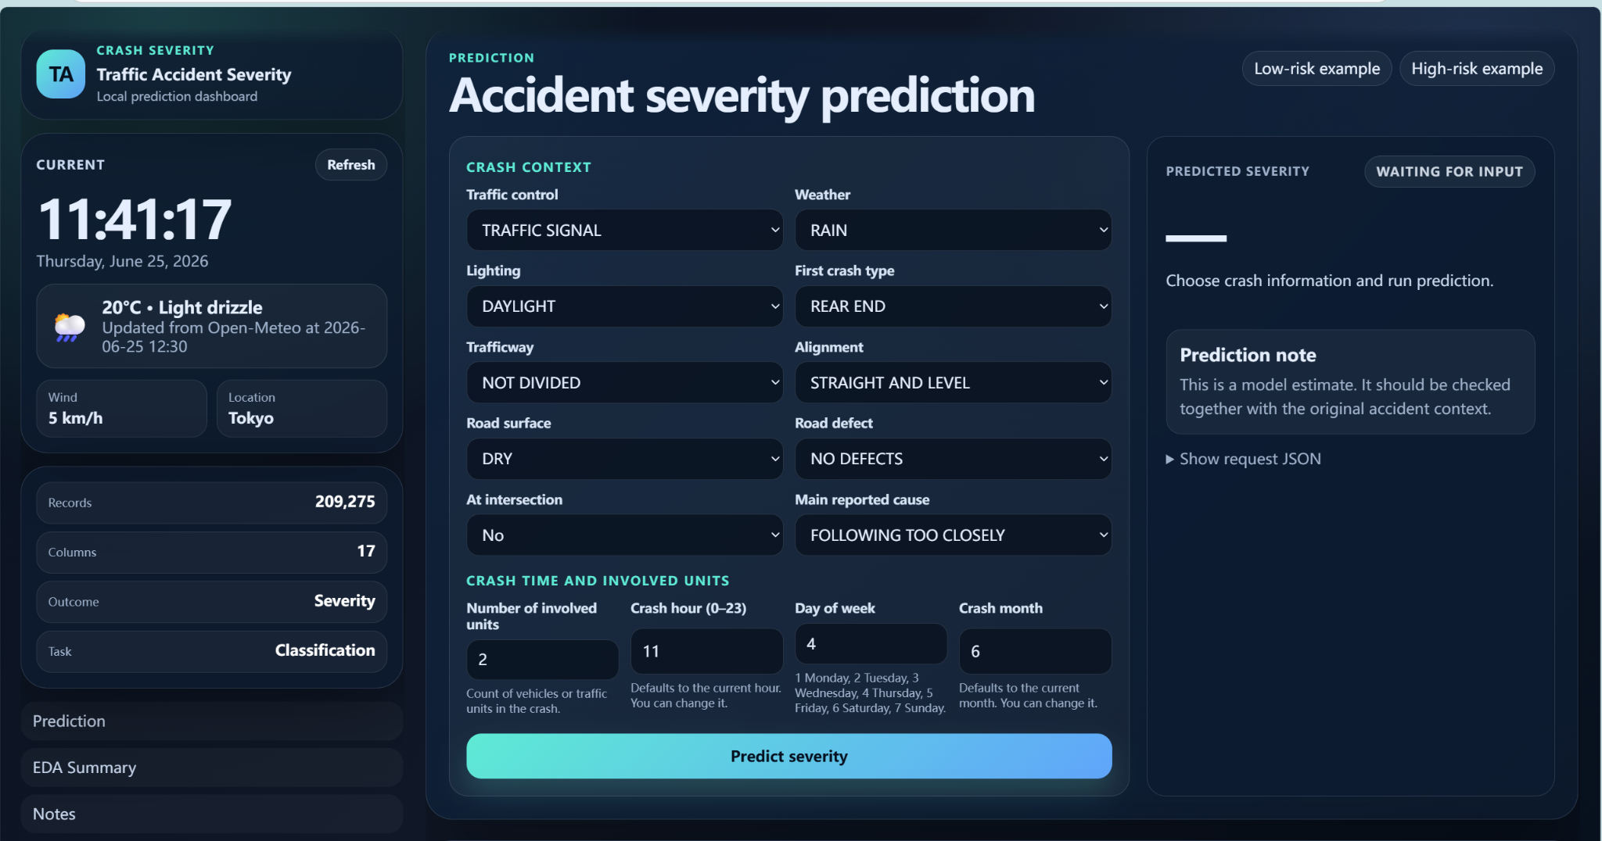
WEB APP DEPLOYMENT
The interface supports both prediction and presentation
It combines operational inputs with model output and explanation panels.
Live demo path
1
Confirm model status
2
Choose low-risk example
3
Run prediction
4
Compare high-risk example
5
Show request JSON
This slide can be followed by a short live run if the classroom timing allows.
INFO 442 · Traffic Accident Severity Prediction
09 / 11
Notes:
【约50秒】这页展示真正的部署界面。讲的时候按三块区域走：左侧实时上下文，中间事故表单，右侧预测结果。 如果现场可以演示，我会按右边的五步做：确认状态、低风险样例、预测、高风险样例、展示 JSON。 这页的重点是说明：系统不是静态截图，而是可以运行的本地原型。

Slide 10
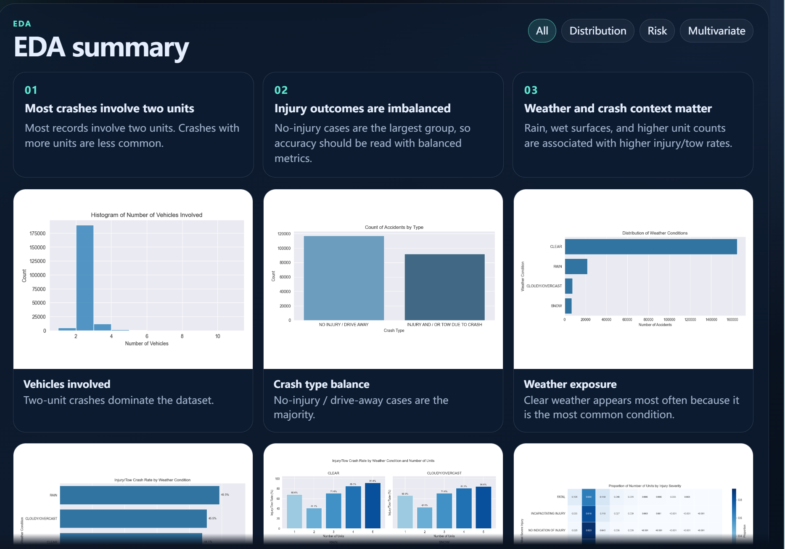
RELIABILITY AND LIMITATIONS
Robust demo behavior, cautious model claims
Fallback behavior is explicit, and the model is not framed as an emergency decision system.
Known limits
•
local prototype: no auth, database, or production logging
•
severe cases are rare and difficult to detect
•
weather defaults depend on browser permission and API access
•
new locations require retraining and validation
Robustness rule
If model files or libraries are unavailable, the interface clearly labels demo fallback mode rather than presenting heuristic output as real model evidence.
INFO 442 · Traffic Accident Severity Prediction
10 / 11
Notes:
【约55秒】这里把鲁棒性和限制合并讲，避免页数过多。 系统考虑了本地课堂演示可能失败的情况：模型文件、包或接口异常时，可以切换到明确标记的 demo fallback。重点是透明，不把启发式输出说成真实模型。 限制方面，最重要的是它不是生产系统：没有认证、数据库、日志和正式部署安全措施；模型对严重伤害类别也不够强。 因此最终定位是决策支持原型和课程展示，不是急救分诊或安全关键自动决策系统。

Slide 11
CONCLUSION
The deployment turns the project into a testable workflow
It connects data, preprocessing, modelling, prediction, EDA communication, and limitations in one prototype.
What works
Next steps
Final position
•
interactive crash scenario input
•
improve severe-class recall
A useful prototype should make both predictions and limitations visible.
•
model-backed prediction API
•
calibrate predicted probabilities
•
probability output
•
add threshold analysis
•
embedded EDA context
•
move beyond local hosting
Thank you. We are ready for questions.
INFO 442 · Traffic Accident Severity Prediction
11 / 11
Notes:
【约45秒】最后总结：我们的贡献不是单个分数，而是把完整流程做成了能运行、能解释、能演示的原型。 它能输入场景、调用后端、输出概率、展示 EDA，也主动说明限制。 下一步是提升严重类识别、校准概率、做阈值分析，并升级到更完整的部署环境。 结束语：Thank you. We are ready for questions.

