Slide 1
JavaScript Juggernauts

Slide 2

This will soon be you…
JavaScript Juggernauts.

Slide 3
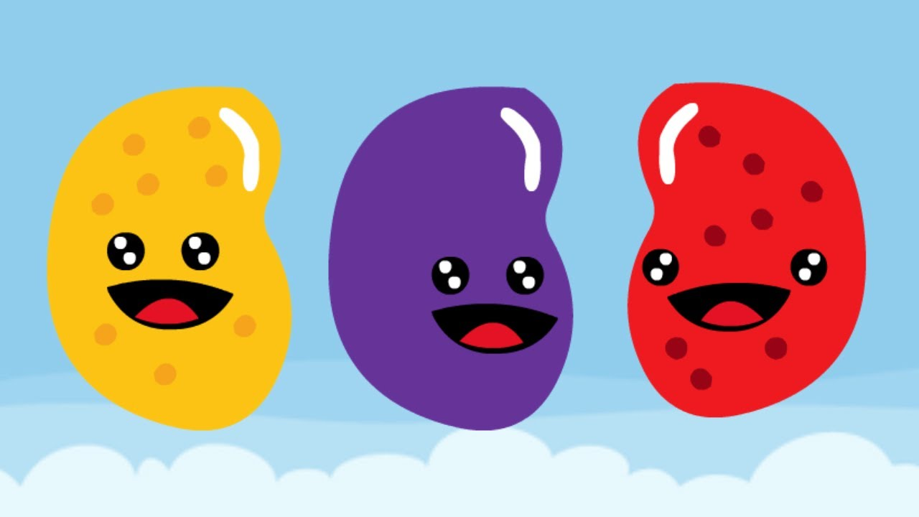
But right now…
Maybe feeling like
JavaScript Jellybeans.

Slide 4
Transformation to Come
HANG IN THERE!

Slide 5
Today’s Class

Slide 6
Objectives
In today’s class we’ll be covering:
JavaScript Functions
JavaScript Objects
Building Simple JavaScript Applications

Slide 7
Functions

Slide 8
> YOUR TURN!!
Activity: 1-LoopTV | Suggested Time: 10 min
Code Dissection: Array Building
Run the program sent to you via slack.
Then, with a partner, fill in the missing comments for each line of code.
Make sure both of you can fully explain what each line means.
Be prepared to share with the class.

Slide 9
Demo Time
Instructor: Demo
(SuperHeroLogging_NoFunctions.html | 2-SuperHeroLogging)

Slide 10
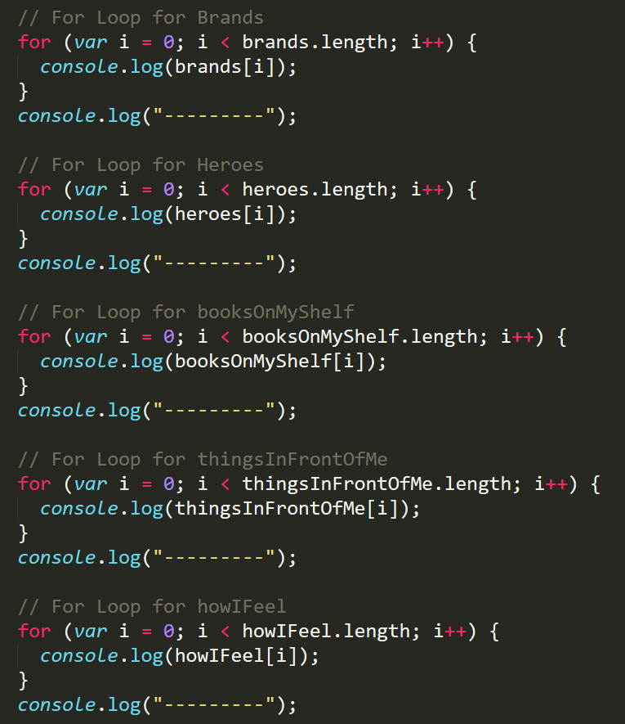
Mondo Repetitive…
Who wants to maintain this??
Hint: No one.

Slide 11
Demo Time
Instructor: Demo
(SuperHeroLogging_WithFunctions.html | 2-SuperHeroLogging)

Slide 12
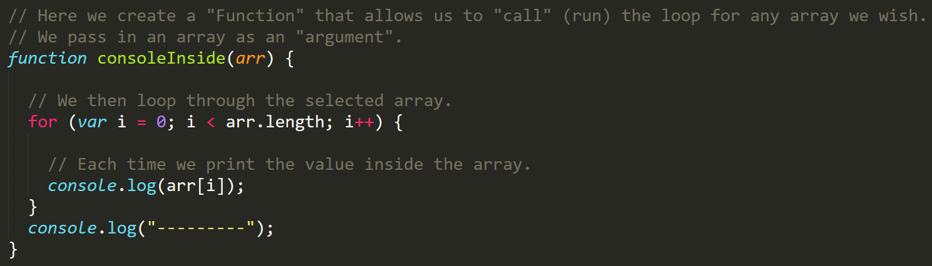
Much Better with Functions!
Squeaky Clean Code.
Minimal repetition

Slide 13
> YOUR TURN!!
Activity: 3-MyFirstFunctions | Suggested Time: 20 min
Code Creation: Function Building
Working in pairs and using the starter file sent to you via slack–fill in the missing functions and function calls.
Note: Try to finish all four functions if you can, but don’t be distressed if you only get 1 or 2. The important thing is that you get at least one function fully done.
HINT: Look back to the previous example if you need help.

Slide 14
Objects

Slide 15
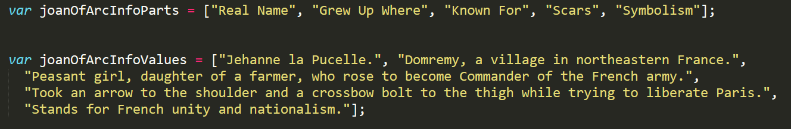
Associated Data ==/== Arrays
Relating two separate arrays is not fun.

Slide 16
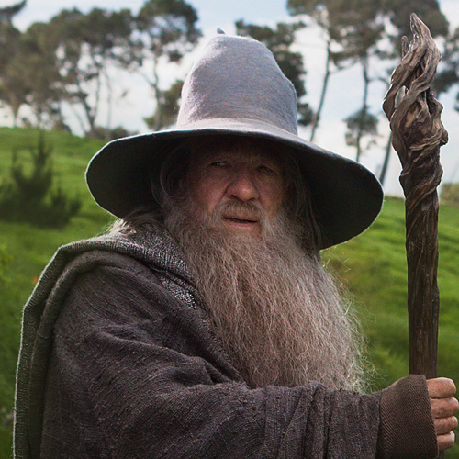
Objects Visualized
var gandalf
=
{
“real name”
:
“Gandalf”
,
“age (est)”
:
11000
,
“race”
:
“Maia”
}
This is Gandalf. According to code… Gandalf is an Object.

Slide 17
Objects Visualized
var gandalf
=
{
“real name”
:
“Gandalf”
,
“age (est)”
:
11000
,
“race”
:
“Maia”
}
These are Gandalf’s properties (like descriptors).

Slide 18
Objects Visualized
var gandalf
=
{
“real name”
:
“Gandalf”
,
“age (est)”
:
11000
,
“race”
:
“Maia”
}
These are the “values” of Gandalf’s properties.

Slide 19
Objects Visualized
var gandalf
=
{
“real name”
:
“Gandalf”
,
“age (est)”
:
11000
,
“race”
:
“Maia”
}
Thus: gandalf[“race”] = “Maia

Slide 20
Demo Time
Instructor: Demo
(gandalf-the-grey-objects.html | 30-GandalfTheGreyObjects)

Slide 21
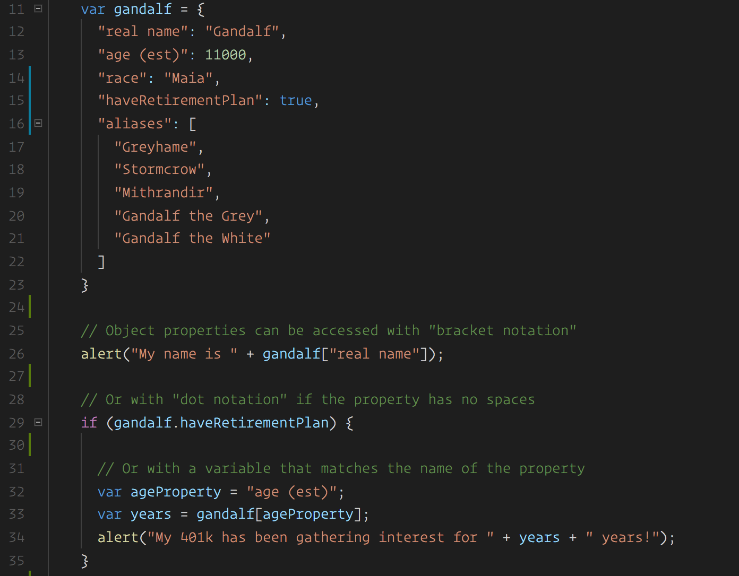
Gandalf – The Object
Gandalf’s “properties” and “values” are associated in object form, making it easy to recall specific data.

Slide 22
Demo Time
Instructor: Repeat Demo
(gandalf-the-grey-objects.html | 30-GandalfTheGreyObjects)

Slide 23
> YOUR TURN!!
Activity: 7-MyFirstObject | Suggested Time: 15 min
Code Dissection / Creation: Basic Objects
With a partner, spend the next few moments studying the code just slacked to you.
Then, write code below each comment to log the relevant information about the provided car object.
Bonus: If you finish early, create a brand new object of your own. Slack out a snippet of the code to the class when you are done. Be Creative!

Slide 24
Demo Time
Instructor: Demo in Browser
(carGame_Solved.html | 8-CarGame)

Slide 25
> YOUR TURN!!
Activity: 8-CarGame | Suggested Time: 20-30 min
Code Creation: Run that Car!
Using the code from the previous activity as a starting point, create a complete application such that:
Users can enter keyboard input (letters).
Each of the car's methods are assigned to a key.
When the user presses a key it calls the appropriate function.
These letters also trigger a global function called reWriteStats() that logs the car’s make, model, color, mileage, and isWorking status to the console.
HINT: You will need to use the document.onkeyup() function to collect input from the user's keyboard.

Slide 26
Scope & Stuff
Everyone Do: Scope & Callbacks

Slide 27
Demo Time
TA: Demo
(Homework Videos!)

Slide 28
> YOUR TURN!!
Activity: 9-TriviaGame | Suggested Time: 45 min
Extra Activity: Trivia Game
With whatever class time remains, complete the following activity in pairs.
Starting from a blank HTML file:
Create an object with 10 questions. The object should be structured like this: q1: [“QUESTION”, “ANSWER”] q2: [“QUESTION”, “ANSWER”]
Then create code that will ask the user questions, one by one. The user must answer by hitting t (for true) or f (for false).
Check the user’s answer against the correct answer, and provide them with an alert telling them if they are right or wrong.
Bonus: Keep track of the user’s score.
Hint: Don’t worry about having DRY code to start with. Just focus on getting working code first.

Slide 29
Questions

