Slide 1

AI Gym Planner
Final University Review — Phase 3
Smart Fitness · Cloud Sync · AI Personalization
Phase 1
Introduction
TEAM — FITTECH INNOVATORS
Voris Ernazarov
Fotima Rahimova
Phase 2
Android Developer
API Integration
Development
Odina Otayorova
Zuhra Rahimova
UI/UX Design
Testing & Docs
Phase 3
Final Review
1 / 12

Slide 2



Project Vision & Value Proposition
Why AI Gym Planner is the future of personal coaching
"Most fitness apps are either too complex or too generic.
AI Gym Planner solves both — intelligently."
AI-Powered
Cloud-First
Zero Friction
Gemini-driven workout suggestions tailored to your history and fitness level
Firebase Firestore keeps your data synced across every device, instantly
Activity Recognition auto-logs your walks and runs — no manual input needed
2 / 12

Slide 3





Final Technology Stack
Production-grade tools chosen for scalability and performance
Kotlin + Jetpack Compose
ARCHITECTURE
100% declarative UI · Material 3
UI Layer
Firebase Auth
Compose Screens + ViewModels
Email/Password · Google Sign-In via Credential Manager
Cloud Firestore
NoSQL sync · offline persistence · real-time listeners
Repository Layer
WorkoutRepository
Activity Recognition API
Google Play Services · walking / running detection
Gemini AI SDK
Data Sources
AI-generated workout plans · context-aware prompts
Room DB · Firestore · APIs
Room Database
Local cache · Single Source of Truth · offline-first
3 / 12

Slide 4
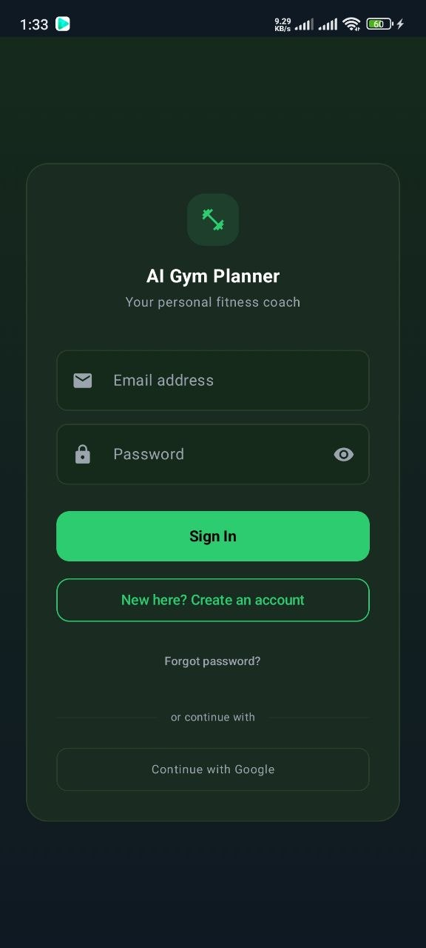


Feature 1 — Seamless Onboarding
Modern authentication with zero-friction user setup
Google Sign-In
One-tap authentication via Credential Manager API. No passwords required. Instant account access.
Email / Password Auth
Full Firebase Auth with form validation, error mapping, and password visibility toggle.
Profile Personalization
Display name, photo, and fitness level stored in Firestore on first login.
✓ IMPLEMENTED
4 / 12

Slide 5
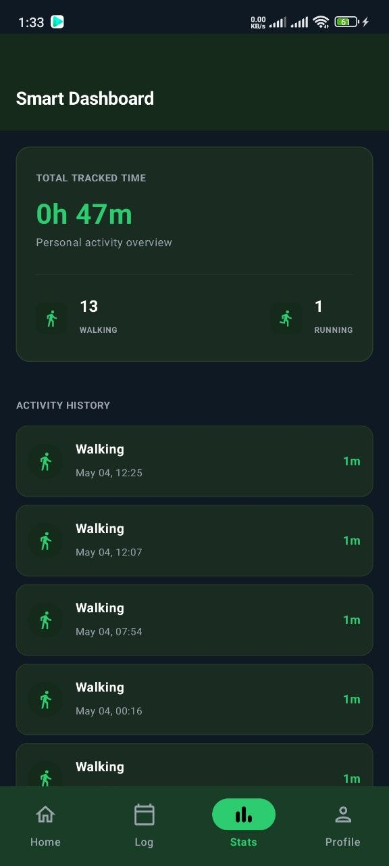


Feature 2 — Smart Activity Engine
Automatic detection of physical movement — no user action required
Google Play Services
Activity Recognition API · 60s interval
Activity Detection
WALKING · RUNNING · 70%+ confidence threshold
Room Database
SmartActivityEntity saved locally (isSynced=false)
Firestore Sync
Background upload · retries on failure
Smart Dashboard
Real-time stats · 0h 47m total · 13 walking sessions
✓ IMPLEMENTED
Foreground service with health notification · ACTIVITY_RECOGNITION permission · minSdk 26
5 / 12

Slide 6
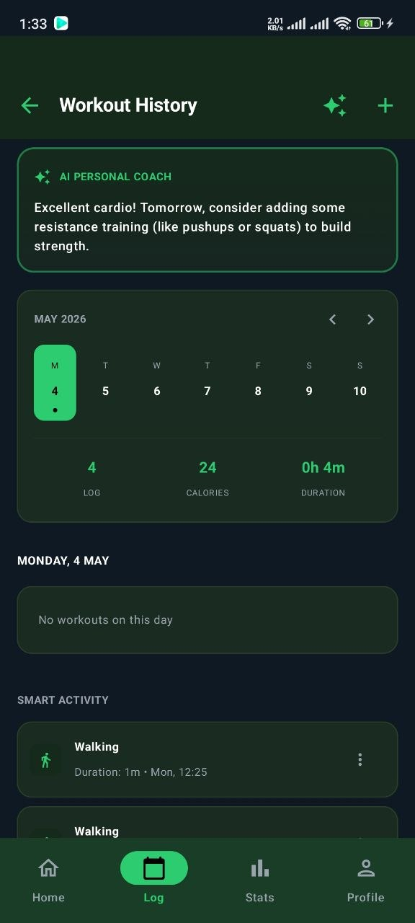
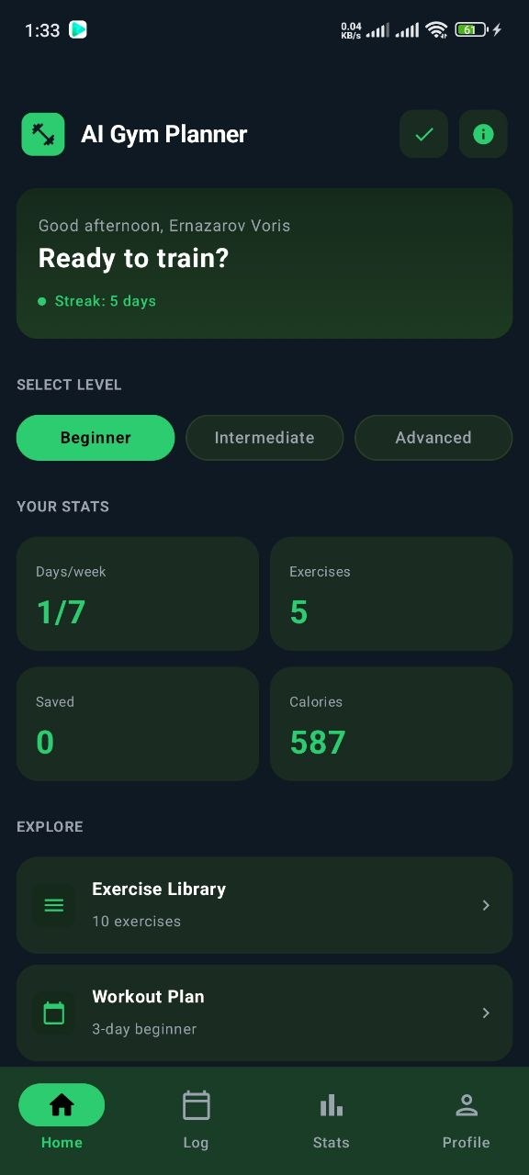


Feature 3 — Workout History & Logging
Manual logging meets AI coaching — unified in one calendar view
Horizontal Calendar
Custom weekly strip with green dot indicators for days with logged activity.
Manual Exercise Logging
Log exercise, sets, reps, weight and notes. Saved to Room instantly.
AI Personal Coach
Gemini analyses your history and surfaces a recommendation card at the top.
Smart Activity Overlay
Walking/running sessions auto-appear in the history alongside manual logs.
✓ IMPLEMENTED
6 / 12

Slide 7

Technical Achievement — The Sync Engine
Offline-first architecture: Room is always the single source of truth
WRITE PATH
SYNC STATES
User logs workout
PENDING (isSynced = false)
Stored locally in Room only
Cloud icon shows queue indicator
Retried on next app launch or connectivity
Room DB insert (instant)
isSynced = false
Background coroutine
SYNCED (isSynced = true)
Mirrored in Firestore
New-device restore reads from cloud
Room is updated — no duplicate writes
Firestore upload ✓
isSynced = true
This pattern guarantees zero data loss even with intermittent connectivity.
7 / 12

Slide 8
UI/UX Transformation
From functional prototype to pixel-perfect Cloud Design System
PHASE 2 — PROGRESS BUILD
PHASE 3 — FINAL PRODUCT
✗ Single HomeScreen + ExerciseList
✓ 8 screens with bottom navigation
✗ Basic Jetpack Compose cards
✓ Cloud Design spec — #0F1923 / #2ECC71
✗ Hardcoded mock data fallback
✓ Firebase Auth + Google Sign-In
✗ No authentication layer
✓ Firestore real-time sync with states
✗ No Firestore sync
✓ Activity Recognition foreground service
✗ Static workout plan logic only
✓ Gemini AI coaching card on History
8 / 12

Slide 9
Database Architecture
Dual-layer persistence — Room for offline, Firestore for cloud sync
CLOUD FIRESTORE STRUCTURE
ROOM LOCAL DATABASE
users/
workout_logs
id (PK)
{uid}/
userId
date
profile/data
exerciseName
sets, reps, weightKg
email, displayName, fitnessLevel
isSynced ← KEY FIELD
smart_activities
workoutLogs/{logId}
activityType
durationMinutes
date, exerciseName, sets, reps
confidence
isSynced
smartActivities/{id}
user_profile
activityType, durationMinutes, confidence
uid (PK)
fitnessLevel
weeklyGoalDays
9 / 12

Slide 10

Challenges & Solutions
Real engineering problems — and how we solved them
SHA-1 Fingerprint Issues
Dependency Conflicts
FIREBASE AUTH
GRADLE
PROBLEM:
Google Sign-In returned error 10 — app not authorized. OAuth screen never appeared.
PROBLEM:
Gradle failed: AGP 8.x incompatible with older KSP version. Room compile errors after adding firebase-bom.
SOLVED:
Added debug SHA-1 via keytool to Firebase Console. Created separate OAuth 2.0 Web Client ID for Credential Manager.
SOLVED:
Pinned KSP to 1.9.20-1.0.14, upgraded coroutines-play-services, added packaging exclusions for META-INF conflicts.
Activity Recognition on Android 14
UI Scaling on Small Screens
ANDROID API
COMPOSE UI
PROBLEM:
foregroundServiceType missing from manifest caused crash on API 34+ devices.
PROBLEM:
Calendar strip overflowed on 5.0" screens. Bottom nav items clipped on some densities.
SOLVED:
Added android:foregroundServiceType="health" + POST_NOTIFICATIONS permission. Raised minSdk to 26.
SOLVED:
Replaced fixed dp widths with Modifier.weight(1f) in LazyRow. Used WindowInsets padding for nav bar.
10 / 12

Slide 11




Future Roadmap
What comes next — from prototype to platform
Q3 2026
HIGH
Q3 2026
HIGH
Q4 2026
MED
Gemini Full Integration
Progress Analytics Screen
Social & Sharing
AI generates a complete next-day workout plan using 14-day history analysis via gemini-1.5-flash.
Weekly muscle group breakdown chart, streak counter, calorie estimation, and personal records.
Share workout plans with friends. Compare weekly stats. Community challenges.
Q4 2026
MED
Q1 2027
LOW
Q1 2027
LOW
Full Offline Mode
Wearable Integration
Play Store Launch
Cache all Firestore data in Room. Full app functionality with zero connectivity.
Wear OS companion app. Heart rate data from Google Health Services.
Production APK, store listing, screenshots, privacy policy, and release build.
11 / 12

Slide 12
AI Gym Planner
Phase 3 Complete — Final University Review
FitTech Innovators · Voris · Fotima · Odina · Zuhra
8
100%
70%
3
Screens Built
Kotlin
Project Complete
External APIs
"We built a production-grade fitness application — not just a university demo."
Thank you · Questions welcome
12 / 12

