Slide 1


TWITTER BOT DETECTION PROGRAM
BY LE THIEN NHAN NGUYGEN, ARIN BANERJEE, HARMEN RAI, KARANJOT SANDHU

Slide 2
BACKGROUND
We're creating a tool to find Twitter bots, those automated accounts that can spread fake news and spam. Using machine learning, we will analyse a user's followers and those they follow to spot potential bot accounts. This helps make online interactions more genuine and reliable
Twitter is swarmed with automated bot accounts that harm the quality of user experiences by spreading fake information, generating fake engagement and spam. To tackle this problem, we're building a tool that can tell apart real users from bots.

Slide 3
FUNCTIONAL REQUIREMENTS
Data Train Collection
Establish a guideline to collect a data train and testing set to training the machine algorithm
The Data should include both genuine users and bot account to help the algorithm to
understand the difference
Extraction
Extract and collect data from user’s profile and tweet behaviour through Twitter API, and process then export it for the Json file into a csv file
Data Labelling
Filter down the user’s data collected, through a predetermined criteria tas they may not provided efficient data
Create a labelled dataset with a ground truth of genuine and bot accounts to train and validate the model.
Machine Learning Model
Develop a machine learning model for bot detection based on the research that was conducted.

Slide 4
FUNCTIONAL REQUIREMENTS CONT.
Training and Testing Data Model
Train the model on the labelled dataset and validate its performance using appropriate metrics, such as precision, recall, F1-score, and accuracy
Real-time data collecting
Establish a system that collect select user’s follower data in-real time through Twitter API model
Filter down redundant data before inserting it in the machine learning model
Reporting
The system represents the data in an easy to understand format for the user. Complete with actual bot’s follower of the account, the percentage, etc

Slide 5
NON-FUNCTIONAL REQUIREMENTS
Usability
User is able easily understand and utilize the UI within 5 minutes
Provide clear and concise documentation or user guides to help users make the most of the system
Performance
Data filtering should be performed efficiently to avoid bottlenecks in data processing. This is especially important when dealing with a large dataset.
Error Handling
Implement error-handling mechanisms to address any issues that may arise during data filtering, ensuring the robustness of the system
Compliance
Ensure that the system complies with relevant data privacy and security regulations, respecting user rights and privacy
Adhere to ethical guidelines and Twitter's terms of service to ensure that data collection and analysis are conducted responsibly and legally
Reliability
System should be available and functional with minimal downtime or service interruptions
Scalability
System should be able to handle an increase of users and data without a decrease in performance

Slide 6
INTRODUCTION/PROJECT SCOPE
The rise of social media has brought both opportunity and challenges. While more people are engaging with these platforms than ever before, there's also a growing presence of inauthentic accounts, known as bots, which spam advertisements, crypto, or political messages. These bots not only disrupt user experiences but also manipulate algorithms, causing spam and potentially misleading investors. This is evident in recent incidents on Twitter/X, where bot-driven replies are irritating users and skewing engagement metrics. To address this, a bot detection program utilizing machine learning can help analyze and mitigate the impact of these bots on social media platforms and websites, ensuring a more authentic and reliable user experience.
The overall scope and key needs that will be included are to train/test an algorithm model to get data and categorise twitter accounts by specific categories like username, follower count, following count, keywords related to the bots, average tweet time, hashtag count and so forth.

Slide 7
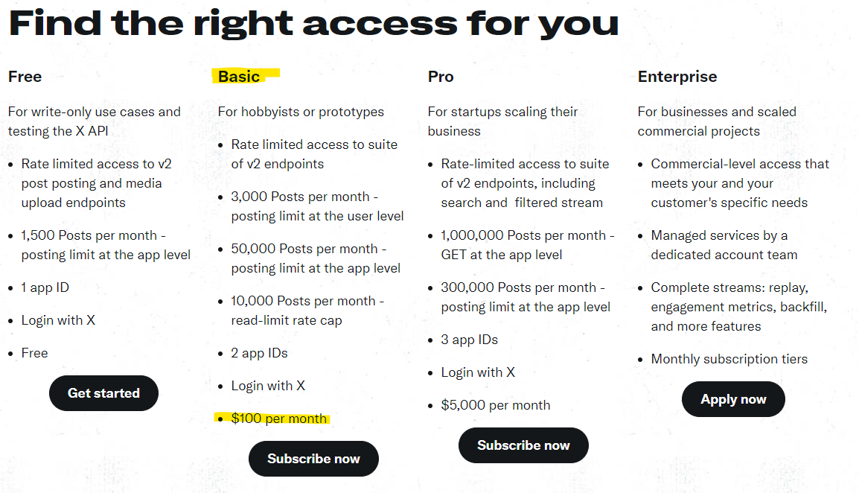
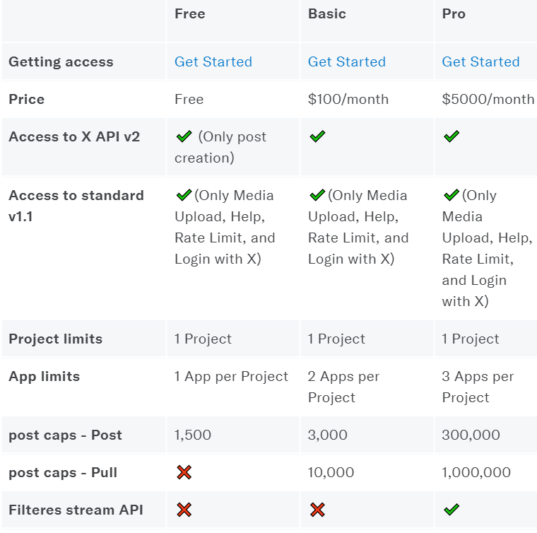
PROJECT BUDGET

Slide 8
CODE/TRAIN MODEL
Training Parameters:
In our pursuit of distinguishing between human users and bots on Twitter, we meticulously selected several parameters extracted from the Twitter API. These parameters, while informative, required manual curation to ensure relevance and reliability in training our models. We incorporated the following key parameters:
Average Tweet Time: We hypothesised that human users exhibit a characteristic reaction time in responding to tweets, whereas automated bots may respond more swiftly. Therefore, we included average tweet time as a distinguishing feature, with lower tweet times potentially indicating bot activity.
Contains Keyword: By identifying specific financial-related keywords within tweets, we aimed to detect content associated with financial advertising, a common characteristic of bot-generated content.
Percentage Difference: Bots often exhibit a skewed follower-following ratio, typically boasting a higher follower count than following count. This disparity, captured through percentage difference calculations, served as an additional discriminatory feature.

Slide 9
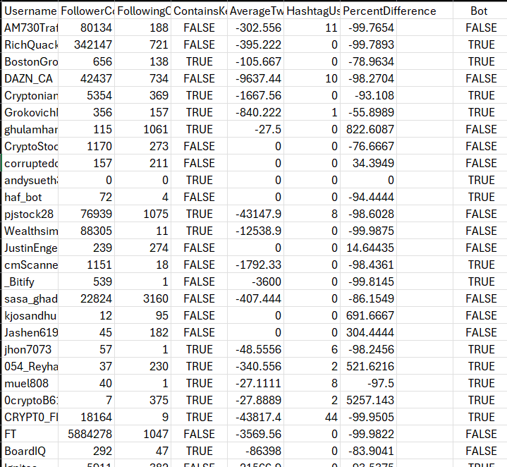
DATASET
The dataset comprises several fields of data input for each Twitter account, including Username, FollowerCount, FollowingCount, ContainsKeywords, AverageTweetTime, HashtagUsage, PercentDifference, and a Boolean classification label for Bot identification.
Username: Unique identifier for each Twitter account.
FollowerCount: Number of followers for each account.
FollowingCount: Number of accounts being followed by each user.
ContainsKeywords: Boolean value indicating whether the account's tweets contain specific keywords associated with bot activity. In this case keywords such as ‘stocks’ and ‘crypto’.
AverageTweetTime: Average time gap between tweets for each account.
HashtagUsage: Frequency and relevance of hashtags used in tweets.
PercentDifference: Percentage difference between followers and following counts.
Bot: Boolean classification indicating whether the account is classified as a bot.(This require manual input before input into our models)

Slide 10
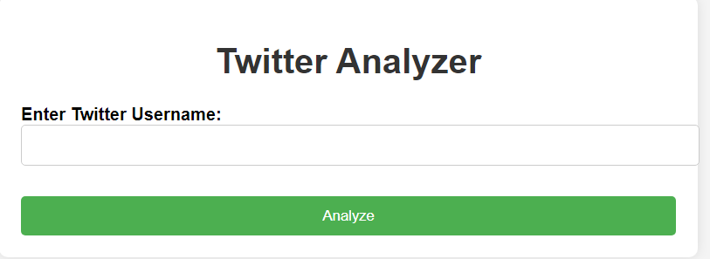
REACT PAGE/UI
For the UI of our project we used html to create a webpage that allows the user to enter a twitter user's username and click a button to fire off the data collection and machine learning code and display the results of what was retrieved and whether the account is likely a bot or not. We used react to host it and fire our code and display the results.

Slide 11
DATA COLLECTION
As part of this project, we developed a Python script to analyse data from Twitter. The aim was to gain insights into user behaviour and interests based on their tweets. By leveraging the Twitter API, we implemented various functionalities to retrieve, process, and analyse tweet data.
Retrieving Tweets: The get_user_tweets(username) function allows us to fetch recent tweets from a specified user. This function utilises the Twitter API endpoint to access tweet data efficiently.
Keyword Analysis: With the contains_keywords(username) function, we can determine if a user's tweets contain keywords related to finance. This analysis provides valuable insights into the user's interests and topics of discussion.
Tweet Timing Analysis: The get_average_tweet_time(username) function calculates the average time between consecutive tweets of a user. This metric offers an understanding of the user's tweeting frequency and engagement patterns.
User Metrics Retrieval: Using the get_user_data(username) function, we retrieve public metrics data of a user, such as follower and following counts. These metrics help in understanding the user's social influence and network size.
API Usage:
The project heavily relies on the Twitter API for accessing tweet data and user metrics. The use of API keys (BEARER_TOKEN) ensures secure authentication and access to Twitter's resources, enabling seamless data retrieval and analysis.
Finance Keyword Detection: By analysing the presence of finance-related keywords in a user's tweets, we gain insights into their financial interests and discussions.
To ensure robustness and reliability, the code incorporates error handling mechanisms. This includes checking for successful API responses and handling exceptions gracefully, thereby enhancing the overall stability of the application.

Slide 12

DEMO

Slide 13
CHALLENGES
Our biggest challenge was figuring out what data we could retrieve from the X API. It was hard to find reliable research on what we can collect because twitter turned into X and lots of features were removed and not correctly documented on. There were certain data points we wanted to include such as whether the user was verified, however the api only returns the old verified checkmark data which is no longer used, and the new ones are not included in it yet. So the change of companies caused issues in what was available and what documentation was available.

Slide 14
CONCLUSION
Overall, this project showcased a variety of factors like machine learning, model training, twitter api and the importance of api in application data analyses. Also with the familiarity of React and how to build user interfaces. With the main topic that was focused on bots on social media, primarily related to financial and crypto and how rampant they can be on twitter/X. We got to see first hand how bots can be influenced to change and control the algorithm to boost certain topics by fake engagement. More companies, like meta and tiktok are cracking down on bots and the quicker twitter/X deals with the issue the better it will be for the consumer experience.

