Slide 1
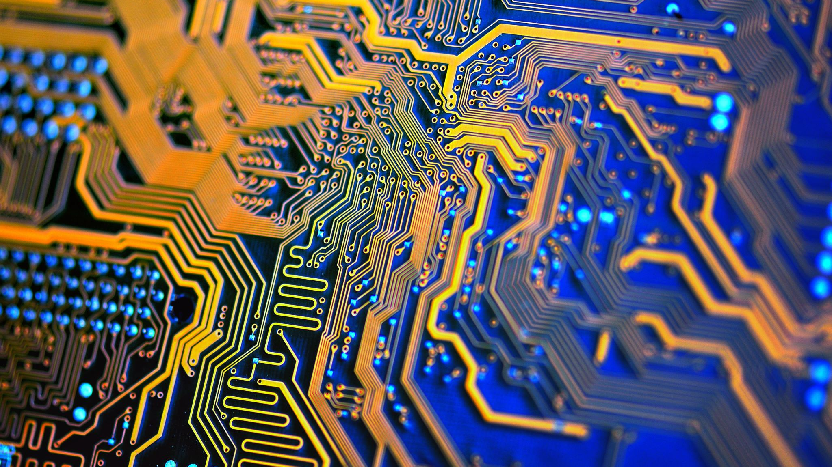
Hardware
Year 9 Computing Technology

Slide 2

Learning Intention
Investigate how hardware and software are used to manage, control and secure the movement of, and access to, data in networked digital systems

Slide 3
Success Criteria
I can differentiate between input and output devices.
I can describe hardware components and storage devices used for computing.

Slide 4

What Is Hardware?
Hardware: physical components of a computer system
Computers are information processors – data is input, processed, stored, or displayed
Hardware components work together to complete tasks
Main functions: input, output, storage, processing, control

Slide 5
Input Devices
Collect data from the outside world and convert it for the computer
Common devices: keyboard, mouse, touchpad, microphones, scanners, cameras, graphics tablets
Sensors can collect data like temperature, light, sound, and movement
Input data is stored in memory until processed by the CPU

Slide 6
Output Devices
Communicate information from computer to user
Common devices: monitor, printer, speakers
Specialised output: 3D printers, laser cutters, head-up displays
Monitors convert digital signals to visual patterns
Speakers convert digital signals to sound waves

Slide 7
Storage
Primary storage: short-term, volatile (RAM, cache)
Secondary storage: long-term, non-volatile
Magnetic: hard drives
Optical: CDs, DVDs
Solid-state/flash: USB drives, SSDs
Storage can be local or remote (cloud storage) for accessibility and security

Slide 8
Processing and Control
CPU: often called the “brain” the primary chip on the motherboard responsible for interpreting and executing instructions from software and hardware
Computer chips are made of microprocessors (millions of transistors)
RAM: volatile, temporary storage
ROM: permanent storage, contains essential startup information
GPU: handles graphics tasks, video rendering, AI, and parallel processing tasks
Chips work together to process, store, and control data

Slide 9
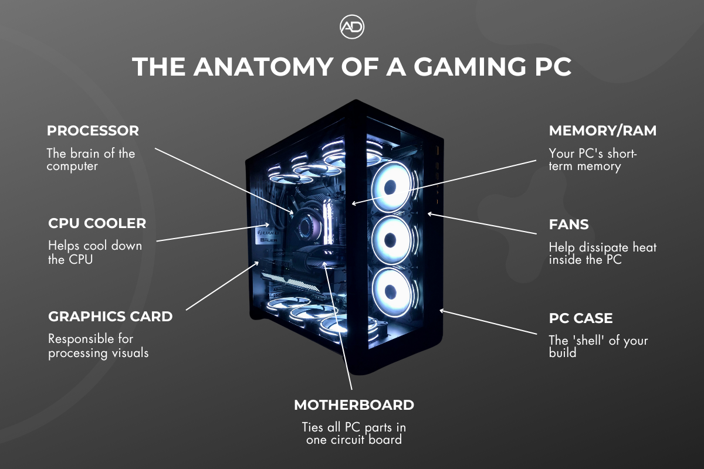
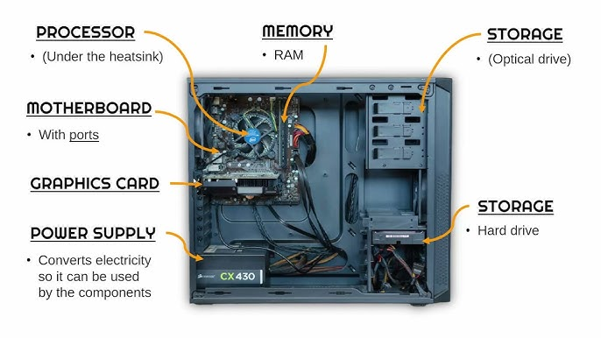
Inside a PC

Slide 10
Classification of Computer Hardware
Smartphones: portable, many sensors, mostly server-processed
Personal computers: self-contained, handle input, processing, output, storage
Desktops, laptops, workstations
Servers: networked, manage software, files, and access for multiple users
Mainframes: large-scale, handle massive transactions (banks, government)
Supercomputers: fastest, perform trillions of calculations (weather, science)
Quantum computers: use qubits, perform complex calculations at unprecedented speeds

Slide 11
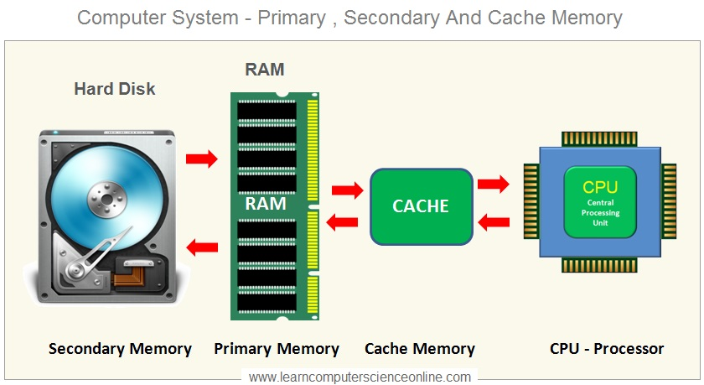
RAM and Secondary Storage

