Slide 1
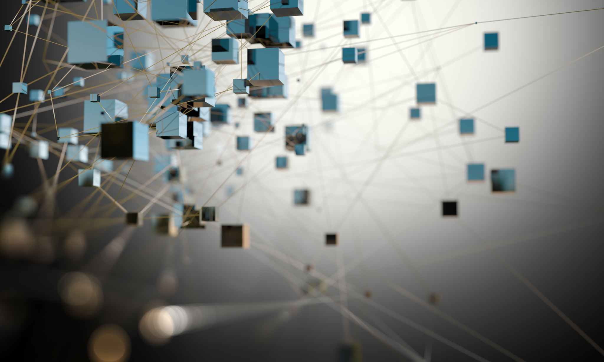
Information Systems
Year 9 Computing Technology

Slide 2


Learning Intention
Describe the purpose of connecting people and systems
Differentiate between data and information

Slide 3



Success Criteria
I can describe the purpose of an information system and a digital system.
I can explain the difference between data and information.
I can outline the components and categories of an information system.

Slide 4




What are Information Systems?
A system is a group of connected components working together to achieve a goal
Examples of systems include biological systems (respiratory system) and natural systems (solar system)
A digital system combines hardware and software to perform tasks
When a digital system also includes data, people and processes, it becomes an information system

Slide 5
Digital Systems
Consist of hardware, software and often networks
Can operate across large distances using the internet
Enable activities such as video calls, online banking and smart home control
Form the technical foundation of information systems

Slide 6




Purpose of an Information System
To collect, process and transform data into useful information
Used to solve problems or meet identified needs
Supports decision-making, automation and efficiency
Commonly used in organisations and enterprises

Slide 7
Components of an Information System
Processes
Hardware
All components must work together for the system to be effective
People
Software
Data
Networks

Slide 8




Hardware
DEFINITION: Physical components of an information system
Includes computers, servers and mobile devices
Uses input and output devices such as keyboards, cameras, printers and scanners
Requires networking hardware like routers, cables and access points

Slide 9


Software
Instructions that tell hardware how to process data
Written in programming languages and converted to machine code
Includes application software (e.g. browsers, apps, databases) and system software (operating systems and utilities)
Enables data processing, storage and user interaction

Slide 10



Networks
Connect two or more computers to share data
Can use wired connections (ethernet, fibre) or wireless connections (Wi-Fi, Bluetooth)
The internet is the largest global network
Enables real-time communication and remote access to systems

Slide 11



Data and information
Data: raw facts collected, stored and processed by a system
Information: processed data that has meaning for users
Data is collected, stored, processed and displayed
Processing turns data into useful outputs for decision-making

Slide 12
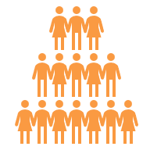



People and Processes
People include users, operators and system maintainers
Human roles are still critical despite advances in AI
Processes are the rules and steps that guide system operation
Processes ensure consistency, accuracy and reliability

Slide 13



Structured Data
Quantitative data stored in predefined formats or models
Organised into records and fields within databases
Easier to store, search and analyse
Examples include names, dates, IDs and timestamps

Slide 14
Unstructured Data
Does not fit predefined formats or models
Often complex and harder to analyse
Examples include photos, videos and audio
Requires technologies such as OCR and machine learning

Slide 15




The Three Vs of Data
Variety: different types of data (structured and unstructured)
Volume: the amount of data collected
Velocity: the speed at which data is generated
Used to determine appropriate data processing methods

Slide 16



Evolution of Data Analysis
Advances in AI allow analysis of unstructured data
Machine learning finds patterns without predefined models
Enables connections between previously separate data sources
Supports deeper insights and automated decision-making

Slide 17



Categories of Information Systems
Management Information Systems (MIS)
Help organisations manage data and make decisions
Transaction Processing Systems (TPS)
Process everyday transactions like purchases and payments
Decision Support Systems (DSS)
Help people make complex decisions using data
Expert Systems
Act like a human expert by using rules and knowledge

Slide 18
Categories of Information Systems
Geographic Information Systems (GIS)
Use maps and location data to show patterns and trends
Enterprise Information Systems
Large systems that combine many functions across an organisation
Learning Management Systems (LMS)
Deliver and manage learning and track student progress
Multimedia Systems
Use text, images, audio and video to create interactive experiences

Slide 19



Databases and Data Warehouses
Databases store organised data
Data warehouses combine multiple databases
Enable data mining and advanced analysis
Can raise ethical concerns when combining personal data

Slide 20

Spreadsheet Software
Used for quantitative data analysis
Can support budgeting, tracking and modelling
Allows custom solutions for small-scale systems
Examples include Microsoft Excel and Google Sheets

Slide 21


Artificial Neural Networks
Programs that learn from experience
Improve performance through machine learning
Used for automated insights and decision support
Common in chatbots, recommendation systems and analytics

