Slide 1

Issues and Cybersecurity
Year 9 Computing Technology

Slide 2
Learning Intention
Investigate issues with the use of data, including cyber safety, security, privacy and ethics
Investigate data collection and interpretation adhering to privacy and cybersecurity principles, including specify what data is collected, who owns it, and how it will be protected

Slide 3
Success Criteria
I can analyse issues with data use including cyber safety, security, privacy and ethics
I can explain how data is collected, who owns it, and how it will be protected

Slide 4
Information Systems – Considerations and Cybersecurity
Information systems operate within a real-world context
Successful systems consider:
People
Processes
Technology
Environment
Cybersecurity is essential for systems that operate online

Slide 5
Information System Context Diagrams
A context diagram shows:
System components
People and processes
Data and information
External environment
Helps identify:
What impacts the system
What the system impacts
Used when designing or documenting systems

Slide 6
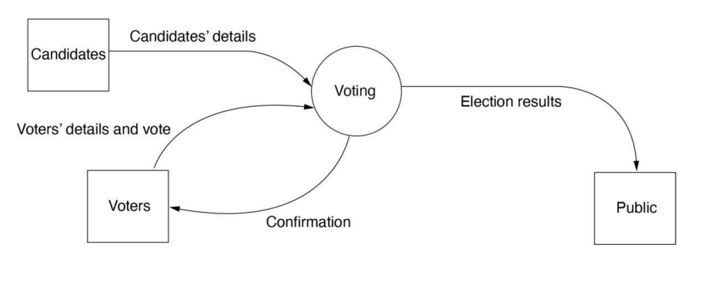
Data Flow Diagram / Context Diagram (Level 0)
Process
External Entity
Data Flow

Slide 7
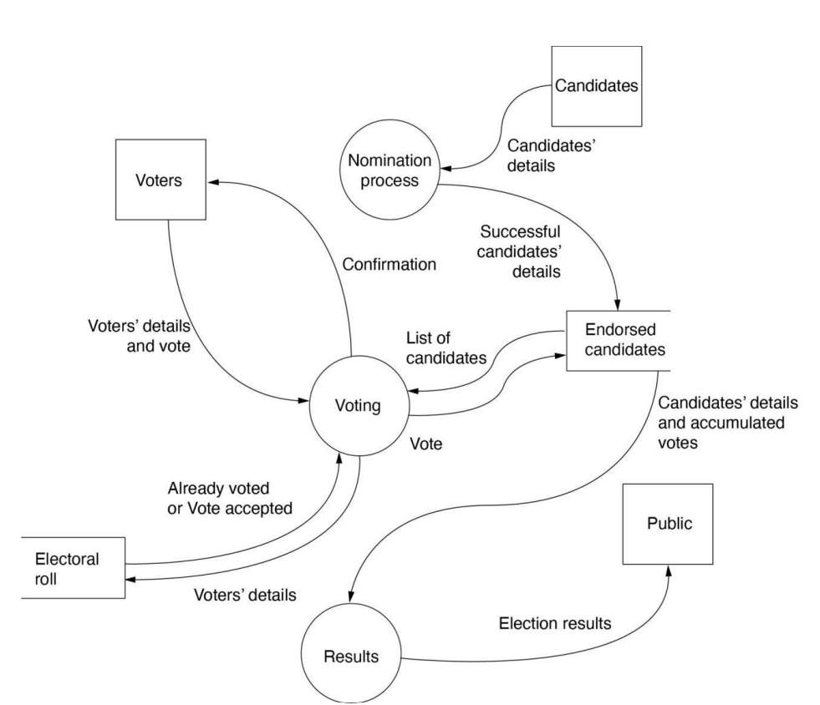
Data Flow Diagram
(Level 1)
Data Store
Process
External Entity
Data Flow

Slide 8
Sociological Considerations
Systems can have positive and negative social impacts
Designers must consider:
Privacy
Equity
Accessibility
User trust
Example:
Opal card improves convenience
Anonymous cards reduce privacy concerns

Slide 9
Inclusive and Ethical Design
Systems must consider diverse user groups:
Aboriginal and Torres Strait Islander Peoples
Culturally and linguistically diverse communities
People with disabilities
Important considerations:
Avoiding data bias
Accessible design (e.g. W3C standards)
Respecting Indigenous Cultural and Intellectual Property (ICIP)

Slide 10
Technical Considerations
Systems must integrate with:
Existing hardware
Software
Networks
Data must be in compatible formats
Systems often interact with external services
Example: Online stores communicating securely with PayPal

Slide 11

Legal Considerations
Copyright: The protection provided to the creators of original works and makers of sound recordings and films, that offers a legal framework for the control and reproduction or transmission of their literary, dramatic, artistic or musical works.
Systems must comply with laws such as:
1
Privacy
Copyright
Personal data must be protected using:
2
Secure passwords
Encryption
Designers must consider whether systems could:
3
Enable illegal actions
Be misused by users

Slide 12
Legal Considerations
Information privacy involves the establishment of rules governing the collection and handling of personal data such as credit information, and medical and government records. It is also known as ‘data protection
Systems must comply with laws such as:
1
Privacy
Copyright
Personal data must be protected using:
2
Secure passwords
Encryption
Designers must consider whether systems could:
3
Enable illegal actions
Be misused by users

Slide 13
Cybersecurity Principles
Cybersecurity: the protection of information technology elements, including hardware and software, data or network services.
Confidentiality: protect sensitive data
Integrity: ensure data is accurate and not altered
Availability: systems accessible when needed
These principles form the foundation of cybersecurity

Slide 14
Authentication, Authorisation and Accountability
Authentication: verifies who the user is
Authorisation: controls what users can access
Accountability: records user actions
Implemented using:
Passwords and biometrics
Permissions and roles
Logs and monitoring
Authentication is the process of verifying who a user is, while authorisation is the process of verifying what they have access to.

Slide 15
Case Study – Shared E-Scooter System
Use mobile apps, GPS, QR codes and payment systems
Benefits:
Low-cost transport
Environmental advantages
Challenges:
User behaviour
Legal restrictions
Context of use
Example solutions:
Photo verification of parking
Speed limiters
Account suspension for misuse

