Slide 1
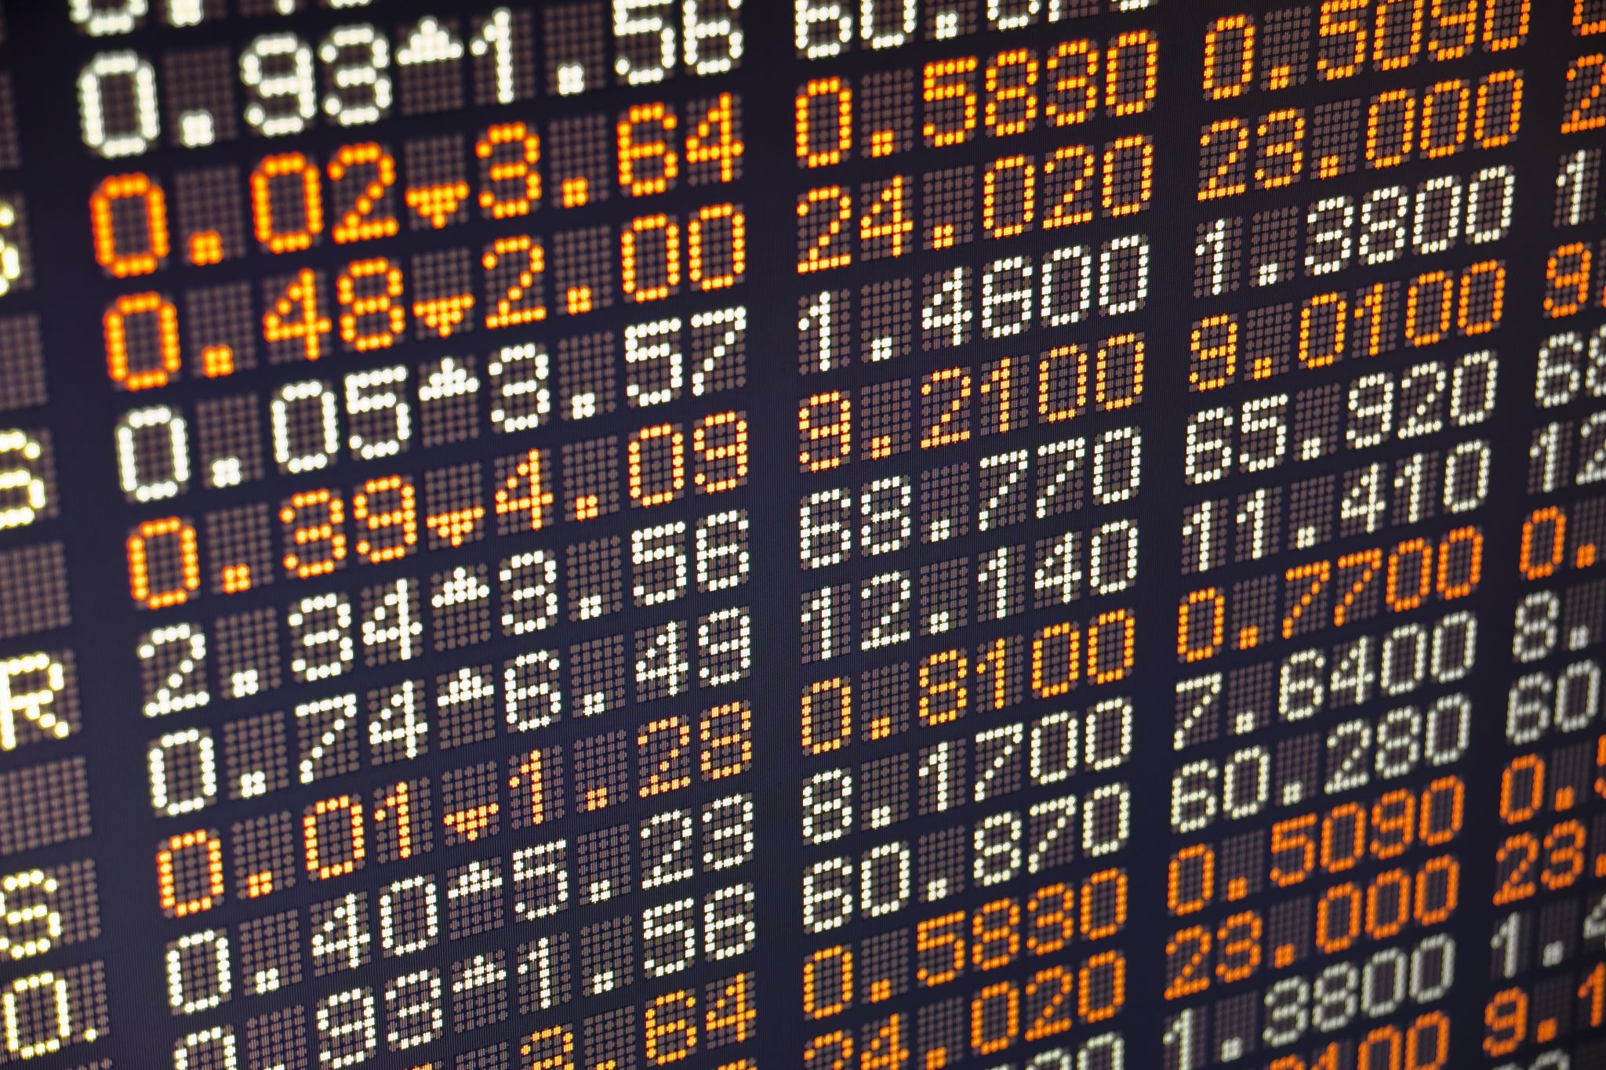
Data and Information
Year 9 Computing Technology

Slide 2
Learning Intention
Differentiate between data and information
Describe the purpose of analysing data
Describe inputs, storage, transmission, processes and outputs in data analysis
Represent and store data to facilitate computation, including selecting appropriate data types, understanding data type limitations and structuring data systematically

Slide 3
Success Criteria
I can explain the difference between data and information, using examples.
I can describe the purpose of analysing data.
I can memorise and describe inputs, storage, transmission, processes and outputs in data analysis
I can describe a variety of different data types commonly used in information systems.

Slide 4
Data and Information
Data and information are everywhere in daily life
Humans collect, process, store and use information constantly
Our brains have limits, so we rely on digital technology
Computers help collect, process, store and transfer data quickly
Unlike humans, computers must be told exactly what to do

Slide 5

Data vs Information
Data: Data is raw, unorganized, and meaningless facts, symbols, or figures
Information: Information is processed, structured, and contextualized data that has meaning and is useful for decision-making
Examples:
A list of numbers = data
Being told they are phone numbers = information
Data becomes information when people interpret it

Slide 6
Data in Computer Systems
Computers require data in digital form
Information becomes data when entered into a computer
Data becomes information again when displayed and understood
Computers only see patterns of binary data (0s and 1s)
Meaning is added by the user, not the computer

Slide 7
Digital Data and Binary
All digital data is made of bits (0 or 1)
Binary allows computers to process data quickly and accurately
Large amounts of data can be stored and processed rapidly
A group of 8 bits is called a byte
One byte can represent 256 different values

Slide 8
Analog vs Digital Data
Analog data: changes smoothly (sound volume, speed, light)
Digital data: fixed, counted values
Computers work only with digital data
Analog data must be digitised before processing
Example: microphone sound converted by a sound card

Slide 9
Data Coding
Computers use binary coding to represent data
The same binary value can mean different things
Meaning depends on how the data is used
Binary data can represent:
Text
Colours
Sounds
Instructions
Context determines interpretation

Slide 10

Data Types and File Formats
A file format defines how data is organised
Same bits can represent different data types
File formats tell software how to interpret the data
Common data types include:
  Text
  Graphics
  Audio
  Animation
  Video

Slide 11
Text and Hypertext
Text: characters, symbols and spaces
Stored and processed digitally
Hypertext: text that links to other documents or locations
Used widely on the internet (web pages, documents)

Slide 12
Graphics
Graphics are images used to communicate information
Bitmap: made of pixels
Vector: made using mathematical shapes
Colour depth affects image quality and file size
More colours = larger file size

Slide 13
Audio
Audio is digitised sound
Represents sound waves using binary values
Used for speech, music and sound effects
Audio files can be large
Compression reduces file size

Slide 14
Animation
Animation is a sequence of images shown quickly
Creates the illusion of movement
Often computer-generated
Techniques include morphing and warping
Used in games, films and simulations

Slide 15
Video
Video is a series of images of the real world
Often includes audio
File sizes can be very large
Streaming allows playback while downloading
Common in media, education and communication

Slide 16
Quantitative and Qualitative Data
Quantitative data is data that can be counted or measured in numerical values
Qualitative data is descriptive data that is not expressed numerically.
Both types are valuable depending on purpose
AI can help analyse qualitative data

Slide 17
Data Analysis
Summarise all
Input:
Raw data is entered into a computer system using input devices such as keyboards, sensors, scanners or microphones.
Process:
The computer manipulates the data using software instructions to sort, calculate, analyse or transform it.
Storage:
Data and information are saved in storage devices or databases so they can be accessed and used later.
Transmission:
Data is transferred between systems or devices using networks such as the internet or local networks.
Output:
Processed data is presented as information that people can understand, such as text, images, sound or video.

Slide 18
Common Uses of Data
Data is used to:
Share information
Control systems (traffic lights, machines)
Analyse trends
Make predictions
AI systems rely on large datasets
More data generally leads to more accurate results

