Slide 1
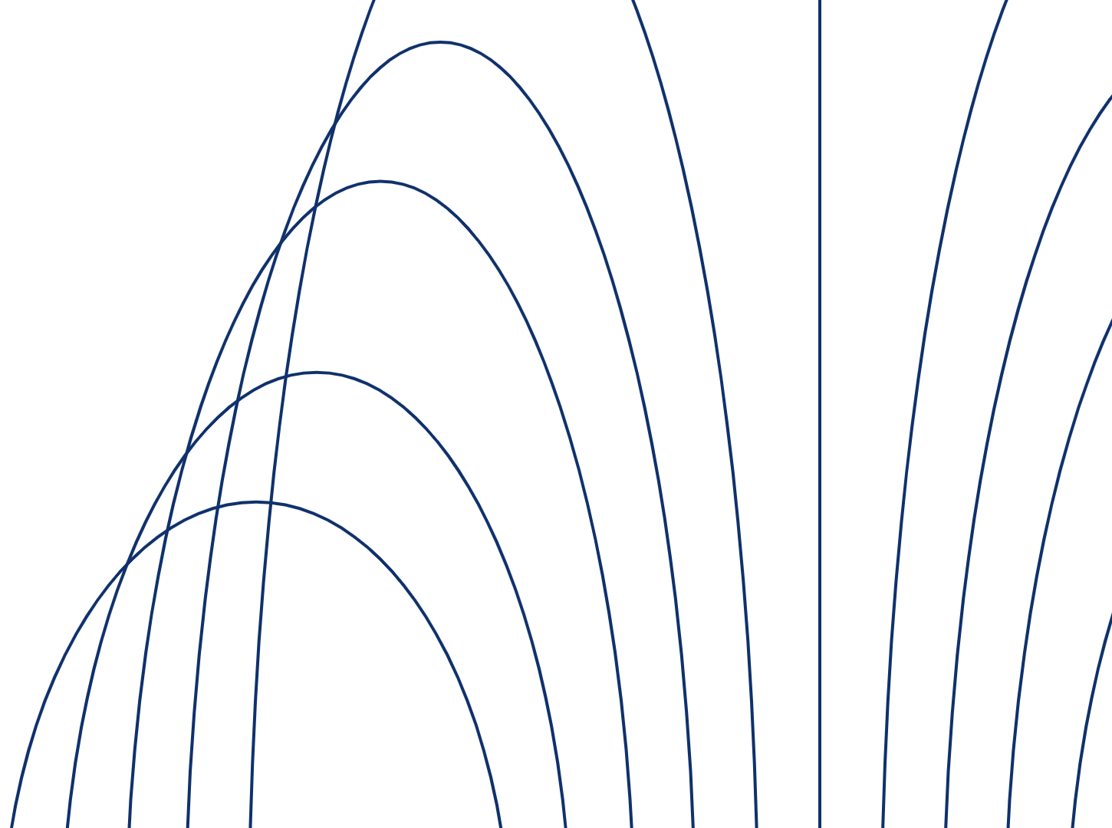





Student: Mikhail Voronin Supervisor: Artem Burmyakov Consultant: Alexander Tormasov June 2026
Research and Adaptation of Components from the Persistent OS Phantom for Genode

Slide 2

Relevance & Objective
Why it matters
Concept developed in the 1970s
The hardware and network balances have changed
Persistent data storage must be protected
Snapshot security in Phantom was not considered
Why now?
It is necessary to examine the relevance of persistence concepts in the current environment
Goals
Analyze computer usage scenarios
Develop security assurance component
Experimentally check protection correctness
Current projects
Different projects are implementing the concept
PhantomOS is our choice. The issue we solve is that snapshots are stored in plaintext
2/13

Slide 3
Persistence
Persistence is the period of time during which an object is usable¹
Two-level store (today’s dominant model, non-persistent)
Data is either active (RAM) or stored (disk)
Programmer manually moves data between levels
Drawbacks
Data loss
I/O boilerplate (≈30% of code)
Frequent initialization and configuration
Alternative: the environment manages persistence
Orthogonal Persistence Principles²
Independence
Data type orthogonality
Identification
Result
No two-level store drawbacks, and improved disk bandwidth utilization
¹ M. P. Atkinson, P. J. Bailey, K. J. Chisholm, W. P. Cockshott, R. Morrison. “PS-algol: A language for persistent programming”, 1983
²R. Morrison, M. P. Atkinson. “Persistent Languages and Architectures”, 1990
.
3/13

Slide 4
PhantomOS & Genode
PhantomOS¹ is a non-Unix-like OS implementing orthogonal persistence²
PhantomOS features
Phantom Virtual Machine (PVM): bytecode VM of a persistent language
Simplified POSIX layer (non-persistent)
Periodical snapshots via Copy-on-Write (implementation of persistence)
Changed pages written to disk (incremental)
Programs temporarily suspended during snapshot preparation
PhantomOS ported to the Genode OS C++ framework³ This is our test platform
Why Genode
Proven microkernels: NOVA, seL4, Fiasco.OC
Capability-based security
Minimal trusted computing base (TCB)
Support modern hardware
¹ http://phantomos.org/
² D. Zavalishin. PhantomOS, 2010
³ https://genode.org/
4/13

Slide 5
Snapshot mechanism & Problem Statement
Snapper¹ is a file-system-based transactional snapshot mechanism²
Previous approach: “superblock”
Snapshots stored as monolithic objects
Fast, but no fault tolerance and no storage recovery
Snapper 2.0
Configurable number of generations
Unchanged pages linked, not copied
ext4 + fsck for crash recovery
Integrity checks (per-file hashes)
Configurable redundancy policy
Problem
Snapshots contain sensitive data which is stored on the disk in plaintext
Consequence
Physical access attacks (Reproduce the machine state)
Challenges
No prior research on this for PhantomOS
No ready-made solution exists in Genode
Solution
Implement a mechanism for the secure storage of snapshots.
¹ https://github.com/rumenmitov/snapper
² R. Mitov. “Snapper (v2): A PhantomOS snapshot mechanism”, FOSDEM 2026.
5/13

Slide 6
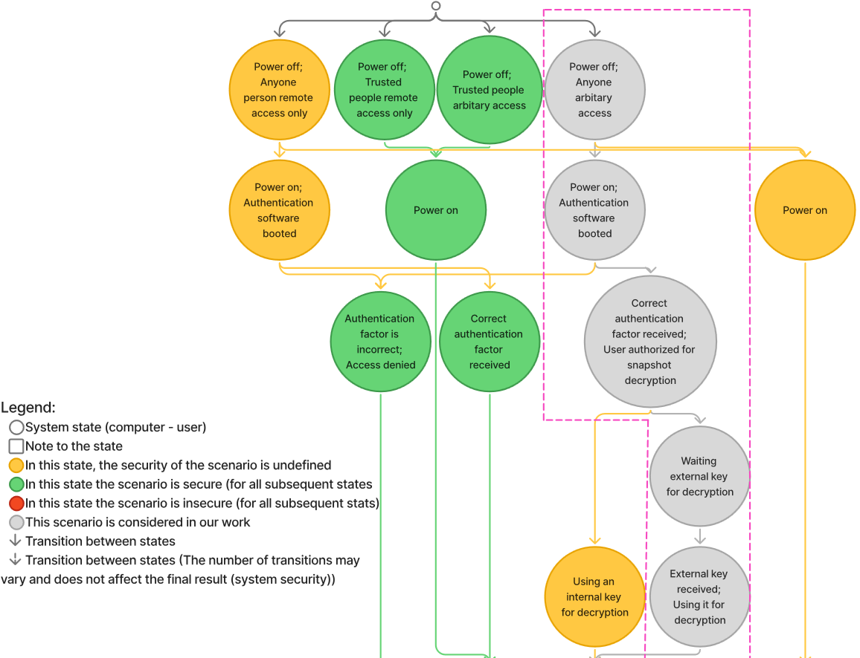
Environment description: Usage scenarios (1/2)
We consider this scenario
6/13

Slide 7
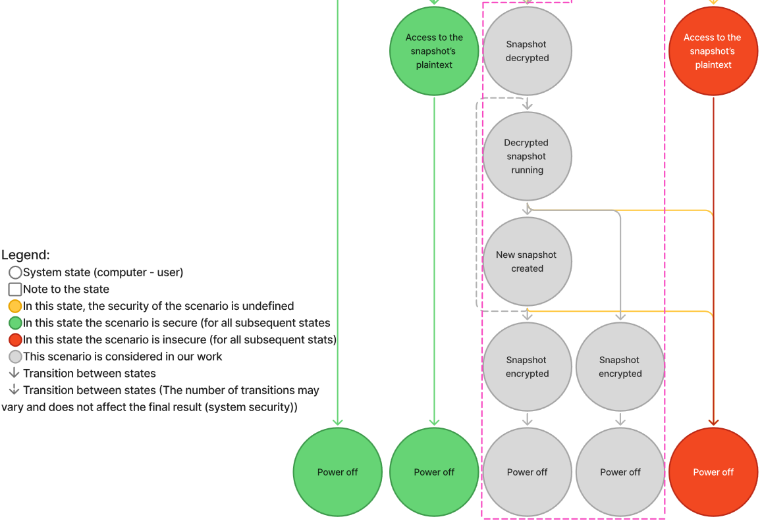
Environment description: Usage scenarios (2/2)
We consider this scenario
7/13

Slide 8
Environment & Requirements
No unauthorized access to data
Target requirements
1. Access control
2. Key stored on an external USB drive
3. Encryption of snapshots (block-level)
4. Only encrypted data written to disk
5. Acceptable performance overhead (≤ 2×)
USB drive = key + auth factor
Requirements 1 and 2 combined: the USB drive both contains the key and serves as the authentication factor.
8/13

Slide 9
Implementation
Built on file_vault² (based on Tresor):
Tresor: AES on 4K blocks, SHA-256 integrity, CoW atomicity
file_vault: state orchestrator providing a secure FS session
Implemented se_vault¹ as modified file_vault
Changes:
Headless operation
Passphrase replaced by USB key file
rump_fs/ext2 replaced by lwext4/ext4
Added fsck crash-recovery support
Direct block session (skip image file)
All block sizes standardized to 4K
Graceful shutdown sequence added
Related fixes & Adaptations:
lwext4³ (ftruncate and sync)
isomem⁴ (power-off button callback and graceful shutdown)
snapper⁵ (client counter and graceful shutdown)
vfs⁶ (client counter, graceful shutdown and clean unmount)
Optimization:
Using a “Block” session directly — initialization time reduced from ≈20 min to ≈1 min
¹https://github.com/genodelabs/genode/tree/sculpt-25.04/repos/gems/src/app/file_vault
²https://github.com/VoronM1522/genode/tree/se/repos/gems/src/app/se_vault
³ https://github.com/VoronM1522/genode-wundertuete
⁴https://github.com/VoronM1522/phantomuserland-snapper
⁵ https://github.com/VoronM1522/snapper
⁶https://github.com/VoronM1522/genode/tree/se/repos/os
9/13

Slide 10
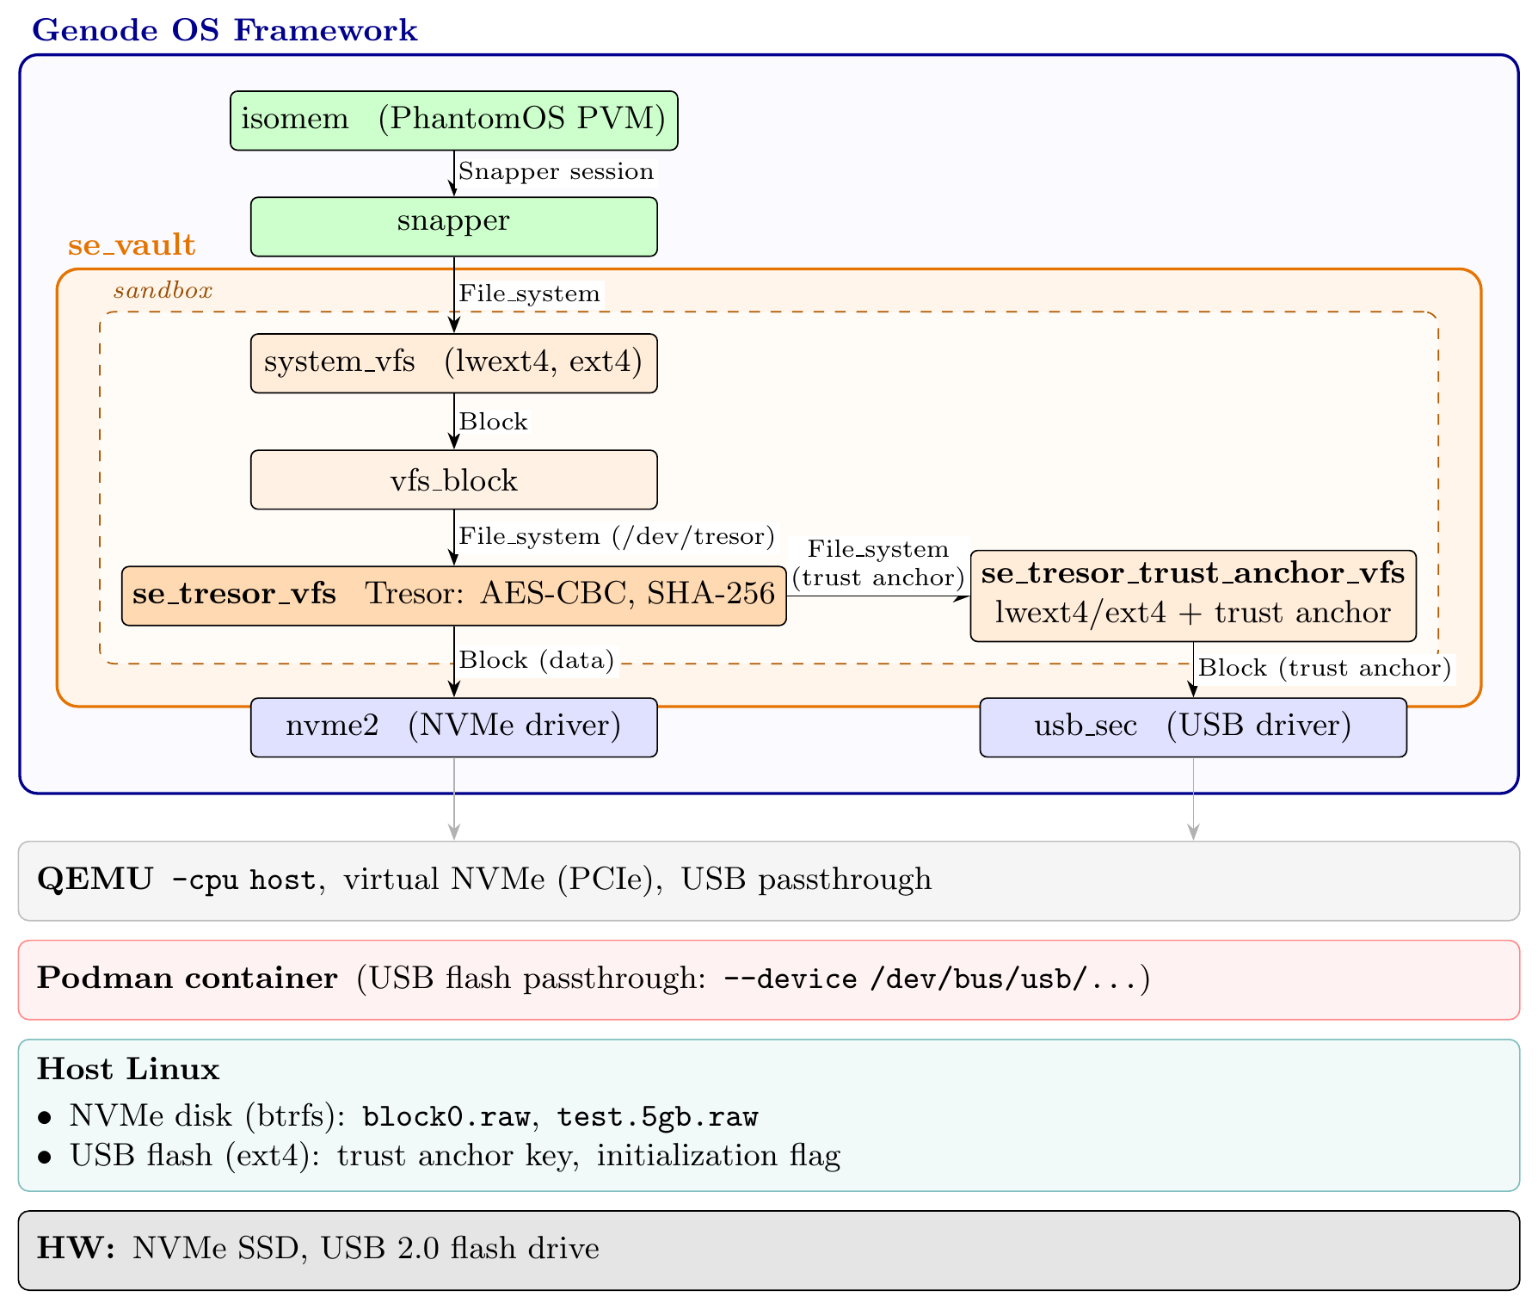
System Architecture
10/13

Slide 11
Implementation results
The system was running on a Linux host inside a Podman container. Virtualized using QEMU with options for AES/SHA hardware acceleration and virtual NVMe usage.
All functional checks were passed
Normal boot / shutdown / restore cycle
Encrypted image cannot be mounted without key
Key/hash replacement attack — superblock not detected
Crash recovery via fsck
Performance overhead measurement setup
First snapshot creation and reboot with restore, 5 runs each (no statistical confirmation)
Operation | Without enc. | With enc. | Overhead
Snapshot creation | 2.10 s | 51.00 s | ≈ 24×
Snapshot restore | 2.50 s | 27.30 s | ≈ 11×
A performance bug was found during the PoC implementation. Reasons require additional investigation. One of them is a known optimization issue in Tresor.
11/13

Slide 12
Evaluation & Conclusion
4 of 5 requirements met; Consistent with the considered scenario
✓ Mandatory authorization (USB key)
✓ Key on external medium
✓ AES block-level encryption
✓ Only encrypted data on disk
✗ Overhead ≤ 2× (Tresor limitation)
The prototype demonstrates feasibility and functional protection, but is not production-ready.
The current overheads may be acceptable in certain scenarios
Improvements
Security gain: snapshot encryption enabled
Integrity gain: SHA-256 at block level (Tresor) and hash at FS level (Snapper)
Future work
Decrease performance overhead (investigate the problem); encrypt the isomem block device
Merge Snapper and Tresor snapshot concepts
Consider other scenarios or additions to the current one, including alternative access options and hardware configurations
Results:
Computer usage scenarios have been described and classified
Scenarios requiring encryption and access analysis have been selected
The applicability of the scenarios was experimentally confirmed based on a mock-up implementation
Objectives of the work mostly achieved. The only issue is a bug in the PoC implementation
12/13

Slide 13
Questions

