Slide 1

Documentation as a project
Notes:
Who am I
What presentation is about

Slide 2
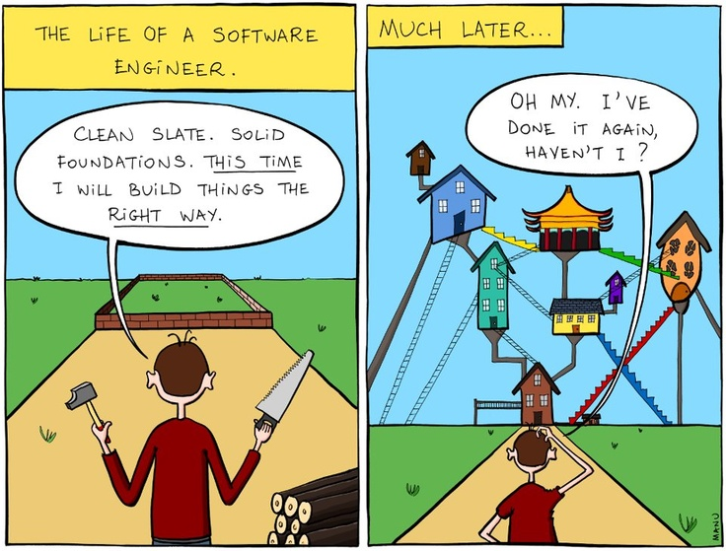
Why document decisions?
Notes:
Why document decisions on project?
When you deliver project, you usually switch to another one. New support team might experience difficulties.
You can help them a lot by documenting decisions

Slide 3

Team – ideal dream
Notes:
Ideally – perfect team collaborates and deals with issues together

Slide 4
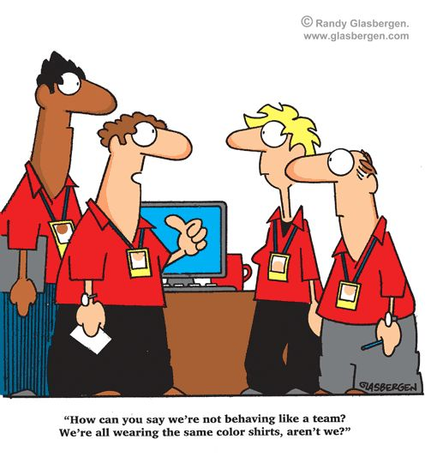
Team – nightmare
Notes:
In reality, if you are in matrix organization and team is constructed on a per project basis – you might be in trouble

Slide 5
Goals
Make easier s/w project transition to support
Get single entry point for updates and info
Get project documented from multiple angles
Get your stakeholders involved
Get your developers involved
Get your ops involved
Get your testers involved

Slide 6

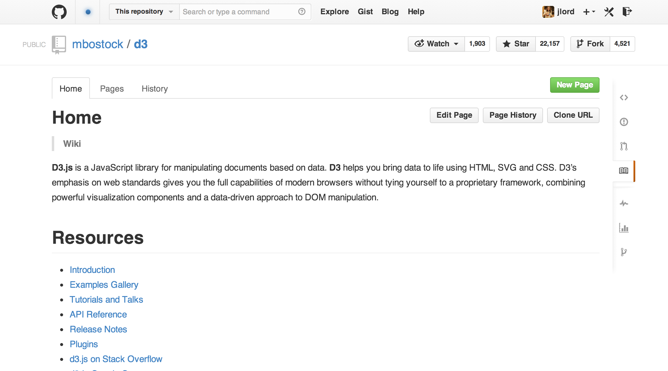
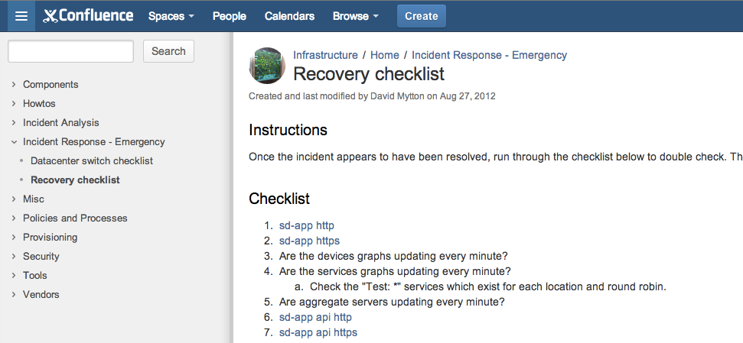
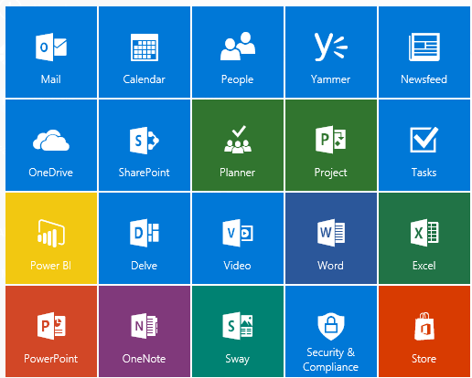
Isn’t it already solved ?

Slide 7

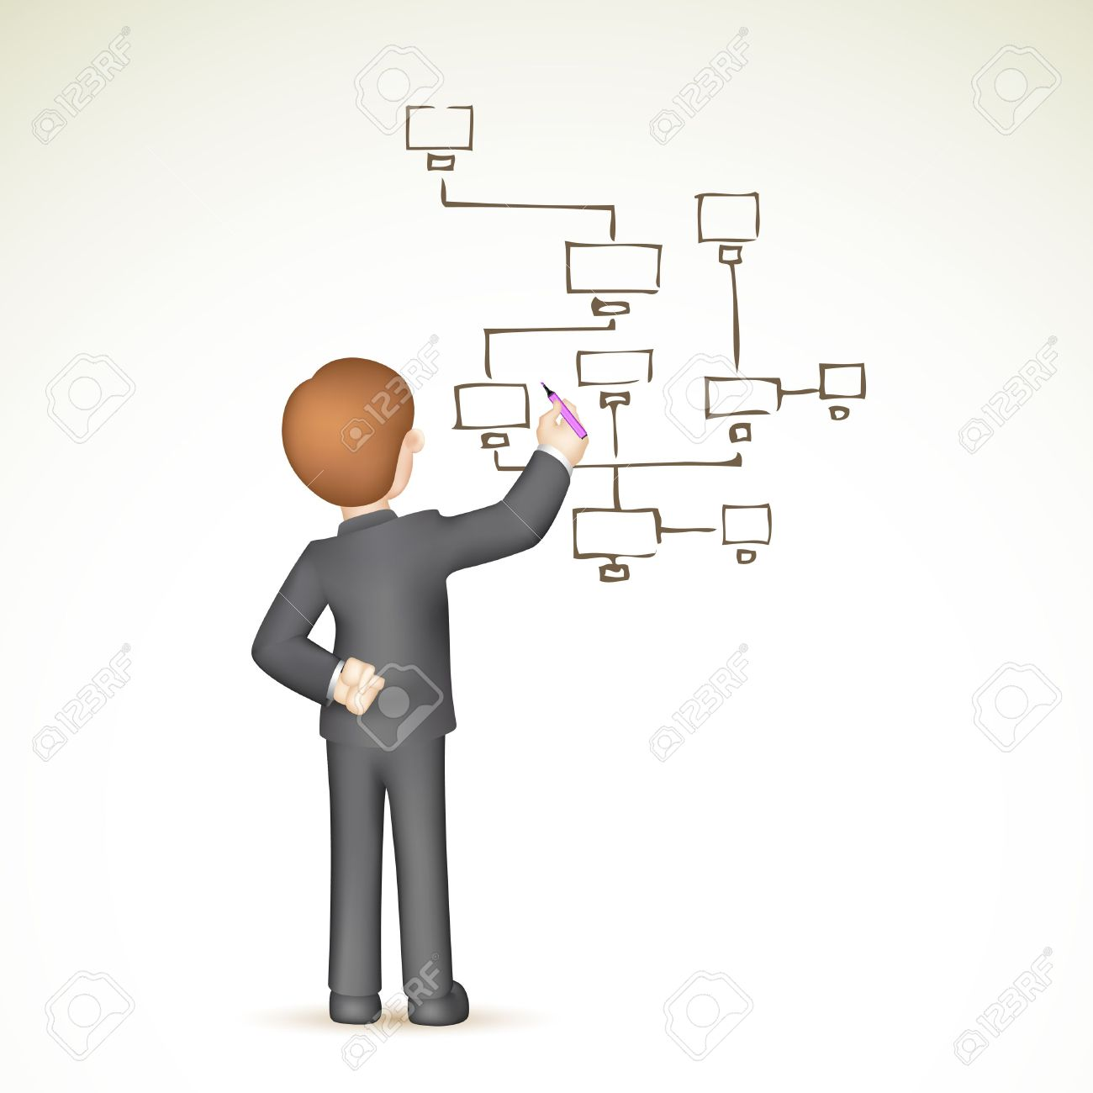

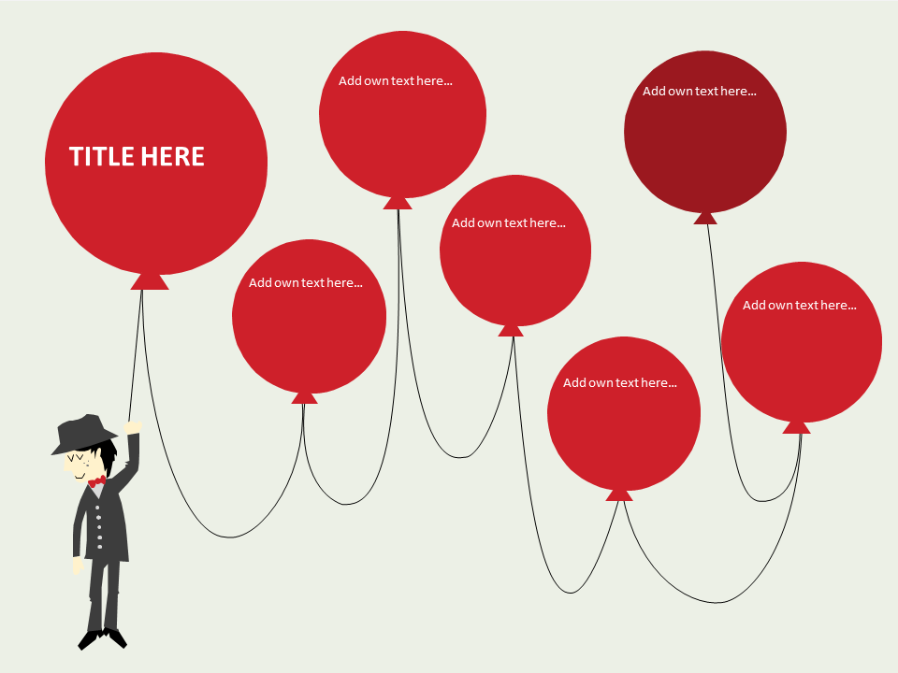
Docs benefit from diagrams

Slide 8
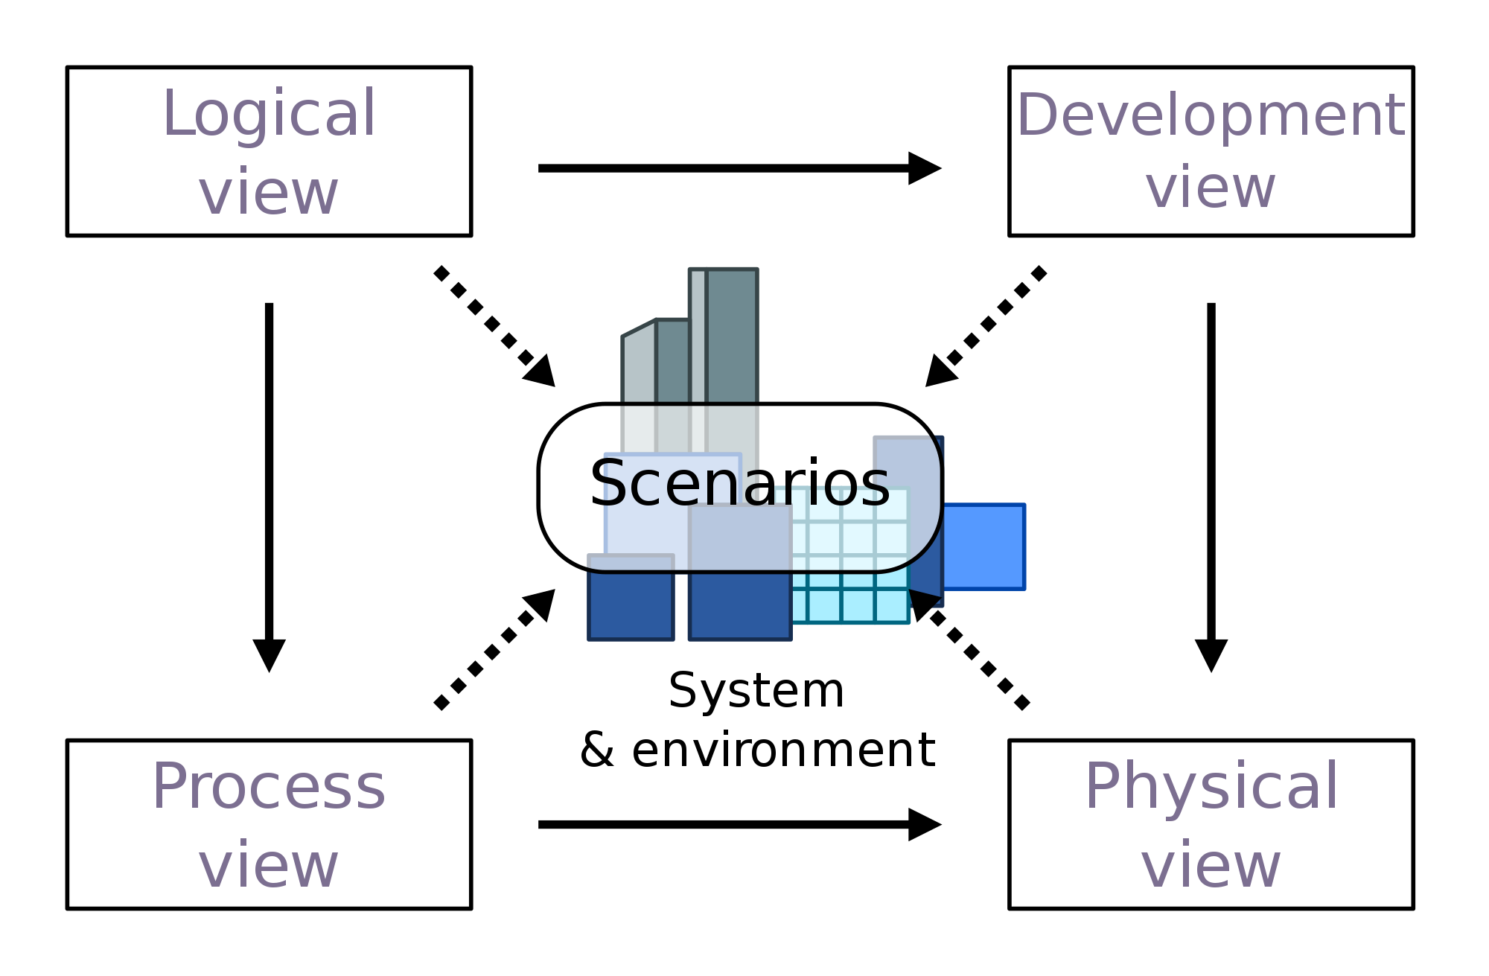
4+1 architectural view
Dev view: Component, Package
Logical view: Activity, State, Class
Physical view: deployment
Process: activity, BPMN
Scenarions: Use Case

Slide 9
Diagramming tools
Offline
MS Visio
Edraw
yEd
Openoffice Draw
...
Online
Gliffy
Lucida charts
Creately
Draw.io
...

Slide 10
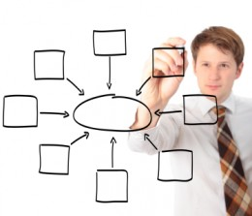
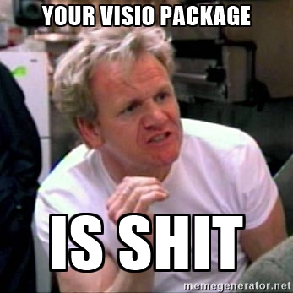
Common cases
Hey, how did I spend my working day?
You would draw much easier with pencil

Slide 11
Diagrams as text
Pros:
You spend minutes to draft diagram
You see history of changes in source control
You can combine diagram with code
Cons:
Pretty simple look (your sales person would hate them :)

Slide 12
Tool #1: Plant UML
Site: http://www.plantuml.com/
Dependencies: java, GraphViz package
Diagrams supported: UML set & a bit more

Slide 13
Demo: Plant UML (1/3)
Mike (the shopper) likes to shop online. His favorite webshop is PC’s shop, owned by the company (the merchant) PC’s shop.
Mike’s long search for the best NAS device is vindicated once he steps into PC shop and discovers their impressive selection of merchandise.
Mike exchanges cash for his chosen NAS with the saleswoman and walks out a happy man.

Slide 14
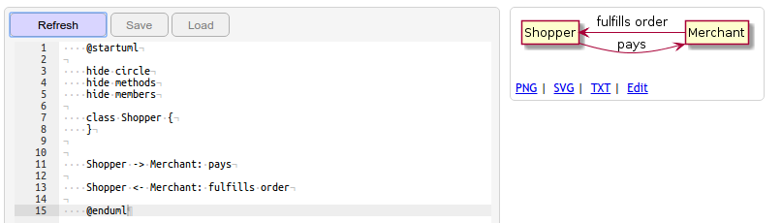
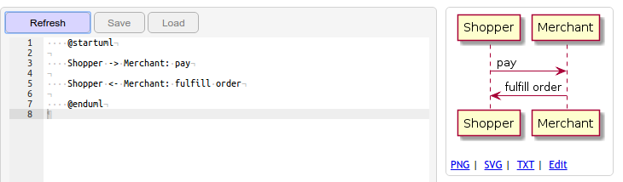
Plant UML 2/3

Slide 15
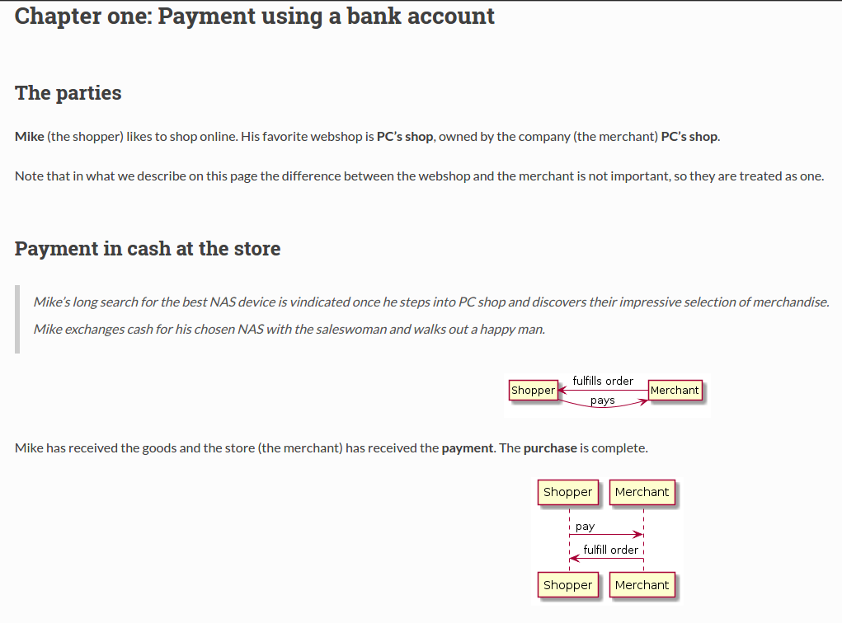
Plant UML 3/3

Slide 16
Perhaps let’s repeat quick :)
Mike is rapidly climbing the ranks of PC shop’ most loyal customers. He’s concerned that his devices may not keep well in his electricity, so he’s back at the store to buy a couple of protective UPS to protect them by. He picks out the items and heads for the checkout register.
The saleswoman informs Mike that the store has just rented a couple of pin terminals to make payment via bank transfer easier for shoppers. Mike agrees to be the first shopper to try paying via pin terminal. The saleswoman picks up the pin machine, types in the amount to be paid and hands the device over to Mike. Mike sticks his bank card into the reader, types his pin, presses “confirm” to approve the transfer, and the screen flashes “completed”. He hands the pin terminal back to the saleswoman.
Mike picks up the goods and heads home.

Slide 17
Diagram text
class Issuer {
}
class Issuer {
shopperAccount
}
class Acquirer {
merchantAccount
}
Shopper --> PinTerminal: authenticates
Shopper --> PinTerminal: authorizes
PinTerminal --> Issuer: instructs to make transfer
PinTerminal <-- Issuer: confirms transfer
PinTerminal --> Merchant: confirms transfer
Shopper .> Merchant: 'pays'
Shopper <- Merchant: fulfills order
Merchant --> Acquirer: checks account
Issuer -> Acquirer: makes transfer

Slide 18
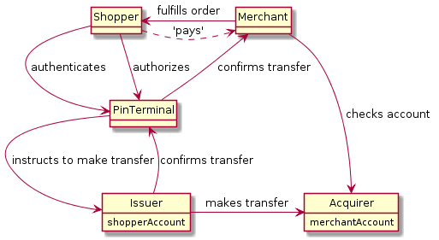
Diagram result

Slide 19
Try Yourself
Interactively: https://www.planttext.com/
On a docs project page: http://bit.ly/plantdiag
Integrations: http://plantuml.com/running

Slide 20
Tool #2: Blockdiag
Site: http://www.blockdiag.com/
Dependencies: python 2+
Diagrams supported: blocks, sequences, activity, network, rack, packet structure
Compared to PlantUML diagrams look better, but cons are that number of options is much lower.

Slide 21
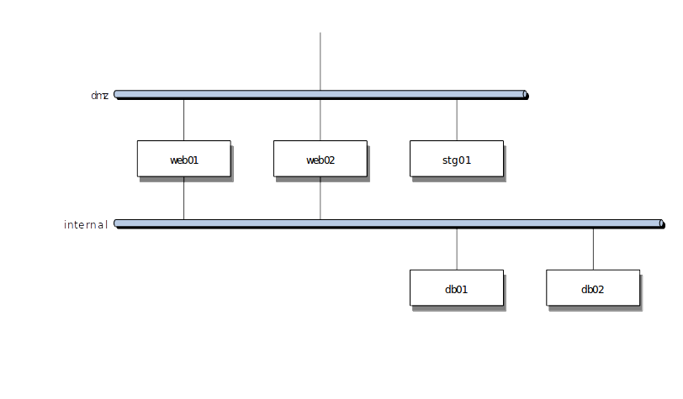
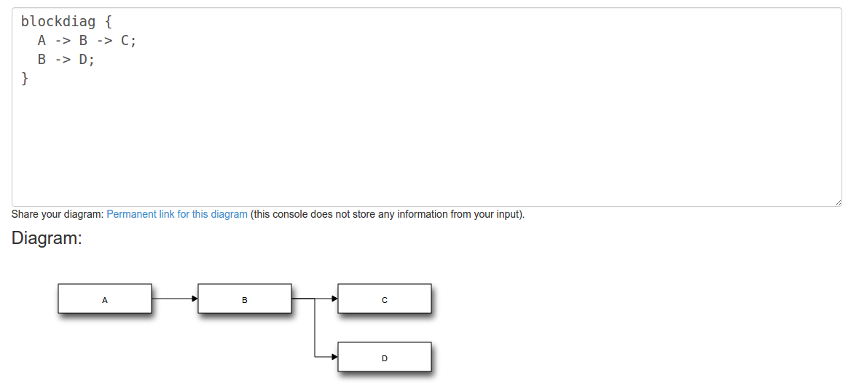
Blockdiag: includes generic diags

Slide 22
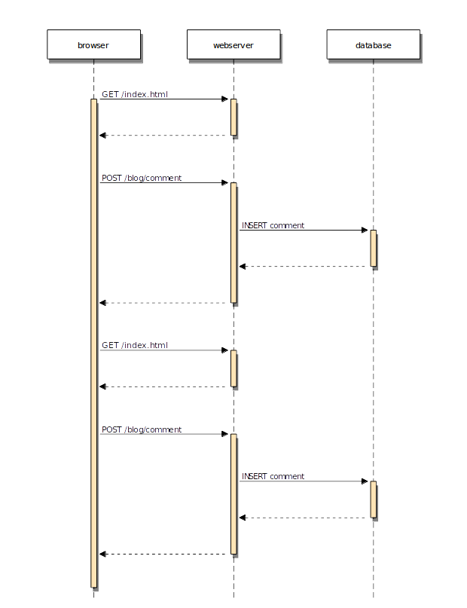
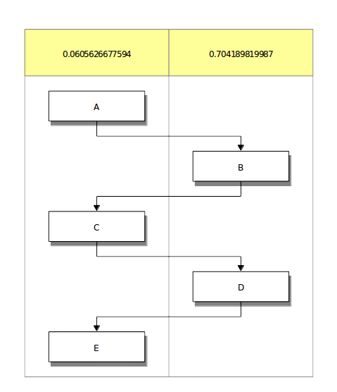
Blockdiag: includes generic diags

Slide 23
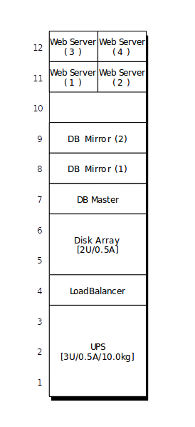
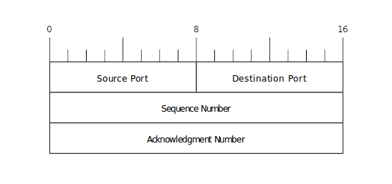
BlockDiag: includes quite rare types

Slide 24


Combining together

Slide 25
Tool #3: Sphinx
Site: http://www.sphinx-doc.org/
Dependencies: python 2+
Pros: universal, including your own custom code to build the pages
Cons: plugins matter

Slide 26
Tool #3: Sphinx
Output formats: HTML (including Windows HTML Help), LaTeX (for printable PDF versions), ePub, Texinfo, manual pages, plain text
Extensive cross-references: semantic markup and automatic links for functions, classes, citations, glossary terms and similar pieces of information
Hierarchical structure: easy definition of a document tree, with automatic links to siblings, parents and children
Automatic indices: general index as well as a language-specific module indices
Code handling: automatic highlighting using the Pygments highlighter
Extensions: automatic testing of code snippets, inclusion of docstrings from Python modules (API docs), and more
Contributed extensions: more than 50 extensions contributed by users in a second repository; most of them installable from PyPI

Slide 27
Why?
Cons
“ReadTheDocs” theme
You need carefully select ones
Development efforts at the start
Confusion on Markdown
Pros
Well known, themable
Wide range of plugins and extensions
Your own custom page generators
Advanced rst syntax

Slide 28
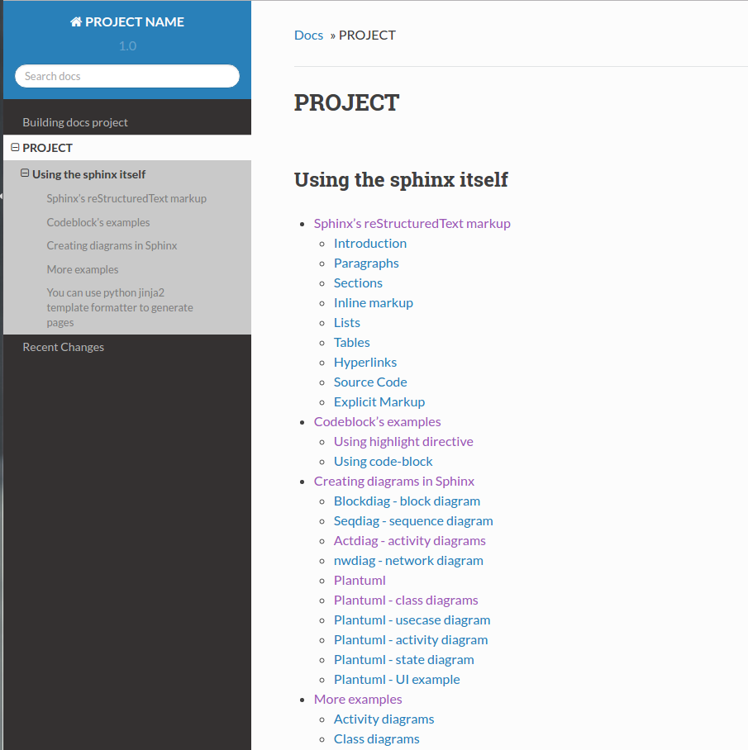
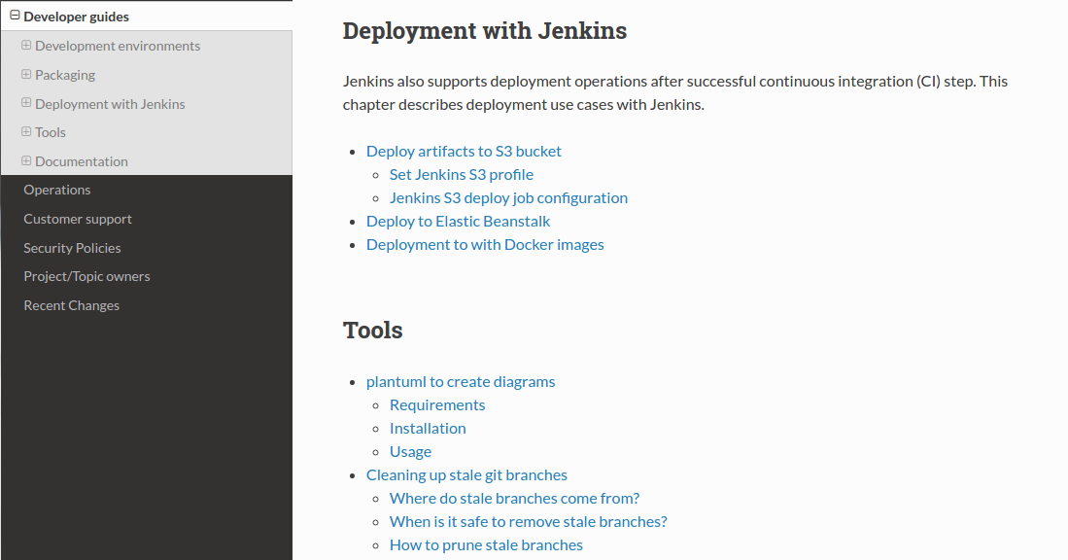
Most popular theme on a Web

Slide 29
Project Docs
Github: https://github.com/voronenko/projectdocs
“Ready to go” configuration : either in form of local install (plantuml & blockdiag need to be installed in the system) or via Docker (alpine based small footprint)
Deployed artifact example:
http://bit.ly/docsexample

Slide 30

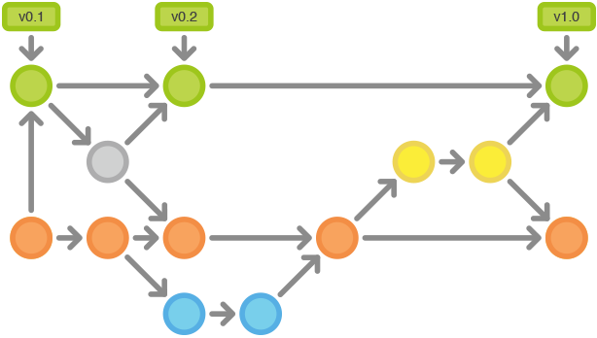
Integration with your code
Dedicated repository or your project branch
The same source flow: pull request, code review, release

Slide 31

Clone and modify
Common page and diagram examples
Build routines
Build routines for docker
Package routines
Deployment draft for Gitlab/Jenkins

Slide 32


Intergration with build pipeline
Local build (run on your own) – packaging and versioning logic on
Docker build (run with dockerized sphinx environment)

Slide 33


Intergration with deploy pipeline
Deploy with Ansible
(jenkins, bamboo, etc)
Deploy with Gitlab

Slide 34

Questions?

Slide 35
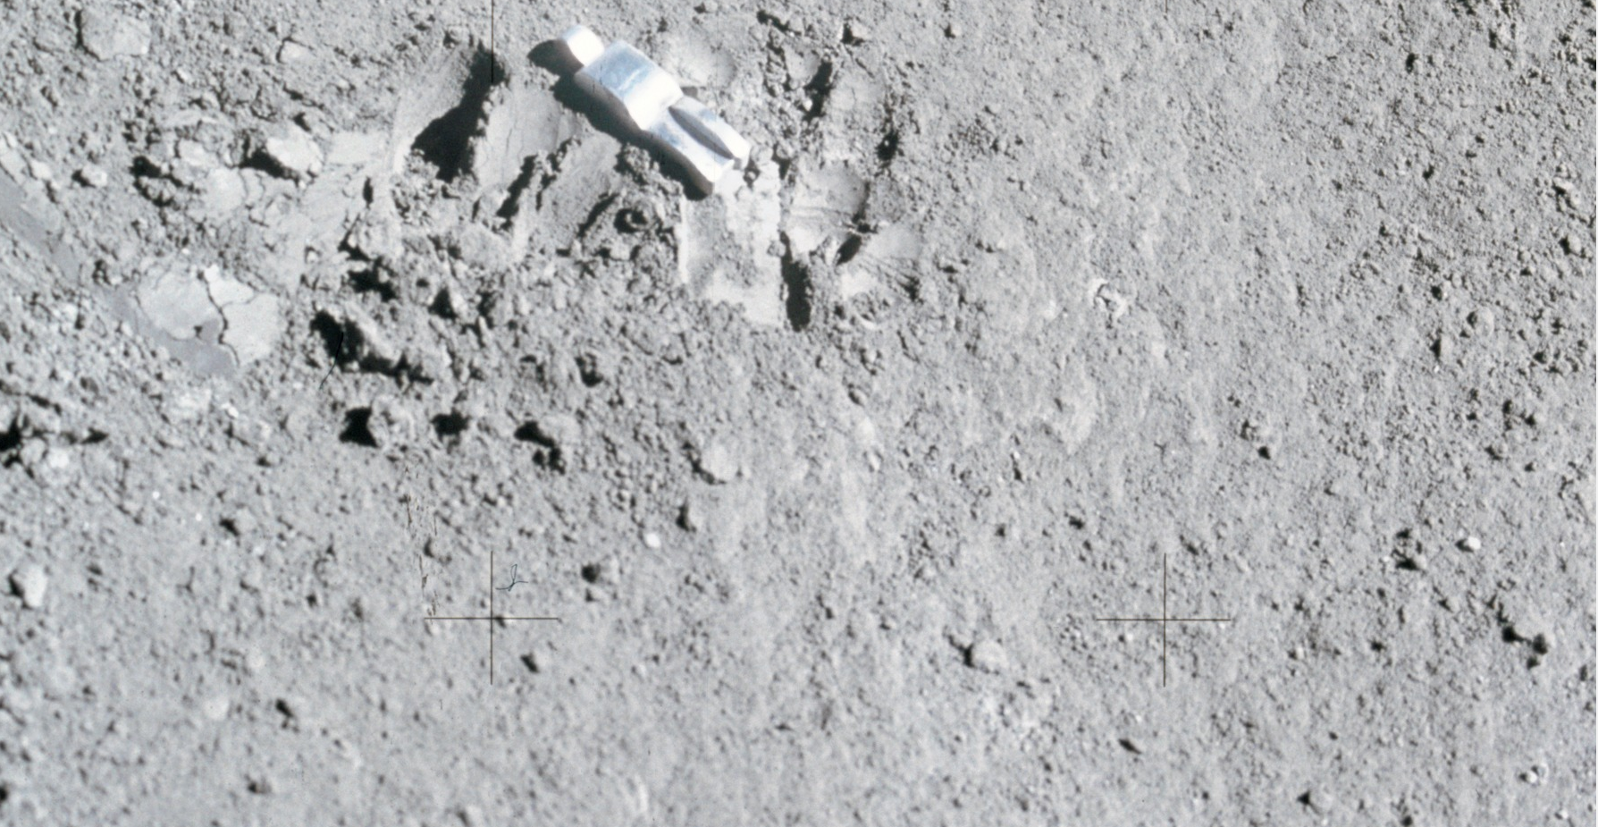
Github: @voronenko

