Slide 1
Hybrid imperative-logical programming in RPA tasks

Slide 2










Robotic Process Automation
Robotic Process Automation (RPA, Robotics) – is the application of technology that allows to configure computer software or a “robot” to capture and interpret existing applications for processing a transaction, manipulating data, triggering responses and communicating with other digital systems.
Key benefits:
Software robots are faster than people and do not make mistakes
Software robots are available for round-the-clock task execution
Software robots allow businesses to free up human resources and reduce operating costs
Software robots work with existing systems, applications, including outdated (legacy) ones and do not change the organization's IT landscape
The results of the work of software robots are much easier to control and log, audit and reporting for security and compliance purposes are much simpler
The tasks / processes performed by software robots are much more easily scaled and replicated between business units and geographies
Limitations:
Inability to work with non-structured information. According to sources, from 50% to 90% of all data of most organizations are unstructured. This is the most important limitation of RPA solutions
Inability to abstract from the details, differences in data formats, features of the implementation of controlled software and highlight common features and work with them on an abstract level. Even minimal changes in controlled applications require reconfiguration of robots
The graphical way of describing tasks is not always convenient and understandable for creation and support. Weak integration with traditional software development tools

Slide 3
Ontology as a set of abstract concepts for describing a domain
Ontology is a formal naming and definition of the types, properties, and interrelationships of the entities that really exist in a particular domain. Most ontologies describe individuals (instances), classes (concepts), attributes, and relations:
Instances are the basic or "ground level" objects of ontology. Can represent both physical objects (people, houses, planets) and abstract ones (numbers, words).
Attributes are aspects, properties, features, characteristics, or parameters that objects (and classes) can have.
Classes are abstract groups, collections, or sets of objects. They can contain instances, other classes, or a combination of both.
Relations are ways in which classes and individuals can be related to one another
Types of languages:
Description logics: OWL, SKOS, ALC.
First order logics: Prolog, CycL
Frame Logic (F-logic): Flora-2
Domain specific languages (DSL): SQ
Key applications:
Business process modelling
Semantic Web
Artificial Intelligence
System Engineering
Software design, information architecture
Medical cybernetics
Library science

Slide 4
Ontology example

Slide 5
Hybrid imperative-logical programming language for building ontologies in RPA tasks
Requirements to ontology
The main goal is to facilitate the creation of robot control programs. Therefore, the means of ontology creation in declarative way and the means of creating control programs in imperative way should be closely integrated.
Language key features:
The language combines logical and imperative paradigms in a natural way. Imperative operators are able to manipulate objects created by declarative descriptions. Declarative elements in its turn can be created with the help of functions written in the imperative style.
The ontology description language should be convenient, have a low entry threshold, be close to traditional programming tools.
The language should be simple as much as possible for both daily work and for training. Type system of imperative component is dynamic, weak, syntax is in JavaScript style. The syntax of the declarative component is in SQL style.
The goal of the ontology is to structure the source data, highlight the repeated patterns in them. The ontology description language should be expressively powerful and flexible to distinguish such an abstract layer of concepts that would be close to concepts in natural language, be relatively resistant to changes on the lower layer of "ground level" facts, could be applied to input data of different formats from different sources.
Declarative component is based on first order logic. It offers tools for describing instances and classes. Instances are set as objects and described by name and a set of attributes in the form of a name-value pair. Classes are set as concepts. Concepts describe structure of an object, as well as the rule for its creation on the basis of already existing concepts and objects, connected by formal logic relations.
There is no need to build an exhaustively complete and consistent ontology, it's just enough to define only those classes that are necessary for solving the current task. Their instances should be found and used in a control software.
The application of logical inference to the concept allows to select a set of corresponding objects from a set of initial facts.

Slide 6
Declarative component: objects
Objects represent specific information (knowledge) about the subject area. Described by a name and set of attributes:
OBJECT profile {
firstName: “Oleksii”,
lastName: “Voropai”,
email: “oleksii.voropai@accenture.com”,
address: address {
country: “Latvia”,
city: “Riga”
}
}
OBJECT cell {
row: 1,
column: 2,
value: 10
}

Slide 7
Declarative component: concepts
Concepts represent generalized information and knowledge about the subject area. They consist of a description of the structure of a new class of objects as well as the rule for creating it.
Concepts types:
Composite concept allows to describe a set of attributes of a new class of objects, associate them with the parent concepts or their attributes, and also specify the relations between parent concepts
Concept based on inheritance allow to extend or override part of the attributes of the parent concept
Concept as a subset of another concept allows to filter out some of the objects of the parent concept. A distinctive feature of this concept is that its objects preserve the structure and names of objects of the parent concept
Concept as a function is a way of describing a new class of objects with a function that returns a list of new objects

Slide 8
Declarative component: composite concepts
CONCEPT profit p IS
table, row, value == i.value - o.value
FROM income i, outcome o
WHERE p.row = i.row = o.row AND
p.table = i.table = o.table;
income(row: 1, value: 5, table: ‘tbl1’)
outcome(row: 1, value: 2, table: ‘tbl1’)
profit(row: 1, value: 3, table: ‘tbl1’)
CONCEPT totals IS
income = sum(i.value),
outcome = sum(o.value),
profit = sum(p.value),
table = i.table
FROM income i, outcome o, profit p
WHERE i.row = o.row = p.row AND i.table = o.table = p.table
GROUP BY i.table;
income(row: 1, value: 5, table: ‘tbl1’)
outcome(row: 1, value: 2, table: ‘tbl1’)
income(row: 2, value: 3, table: ‘tbl1’)
outcome(row: 2, value: 4, table: ‘tbl1’)
totals(table: ‘tbl1’, income: 8, outcome: 6, profit: 2)

Slide 9
Declarative component: concepts based on inheritance
CONCEPT income EXTENDS
tableCell c WITHOUT id, column
WHERE c.column = 2;
tableCell(row: 1, column: 2, value: 5, table: ‘tbl1’, id: 1)
income(row: 1, value: 5, table: ‘tbl1’)
CONCEPT productAvailability
EXTENDS pageSpan e WITH
value == convertColors(
e.backgroundColorName
) WHERE
e.backgroundColorName IN (
‘DarkOliveGreen’,
‘Brown’,
‘Crimson’
);
pageSpan(
id: ‘product-availability-1234’,
backgroundColorName: ‘Green’, …
)
productAvailability(
id: ‘product-availability-1234’,
backgroundColorName: ‘Green’,
value: ‘available’, …
)

Slide 10
Declarative component: subset concepts
CONCEPT productLink IS
pageLink e
WHERE e. text == "PRODUCTS“;
pageLink(text: ‘PRODUCTS’)
pageLink(text: ‘STORES’)
pageLink(text: ‘PRODUCTS’)
CONCEPT webPageElement IS PageLink;
CONCEPT WebPageElement IS PageInput;
pageInput(text: ‘Search…’)
tableCell(column: 1, row: 1, value: 1)
CONCEPT atTheTopOfThePage IS
webPageElement e WHERE
EXIST (pageTitle t WHERE
t.page == e.page AND
e.positionY > 0 AND
e.positionY + e.height < t.pageHeight / 2.0
);
pageTitle(title: ‘homepage’,
pageHeight: 100, pageWidth: 100)
pageInput(text: ‘Search…’,
positionX: 80, PositionY: 10, …)
pageLink(text: ‘About’,
positionX: 50, PositionY: 90, …)

Slide 11
Declarative component: concepts as a function
CONCEPT randomNumber (value) {
var numbers = [];
var size = Math.random(1, 5);
for( i=0; i<size; i=i+1){
numbers [] = number {value: Math.random(1, 10)};
};
return numbers;
};
randomNumber(value: 6)
randomNumber(value: 2)
randomNumber(value: 9)

Slide 12
Declarative component: recursive concepts
CONCEPT inside IS insideElement = ie, outsideElement = oe
FROM webPageElement ie, webPageElement oe WHERE
ie.parent = oe.id OR EXIST(
webPageElement int, inside intRel WHERE
int.id == ie.parent AND intRel.insideElement == ie AND intRel.outsideElement = int
);
inside(
insideElement: pageDiv (id: ‘product-123’, …),
outsideElement: pageDiv (id: ‘search-results’, …),
)
inside(
insideElement: pageDiv (id: ‘product-price-123’, …),
outsideElement: pageDiv (id: ‘search-results’, …),
)
inside(
insideElement: pageDiv (id: ‘product-price-123’, …),
outsideElement: pageDiv (id: ‘product-123’, …),
)
pageDiv(
id: ‘search-results’, …
)
pageDiv(
id: ‘product-123’,
parent: ‘search-results’, …
)
pageDiv(
id: ‘product-price-123’,
parent: ‘product-123’, …
)

Slide 13
Declarative component: variables and higher-order logic
CONCEPT notFarAway IS
point1 = p1, point2 = p2
FROM Point p1, Point p2 WHERE
p1 != p2 AND ?dist = Math.sqrt(
(p2.x - p1.x) * (p2.x - p1.x) +
(p2.y - p1.y) * (p2.y - p1.y) +
) AND ?dist > 10 AND ?dist < 50;
notFarAway(
point1: point
(x: 1, y: 1),
point2: point
(x: 2, y: 2)
)
point(x: 1, y: 1)
point(x: 2, y: 2)
point(x: 60, y: 60)
CONCEPT Point IS ?anyObject o
WHERE o.x != NULL AND o.y != NULL;
circle(x: 1, y: 1, radius: 2)
rectangle(x1: 1, y1: 1, x2: 2, y2: 2)
CONCEPT pageClass IS
name = ?name, object = obj
FROM ?name obj WHERE obj.page != null;
pageInput(
id: ‘1’,
page: ‘homepage’,
…
)
pageClass(
object: pageInput(id: ‘1’,
page: ‘homepage’, …),
name: pageInput
)

Slide 14
Imperative component
The type system is weak, dynamic.
Basic data types: boolean, integer, floating, string.
Composite data types:
list: [1, 2, 3]
map: {‘key1’: ‘value1’, ‘key2’: ‘value2’}
object: objectName {attribute1: ‘value1’, attribute2: ‘value’}
Basic operators:
Variables declaration : variable = valueExpression;
Branching : if(condition) { thenBlock } else { elseBlock };
Loops:
for(initialization; termination; increment) {loopBody};
for(item in collection) {loopBody };
while(condition) { loopBody }
Functions: function name ( arguments ) { functionBody }

Slide 15
Integration of the declarative and imperative components
The imperative component includes operators for the solving of the concept (finding the corresponding objects): find conceptname {attribute: value, …}. The result is a list of objects. It can be assigned to a variable, used as an argument of a function or component of an expression:
cells = find cell {table: ‘tbl1’};
for(product in (find product {})) {…}
Declarative components definitions (objects and concepts) include arithmetic and logical expressions, which can include variables and function calls created in imperative way:
categories = [‘wine’, ‘beer’, ‘cider’];
for(category in categories) {
products = find product {type: category};
OBJECT productCategory {name: category, productList: products};
}
If a variable or an imperative expression is used in concept definition then its value will be calculated at the moment of concept creation, passed to Knowledge Base and then used at concept resolving:
Also, the concept as a function described in the imperative way can used as parent concept for other concepts described in the declarative way
vat = 0.2;
CONCEPT priceWithTax EXTENDS price p WITH
tax = p.value * vat;
price { value: 10 };
priceWithTax { value: 10, tax: 12 };

Slide 16
Knowledge base features
The language includes a built-in knowledge base that allows to organize storage and access to objects and concepts
Declarative objects and concepts definitions change the state of the knowledge base
find statement performs a query on the knowledge base. Only objects and concepts added at the time of its call are processed. The ones added later are not taken into account:
OBJECT digit {value: 1};
digits = find digit {}; // [digit {value: 1}]
OBJECT digit {value: 2};
digits = find digit {}; // [digit {value: 1}, digit {value: 2}]
At the same time, the order of declaring objects and concepts does not matter. Thus, one can declare a derived concept first, and then the concepts from which it consists:
CONCEPT profit EXTENDS financialResults r WITH profit = r.income – r.outcome;
CONCEPT financialResults (income = i.value, outcome = o.value, row = i.row)
FROM cell i, cell o WHERE o.row = i.row AND i.column = 1 AND o.column = 2;
OBJECT cell {row: 1, column: 1: value: 3}; OBJECT cell {row: 1, column: 2: value: 2};
profits = find profit {}; // [profit {row: 1, income: 3, outcome: 2, profit: 1}]

Slide 17
The scope of concepts and objects
The content of the knowledge base depends on the scope. Objects and concepts declared within a function will not be visible beyond its limits. This allows to make the code more reliable and predictable, since the functions will not have side effects in terms of impact on the knowledge base:
function doSomething() { OBJECT digit {value: 1} ;}
doSomething();
OBJECT digit {value: 2};
digits = find digit {}; // [digit{value: 2}]
Objects and concepts can be declared in a separate file and loaded by include or require statements
Also, the list of objects can be prepared inside the function and returned as a result. After that the list of objects can be added to the knowledge base by single statement :
function prepareNumberObjects() {
return [number{value:1}, number{value:2}, number{value:3}];
}
OBJECTS prepareNumberObjects();

Slide 18
vat = 0.2;
CONCEPT priceWithTax EXTENDS price p WITH
tax = p.value * vat;
price { value: 10 };
priceWithTax { value: 10, tax: 12 };

Slide 19
Usage examples: CSV files processing
OBJECPTS Table.readFromCSVFile("examples/profitExample.csv", ",", true);
CONCEPT name EXTENDS tableCell WITHOUT columnNum, id, pos WHERE columnNum = 1;
CONCEPT income EXTENDS tableCell WITHOUT columnNum, id, pos WHERE columnNum = 2;
CONCEPT outcome EXTENDS tableCell WITHOUT columnNum, id, pos WHERE columnNum = 3;
CONCEPT profit EXTENDS income i, outcome o WITH value = i.value - o.value;
CONCEPT totals IS
income = sum(i.value),
outcome = sum(o.value),
profit = sum(p.value)
FROM income i, outcome o, profit p WHERE i.row = o.row = p.row;
totals = find totals {};
output = "Total income: " + totals[0]["income"] + ", outcome: " + totals[0]["outcome"] + ", profit: " + totals[0]["profit"];
print output;
"row", "income", "outcome"
"row1", 12, 10
"row2", 24, 26
"row3", 21, 14
Total income: 57, outcome: 50, profit: 7

Slide 20
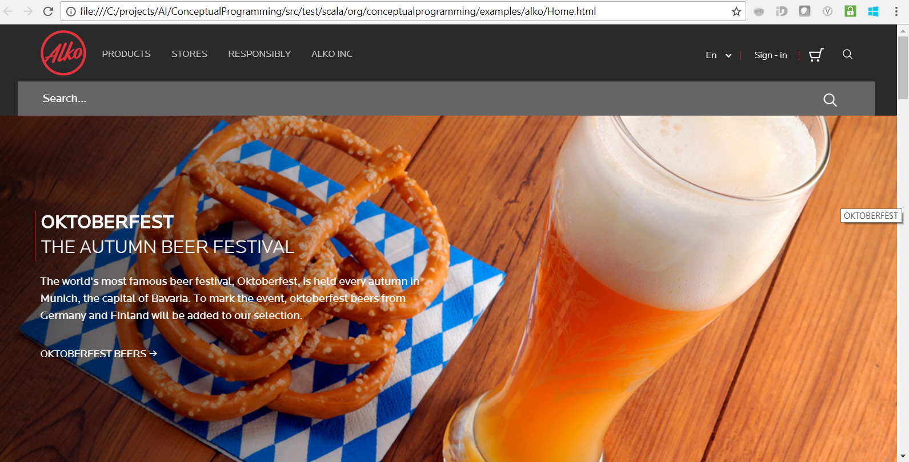
Usage examples: WEB pages processing

Slide 21
Usage examples: WEB pages processing
url = "file:////examples/alko/Home.html"; OBJECTS HTML.openWebPage(url);
CONCEPT productLink IS pageLink WHERE text = "PRODUCTS";
CONCEPT storesLink IS pageLink WHERE text = "STORES";
CONCEPT otherMenuItems IS PageLink e WHERE
EXIST (productLink p, inTheSameRow r WHERE r.element1 = e AND r.element2 = p) AND
EXIST (storesLink s, inTheSameRow r WHERE r.element1 = e AND r.element2 = s);
CONCEPT searchLink IS PageLink e WHERE e.title = "Search Magnifier Icon“
AND EXIST (otherMenuItems m WHERE e = m);
searchLink = find searchLink {};
HTML.click(searchLink[0]);
CONCEPT searchForm IS form = f, input = i, submit = s FROM
pageForm f,
pageInput i (form = f.id),
pageInput s (type = "submit", form = f.id),
withLabel l (labelText = "Search...", element = i);
searchForm = find searchForm {};
HTML.enterText(searchForm[0]["input"], "Sake");
OBJECTS HTML.followLink(searchForm[0]["submit"]);

Slide 22
Usage examples: WEB pages processing

Slide 23
Usage examples: WEB pages processing
CONCEPT productTile IS pageDivision e WHERE e.backgroundBasicColorName == "White“
AND startsWith(e.id, "product-tile-");
CONCEPT productAvailability IS PageSpan e WHERE
e.backgroundColorName IN ("DarkOliveGreen“, "Brown“, "Crimson“);
function convertColors(color) {
if (color == "DarkOliveGreen") { return "green"; };
if (color == "Brown") { return “yellow"; };
if (color == "Crimson") { return "red"; };
return "unknown";
};
CONCEPT productPrice IS
value = 1.0 * (left.text + "." + right.text),
leftPart = left,
rightPart = right
FROM pageSpan left, pageSpan right WHERE
left.parent = right.parent AND
substring(left.xPath, 0, size(left.xPath) - 8) = substring(right.xPath, 0, String.size(right.xPath) - 8)
AND left.pos < right.pos AND left.text > "“ AND right.text > "";
CONCEPT productName IS pageDivision WHERE text > ““ AND basicColorName = "Black";
CONCEPT productCountry IS pageDivision WHERE text > ““ AND basicColorName == "Gray";
CONCEPT productVolume IS pageDivision WHERE text > ““ AND basicColorName == "Gray“
AND endsWith(text, " l");

Slide 24
Usage examples: WEB pages processing
CONCEPT product IS
name = nameEl.text,
price = priceEl.value,
volume = substring(volumeEl.text, 0, size(volumeEl.text) - 2),
country = countryEl.text,
availability = convertColors(availabilityEl.backgroundColorName)
FROM
productTile tileEl,
productName nameEl, atTheBottomOf nameRel (inner = nameEl, outer = tileEl),
productPrice priceEl, atTheTopOf priceRel (inner = priceEl.leftPart, outer = tileEl),
productVolume volumeEl, atTheTopOf volumeRel (inner = volumeEl, outer = tileEl),
productCountry countryEl, atTheBottomOf countryRel (inner = countryEl, outer = tileEl),
productAvailability availabilityEl, atTheTopOf availabilityRel (inner = availabilityEl, outer = tileEl);
products = find product {};
output = "Products found:\n";
for(product in products) {
output = output + product["name"] + ", " + product["volume"] + " l, " +
product["price"] + " eur, " + product["country"] + ", " + product["availability"] + ".\n";
};
HTML.closeWebPage(url);
return output;

Slide 25
Usage examples: WEB pages processing
Products found:
Yamada-Nishiki Tokubetsu Junmai-shu Sake, 0.72 l, 19.99 eur, Japan, green.
Kirin Junmai Daiginjo Sake, 0.72 l, 47.8 eur, Japan, red.
Kura no Machi Tokubetsu Junmai Ginjo Sake, 0.3 l, 5.21 eur, Japan, green.
Hakutsuru Sayuri Nigori Sake, 0.3 l, 11.97 eur, Japan, green.
Hakutsuru Tanrei Junmai Sake, 0.18 l, 6.58 eur, Japan, green.
Masaki Yamadanishiki Junmai Genshu Sake, 0.3 l, 9.73 eur, Japan, green.
Aizu Homare Junmai Daiginjo Banshu Sake, 0.72 l, 49.4 eur, Japan, green.
Takehara Junmai True Mirror Sake, 0.72 l, 26.81 eur, Japan, green.
Hakutsuru Superior Junmai Ginjo Sake, 0.72 l, 25.5 eur, Japan, green.
Tatenokawa Junmai Daiginjo Sake, 0.3 l, 20.9 eur, Japan, green.

Slide 26
Possible applications
Automation of testing and control of WEB applications, search robots creation
Analysis of texts in natural language. E.g. rule-based analysis and retrieval of reports, protocols, court decisions, messages in social networks, letters, etc.
Analysis of logs, sequences of actions. For example, analyzing the actions of site visitors, highlighting behavior patterns, classifying users based on their behavior
Grounding (localizing) arbitrary, free-form textual phrases in visual content. Rule-based search of objects consisting of a set of graphic primitives related to each other. It can be applied for human-computer interaction and image-text reference resolution tasks.
Description of the data hierarchy and ways of their composition in traditional programming. For example, most of the classes in server-side OOP applications are just the simple structures for describing data: POJO, JavaBeans, and so on. Describing a structure, relationships and ways of obtaining data in a declarative form would greatly simplify the source code of applications

Slide 27
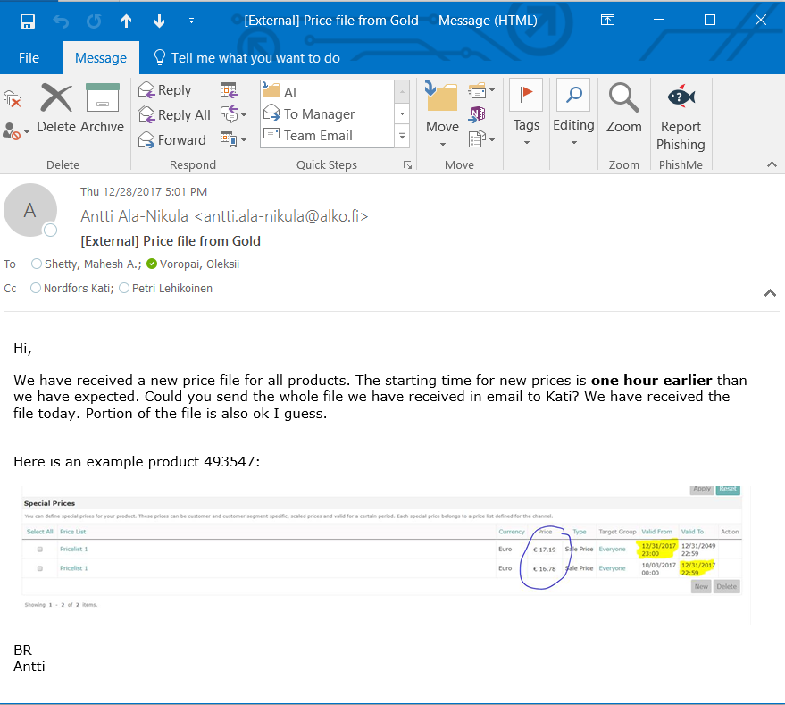
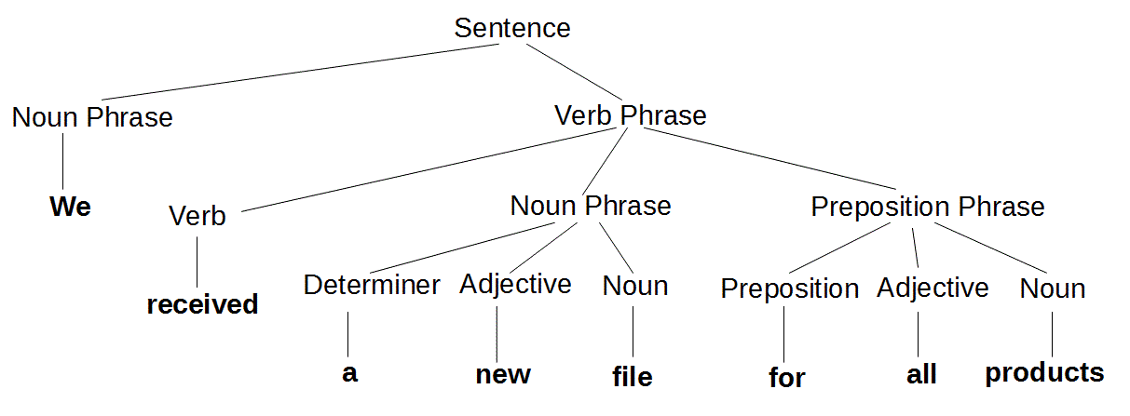
Analysis of texts in natural language
Sentence {
nounPhrase: Pronoun: {
value: “we”,
number: “plural”
}
},
verbPhrase: VerbPhrase {
predicate: Verb {
value: “receive”,
tense: “past simple”
},
nounPhrase: NounPhrase {
determiner: …
adjective: …
noun: …
},
prepositionPhrase: …
}
}
sendAction {
subject: Pronoun{
value: “we”,
number: “plural”
},
object: NounPhrase {
determiner: “a”,
adjective: “”new,
noun: Noun {value: “file”, number: “singular”}
}
}
CONCEPT sendAction IS
subject = s.nounPhrase, object = s.verbPhrase.nounPhrase, …
FROM Sentence s, … WHERE s.verbPhrase.predicate.value = “receive” …;
CONCEPT sendAction IS
subject = s.verbPhrase.nounPhrase1, object = s.verbPhrase.nounPhrase2, …
FROM Sentence s, … WHERE s.verbPhrase.predicate.value = “send”, …;
whatWereSent = find sendAction {};

Slide 28
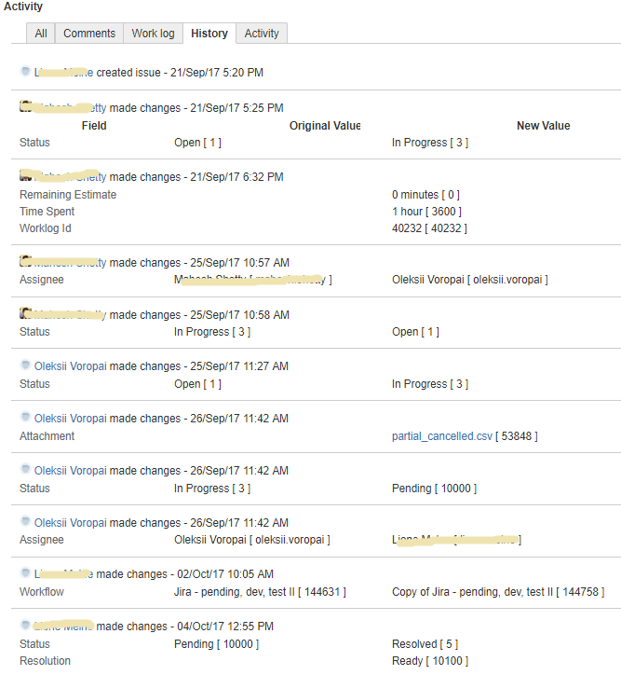
Analysis of logs
TaskEvent {
id: “6824”,
assignee: “oleksii,.voropai”,
author: “oleksii.voropai”,
time: 21/Sep/17 5:20PM,
statusUpdate: changes {original: “New”, new: “InProgress”},
…
}
CONCEPT TaskStart IS TaskEvent t WHERE t.statusUpdate IS NOT NULL AND t.statusUpdate.new != t.statusUpdate.original AND t.statusUpdate.new = “InProgress”;
CONCEPT TaskEnd IS TaskEvent t WHERE t.statusUpdate IS NOT NULL AND t.statusUpdate.new != t.statusUpdate.original AND t.statusUpdate.new != “InProgress”;
CONCEPT TaskEnd Extends TaskEvent t WITH assignee = t.assigneeUpdate.original WHERE t.assigneeUpdate IS NOT NULL AND t.assigneeUpdate.new != t.assigneeUpdate.original;
CONCEPT TaskDuration IS id = t1.id, assignee = t1.assignee, timeStart = t1.time, tineEnd = t2.time, dutation = timeEnd - timeStart
FROM TaskStart t1, TaskEnd t2 WHERE t1.id = t2.id AND t1.assignee = t2.assignee AND NOT EXIST (TaskEnd t3 WHERE t2.id = t3.id AND t2.assignee = t3.assignee AND t3.time < t2.time);
CONCEPT TotalDurationByAssignee IS assignee = t.assignee, duration = SUM(t.duration) FROM TaskDuration t GROUP BY t.assignee;
TotalDurationByAssignee {assignee: “oleksii.voropai”, duration: 80h}

Slide 29
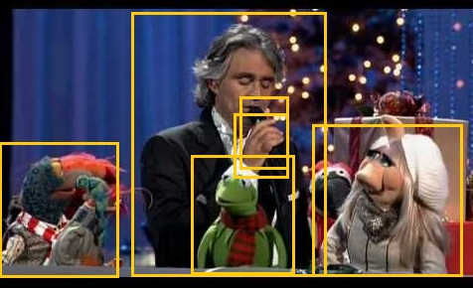
Text grounding
Person {
type: “Puppet”,
name: “Piggy”,
location: Square {x1: …, x2: …, y1: …, y2: …}, …
}
Person {
name: “Bocelli”,
location: Square {x1: …, x2: …, y1: …, y2: …}, …
}
Object {
name: “hand”,
location: Square {x1: …, x2: …, y1: …, y2: …}, …
}
Object {
name: “microphone”,
location: Square {x1: …, x2: …, y1: …, y2: …}, …
}
CONCEPT Singer IS Person p WHERE EXIST (
Object h, Object m WHERE h.name = “hand” AND m.name = “microphone”
AND h.belongsTo = p.name AND overlap(h.location, m.location)
);
CONCEPT Muppet IS Person WHERE type = “PUPPET” AND
name IN (“Cermit”, “Piggy”, “Gonzo”, “Rowlf”, “Fozzie”, “Animal”, …);
CONCEPT SingsWithMuppet IS singer = s,name, muppet = m.name
FROM Singer s, Muppet m;
bocelliSingsWithMuppet = find SingsWithMuppet {singer: “Bocelli”};
Bocelli sings with Muppets

Slide 30
Data flow modelling

Slide 31
Plans for the future
Language design:
Finalize the syntax of the imperative part, bring it closer to JS standards
Finalize the syntax of the declarative part, bring it closer to SQL standards, implement built-in variables, subqueries, higher-order logic
Implement elements of functional programming
Finalize the language translator, output of compilation error messages
Implement a system of exceptions
Implement a debugger
Optimize queries to the knowledge base, improve caching and indexing
Application in practice:
Solve the task of quick access to elements of a WEB page
Create a set of predefined concepts and functions for a convenient description of the relationships between elements of a WEB page: color, dimensions, mutual position, hierarchy, functional purpose
Integrate the language with natural language processing systems to structure the content of text documents
Integrate the language with existing RPA systems, implement visual tools for concepts creation

Slide 32
Conclusions
The design and implementation of a hybrid programming language that combines declarative and imperative components are proposed.
The language allows to create abstract conceptual models of a subject area in a declarative way and also to manipulate the elements of these models to solve practical tasks in the field of RPA.
Examples of application of language for automation of work with WEB applications and tabular data are shown.

