Slide 1
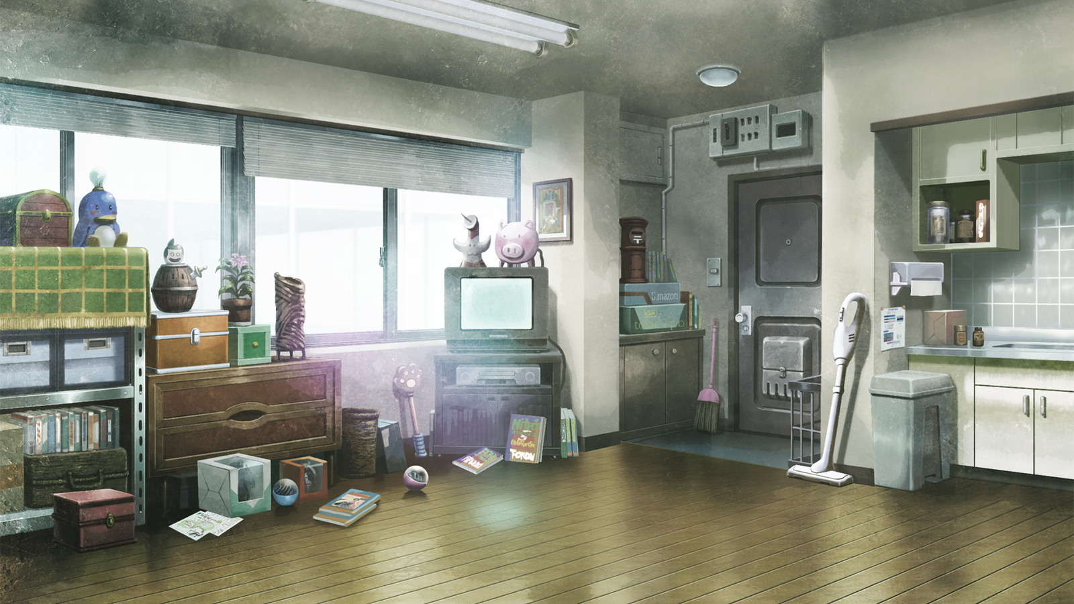

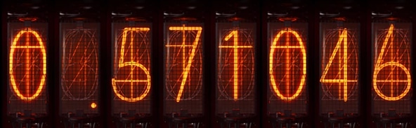
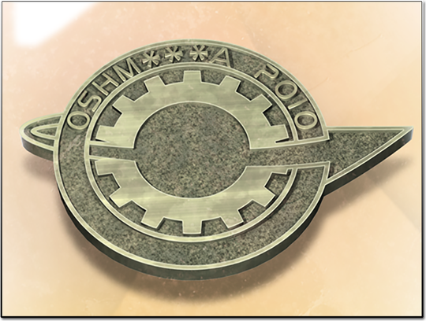
FUTURE GADGET LABORATORY
01 / 42
STAGE 2 PRESENTATION
Aleksandria
Big Data &
Connectionist AI
From raw data to neural-network learning
A beginner-friendly introduction using handwritten-digit recognition
DIVERGENCE
Notes:
Allow 20 seconds. Ask how a scanner could recognize a handwritten 5 when two people write it differently. Invite one suggestion and hold it for the pixel example.
Repository companion: https://github.com/Voryalis/aleksandria/blob/main/docs/04-case-study.md#41-from-individual-ideas-to-a-complete-system
ARTWORK AND DESIGN CREDITS
Future Gadget Laboratory artwork, Steins;Gate (Steam HD Edition), archived by Adrot. https://www.spriters-resource.com/pc_computer/steinsgatesteamhdedition/asset/107557/
Rintaro Okabe portrait, Steins;Gate: Linear Bounded Phenogram, archived by delta. https://www.spriters-resource.com/pc_computer/steinsgatelinearboundedphenogram/asset/153185/
Divergence meter artwork, archived by Adrot. The display follows Operation World Line. https://www.spriters-resource.com/pc_computer/steinsgatesteamhdedition/asset/107527/ | https://github.com/Voryalis/aleksandria/tree/main/interactive-learning/python-game
Steins;Gate game artwork retains its original rights and falls outside the ALEKSANDRIA content license.
Future Gadget Laboratory artwork (daylight interior). Steins;Gate (Steam HD Edition), archived by Adrot. https://www.spriters-resource.com/pc_computer/steinsgatesteamhdedition/asset/107557/
Lab member pin. Steins;Gate (Steam HD Edition), archived by Adrot. https://www.spriters-resource.com/pc_computer/steinsgatesteamhdedition/asset/107526/

Slide 2


The Aleksandria team
AKIHABARA RADIO KAIKAN
Aleksandr Iatsenko
Kamran Abdullayev
Project coordinator
Repository and technical workflow
Grigorii Virin
Mirad Kapiz
PHOTOGRAPH · MARCH 2010
Content lead
Video lead
Tamerlan Koldas
Arsentii Balanin
Quality lead
Visual design lead
STEINS;GATE VISUAL NOVEL
STAGE 2
02 / 42
Notes:
Allow 15 seconds. Introduce the group and its roles. Move directly to the scanner problem.
Repository companion: https://github.com/Voryalis/aleksandria/blob/main/docs/04-case-study.md#41-from-individual-ideas-to-a-complete-system
ARTWORK AND DESIGN CREDITS
“Akihabara Radio Kaikan, 2010-03-06.jpg” by street viewer. Wikimedia Commons, CC BY 2.0. Cropped and colour-graded. https://commons.wikimedia.org/wiki/File:Akihabara_Radio_Kaikan,_2010-03-06.jpg | https://creativecommons.org/licenses/by/2.0/
Radio Kaikan storefront artwork. Steins;Gate (Steam HD Edition), archived by Adrot. https://www.spriters-resource.com/pc_computer/steinsgatesteamhdedition/asset/107559/
Steins;Gate game artwork retains its original rights and falls outside the ALEKSANDRIA content license.

Slide 3
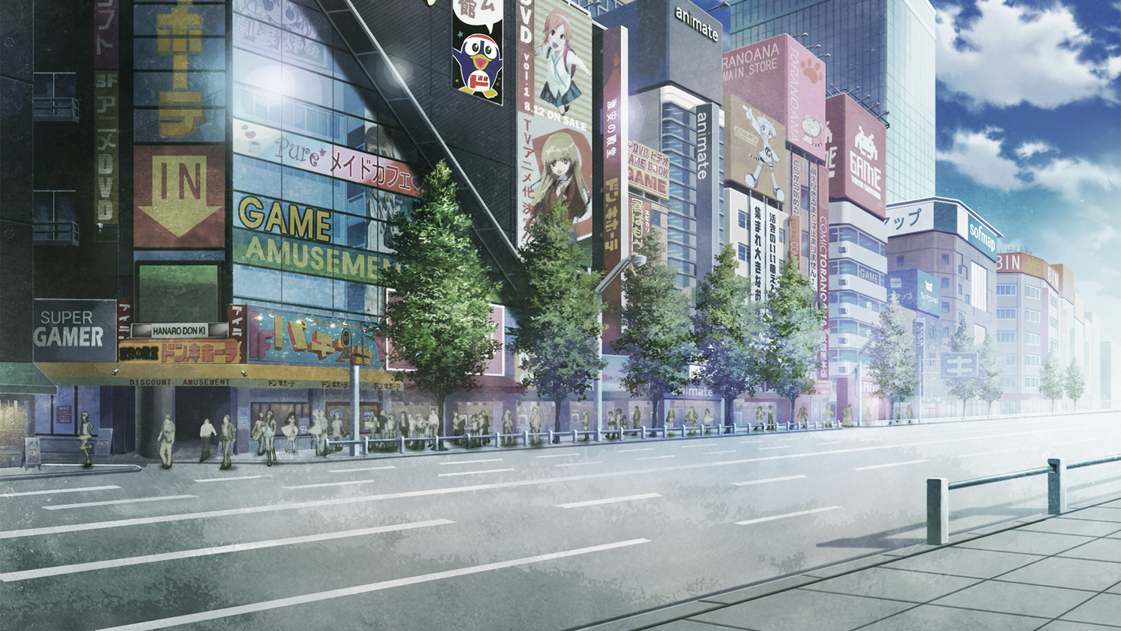

AKIHABARA
03 / 42
How does a network
recognize a digit?
Learning materials for beginners
Follow a handwritten digit from a parcel scan to a network prediction. How could we tell whether the network learned?
Notes:
Allow about one minute. Ask learners how a scanner could read an unfamiliar handwriting style. Begin with the raw picture and return to the same question after training and evaluation.
SOURCE AND RESOURCE ALIGNMENT
https://github.com/Voryalis/aleksandria/blob/main/docs/01-big-data.md
Repository companion: https://github.com/Voryalis/aleksandria/blob/main/docs/04-case-study.md#41-from-individual-ideas-to-a-complete-system
Tutorial scene: https://github.com/Voryalis/aleksandria/blob/main/videos/first-video-storyboard.md#scene-1--hook-what-the-computer-sees-000015
ARTWORK AND DESIGN CREDITS
Rintaro Okabe phone portrait, Steins;Gate: Linear Bounded Phenogram, archived by delta. https://www.spriters-resource.com/pc_computer/steinsgatelinearboundedphenogram/asset/153185/
Steins;Gate game artwork retains its original rights and falls outside the ALEKSANDRIA content license.
Akihabara street background. Steins;Gate (Steam HD Edition), archived by Adrot. https://www.spriters-resource.com/pc_computer/steinsgatesteamhdedition/asset/107518/

Slide 4
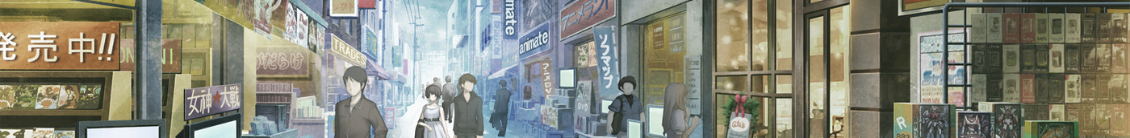
What you will learn
Check and prepare image data
Calculate a neuron output
Explain a training update
Use unseen examples to judge how well a model recognizes handwriting.
OPENING
04 / 42
Notes:
Allow about one minute. Ask learners to choose one goal. Return to it after the digit case study and ask for a worked example.
SOURCE AND RESOURCE ALIGNMENT
https://github.com/Voryalis/aleksandria/blob/main/docs/chapters.md
Repository companion: https://github.com/Voryalis/aleksandria/blob/main/docs/04-case-study.md#41-from-individual-ideas-to-a-complete-system
ARTWORK AND DESIGN CREDITS
Akihabara shopping street background. Steins;Gate (Steam HD Edition), archived by Adrot. https://www.spriters-resource.com/pc_computer/steinsgatesteamhdedition/asset/107518/
Steins;Gate game artwork retains its original rights and falls outside the ALEKSANDRIA content license.

Slide 5
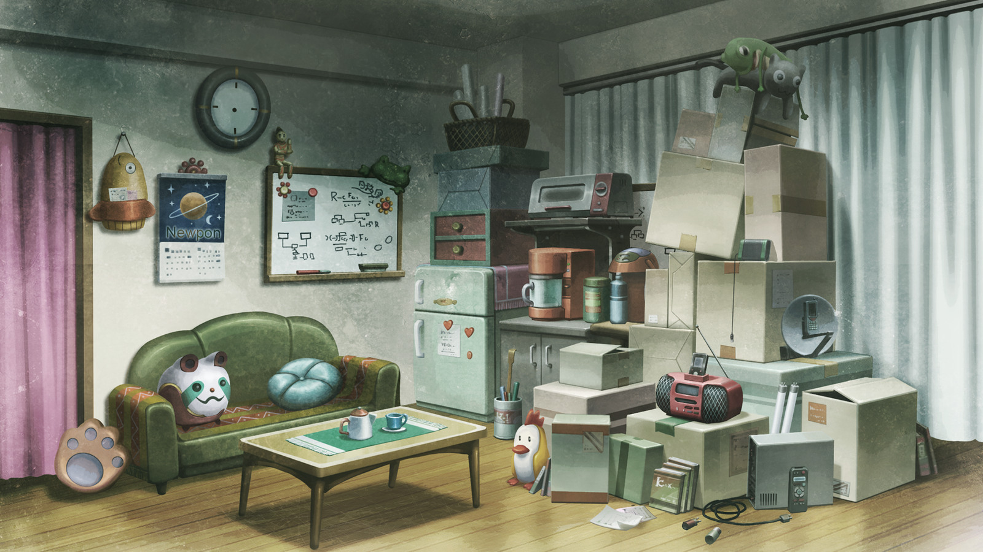
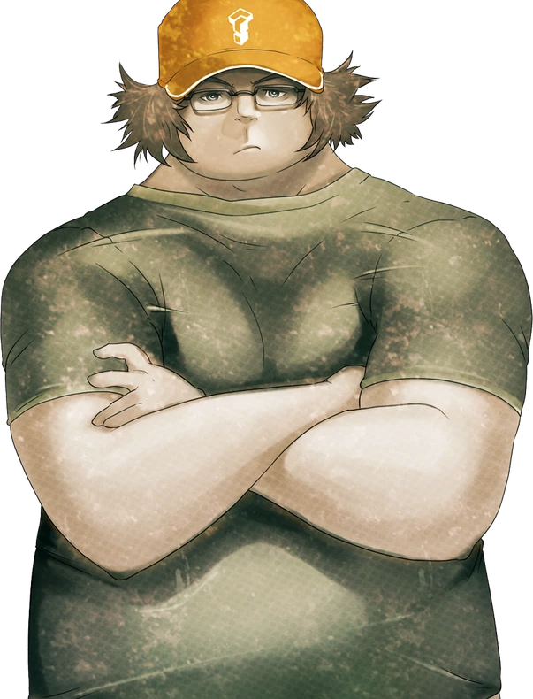
BIG DATA
05 / 42
Big Data has several challenges
Data whose scale, speed or complexity challenges conventional tools
Volume
How much data?
Velocity
How quickly does it arrive?
Variety
Which forms and formats?
Veracity
How reliable is it?
Value
What useful purpose does it serve?
Notes:
ABOUT 2 minutes. Explain volume as amount, velocity as arrival/processing speed, variety as different forms, veracity as trustworthiness, and value as usefulness for a purpose. Use many images, continuously arriving scans, image/metadata formats, incorrect labels, and useful recognition as examples. A small toy grid or a manageable dataset does not by itself demonstrate Big Data scale. Data quality matters at every scale. Transition: examine defects before modelling.
SOURCE AND RESOURCE ALIGNMENT
https://github.com/Voryalis/aleksandria/blob/main/docs/01-big-data.md — Big Data and data quality
https://www.ibm.com/think/topics/big-data
Attached teaching guide: 01-big-data(3).md, section 1.2
Repository companion: https://github.com/Voryalis/aleksandria/blob/main/docs/01-big-data.md#11-so-what-is-big-data
ARTWORK AND DESIGN CREDITS
Future Gadget Laboratory artwork and Itaru Hashida portrait, Steins;Gate (Steam HD Edition), archived by Adrot. https://www.spriters-resource.com/pc_computer/steinsgatesteamhdedition/asset/107557/ | https://www.spriters-resource.com/pc_computer/steinsgatesteamhdedition/asset/107534/
Steins;Gate game artwork retains its original rights and falls outside the ALEKSANDRIA content license.
Future Gadget Laboratory artwork (daylight sitting area). Steins;Gate (Steam HD Edition), archived by Adrot. https://www.spriters-resource.com/pc_computer/steinsgatesteamhdedition/asset/107557/

Slide 6
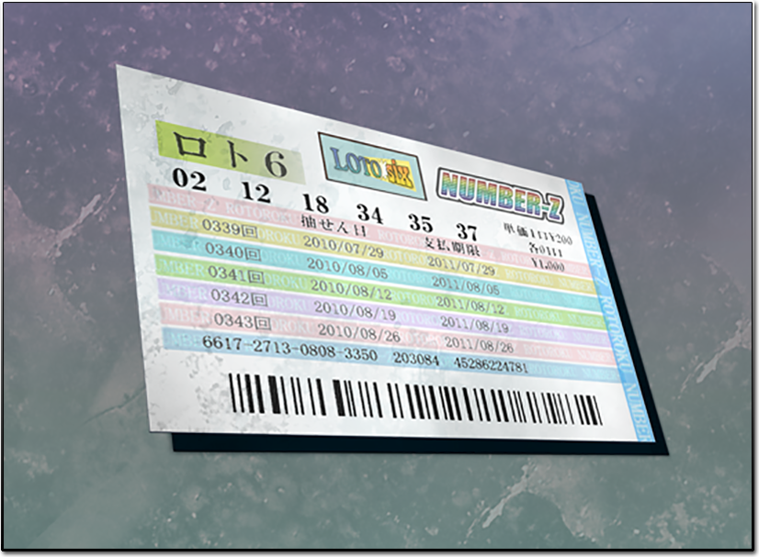
Three forms of data
Form
Digit-project example
Structured
Table of image IDs and labels
Semi-structured
JSON image metadata
Unstructured
The handwritten image itself
TICKET ARTWORK FROM STEINS;GATE
The representation depends on the kind of data and the task.
BIG DATA · INTRODUCTION
06 / 42
Notes:
ABOUT 90 seconds. Compare a table of image IDs and labels with a JSON record and an image file. Structured data has a defined tabular organization; semi-structured data uses keys or tags with flexible records; an image is usually treated as unstructured content even though its file has a defined encoding. All must be represented appropriately for the task. Teaching comparison adapted from the supplied Aleksandria extended deck, slides 8–11, and PPT BIG DATA COMPLETE, page 6.
SOURCE AND RESOURCE ALIGNMENT
https://github.com/Voryalis/aleksandria/blob/main/docs/01-big-data.md
Attached teaching guide: 01-big-data(3).md, section 1.2.1
Repository companion: https://github.com/Voryalis/aleksandria/blob/main/docs/01-big-data.md#12-why-should-we-care-about-data-quality
ARTWORK AND DESIGN CREDITS
Ticket artwork. Steins;Gate (Steam HD Edition), archived by Adrot. https://www.spriters-resource.com/pc_computer/steinsgatesteamhdedition/asset/107526/
Steins;Gate game artwork retains its original rights and falls outside the ALEKSANDRIA content license.

Slide 7

What a parcel scanner records
A conveyor scanner captures the label image. Its log records the time and device ID. A worker can supply a checked postcode.
Link the image, the event and the checked label by a scan ID.
BIG DATA · INTRODUCTION
07 / 42
Notes:
Allow about one minute. A conveyor scanner captures the label image. Its log records the time and device ID. A worker can supply a checked postcode. Link the image, the event and the checked label by a scan ID. Image: AI-generated illustrative photograph.
SOURCE AND RESOURCE ALIGNMENT
https://github.com/Voryalis/aleksandria/blob/main/docs/01-big-data.md
Attached teaching guide: 01-big-data(3).md, section 1.2.1
Repository companion: https://github.com/Voryalis/aleksandria/blob/main/docs/01-big-data.md#12-why-should-we-care-about-data-quality

Slide 8
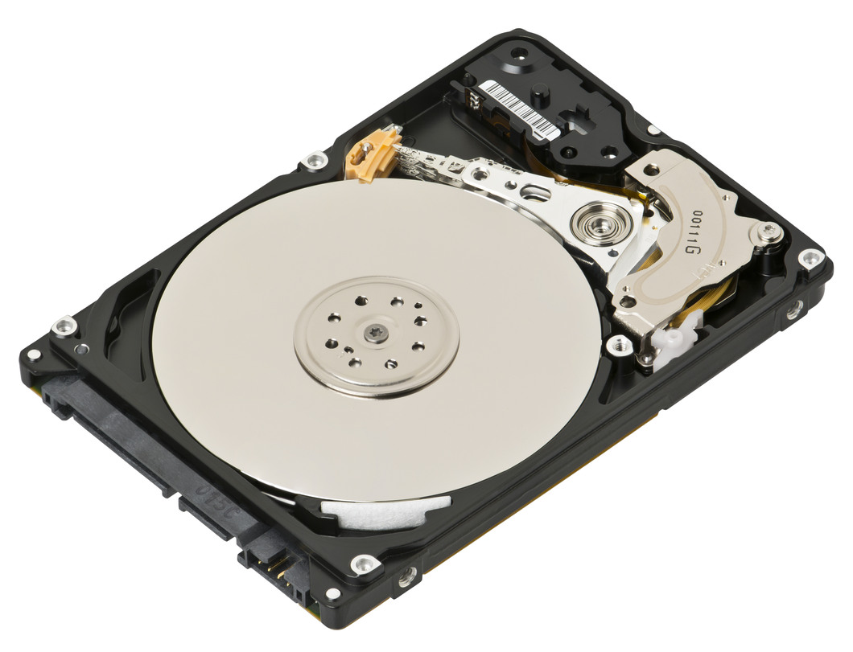

From a storage device to a data centre
A drive stores the scan
A rack holds multiple servers
A server reads it when a depot requests the image.
The data centre supplies their electricity, cooling and network.
BIG DATA · TECHNOLOGIES
08 / 42
Notes:
Point to the drive bays, then one rack-mounted server, then the rack holding the machines. Ask where cooling and shared power are supplied. Photo credit: AI-generated teaching illustration. Allow about one minute. Follow one scan. A drive holds the file, a server handles requests, and a rack groups machines. A data centre supplies power, networking and cooling. Software indexes and retrieves the scan by ID. Ask which part would help if many depots requested the same file at once.
SOURCE AND RESOURCE ALIGNMENT
01-big-data(3).md, sections 2.1–2.5
Attached teaching guide: 01-big-data(3).md, section 2.1–2.5
Repository companion: https://github.com/Voryalis/aleksandria/blob/main/docs/01-big-data.md#14-bigger-datasets-what-changes
ARTWORK AND DESIGN CREDITS
Laptop-hard-drive-exposed.jpg. Evan-Amos, CC BY-SA 3.0. Resized. https://creativecommons.org/licenses/by-sa/3.0/ https://commons.wikimedia.org/wiki/File:Laptop-hard-drive-exposed.jpg

Slide 9
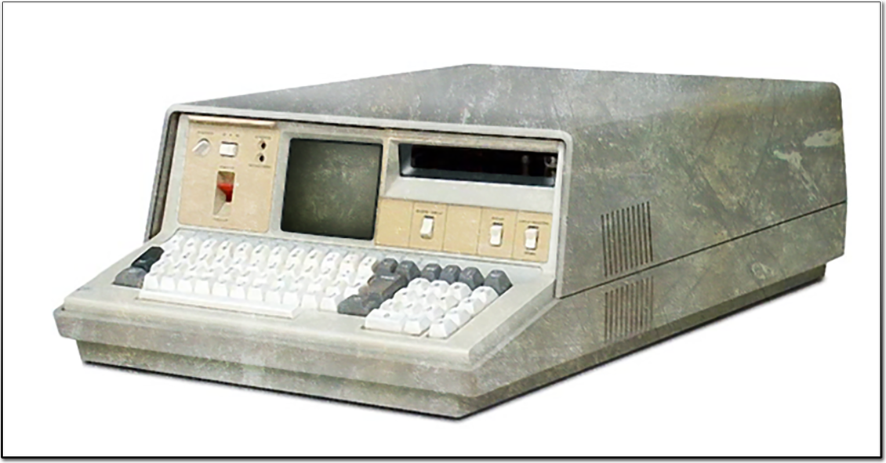
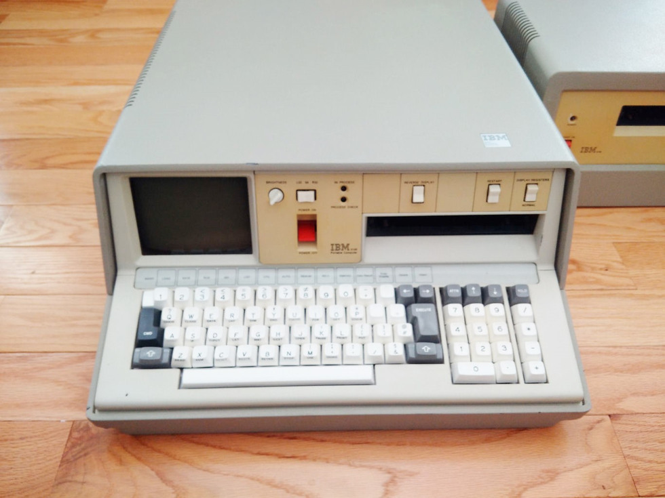
Local files, network storage and the cloud
One depot
Several depots
Network-attached storage (NAS) lets devices share files over the local network.
Cloud storage lets sites retrieve scans over a wide-area network. Access depends on connectivity and permissions.
STEINS;GATE AND EARLY PORTABLE COMPUTING
IBN 5100 · IN-GAME COMPUTER
IBM 5100 · HISTORICAL COMPUTER
BIG DATA · TECHNOLOGIES
09 / 42
Notes:
Allow about one minute. NAS means network-attached storage. LAN, MAN and WAN describe local, metropolitan and wide-area networks. A depot can buy a cloud service from another business (B2B); a customer tracking a parcel uses a consumer-facing service (B2C). Compare the need for offline access with the cost of supporting hardware.
SOURCE AND RESOURCE ALIGNMENT
01-big-data(3).md, sections 3.1–3.5
ARTWORK AND DESIGN CREDITS
IBN 5100 computer illustration. Steins;Gate (Steam HD Edition), archived by Adrot. https://www.spriters-resource.com/pc_computer/steinsgatesteamhdedition/asset/107526/
IBM 5100 (1).jpg. Wikimedia Commons, CC0 1.0. https://creativecommons.org/publicdomain/zero/1.0/ https://commons.wikimedia.org/wiki/File:IBM_5100_(1).jpg
Steins;Gate game artwork retains its original rights and falls outside the ALEKSANDRIA content license.

Slide 10
Storing and processing scans
Daily batch
Live event stream
Group a day of scan records by depot. Count failures and divide by the number of scans.
Update a five-minute failure rate as scans arrive. Alert staff while there is time to inspect the scanner.
BIG DATA · PROCESSING
10 / 42
Notes:
Allow about one minute. Keep image files in object storage and searchable event records in a table. When scale warrants it, partition the work across machines. Hadoop HDFS is one distributed file system and Spark is one processing engine.
SOURCE AND RESOURCE ALIGNMENT
https://github.com/Voryalis/aleksandria/blob/main/docs/01-big-data.md
Attached teaching guide: 01-big-data(3).md, section 4.1–4.2
Repository companion: https://github.com/Voryalis/aleksandria/blob/main/docs/01-big-data.md#14-bigger-datasets-what-changes

Slide 11
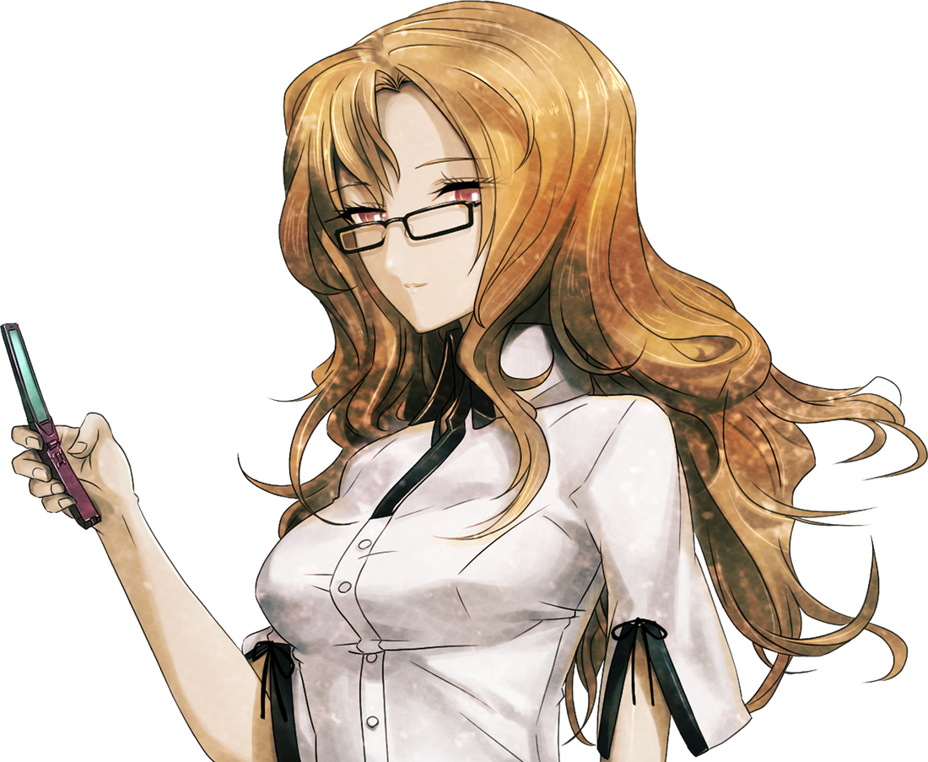
Activity · Inspect the dataset first
Some images of 7 are labelled as 1.
A
The same images appear in training and test sets.
B
Almost every image comes from one writer.
C
What could go wrong? Suggest one fix for each problem.
BIG DATA · PROCESSING
11 / 42
Notes:
ACTIVITY — allow 45 seconds to think and 45 seconds to discuss. Read the three defects. Ask for one consequence and one fix for each. Do not show the next slide before learners respond. Explain only the task, without suggesting the answers. This activity aligns with Chapter 1 data quality and Tutorial 1 preparation. No external software is required.
SOURCE AND RESOURCE ALIGNMENT
https://github.com/Voryalis/aleksandria/blob/main/docs/01-big-data.md — preparing a dataset
https://github.com/Voryalis/aleksandria/blob/main/videos/first-video-storyboard.md
Attached teaching guide: 01-big-data(3).md, section 1.2.2
Repository companion: https://github.com/Voryalis/aleksandria/blob/main/docs/01-big-data.md#15-try-it-yourself
ARTWORK AND DESIGN CREDITS
Moeka Kiryu portrait. Steins;Gate (Steam HD Edition), archived by Adrot. https://www.spriters-resource.com/pc_computer/steinsgatesteamhdedition/asset/107536/
Steins;Gate game artwork retains its original rights and falls outside the ALEKSANDRIA content license.

Slide 12
Dataset fixes and their reasons
Check labels against the original images.
A
Keep duplicate images out of the test set.
B
Include varied handwriting and unseen writers.
C
Reliable evaluation starts with how the data is prepared.
BIG DATA · PROCESSING
12 / 42
Notes:
DEBRIEF — about 2 minutes. A: check against original images, correct or exclude ambiguous labels; incorrect targets teach an unintended mapping. B: remove duplicate leakage and partition original examples before generating variants; repeated images can inflate test results. C: gather representative handwriting and evaluate on unseen writers. More data helps only when it is relevant and appropriately collected. Explain why privacy and consent matter when collecting identifiable handwriting. Transition: represent a checked image numerically.
SOURCE AND RESOURCE ALIGNMENT
https://github.com/Voryalis/aleksandria/blob/main/docs/01-big-data.md — data-quality activity and answers
Data quality: Chapter 1, Section 1.2.2 (Veracity).
Repository companion: https://github.com/Voryalis/aleksandria/blob/main/docs/01-big-data.md#122-veracity

Slide 13
Failed scans per 100 scans
Each day covers 100 scans.
What else could explain Tuesday’s peak?
Would you replace the scanner after Tuesday? What would you check first?
BIG DATA · VISUALIZATION
13 / 42
Notes:
Give learners 20 seconds to vote: replace the scanner after Tuesday, or investigate first? Ask for one piece of evidence. A defensible answer is to inspect similar shifts, lighting and device logs. Three illustrative days show variation and cannot establish a hardware fault. Each denominator is 100 scans.
SOURCE AND RESOURCE ALIGNMENT
Classroom example using illustrative data.
Attached teaching guide: 01-big-data(3).md, section 4.3
Repository companion: https://github.com/Voryalis/aleksandria/blob/main/docs/01-big-data.md#14-bigger-datasets-what-changes

Slide 14
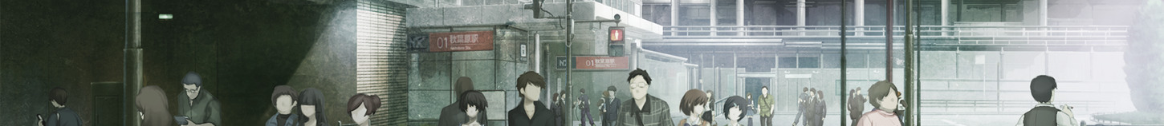
Two decisions at the sorting depot
Plan the next shift
Route one parcel
Count scans and failures by hour. Compare similar shifts to decide when reviewers are needed.
Inspect its cropped postcode. If a digit is uncertain, ask a person to check it.
Which task needs the original image?
BIG DATA · USE CASES
14 / 42
Notes:
Allow one minute. Ask whether a supervisor needs addresses to plan shifts. Aggregate counts can answer that question. Resolving a sorting exception requires a cropped image and a human-checked label. This distinction motivates the access decision on the next slide.
SOURCE AND RESOURCE ALIGNMENT
01-big-data(3).md, sections 4.1–4.4
Attached teaching guide: 01-big-data(3).md, section 4.4
Repository companion: https://github.com/Voryalis/aleksandria/blob/main/docs/04-case-study.md#48-from-classroom-illustration-to-real-use
ARTWORK AND DESIGN CREDITS
Akihabara Station plaza background. Steins;Gate (Steam HD Edition), archived by Adrot. https://www.spriters-resource.com/pc_computer/steinsgatesteamhdedition/asset/107518/
Steins;Gate game artwork retains its original rights and falls outside the ALEKSANDRIA content license.

Slide 15
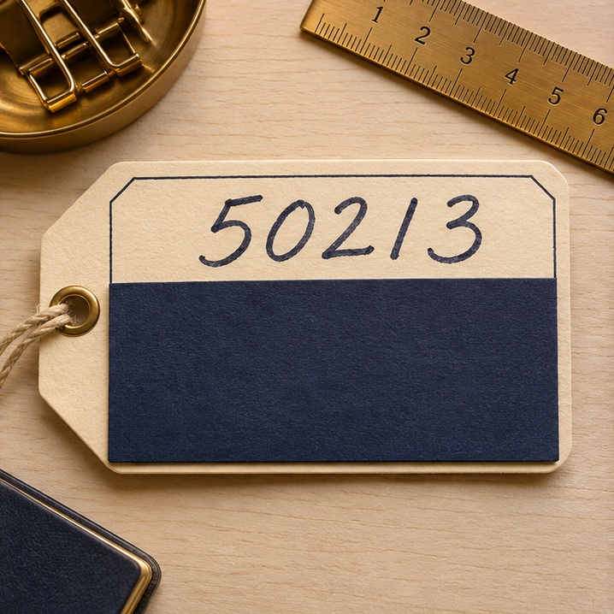
Who can use a parcel scan?
Which part would you share?
For this exercise, learners need only the handwritten 5.
Prepare the classroom copy
Crop the 5 before sharing. Restrict access to the original scan.
BIG DATA · ETHICS AND PRIVACY
15 / 42
Notes:
Give the class 15 seconds to name the smallest useful crop. The cover on this staged label hides address details, but even the full postcode is unnecessary here. Export only the single digit for the exercise. Photo credit: AI-generated teaching illustration. Allow about one minute. The chapter raises privacy, consent, security and bias. A full parcel label can reveal a name and address. A cropped digit is enough for this recognition exercise. Discuss who needs raw images and when copies should be removed.
SOURCE AND RESOURCE ALIGNMENT
01-big-data(3).md, section 5

Slide 16

CONNECTIONIST AI
16 / 42
Rules and learned connections
Symbolic rule
A postcode field requires five digits. A length check can flag an incomplete entry.
Connectionist model
Handwritten fives vary in shape. A network learns weighted connections from labelled images.
A sorting system can recognize a digit with a network and check the result with a rule.
Notes:
Allow about one minute. Bring back the cropped digit from the previous slide. Ask what a length check can tell us about its shape. It cannot identify the digit. An explicit rule can reject a postcode with the wrong length. Connectionist AI uses networks of simple units whose weights can be learned from examples. Both methods can be used in a sorting system. AI is the broader field; machine learning includes learning from data, and deep learning uses multilayer networks.
SOURCE AND RESOURCE ALIGNMENT
02-connectionist-ai(4).md, sections 1.1–1.3
Attached teaching guide: 02-connectionist-ai(4).md, section 1.1–1.3
Repository companion: https://github.com/Voryalis/aleksandria/blob/main/docs/02-connectionist-ai.md#21-from-data-to-an-artificial-neuron
ARTWORK AND DESIGN CREDITS
Steins;Gate game artwork retains its original rights and falls outside the ALEKSANDRIA content license.
Future Gadget Laboratory artwork (daylight sitting area). Steins;Gate (Steam HD Edition), archived by Adrot. https://www.spriters-resource.com/pc_computer/steinsgatesteamhdedition/asset/107557/
Kurisu Makise in a lab coat. Steins;Gate (Steam HD Edition), archived by Adrot. https://www.spriters-resource.com/pc_computer/steinsgatesteamhdedition/asset/107533/

Slide 17
An image becomes a vector of numbers
1
1
1
1
1
Read rows in a fixed order
1
0
0
0
0
[1, 1, 1, 1, 1,
1, 0, 0, 0, 0, …]
1
1
1
1
0
0
0
0
0
1
1
1
1
1
1
25 pixel features
Target label: 5
Illustrative 5 × 5 image
CONNECTIONIST AI · NEURAL NETWORK BASICS
17 / 42
Notes:
ABOUT 2 minutes. Walk through the invented 5 by 5 image of a five. Dark cells represent 255 and light cells 0; dividing by 255 gives 1 or 0. Read the first row left to right, then continue row by row. This produces 25 features for this toy example. Real MNIST images are 28 by 28, so flattening gives 784 features; the toy image is not an MNIST sample. A grayscale value such as 128 would become approximately 0.502. The target label 5 is separate from these features. Tutorial 1 uses this image-to-data route.
SOURCE AND RESOURCE ALIGNMENT
https://github.com/Voryalis/aleksandria/blob/main/docs/01-big-data.md — pixel representation and normalization
https://github.com/Voryalis/aleksandria/blob/main/videos/first-video-storyboard.md
Image preparation: Chapter 4, Section 4.3 (Preparing the Image).
Repository companion: https://github.com/Voryalis/aleksandria/blob/main/docs/04-case-study.md#43-preparing-the-image
Tutorial scene: https://github.com/Voryalis/aleksandria/blob/main/videos/first-video-storyboard.md#scene-3--replace-a-picture-with-numbers-035102

Slide 18
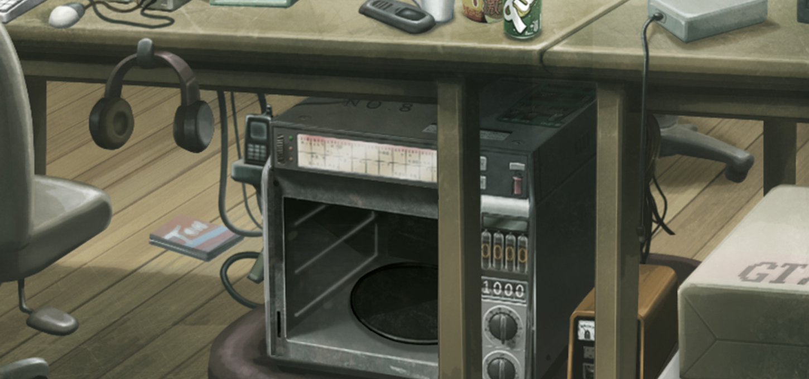
The parts of an artificial neuron
Inputs
Weighted sum
Activation
x₁ and x₂
plus bias
then output
z = w₁x₁ + w₂x₂ + b
ReLU output = max(0, z)
PHONEWAVE · LAB WORKBENCH
CONNECTIONIST AI · NEURAL NETWORK BASICS
18 / 42
Notes:
ABOUT 2 minutes. A connectionist model represents computation through connected units with numerical parameters. Explain one unit before showing a whole network: each input is multiplied by its weight, contributions are added with bias, and an activation function transforms the sum. Weights scale input effects; bias shifts the sum. ReLU returns zero for a negative sum and otherwise returns that sum. This simplified artificial neuron is a mathematical model, not a literal biological neuron.
SOURCE AND RESOURCE ALIGNMENT
https://github.com/Voryalis/aleksandria/blob/main/docs/02-connectionist-ai.md — weighted inputs, bias and activation
Attached teaching guide: 02-connectionist-ai(4).md, section 2.2–2.3
Repository companion: https://github.com/Voryalis/aleksandria/blob/main/docs/02-connectionist-ai.md#21-from-data-to-an-artificial-neuron
ARTWORK AND DESIGN CREDITS
Future Gadget Laboratory artwork (PhoneWave close-up). Steins;Gate (Steam HD Edition), archived by Adrot. https://www.spriters-resource.com/pc_computer/steinsgatesteamhdedition/asset/107557/
Steins;Gate game artwork retains its original rights and falls outside the ALEKSANDRIA content license.

Slide 19
A worked neuron calculation
Inputs and parameters
Calculation
x₁ = 0.8 w₁ = 0.5
x₂ = 0.2 w₂ = −0.25
b = 0.1
z = 0.40 − 0.05 + 0.10
z = 0.45
ReLU(0.45) = 0.45
The value 0.45 is this neuron’s activation. The network’s output layer supplies the digit scores.
CONNECTIONIST AI · NEURAL NETWORK BASICS
19 / 42
Notes:
ABOUT 2 minutes. This uses the Chapter 2 teaching values. Calculate each contribution aloud: 0.5 times 0.8 is 0.40; negative 0.25 times 0.2 is negative 0.05. Add the bias 0.10 to obtain 0.45. ReLU leaves the positive result unchanged. A negative weight reduces this sum for a positive input. The result is a neuron activation, not a probability or predicted digit. Transition: test the effect of changing bias.
SOURCE AND RESOURCE ALIGNMENT
https://github.com/Voryalis/aleksandria/blob/main/docs/02-connectionist-ai.md — worked neuron computation
Attached teaching guide: 02-connectionist-ai(4).md, section 2.2
Repository companion: https://github.com/Voryalis/aleksandria/blob/main/docs/02-connectionist-ai.md#22-worked-example--one-neuron-step-by-step

Slide 20

Activity · Change only the bias
Keep the weighted inputs: 0.40 and −0.05
New bias b = −0.50
Calculate z. Then calculate ReLU(z).
CONNECTIONIST AI · NEURAL NETWORK BASICS
20 / 42
Notes:
ACTIVITY — give 45 seconds, then ask a learner to explain their steps. Inputs and weights remain exactly as on the previous slide. Only bias changes to negative 0.50. Ask for both the pre-activation weighted sum and the post-activation output. Do not reveal the answer until the next slide. If needed, hint that the two weighted input contributions are 0.40 and negative 0.05.
SOURCE AND RESOURCE ALIGNMENT
https://github.com/Voryalis/aleksandria/blob/main/docs/02-connectionist-ai.md — changed-bias example
Attached teaching guide: 02-connectionist-ai(4).md, section 2.2
Repository companion: https://github.com/Voryalis/aleksandria/blob/main/docs/02-connectionist-ai.md#25-activities--show-your-reasoning
ARTWORK AND DESIGN CREDITS
Kurisu Makise with her arms crossed. Steins;Gate (Steam HD Edition), archived by Adrot. https://www.spriters-resource.com/pc_computer/steinsgatesteamhdedition/asset/107533/
Steins;Gate game artwork retains its original rights and falls outside the ALEKSANDRIA content license.

Slide 21
A negative sum gives zero
z = 0.40 − 0.05 − 0.50 = −0.15
ReLU(−0.15) = 0
Bias shifts the sum. Activation determines the output.
CONNECTIONIST AI · NEURAL NETWORK BASICS
21 / 42
Notes:
DEBRIEF — about 1 minute. 0.40 minus 0.05 minus 0.50 equals negative 0.15. ReLU maps this to zero. Correct the misconception that bias is always positive or that changing one parameter must improve a prediction. We have demonstrated a mathematical effect, not trained a model or shown lower loss.
SOURCE AND RESOURCE ALIGNMENT
https://github.com/Voryalis/aleksandria/blob/main/docs/02-connectionist-ai.md — changed-bias example
Attached teaching guide: 02-connectionist-ai(4).md, section 2.3
Repository companion: https://github.com/Voryalis/aleksandria/blob/main/docs/02-connectionist-ai.md#22-worked-example--one-neuron-step-by-step

Slide 22
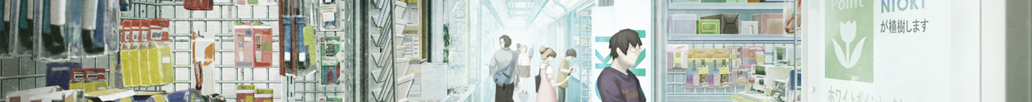
Which architecture fits the input?
Convolutional neural network
Recurrent neural network
A convolutional filter looks for a stroke at different positions in an image.
A recurrent network carries information from one step to the next, such as the order of letters in a word.
Reading a handwritten word requires both stroke shapes and their order.
CONNECTIONIST AI · NETWORK ARCHITECTURES
22 / 42
Notes:
Allow about one minute. An MLP connects layers of units and can accept flattened pixel values. A CNN shares filters across nearby pixels. Recurrent networks carry a hidden state through a sequence; an LSTM uses gates to control which information it retains. For a line of handwriting, local image features and their order can both matter.
SOURCE AND RESOURCE ALIGNMENT
02-connectionist-ai(4).md, sections 3.5 and 4.1–4.4
Attached teaching guide: 02-connectionist-ai(4).md, section 3.5 and 4.1–4.4
Repository companion: https://github.com/Voryalis/aleksandria/blob/main/docs/02-connectionist-ai.md#23-connect-neurons-into-layers
ARTWORK AND DESIGN CREDITS
Akihabara covered arcade background. Steins;Gate (Steam HD Edition), archived by Adrot. https://www.spriters-resource.com/pc_computer/steinsgatesteamhdedition/asset/107518/
Steins;Gate game artwork retains its original rights and falls outside the ALEKSANDRIA content license.

Slide 23
Which pixel pair signals an edge?
Predict the filter response
A filter with weights [1, −1] gives:
A
Two ink pixels [1, 1]
B
Ink beside paper [1, 0]
Same digit 5
Calculate first pixel minus second pixel. Which pair gives the larger response?
CONNECTIONIST AI · DEEP LEARNING
23 / 42
Notes:
Allow 90 seconds. The gold cells are the first two ink pixels on row one. Give pairs 20 seconds to choose A or B and calculate both responses. Take a vote, then advance to slide 24 for the reveal. This illustrative fixed filter can detect one edge orientation; trained networks learn many filters. Earlier image layers can respond to local edges. Later layers can combine those responses into patterns relevant to classification. These descriptions are illustrative. Individual units need not have a simple human-readable interpretation.
SOURCE AND RESOURCE ALIGNMENT
https://github.com/Voryalis/aleksandria/blob/main/docs/03-neural-networks-learning.md
Attached teaching guide: 02-connectionist-ai(4).md, section 3.2–3.4
Repository companion: https://github.com/Voryalis/aleksandria/blob/main/docs/02-connectionist-ai.md#23-connect-neurons-into-layers

Slide 24

The edge produces the larger response
A Across ink
1 × 1 + (−1) × 1 = 0
B Ink to paper
1 × 1 + (−1) × 0 = 1
This filter detects a local change. Several digits share the same edge.
CONNECTIONIST AI · DEEP LEARNING
24 / 42
Notes:
Allow one minute. Reveal B after the vote. Two equal values cancel; the ink-to-paper change gives a positive response. Reversing the order would give −1. A single edge occurs in many digits. The next layers combine multiple features, as slide 27 illustrates. Photo is an AI-generated classroom illustration.
SOURCE AND RESOURCE ALIGNMENT
https://github.com/Voryalis/aleksandria/blob/main/docs/02-connectionist-ai.md
Attached teaching guide: 02-connectionist-ai(4).md, section 4.3
Repository companion: https://github.com/Voryalis/aleksandria/blob/main/docs/04-case-study.md#42-meet-the-mnist-dataset
Tutorial scene: https://github.com/Voryalis/aleksandria/blob/main/videos/first-video-storyboard.md#scene-6--pair-input-with-the-correct-training-label-144206

Slide 25
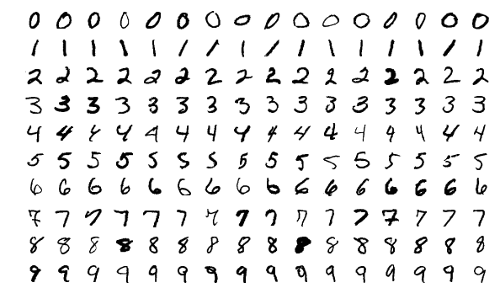
The MNIST digit collection
Standard training set
60,000
labelled images. Reserve a portion for validation when comparing models.
Standard test set
10,000
labelled images for evaluating the selected model.
SAMPLES FROM THE MNIST TEST SET
Each grayscale image measures 28 × 28 pixels and has one digit label.
CONNECTIONIST AI · DEEP LEARNING
25 / 42
Notes:
Allow about one minute. Contrast the 5 × 5 classroom sketch with the real dataset dimensions. Each of the ten digit classes can appear in many handwriting styles.
SOURCE AND RESOURCE ALIGNMENT
https://github.com/Voryalis/aleksandria/blob/main/docs/04-case-study.md
https://keras.io/api/datasets/mnist/
Attached teaching guide: 03-neural-networks-learning(1).md, section 3.1
Repository companion: https://github.com/Voryalis/aleksandria/blob/main/docs/04-case-study.md#42-meet-the-mnist-dataset
ARTWORK AND DESIGN CREDITS
MnistExamples.png. Josef Steppan, CC BY-SA 4.0. https://creativecommons.org/licenses/by-sa/4.0/ https://commons.wikimedia.org/wiki/File:MnistExamples.png

Slide 26

Preparing the tutorial’s digit 5
28 × 28 pixels
Divide values by 255
Read rows in order
MNIST SAMPLE
The model receives 784 values. The checked label 5 stays separate.
CONNECTIONIST AI · DEEP LEARNING
26 / 42
Notes:
Allow about one minute. A dark digit on a white slide can use an inverted display palette. Changing pixel values is a separate preprocessing decision that must be consistent across examples.
SOURCE AND RESOURCE ALIGNMENT
https://github.com/Voryalis/aleksandria/blob/main/docs/04-case-study.md
https://github.com/Voryalis/aleksandria/blob/main/videos/first-video-storyboard.md
Attached teaching guide: 02-connectionist-ai(4).md, section 4.3
Repository companion: https://github.com/Voryalis/aleksandria/blob/main/docs/04-case-study.md#43-preparing-the-image
Tutorial scene: https://github.com/Voryalis/aleksandria/blob/main/videos/first-video-storyboard.md#scene-5--form-the-model-input-126144
ARTWORK AND DESIGN CREDITS
Handwritten five cropped from MnistExamples.png. Josef Steppan, CC BY-SA 4.0. Cropped and enlarged with nearest-neighbour scaling. https://creativecommons.org/licenses/by-sa/4.0/ https://commons.wikimedia.org/wiki/File:MnistExamples.png

Slide 27
How features contribute to a digit score
Two hidden units respond with 1 and 0.5 in this example.
Output for digit 5
Output for digit 3
2 × 1 + 1 × 0.5 = 2.5
1 × 1 + 2 × 0.5 = 2.0
Each class weights the same features differently. These are raw scores.
CONNECTIONIST AI · DEEP LEARNING
27 / 42
Notes:
Allow two minutes. In the illustrative fully connected model, 784 pixels feed 128 hidden units, then ten output units. Each output has its own weights and bias. For the hand calculation, keep only two hidden-unit responses and set both output biases to zero. These invented raw scores illustrate the arithmetic and are separate from the probability example on slide 28. Hidden features need not have simple visual names.
SOURCE AND RESOURCE ALIGNMENT
https://github.com/Voryalis/aleksandria/blob/main/docs/04-case-study.md
Attached teaching guide: 02-connectionist-ai(4).md, section 3.2
Repository companion: https://github.com/Voryalis/aleksandria/blob/main/docs/04-case-study.md#44-how-the-network-makes-a-prediction
Tutorial scene: https://github.com/Voryalis/aleksandria/blob/main/videos/second-video-storyboard.md#scene-2--show-the-network-producing-a-prediction-020046

Slide 28
Prediction and target label are different
Hypothetical model output
Checked reference
Digit 3
60%
Target label 5
Digit 5
30%
Predicted label 3
Other digits together
10%
This prediction is incorrect.
The prediction comes from the model. The target comes with the data.
CONNECTIONIST AI · DEEP LEARNING
28 / 42
Notes:
ABOUT 2 minutes. All displayed probabilities are invented, total 100 percent, and come from the video storyboard. The model predicts 3 because its probability is highest. The checked target label is 5, so this prediction is incorrect. The remaining eight classes share 10 percent. A target is supplied during supervised training and evaluation; an unknown image can be predicted without knowing its true label. These probabilities do not establish a measured accuracy. Transition: how does training respond to this error?
SOURCE AND RESOURCE ALIGNMENT
https://github.com/Voryalis/aleksandria/blob/main/docs/03-neural-networks-learning.md — prediction versus target
https://github.com/Voryalis/aleksandria/blob/main/videos/second-video-storyboard.md
Attached teaching guide: 03-neural-networks-learning(1).md, section 3.2
Repository companion: https://github.com/Voryalis/aleksandria/blob/main/docs/03-neural-networks-learning.md#32-a-prediction-is-not-the-correct-answer
Tutorial scene: https://github.com/Voryalis/aleksandria/blob/main/videos/second-video-storyboard.md#scene-3--compare-the-prediction-with-the-label-046112

Slide 29
A loss value for the tutorial prediction
The correct digit is 5. The model assigned it 30%.
Loss = −ln(0.30) ≈ 1.20
Assigning a higher probability to the correct digit would reduce this loss.
CONNECTIONIST AI · DEEP LEARNING
29 / 42
Notes:
Allow about one minute. Use the probability assigned to the correct class. For a target of 5, the relevant probability is 0.30. The natural logarithm gives a cross-entropy of about 1.20 for this one training example.
SOURCE AND RESOURCE ALIGNMENT
https://github.com/Voryalis/aleksandria/blob/main/docs/04-case-study.md
https://github.com/Voryalis/aleksandria/blob/main/videos/second-video-storyboard.md
Attached teaching guide: 03-neural-networks-learning(1).md, section 3.3
Repository companion: https://github.com/Voryalis/aleksandria/blob/main/docs/03-neural-networks-learning.md#33-loss-putting-a-number-on-the-mismatch
Tutorial scene: https://github.com/Voryalis/aleksandria/blob/main/videos/second-video-storyboard.md#scene-4--give-the-loss-a-concrete-meaning-112139

Slide 30
Squared error for a numerical prediction
Target 1.0, output 0.6
Target 1.0, output 0.9
(0.6 − 1.0)² = 0.16
(0.9 − 1.0)² = 0.01
Moving the numerical output closer to the target reduces squared error.
CONNECTIONIST AI · DEEP LEARNING
30 / 42
Notes:
Allow about one minute. Compare the same target with two numerical outputs. Squaring each difference gives the displayed losses. Digit labels are categories; the preceding slide used the probability assigned to the checked class.
SOURCE AND RESOURCE ALIGNMENT
03-neural-networks-learning(1).md, section 3.3

Slide 31
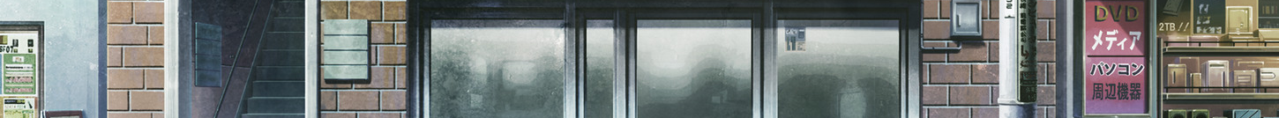
Training and inference
Training
Inference
Input plus known target
Measure loss
Update weights and biases
New prepared input
Use fixed model parameters
Produce a prediction
A prediction can be made before its true label is known.
CONNECTIONIST AI · DEEP LEARNING
31 / 42
Notes:
ABOUT 90 seconds. Training uses labelled examples and a loss signal to update the model. Inference uses the selected parameters to produce an output for an input. The target label is not required to make a prediction for an unknown image. This slide describes a conventional supervised model with fixed parameters during inference. Comparison inspired by the supplied Aleksandria extended deck slide 35 and the Connectionist AI reference teaching sequence.
SOURCE AND RESOURCE ALIGNMENT
https://github.com/Voryalis/aleksandria/blob/main/docs/03-neural-networks-learning.md
Attached teaching guide: 03-neural-networks-learning(1).md, section 3.1
Repository companion: https://github.com/Voryalis/aleksandria/blob/main/docs/03-neural-networks-learning.md#31-learning-from-examples-with-known-answers
ARTWORK AND DESIGN CREDITS
Mr. Braun’s TV shop background. Steins;Gate (Steam HD Edition), archived by Adrot. https://www.spriters-resource.com/pc_computer/steinsgatesteamhdedition/asset/107516/
Steins;Gate game artwork retains its original rights and falls outside the ALEKSANDRIA content license.

Slide 32
The supervised training cycle
Predict
Measure loss
Compute gradients
Update parameters
Repeat with labelled training examples
Learning changes weights and biases.
CONNECTIONIST AI · DEEP LEARNING
32 / 42
Notes:
ABOUT 2 minutes. Start with input and known target. A forward pass produces an output; a loss function compares output with target. Backpropagation computes gradients indicating how parameters affect loss. An optimizer uses those gradients and a learning rate to update weights and biases. Repeat across training data. Backpropagation and the optimizer update are different operations. Show the sequence left to right, then explain repetition verbally. A single update need not fix the prediction or improve performance on unseen data.
SOURCE AND RESOURCE ALIGNMENT
https://github.com/Voryalis/aleksandria/blob/main/docs/03-neural-networks-learning.md — loss, backpropagation and optimizer updates
https://github.com/Voryalis/aleksandria/blob/main/videos/second-video-storyboard.md
Attached teaching guide: 03-neural-networks-learning(1).md, section 3.4
Repository companion: https://github.com/Voryalis/aleksandria/blob/main/docs/03-neural-networks-learning.md#34-gradients-and-backpropagation
Tutorial scene: https://github.com/Voryalis/aleksandria/blob/main/videos/second-video-storyboard.md#scene-5--backpropagation-calculates-gradients-139204

Slide 33
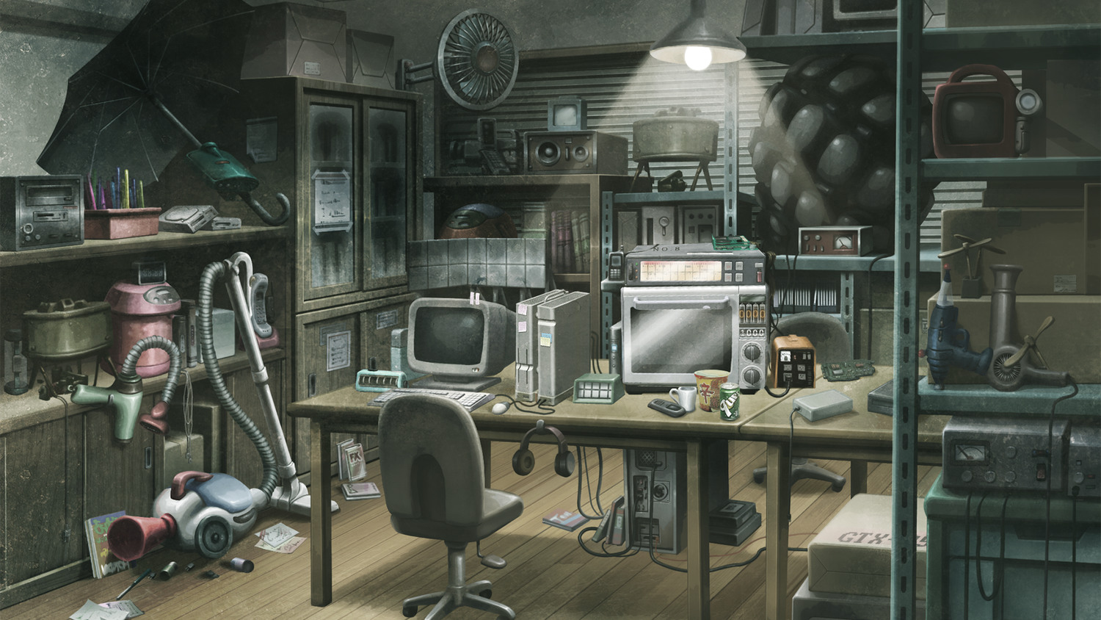
FUTURE GADGET LABORATORY
33 / 42
One small parameter update
new weight = old weight
− learning rate × gradient
Weight 0.40 Learning rate 0.10 Gradient +0.20
Will the weight rise or fall? Vote, then calculate its new value.
Notes:
Allow 20 seconds for a vote, then 20 seconds to calculate. Reveal aloud: lower, because a positive gradient means that increasing the weight locally increases loss. New weight = 0.40 − 0.10 × 0.20 = 0.38. This is an independent scalar example, not a gradient derived from the classifier probabilities in the earlier prediction example. Old weight is 0.40, learning rate is 0.10, and the illustrative gradient is 0.20. Subtract learning rate times gradient: 0.40 minus 0.02 equals 0.38. A positive gradient means increasing this parameter locally increases the loss, so a small descent step reduces it. Do not claim guaranteed improvement for arbitrary step sizes or future test results. Biases can also be updated.
SOURCE AND RESOURCE ALIGNMENT
https://github.com/Voryalis/aleksandria/blob/main/docs/03-neural-networks-learning.md — optimizer update
https://github.com/Voryalis/aleksandria/blob/main/videos/second-video-storyboard.md
Attached teaching guide: 03-neural-networks-learning(1).md, section 3.5
Repository companion: https://github.com/Voryalis/aleksandria/blob/main/docs/03-neural-networks-learning.md#35-the-optimizer-updates-parameters
Tutorial scene: https://github.com/Voryalis/aleksandria/blob/main/videos/second-video-storyboard.md#scene-6--optimizer-updates-weights-204231
ARTWORK AND DESIGN CREDITS
Future Gadget Laboratory workbench artwork, Steins;Gate (Steam HD Edition), archived by Adrot. https://www.spriters-resource.com/pc_computer/steinsgatesteamhdedition/asset/107557/
Steins;Gate game artwork retains its original rights and falls outside the ALEKSANDRIA content license.
Future Gadget Laboratory artwork (electronics workbench). Steins;Gate (Steam HD Edition), archived by Adrot. https://www.spriters-resource.com/pc_computer/steinsgatesteamhdedition/asset/107557/

Slide 34
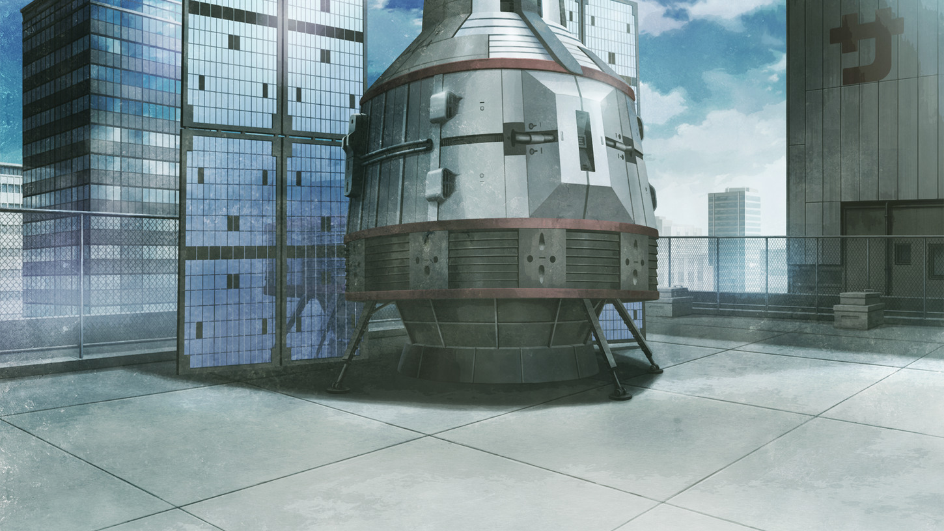
Training and evaluation use different data
Training
Adjust parameters
Validation
Choose settings
Test
Evaluate the chosen model
RADIO KAIKAN ROOFTOP
Weight check 0.40 − 0.10 × 0.20 = 0.38. Test the effect on unseen data.
CONNECTIONIST AI · DEEP LEARNING
34 / 42
Notes:
ABOUT 2 minutes. Training data changes parameters. Validation data supports choices such as learning rate or stopping point. Test data evaluates a chosen model after those decisions. All sets should be appropriately separated; near-duplicates and related writers can leak information. If a test result is used repeatedly to tune choices, it becomes part of development and ceases to be a clean final check. No fixed percentage split is required here.
SOURCE AND RESOURCE ALIGNMENT
https://github.com/Voryalis/aleksandria/blob/main/docs/03-neural-networks-learning.md — training, validation and test sets
Attached teaching guide: 03-neural-networks-learning(1).md, section 3.6
Repository companion: https://github.com/Voryalis/aleksandria/blob/main/docs/03-neural-networks-learning.md#36-why-good-training-results-are-not-enough
Tutorial scene: https://github.com/Voryalis/aleksandria/blob/main/videos/second-video-storyboard.md#scene-7--repeat-training-then-evaluate-231302
ARTWORK AND DESIGN CREDITS
Time machine on the Radio Kaikan rooftop. Steins;Gate (Steam HD Edition), archived by Adrot. https://www.spriters-resource.com/pc_computer/steinsgatesteamhdedition/asset/107559/
Steins;Gate game artwork retains its original rights and falls outside the ALEKSANDRIA content license.

Slide 35
Recognizing an image and generating one
Recognition
Generation
A classifier scores possible digit labels for an existing image.
A diffusion model starts with noise and progressively refines an image using learned patterns.
A generated reconstruction of a damaged manuscript can contain invented details.
CONNECTIONIST AI · APPLICATIONS
35 / 42
Notes:
Allow about one minute. CNNs can classify image content, while a diffusion model can synthesize images by learning to reverse a noising process. In an archive, a generated reconstruction should be clearly identified. A plausible detail is not historical evidence. Speech recognition is another application where the order of observations matters.
SOURCE AND RESOURCE ALIGNMENT
02-connectionist-ai(4).md, sections 4.1–4.4
Attached teaching guide: 02-connectionist-ai(4).md, section 4.1–4.4
Repository companion: https://github.com/Voryalis/aleksandria/blob/main/docs/04-case-study.md#48-from-classroom-illustration-to-real-use

Slide 36

Responsible use of image data
Would all six be equally easy to read?
Compare errors for faint pencil, thick ink and unfamiliar handwriting.
When the result is uncertain
Send the scan for human review. Keep personal details out of the test set.
CONNECTIONIST AI · ETHICS AND CHALLENGES
36 / 42
Notes:
Ask which writing condition they would test first and why. Accept any defensible answer and ask what labelled examples would be needed to check it. These pictures illustrate visual variation; they are not measured outcomes or examples from six identified writers. Photo credit: AI-generated teaching illustration. ABOUT 90 seconds. Ask learners whether they would collect names together with handwriting when names are unnecessary for the learning task. Minimize personal information and obtain appropriate permission. Evaluate errors across handwriting styles rather than reporting only an average. Explain that an uncertain or consequential result may need human review. Adapted from the responsible-use topics in the supplied Aleksandria extended deck and Connectionist AI reference; no legal compliance claim is made.
SOURCE AND RESOURCE ALIGNMENT
https://github.com/Voryalis/aleksandria/blob/main/docs/01-big-data.md
https://github.com/Voryalis/aleksandria/blob/main/docs/03-neural-networks-learning.md
Attached teaching guide: 02-connectionist-ai(4).md, section 5
Repository companion: https://github.com/Voryalis/aleksandria/blob/main/docs/04-case-study.md#48-from-classroom-illustration-to-real-use

Slide 37

Where do the errors fall?
 | Predicted 3 | Predicted 5
True digit 3 | 8 | 2
True digit 5 | 4 | 6
MNIST SAMPLES
Which mistake occurs more often? How many of the 20 digits are correct?
CONNECTIONIST AI · ETHICS AND CHALLENGES
37 / 42
Notes:
Allow 30 seconds. Read rows as true labels and columns as predictions. These invented counts cover a two-class exercise. The full MNIST confusion matrix has ten rows and ten columns.
SOURCE AND RESOURCE ALIGNMENT
https://github.com/Voryalis/aleksandria/blob/main/docs/04-case-study.md
Attached teaching guide: 03-neural-networks-learning(1).md, section 3.6
Repository companion: https://github.com/Voryalis/aleksandria/blob/main/docs/04-case-study.md#46-evaluating-the-model
ARTWORK AND DESIGN CREDITS
Handwritten three and five cropped from MnistExamples.png. Josef Steppan, CC BY-SA 4.0. Cropped and enlarged with nearest-neighbour scaling. https://creativecommons.org/licenses/by-sa/4.0/ https://commons.wikimedia.org/wiki/File:MnistExamples.png

Slide 38
What the diagonal tells us
 | Predicted 3 | Predicted 5
True digit 3 | 8 | 2
True digit 5 | 4 | 6
4 fives read as 3
2 threes read as 5
Accuracy = (8 + 6) ÷ 20 = 70%. Investigate the four missed fives.
CONNECTIONIST AI · ETHICS AND CHALLENGES
38 / 42
Notes:
Allow one minute. Read the true-5 row, then the predicted-3 column. Four fives became threes. The reverse happened twice. Add the two highlighted cells to find the number correct. These twenty illustrative cases cannot establish overall MNIST performance.
SOURCE AND RESOURCE ALIGNMENT
https://github.com/Voryalis/aleksandria/blob/main/docs/04-case-study.md
Attached teaching guide: 03-neural-networks-learning(1).md, section 3.6
Repository companion: https://github.com/Voryalis/aleksandria/blob/main/docs/04-case-study.md#46-evaluating-the-model

Slide 39

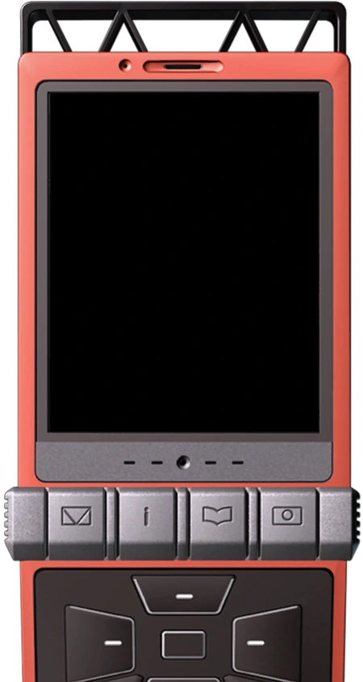
FINAL CASE
39 / 42
A parcel goes to
the wrong route
A new camera scans a handwritten 5. The sorter reads it as 3.
D-MAIL
What should the depot do with this parcel?
DEPOT
ALERT
What would you inspect before changing the model?
Notes:
Allow 45 seconds for pairs to discuss this hypothetical case. Ask for one immediate decision and one diagnostic check. Keep the next slide hidden until two learners have answered. Transition: the depot checks the original label against the image the model received.
ARTWORK AND DESIGN CREDITS
Okabe’s D-Mail phone, Steins;Gate (Steam HD Edition), archived by Adrot. https://www.spriters-resource.com/pc_computer/steinsgatesteamhdedition/asset/107517/
Steins;Gate game artwork retains its original rights and falls outside the ALEKSANDRIA content license.
Future Gadget Laboratory artwork (daylight sitting area). Steins;Gate (Steam HD Edition), archived by Adrot. https://www.spriters-resource.com/pc_computer/steinsgatesteamhdedition/asset/107557/
Suzuha Amane portrait. Steins;Gate (Steam HD Edition), archived by Adrot. https://www.spriters-resource.com/pc_computer/steinsgatesteamhdedition/asset/107545/

Slide 40
What the depot found
The label
A reviewer confirms the 5 and routes the parcel correctly.
The scan
The new crop clipped the top stroke. With the whole digit visible, the same model predicts 5.
The decision
Fix the crop. Check fresh, labelled scans before using the change across the depot.
FINAL CASE · THE MISREAD PARCEL
40 / 42
Notes:
Allow one minute. Reveal the illustrative outcome: hold model weights fixed and compare the original crop with a corrected crop of the same digit. That comparison points to preprocessing as a cause in this case. One successful retry is insufficient to establish a general improvement. Ask how the class would check the fix across writers and camera conditions. Transition: return to the opening image and close the lesson.

Slide 41
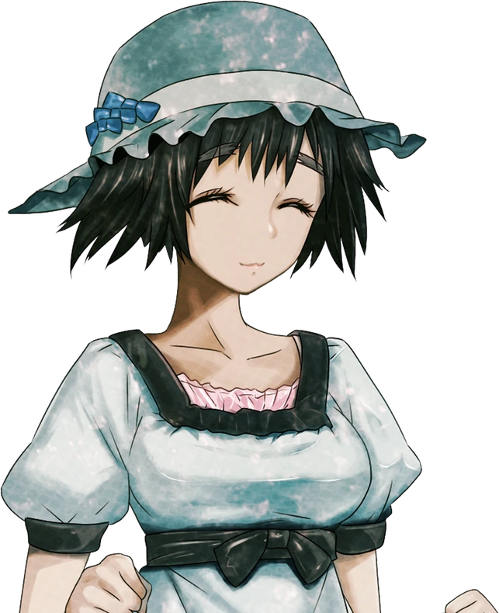
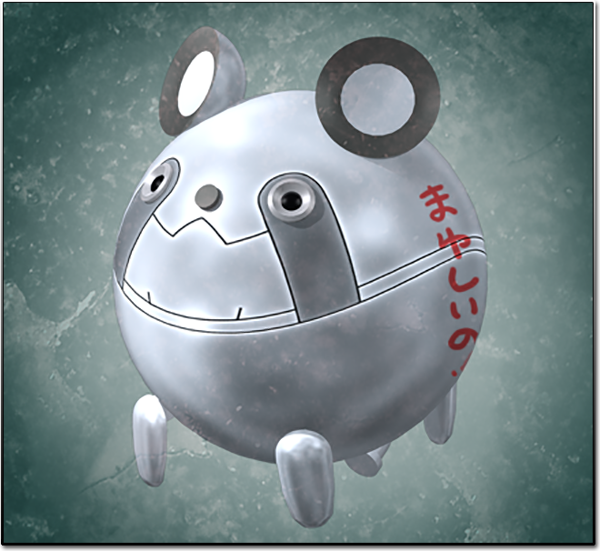
FINAL CASE
41 / 42
What it took to read this 5
The camera captured the strokes. The network used patterns learned from labelled examples to score the image.
The reader needed the whole digit. Before trusting it with the next parcel, test it on handwriting it has never seen.
METAL UPA
Notes:
Close in 30 seconds. Point to the handwritten 5. Ask for one sentence linking the crop, the learned weights and evaluation on unseen scans. Expected answer: a readable crop supplies the features, training teaches the model to score them, and checked new examples show whether the system works in practice. Pause here to end the lesson. For follow-up practice: Big Data §6.2 Q4 and Tutorial 2 scenes 3–6; slides 28–34 provide an offline exercise. Image credit: AI-generated teaching illustration.
ARTWORK AND DESIGN CREDITS
Future Gadget Laboratory artwork and Mayuri Shiina portrait, Steins;Gate (Steam HD Edition), archived by Adrot. https://www.spriters-resource.com/pc_computer/steinsgatesteamhdedition/asset/107557/ | https://www.spriters-resource.com/pc_computer/steinsgatesteamhdedition/asset/107547/
Steins;Gate game artwork retains its original rights and falls outside the ALEKSANDRIA content license.
Future Gadget Laboratory artwork (daylight interior). Steins;Gate (Steam HD Edition), archived by Adrot. https://www.spriters-resource.com/pc_computer/steinsgatesteamhdedition/asset/107557/
Metal Upa charm. Steins;Gate (Steam HD Edition), archived by Adrot. https://www.spriters-resource.com/pc_computer/steinsgatesteamhdedition/asset/107526/

Slide 42
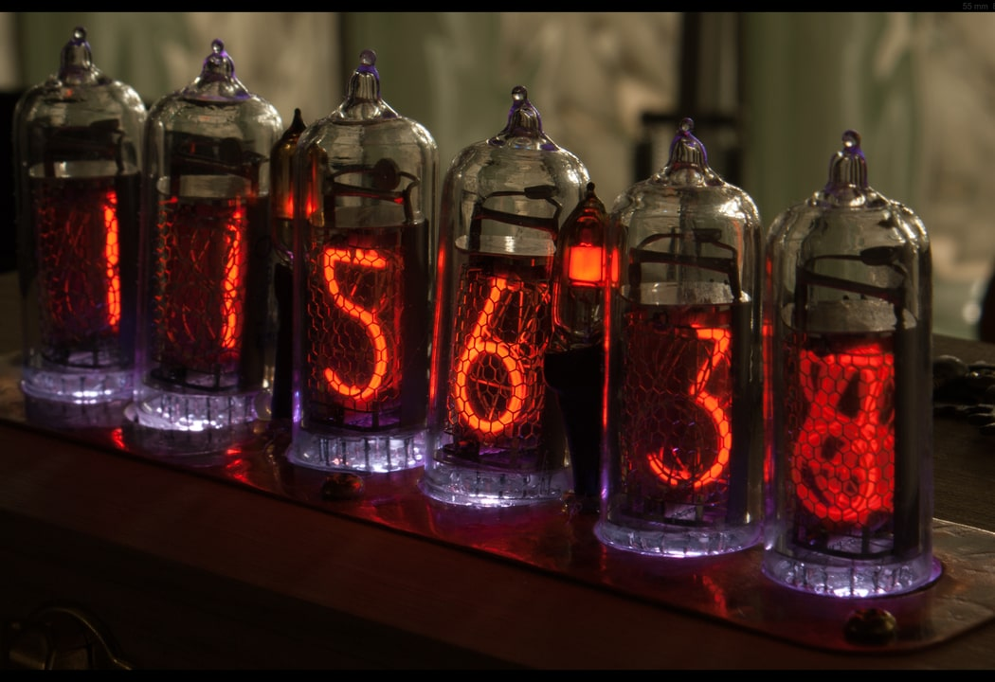
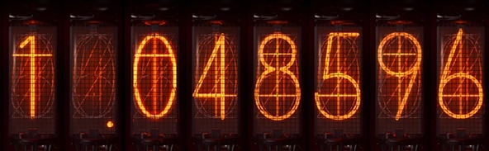
Thank you for your attention
REFERENCES
Big Data and the five Vs
IBM, What Is Big Data?
Data quality and preparation
Google, Dataset Characteristics and Normalization
Neural networks and training
Google, Neural Networks and Gradient Descent
Handwritten-digit recognition
Keras, MNIST Digits Classification Dataset
TensorFlow, Quickstart for Beginners
NIXIE TUBE CLOCK
Project examples and visuals
DIVERGENCE
Team Aleksandria
Play Operation World Line
Notes:
Return to the handwritten 5. Ask how we could tell whether the network learned to recognize a new writer’s digits. Take one answer, then thank the audience and invite questions.
Repository companion: https://github.com/Voryalis/aleksandria/blob/main/docs/04-case-study.md#41-from-individual-ideas-to-a-complete-system
ARTWORK AND DESIGN CREDITS
“Nixie Tube Clock.jpg” by Rob Robinette (RobRobinette.com), Wikimedia Commons, CC BY-SA 4.0. Cropped and shaded. https://commons.wikimedia.org/wiki/File:Nixie_Tube_Clock.jpg | https://creativecommons.org/licenses/by-sa/4.0/
Divergence meter artwork, Steins;Gate (Steam HD Edition), archived by Adrot. Display value matches the Operation World Line ending. https://www.spriters-resource.com/pc_computer/steinsgatesteamhdedition/asset/107527/ | https://github.com/Voryalis/aleksandria/tree/main/interactive-learning/python-game
Steins;Gate game artwork retains its original rights and falls outside the ALEKSANDRIA content license.
Original Stage 2 educational content and teaching illustrations by Team ALEKSANDRIA, CC BY 4.0. This edition changes the design and makes minor wording edits. https://github.com/Voryalis/aleksandria | https://creativecommons.org/licenses/by/4.0/
Instrument Serif, Instrument Sans, and IBM Plex Mono use the SIL Open Font License 1.1. Font licenses are available in the Operation World Line asset directory. https://github.com/Voryalis/aleksandria/tree/main/interactive-learning/python-game/web/assets

