Slide 1
Tutorial of Turn On / Turn Off Led
By using ESP8266 & Firebase

Slide 2
Agenda
Preparation
Setting
Implementation

Slide 3
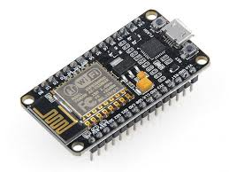
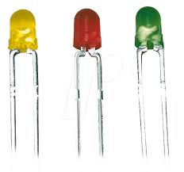
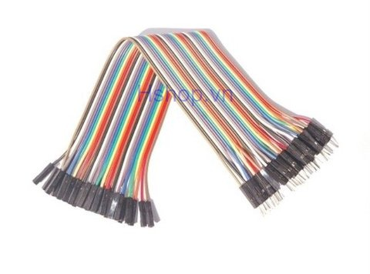
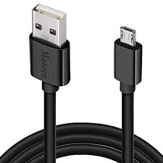
1. ESP8266 NodeMCU Lua CP2102
2. Led
3. Cables
Preparation - Hardware

Slide 4


1. Arduino IDE
2. Firebase (1 account)
Preparation – Another
Preparation

Slide 5
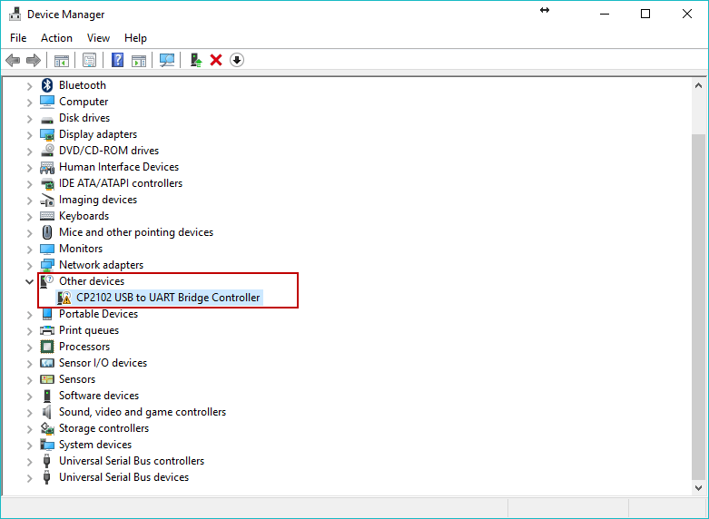
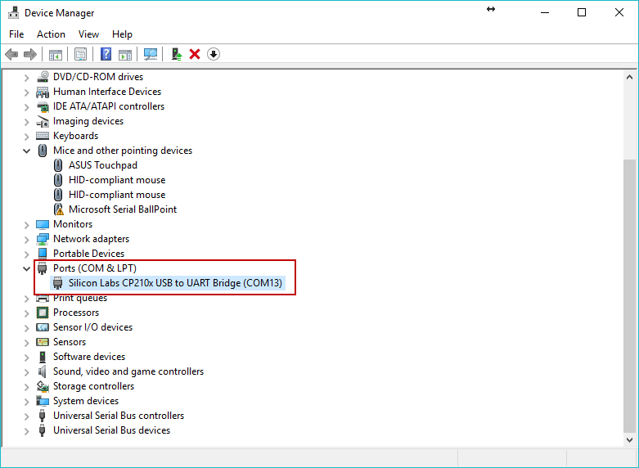
1. Installed driver CP2102 (Steps: Right click to My Computer -> Device Manager)
Not Installed
Installed
Setting
Notes:
- Tutorial install driver CP2102: https://hocarm.org/huong-dan-sua-loi-khong-ket-noi-cua-nodemcu/

Slide 6
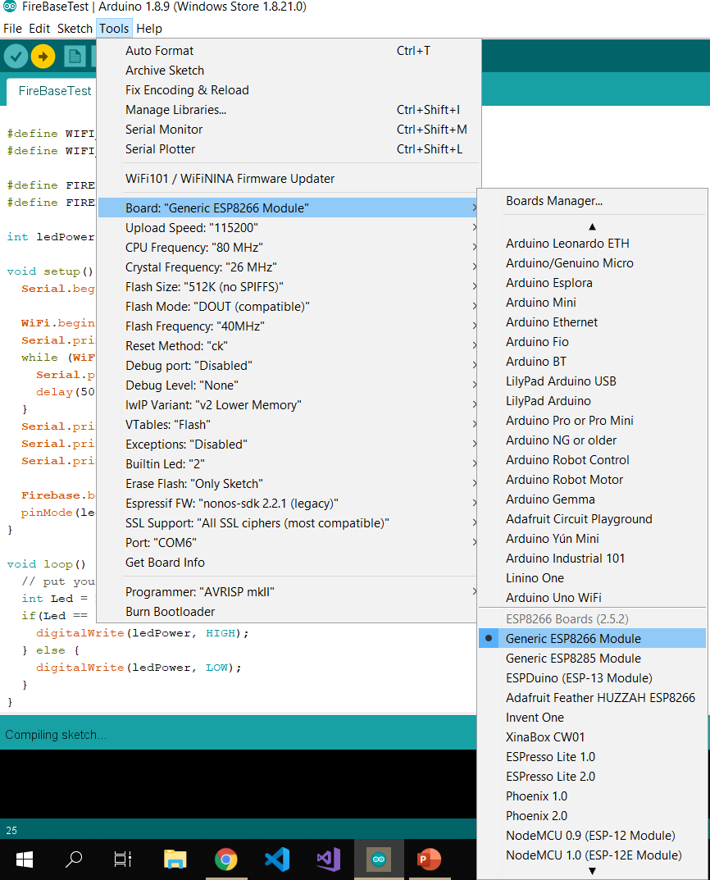
2. Add board Esp8266 in Arduino IDE
Setting
Notes:
- Tutorial setting and use ESP8266 in Arduino: https://wiki.chipfc.com/index.php?title=C%C3%A0i_%C4%91%E1%BA%B7t_ESP8266_trong_Arduino_IDE

Slide 7
3. Add library
Firebase Arduino
Arduino Json
Tutorial add library:
https://www.youtube.com/watch?v=z4Juj6gV2zY&list=PL7WXsvZeERD6cGR15DXd8C7HqURzXIVom&index=16&t=0s
Setting

Slide 8
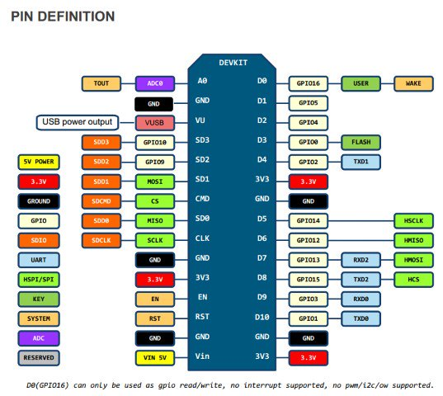
Implementation - Connection

Slide 9
Create account in firebase
Access: https://firebase.google.com/
Login with Google Account
Click Go to console
Click Add project
Click Add an application
Click Database -> Create Database -> Realtime Database
Take HOST and AUTH
Click Database -> Create Database -> Realtime Database -> Take HOST
Click Project Setting -> Services Accounts -> Secret codes of the database -> Take AUTH
Implementation - Firebase

Slide 10
#include <FirebaseArduino.h>
#include <ESP8266WiFi.h>
#define WIFI_SSID "Name_Of_Wifi"
#define WIFI_PASSWORD "Password_Of_Wifi"
#define FIREBASE_HOST "Your_Host"
#define FIREBASE_DTB "Your_Database“
int ledPower = 5;
void setup() {
Serial.begin(115200);
WiFi.begin(WIFI_SSID, WIFI_PASSWORD);
Serial.print("connecting");
while (WiFi.status() != WL_CONNECTED) {
Serial.print(".");
delay(500);
}
Serial.println();
Serial.print("connected: ");
Serial.println(WiFi.localIP());
Firebase.begin(FIREBASE_HOST, FIREBASE_DTB);
pinMode(ledPower, OUTPUT);
}
void loop() {
int Led = Firebase.getInt("Led");
if(Led == 1){
digitalWrite(ledPower, HIGH);
} else {
digitalWrite(ledPower, LOW);
}
}
Implementation - Code

