Slide 1
CSS 422 Disassembler

Slide 2
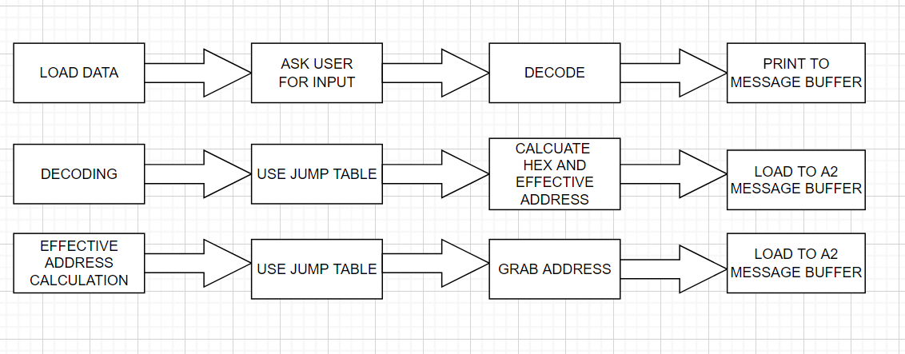
Flow charts

Slide 3
IO, OPCODES, EA IMPLEMENTED
OPCODES
0000 ORI
0011 MOVE/MOVEA
1011 CMP
1101 ADD
0100 NOP/MOVEM/LEA
1001 SUB
1100 MULU
1101 ADD/ADDA
EFFECTIVE ADDRESS MODES
Not fully tested but is inside code
DATA REGISTER DIRECT (MODE 0)
ADDRESS REGISTER DIRECT (MODE 1)
ADDRESS REGISTER INDIRECT (MODE 2)
ADDRESS REGISTER INDIRECT WITH POST INCREMENT (MODE 3)
ADDRESS REGISTER INDIRECT WITH PRE-DECREMENT (MODE 4)
ABSOLUTE WORD ADDRESS (MODE 7 SUBCLASS 0)
ABSOLUTE LONG ADDRESS (MODE 7 SUBCLASS 1)
IMMEDIATE DATA (MODE 7 SUBCLASS 4)

Slide 4
CHALLENGES
Time management over such a big project
Connecting op codes with bit observation
Implementing all op codes
Calculating hex address and sizes
More testing needed

