Slide 1
Memory management.
Garbage collection.
Notes:
1

Slide 2
Main concepts
Languages, like C, have low-level memory management primitives such as malloc() and free(). These primitives are used by the developer to explicitly allocate and free memory from and to the operating system.
At the same time, JavaScript allocates memory when things (objects, functions, etc.) are created and "automatically" frees it up when they are not used anymore, a process called garbage collection.
This seemingly "automatical" nature of freeing up resources is a source of confusion and gives JavaScript (and other high-level-language) developers the false impression they can choose not to care about memory management. This is a mistake.

Slide 3
Memory life cycle
  No matter what programming language you’re using, memory life cycle is pretty much always the same:
Allocate memory — memory is allocated by the operating system which allows your program to use it. In low-level languages (e.g. C) this is an explicit operation that you as a developer should handle. In high-level languages, however, this is taken care of for you.
Use memory — this is the time when your program actually makes use of the previously allocated memory. Read and write operations are taking place as you’re using the allocated variables in your code.
Release memory — now is the time to release the entire memory that you don’t need so that it can become free and available again. As with the Allocate memory operation, this one is explicit in low-level languages.
Allocate memory
Use memory
Release memory

Slide 4
Release memory
The basic idea is simple: figure out which variables aren’t going to be used and free the memory associated with them. This process is periodic, with the garbage collector running at specified intervals (or at predefined collection moments in code execution). The process of garbage collection is an approximate and imperfect solution because the general problem of knowing whether some piece of memory is needed is “ undecidable ,” meaning it cannot be solved by an algorithm.
The strategy for identifying the unused variables may differ on an implementation basis, though two strategies have traditionally been used in browsers: mark-and-sweep, and reference counting.

Slide 5
Mark-and-Sweep
When a variable comes into context, such as when a variable is declared inside a function, it is flagged as being in context. Variables that are in context, logically, should never have their memory freed, because they may be used as long as execution continues in that context. When a variable goes out of context, it is also flagged as being out of context.
Variables can be flagged in any number of ways. There may be a specific bit that is flipped when a variable is in context, or there may be an “in-context” variable list and an “out-of-context” variable list between which variables are moved. The implementation of the flagging is unimportant; it’s really the theory that is key. When the garbage collector runs, it marks all variables stored in memory (once again, in any number of ways). It then clears its mark off of variables that are in context and variables that are referenced by in-context variables. The variables that are marked after that are considered ready for deletion, because they can’t be reached by any in-context variables. The garbage collector then does a memory sweep, destroying each of the marked values and reclaiming the memory associated with them.

Slide 6
Reference Counting
The idea is that every value keeps track of how many references are made to it. When a variable is declared and a reference value is assigned, the reference count is one. If another variable is then assigned to the same value, the reference count is incremented. Likewise, if a variable with a reference to that value is overwritten with another value, then the reference count is decremented. When the reference count of a value reaches zero, there is no way to reach that value and it is safe to reclaim the associated memory. The garbage collector frees the memory for values with a reference count of zero the next time it runs.

Slide 7
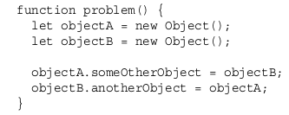
Serious issue: circular references
A circular reference occurs when object A has a pointer to object B and object B has a reference to object A, as in the following example:
In this example, objectA and objectB reference each other through their properties, meaning that each has a reference count of two. In a mark-and-sweep system, this wouldn’t be a problem because both objects go out of scope after the function has completed. In a reference-counting system, however, objectA and objectB will continue to exist after the function has exited because their reference counts will never reach zero. If this function were called repeatedly, it would lead to a large amount of memory never being reclaimed

Slide 8
Performance
You cannot know when garbage collection is coming, so the best strategy is to organize your code in such a way that it allows garbage collection to do its job to the best of its ability whenever it is scheduled to run.
Modern garbage collectors decide when to run based on a collection of heuristics that are measured from the JavaScript runtime environment. These heuristics will vary by engine, but they will all be approximately based upon the size and number of objects that have been allocated.
Internet Explorer was infamous for its performance issues related to how often the garbage collector ran - it ran based on the number of allocations, specifically 256 variable allocations, 4,096 object/ array literals and array slots, or 64KB of strings. If any of these thresholds were reached, the garbage collector would run.
The Internet Explorer 7 thresholds start out equal to those in Internet Explorer 6. If the garbage-collection routine reclaims less than 15 percent of the allocations, the threshold for variables, literals, and/or array slots doubles. If the routine ever reclaims 85 percent of the allocations, then the threshold is reset to the default. This simple change greatly improved the performance of the browser on JavaScript-heavy web pages.

Slide 9
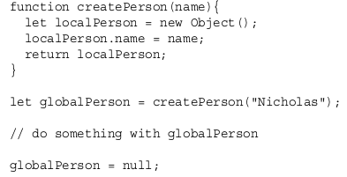
Managing Memory
Keeping the amount of used memory to a minimum leads to better page performance. The best way to optimize memory usage is to ensure that you’re keeping around only data that is necessary for the execution of your code.When data is no longer necessary, it’s best to set the value to null , freeing up the reference—this is called dereferencing the value
Keep in mind that dereferencing a value doesn’t automatically reclaim the memory associated with it. The point of dereferencing is to make sure the value is out of context and will be reclaimed the next time garbage collection occurs

Slide 10
Performance with const and let Declarations
The introduction of these keywords in ES6 isn’t just a boon for your code style but also for the garbage collection process. Because const and let are scoped to a block instead of a function, depending on how your code is organized this may signal to the garbage collector that an allocated variable is eligible for cleanup far sooner than it would have been when using var . This would occur in situations when the block scope terminates far sooner than the function scope.
Notes:
While a monolithic application is a single unified unit, a microservices architecture breaks it down into a collection of smaller independent units. These units carry out every application process as a separate service. So all the services have their own logic and the database as well as perform the specific functions.
Within a microservices architecture, the entire functionality is split up into independently deployable modules which communicate with each other through defined methods called APIs (Application Programming Interfaces). Each service covers its own scope and can be updated, deployed, and scaled independently.
10

Slide 11
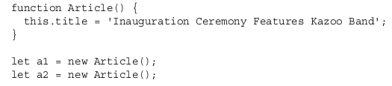

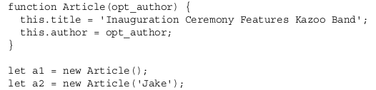
Hidden Classes and the delete Operation
As of 2017, the most popular web browser is Google Chrome, which uses the V8 JavaScript engine. This engine utilizes “hidden classes” when compiling the interpreted JavaScript code into actual machine code, and if you are writing performance-sensitive code, this might matter to you.
During runtime, V8 will associate hidden classes for every object created to keep track of the shape of its properties. Objects that are able to share the same hidden class will have better performance, and V8 will optimize for this but may not always be able to.
Notes:
With microservices, we are also able to adopt technology more quickly, and understand
how new advancements may help us. One of the biggest barriers to trying out and
adopting new technology is the risks associated with it. With a monolithic application, if I
want to try a new programming language, database, or framework, any change will impact
a large amount of my system. With a system consisting of multiple services, I have
multiple new places in which to try out a new piece of technology. I can pick a service that
is perhaps lowest risk and use the technology there, knowing that I can limit any potential
negative impact. Many organizations find this ability to more quickly absorb new
technologies to be a real advantage for them.

Slide 12
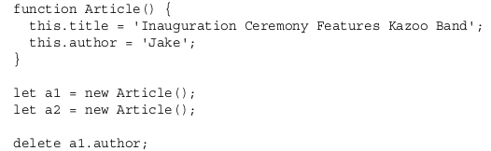
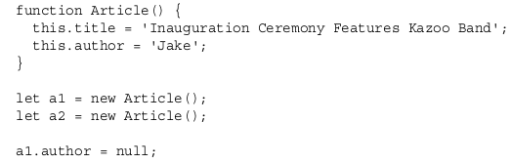
Delete operation
Bear in mind though that using the delete keyword can generate the same hidden class fragmentation. This is demonstrated here:
At the end of this snippet, the two instances will no longer share a hidden class even though they use a unified constructor. Dynamic deletion of a property will yield the same effect as dynamic addition. Best practices dictate that unwanted properties should be set to null . It will allow the hidden classes to remain intact and shared, and it has the same effect on removing references for the benefit of the garbage collector.

Slide 13


Memory Leaks in JavaScript
In essence, memory leaks can be defined as memory that is not required by an application anymore that for some reason is not returned to the operating system or the pool of free memory.
One of the most common and easily fixed memory leaks is accidentally declaring global variables. In the following code, the variable is not prefixed with a declaration keyword:
As long as this interval timer is running, the handler function containing a reference to name remains allocated. The garbage collector recognizes this and therefore is unable to clean up the outer variable.
Notes:
With microservices, we can make a change to a single service and deploy it independently of the rest of the system. This allows us to get our code deployed faster. If a problem does occur, it can be isolated quickly to an individual service, making fast rollback easy to achieve.
13

Slide 14
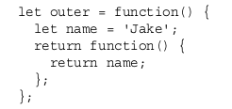
Memory Leaks in JavaScript
JavaScript closures are an exceedingly common way to leak memory without realizing it
This leaks the memory allocated for name . This code creates an internal closure, so as long as the outer function exists, the name variable cannot be cleaned up because there will be a persistent reference to it through that closure. If the contents of the name variable were extremely large instead of just a short string, major problems could result.
Notes:
Rather than renting a server for your application, setting up the environment, and deploying it, you upload your application to your serverless provider, which takes care of assigning servers, storage, application handling, setup, and execution.
More precisely, the provider stores your application inside a certain container. The container represents an isolated environment that contains everything your application needs to run.
Finally, serverless providers offer various triggers that can run your functions. The list of triggers depends on the provider and implementation, but some of the most common triggers are HTTP requests, file uploads to file storage, database updates, and Internet of Things (IoT) events. There are
many more.
14

Slide 15


