Slide 1
Javascript Build Tools: Grunt, Gulp, Webpack
Notes:
1

Slide 2
Concepts
At its core, webpack is a static module bundler for modern JavaScript applications. When webpack processes your application, it internally builds a dependency graph which maps every module your project needs and generates one or more bundles.
To get started you only need to understand its Core Concepts:
Entry
Output
Loaders
Plugins
Mode
Browser Compatibility

Slide 3
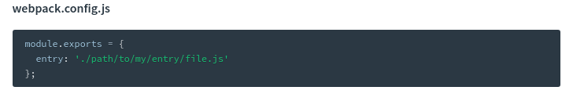
Entry
An entry point indicates which module webpack should use to begin building out its internal dependency graph. webpack will figure out which other modules and libraries that entry point depends on (directly and indirectly).
By default its value is ./src/index.js, but you can specify a different (or multiple entry points) by setting an entry property in the webpack configuration. For example:

Slide 4
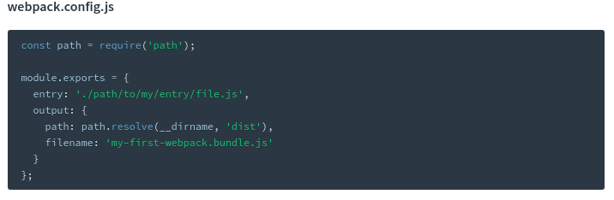
Output
The output property tells webpack where to emit the bundles it creates and how to name these files. It defaults to ./dist/main.js for the main output file and to the ./dist folder for any other generated file. You can configure this part of the process by specifying an output field in your configuration:

Slide 5
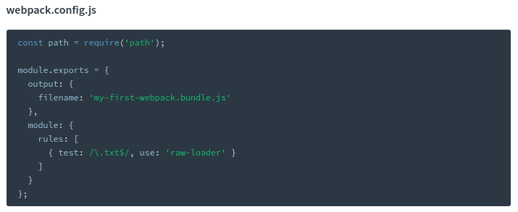
Loaders
Out of the box, webpack only understands JavaScript and JSON files. Loaders allow webpack to process other types of files and convert them into valid modules that can be consumed by your application and added to the dependency graph.
At a high level, loaders have two properties in your webpack configuration: The test property identifies which file or files should be transformed. The use property indicates which loader should be used to do the transforming.

Slide 6
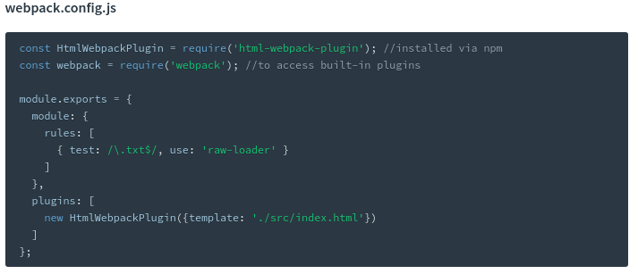
Plugins
While loaders are used to transform certain types of modules, plugins can be leveraged to perform a wider range of tasks like bundle optimization, asset management and injection of environment variables.
In order to use a plugin, you need to require() it and add it to the plugins array. Most plugins are customizable through options. Since you can use a plugin multiple times in a configuration for different purposes, you need to create an instance of it by calling it with the new operator.
In the example above, the html-webpack-plugin generates an HTML file for your application by injecting automatically all your generated bundles.

Slide 7

Mode
By setting the mode parameter to either development, production or none, you can enable webpack's built-in optimizations that correspond to each environment. The default value is production.
Browser Compatibility
webpack supports all browsers that are ES5-compliant (IE8 and below are not supported).

Slide 8
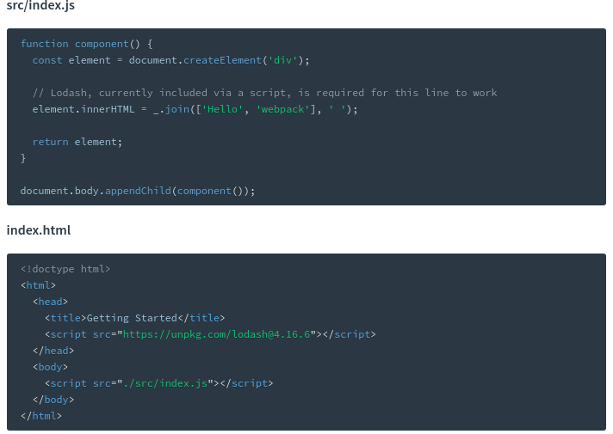

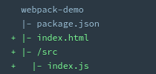
Basic Setup
First let's create a directory, initialize npm, install webpack locally, and install the webpack-cli (the tool used to run webpack on the command line):
Now we'll create the following directory structure, files and their contents:
Notes:
n this example, there are implicit dependencies between the <script> tags. Our index.js file depends on lodash being included in the page before it runs. This is because index.js never explicitly declared a need for lodash; it just assumes that the global variable _ exists.
There are problems with managing JavaScript projects this way:
It is not immediately apparent that the script depends on an external library.
If a dependency is missing, or included in the wrong order, the application will not function properly.
If a dependency is included but not used, the browser will be forced to download unnecessary code.
Let's use webpack to manage these scripts instead.

Slide 9
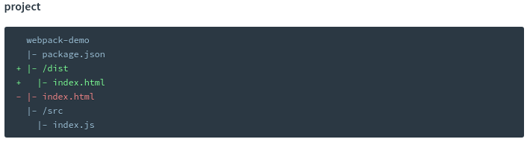
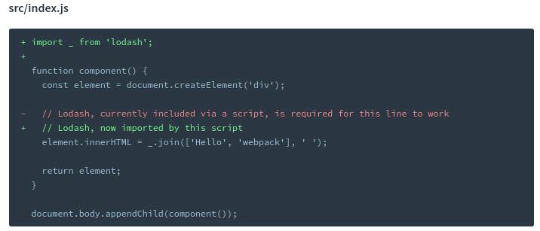
Creating a Bundle
The "source" code is the code that we'll write and edit. The "distribution" code is the minimized and optimized output of our build process that will eventually be loaded in the browser. Tweak the directory structure as follows:

Slide 10
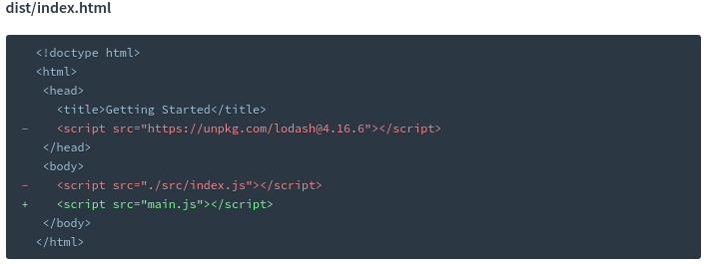
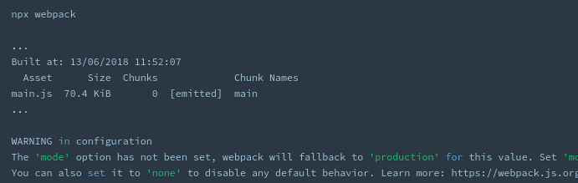
Creating a Bundle
By stating what dependencies a module needs, webpack can use this information to build a dependency graph. It then uses the graph to generate an optimized bundle where scripts will be executed in the correct order.
Notes:
With that said, let's run npx webpack, which will take our script at src/index.js as the entry point, and will generate dist/main.js as the output. The npx command, which ships with Node 8.2/npm 5.2.0 or higher, runs the webpack binary (./node_modules/.bin/webpack) of the webpack package we installed in the beginning:

Slide 11
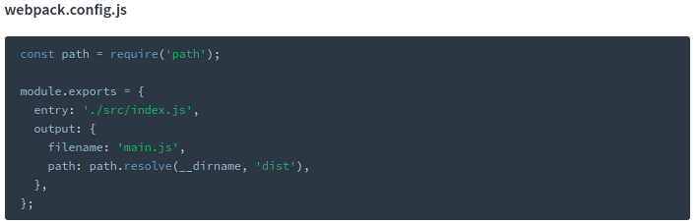
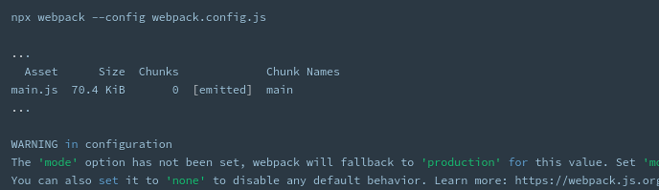
Using a Configuration
As of version 4, webpack doesn't require any configuration, but most projects will need a more complex setup, which is why webpack supports a configuration file. This is much more efficient than having to manually type in a lot of commands in the terminal, so let's create one:
Notes:
With microservices, we can make a change to a single service and deploy it independently of the rest of the system. This allows us to get our code deployed faster. If a problem does occur, it can be isolated quickly to an individual service, making fast rollback easy to achieve.
11

Slide 12
Gulp
Spinning up a web server
Reloading the browser automatically whenever a file is saved
Using preprocessors like Sass or LESS
Optimizing assets like CSS, JavaScript, and images
Notes:
With microservices, we can make a change to a single service and deploy it independently of the rest of the system. This allows us to get our code deployed faster. If a problem does occur, it can be isolated quickly to an individual service, making fast rollback easy to achieve.
12

Slide 13
Why Gulp?
Tools like Gulp are often referred to as “build tools” because they are tools for running the tasks for building a website. The two most popular build tools out there right now are Gulp and Grunt.
The main difference is how you configure a workflow with them. Gulp configurations tend to be much shorter and simpler when compared with Grunt. Gulp also tends to run faster.
Notes:
With microservices, we can make a change to a single service and deploy it independently of the rest of the system. This allows us to get our code deployed faster. If a problem does occur, it can be isolated quickly to an individual service, making fast rollback easy to achieve.
13

Slide 14


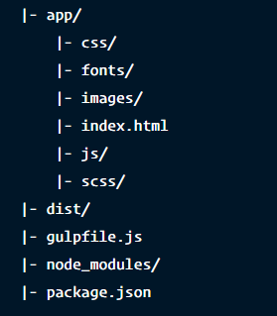
Creating a Gulp Project
Determining Folder Structure
Gulp is flexible enough to work with any folder structure.
In this structure, we’ll use the app folder for development purposes, while the dist (as in “distribution”) folder is used to contain optimized files for the production site

Slide 15
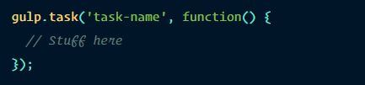
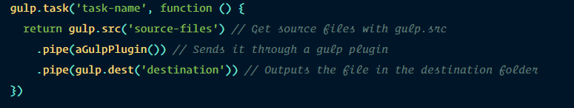
Writing Gulp Task
The basic syntax of a gulp task is:
Here’s what a real task may look like:
gulp.src tells the Gulp task what files to use for the task, while
gulp.dest tells Gulp where to output the files once the task is completed.

Slide 16


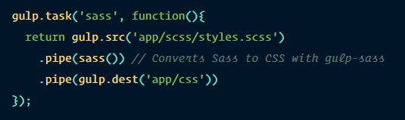
Preprocessing with Gulp
We can compile Sass to CSS in Gulp with the help of a plugin called gulp-sass.

Slide 17
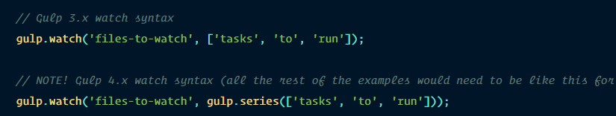
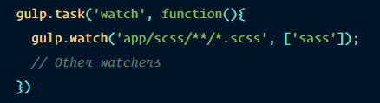
Watching Sass files for changes
Gulp provides us with a watch method that checks to see if a file was saved. The syntax for the watch method is

Slide 18


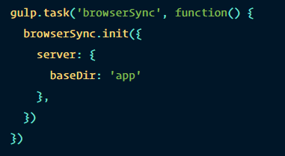
Live-reloading with Browser Sync
Browser Sync helps make web development easier by spinning up a web server that helps us do live-reloading easily
We need to create a browserSync task to enable Gulp to spin up a server using Browser Sync. Since we’re running a server, we need to let Browser Sync know where the root of the server should be
Notes:
18

Slide 19
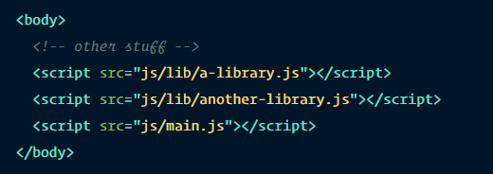
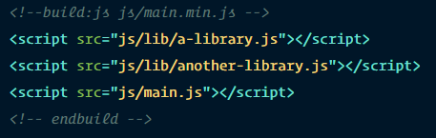
Optimizing CSS and JavaScript files
Developers have two tasks to perform when we try to optimize CSS and JavaScript files for production: minification and concatenation.
Gulp-useref concatenates any number of CSS and JavaScript files into a single file by looking for a comment that starts with “<!–build:” and ends with “<!–endbuild–>”. Its syntax is:

Slide 20
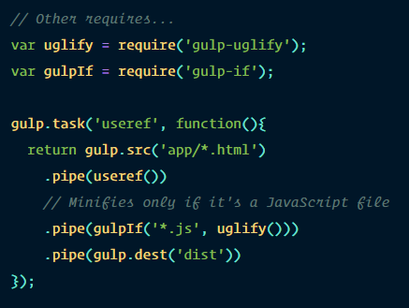
Optimizing CSS and JavaScript files
The file however, isn’t minified right now. We’ll have to use the gulp-uglify plugin to help with minifying JavaScript files. We also need a second plugin called gulp-if to ensure that we only attempt to minify JavaScript files.

Slide 21


