Slide 1
JavaScript Code Convention, Linters: JSLint, JSHint, ESLint.
Notes:
<number>

Slide 2
Why We Need JavaScript Coding Conventions?
Having conventions make things easier to understand since codebases follow the same patterns.
Naming and declaration of variables, functions, classes, and other entities are consistent in their naming scheme. This means that we can understand code easier and makes things more predictable.
White space, indentation, and comments make code easy to read and don’t clutter up the screen.
Also, maintenance is faster since it’s easier to understand and trace. This makes debugging more effective.
Notes:
<number>

Slide 3


Code Indentation
2 spaces for indentation is the accepted convention for indentation: For example, the following is good:
But the following is bad:
It’s better to use spaces instead of tabs since tabs are interpreted differently by different programs and operating systems.

Slide 4




Spacing Around Operators
There should be one space between the operand and the operator for binary operators, like +, -, =, *, / and after commas. For example, the following is good:
However, the following is bad:
Comma-separated items should have one space after the comma. For example, the following is good:
But the following code is bad:

Slide 5
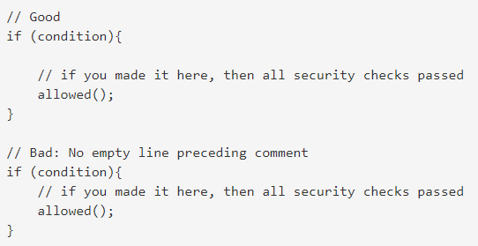
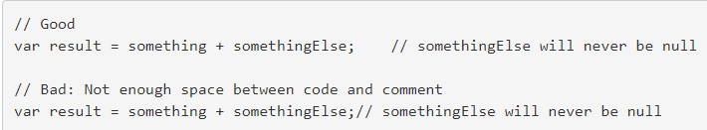
Comments
Single-line comments should be used to document one line of code or a group of related lines of code. A single-line comment may be used in three ways:
On a separate line, describing the code beneath it.
At the end of a line, describing the code before it.
On multiple lines, to comment out sections of code.

Slide 6

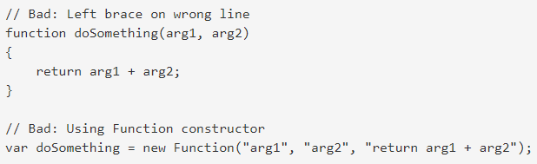
Variables and Functions
All variables should be declared before they are used. Variable declarations should take place at the beginning of a function using a single (var, let , const) statement with one variable per line. Variables should be initialized when declared if applicable and the equals operator should be at a consistent indentation level. Initialized variables should come first followed by uninitialized variables.
When a function is not a method (not attached to an object) it should be defined using function declaration format (not function expression format nor using the Function constructor). There should be no space between the function name and the opening parentheses. There should be one space between the closing parentheses and the right brace. The right brace should be on the same line as the function keyword

Slide 7
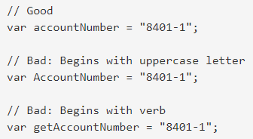
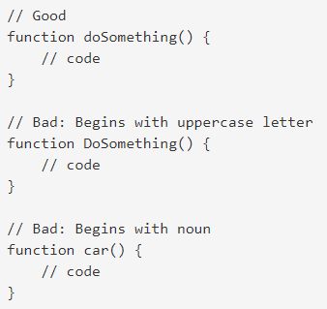
Naming
Care should be taken to name variables and functions properly. Names should be limited to alphanumeric characters and, in some cases, the underscore character. Do not use the dollar sign ($) or back slash (\) characters in any names.
Variable names should be formatted in camel case with the first letter being lowercase and the first letter of each subsequent word being uppercase. The first word of a variable name should be a noun (not a verb) to avoid confusion with functions. Do not use underscore for variable names.

Slide 8
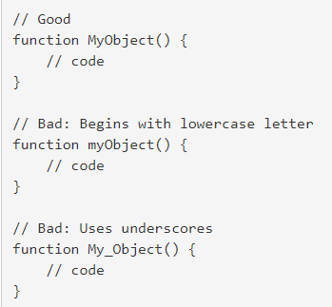
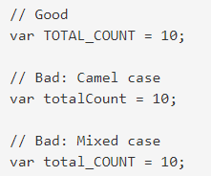
Naming
Constructor functions, those functions used with the new operator to create new objects, should be formatted in camel case but must begin with an uppercase letter. Constructor function names should begin with a non-verb because new is the action of creating an object instance.
Variables that act as constants (values that won't be changed) should be formatted using all uppercase letters with words separated by a single underscore.
FileNames
Windows filenames aren’t case sensitive. However, most other operating systems have case sensitive file names. Therefore, it’s best to name them all lower case to avoid issues with file name casing.

Slide 9



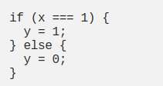
Statements
Statements should end with a semicolon at the end. For example, the following is good:
But this is bad:
For complex statements, we should put curly braces around the block and semicolons at the end of each line to make everything clear.
Also, there should be one space before the opening bracket. The closing bracket should be in a new line without any leading spaces. Complex statements shouldn’t end with a semicolon even though it’s allowed.

Slide 10
Object Literals
The opening brace should be on the same line as the containing statement.
Each property-value pair should be indented one level with the first property appearing on the next line after the opening brace.
Each property-value pair should have an unquoted property name, followed by a colon (no space preceding it), followed by the value.
If the value is a function, it should wrap under the property name and should have a blank line both before and after the function.
Additional empty lines may be inserted to group related properties or otherwise improve readability.
The closing brace should be on a separate line.

Slide 11
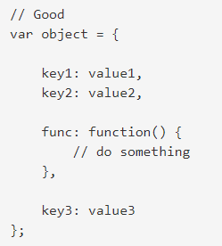
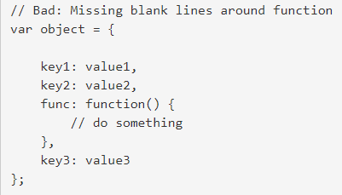
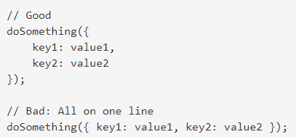
Object Literals
When an object literal is passed to a function, the opening brace should be on the same line as if the value is a variable. All other formatting rules from above still apply.

Slide 12

JSLint
Pros
Comes configured and ready to go (if you agree with the rules it enforces)
Cons
JSLint doesn’t have a configuration file, which can be problematic if you need to change the settings
Limited number of configuration options, many rules cannot be disabled
You can’t add custom rules
Undocumented features
Difficult to know which rule is causing which error

Slide 13

JSHint
Pros
Most settings can be configured
Supports a configuration file, making it easier to use in larger projects
Has support for many libraries out of the box, like jQuery, QUnit, NodeJS, Mocha, etc.
Basic ES6 support
Cons
Difficult to know which rule is causing an error
Has two types of option: enforcing and relaxing (which can be used to make JSHint stricter, or to suppress its warnings). This can make configuration slightly confusing
No custom rule support

Slide 14

ESLint
Pros
Flexible: any rule can be toggled, and many rules have extra settings that can be tweaked
Very extensible and has many plugins available
Easy to understand output
Includes many rules not available in other linters, making ESLint more useful for detecting problems
Best ES6 support, and also the only tool to support JSX
Supports custom reporters
Cons
Some configuration required
Slow, but not a hindrance

Slide 15



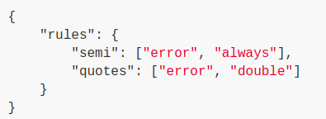
Getting started with ESLint
You should then set up a configuration file:
After that, you can run ESLint on any file or directory like this:
After running eslint --init, you'll have a .eslintrc file in your directory. In it, you'll see some rules configured like this:

Slide 16


