Slide 1
Proxy component, Style component. Higher-order component, State hoisting, Controlled input
Notes:
1

Slide 2
Higher-order component
Concretely, a higher-order component is a function that takes a component and returns a new component.
Whereas a component transforms props into UI, a higher-order component transforms a component into another component.
Higher-order-component helps us to share common functionality between components.

Slide 3
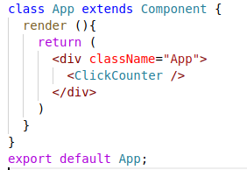
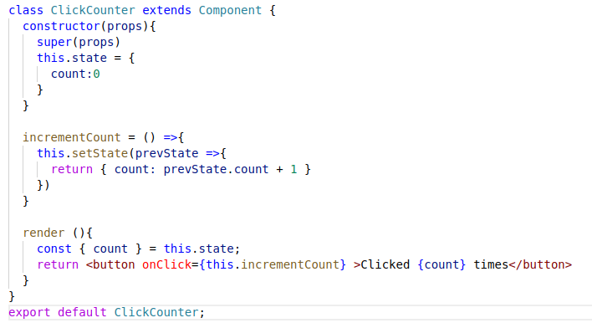

Higher-order component

Slide 4
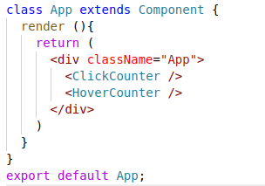
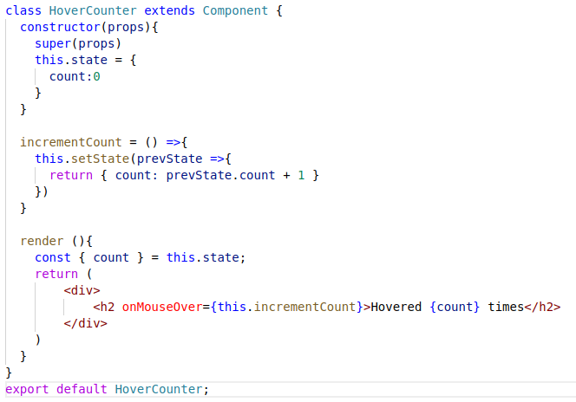

Higher-order component

Slide 5
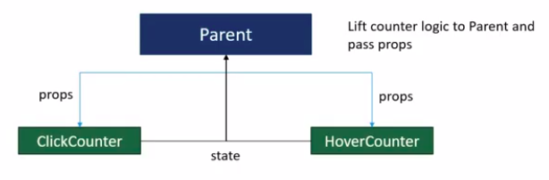
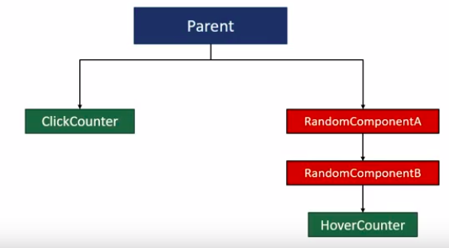
Higher-order component

Slide 6
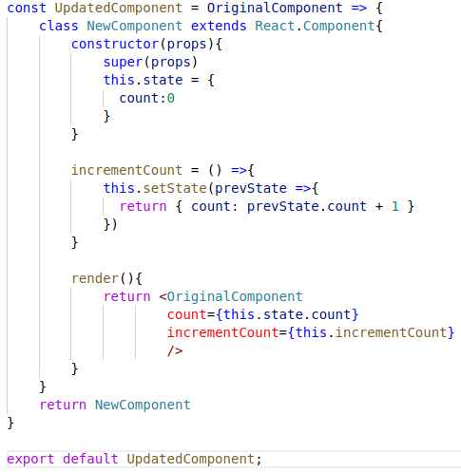
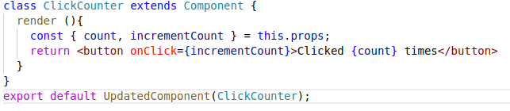
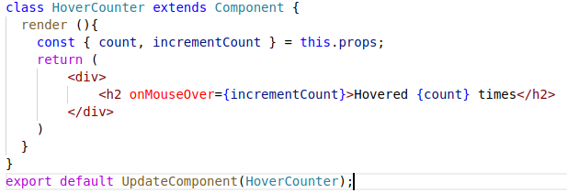
Higher-order component

Slide 7
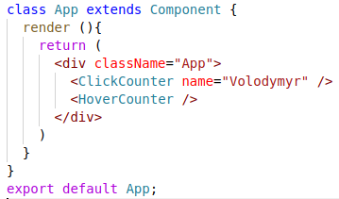
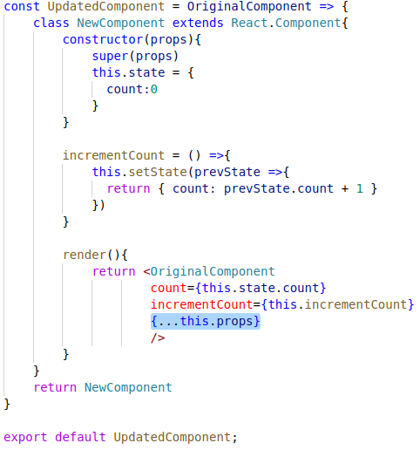
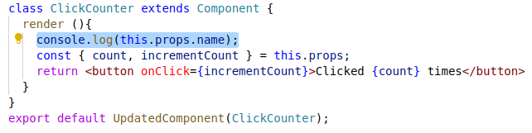
Passing down the props

Slide 8
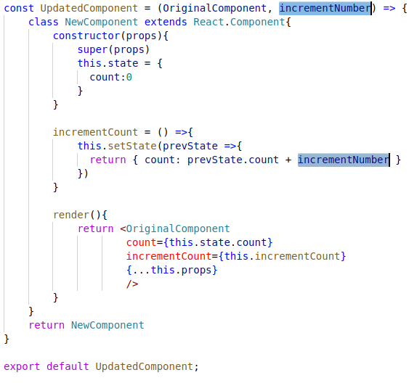
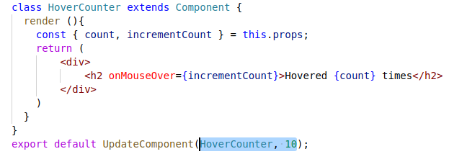
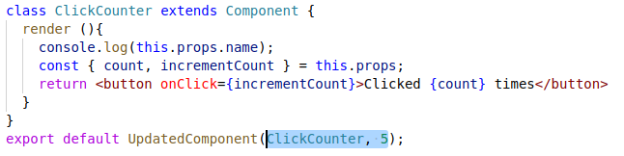
Passing parameters to HOC function

Slide 9
State hoisting (Lifting State Up)
One of the React patterns is called state hoisting. As we know stateless functions don’t hold state and events are changes in state. Their data needs to be passed to stateful container components parents. This is a perfect situation to use state hoisting and it’s accomplished by passing a callback from a container component to a child component.

Slide 10
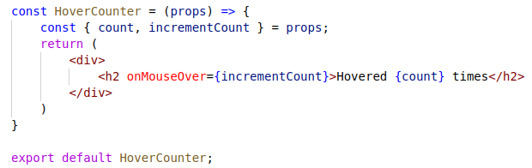
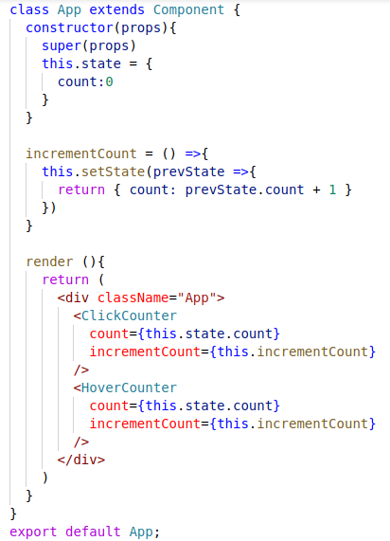
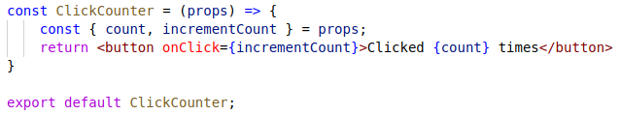

State hoisting (Lifting State Up)

Slide 11


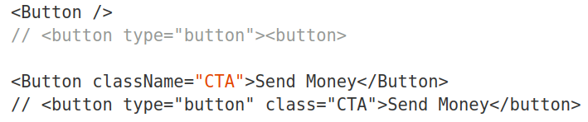
Proxy component
Buttons are everywhere in web apps. And every one of them must have the type attribute set to "button".
Writing this attribute hundreds of times is error prone. We can write a higher level component to proxy props to a lower-level button component.
We can use Button in place of button and ensure that the type attribute is consistently applied everywhere.

Slide 12
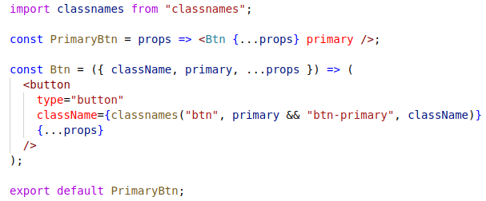

Style component
This is a Proxy component applied to the practices of style. Say we have a button. It uses classes to be styled as a "primary" button.
We can generate this output using a couple single-purpose components.
Using these components, all of these result in the same output.

Slide 13
Controlled input
Now you can change the value and see the state changes. It only updates the DOM when state has changed. This is very important when creating large UIs.

Slide 14


