Slide 1
WELCOME TO THE FUTURE
by Volodymyr Hrytsiv

Slide 2
Site Layout. Best practices. Cross browser’s implementation.
Normal flow
The display property
Flexbox
Grid
Floats
Multi-column layout

Slide 3
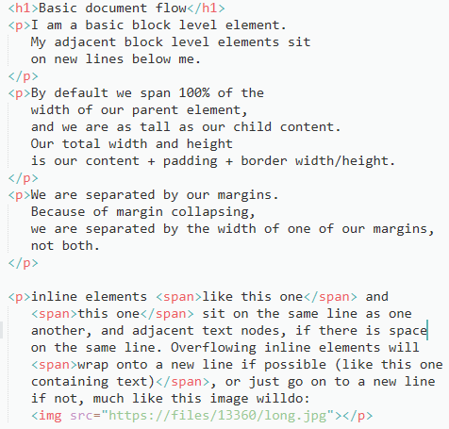
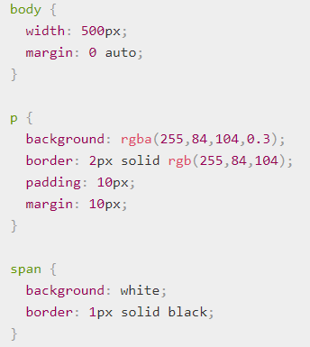
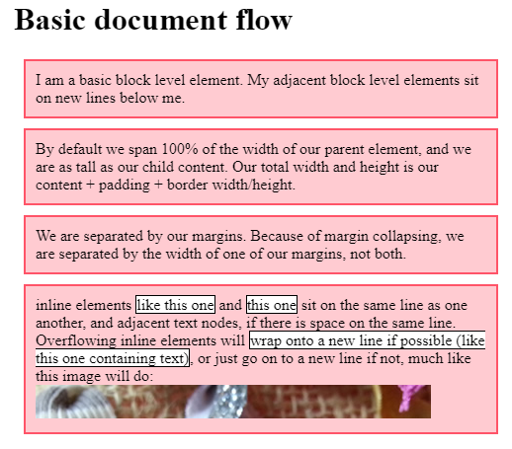
Normal Flow

Slide 4
The display property
The main methods of achieving page layout in CSS are all values of the display property.
The fact that you can change the value of display for any element means that you can pick HTML elements for their semantic meaning, without being concerned about how they will look. The way they look is something that you can change.
The two values most important for our purposes when discussing layout are display:flex,
and display: grid.

Slide 5
Flexbox
Vertically centering a block of content inside its parent.
Making all the children of a container take up an equal amount of the available width/height, regardless of how much width/height is available
Making all columns in a multiple column layout adopt the same height even if they contain a different amount of content.

Slide 6
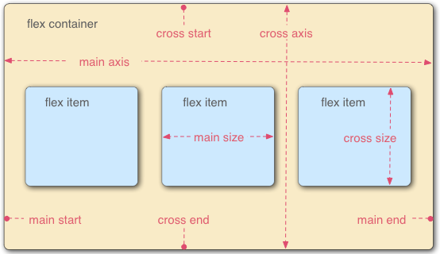
Directions and Size
The main axis is the axis running in the direction the flex items are being laid out in (e.g. as rows across the page, or columns down the page.) The start and end of this axis are called the main start and main end.(flex-direction:row)
The cross axis is the axis running perpendicular to the direction the flex items are being laid out in. The start and end of this axis are called the cross start and cross end.
The parent element has display: flex set on it ( the <section> in our example) is called a flex container.
The items being laid out as flexible boxes inside the flex container are called flex items (the <article> elements in our example)

Slide 7
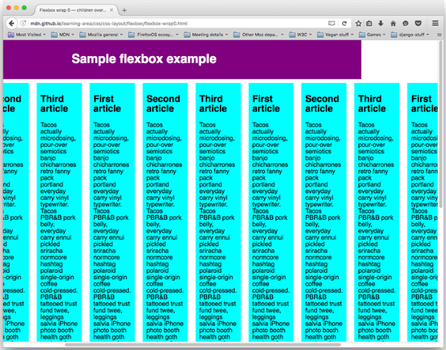


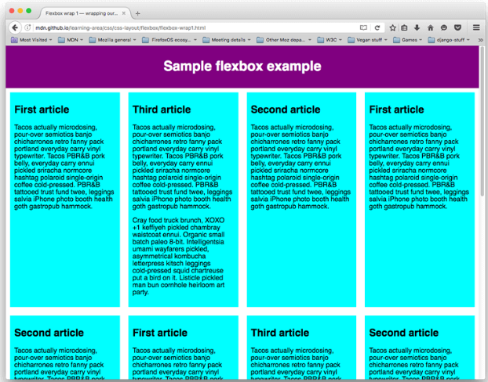
Wrapping
=

Slide 8
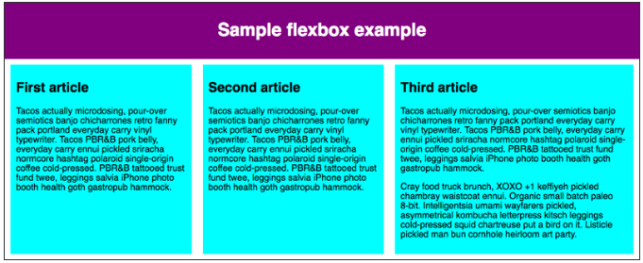


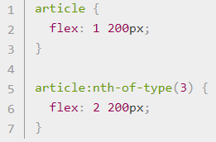
Flexible sizing of flex items

Slide 9
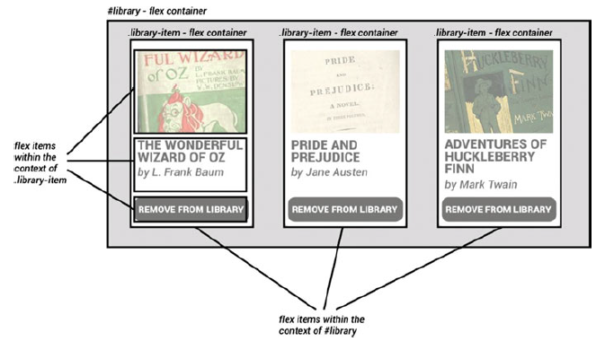
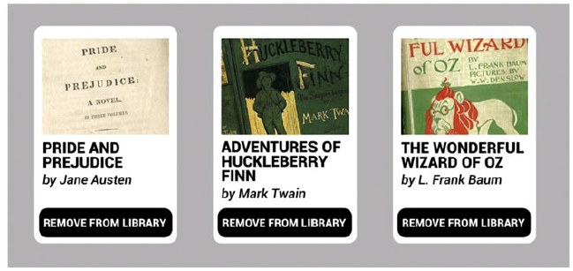
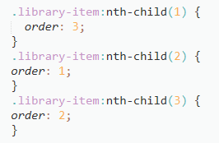
Ordering flex items
By default, all flex items have an order value 0
Flex items with higher order values set on them will appear later in the display order than items with lower order values.
Flex items with the same order value will appear in their source order. So if you have four items with order values of 2, 1, 1, and 0 set on them respectively, their display order would be 4th, 2nd, 3rd, then 1st.
The 3rd item appears after the 2nd because it has the same order value and is after it in the source order.

Slide 10
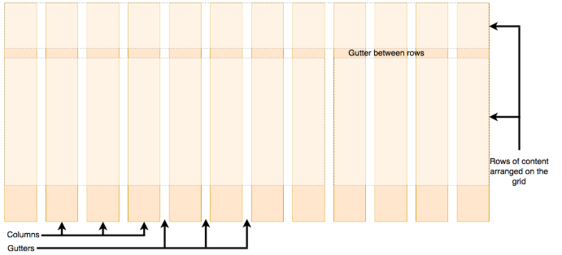
CSS Grid Layout
CSS Grid Layout is a two-dimensional layout system for the web. It lets you lay content out in rows and columns, and has many features that make building complex layouts straightforward.
A grid will typically have columns, rows, and then gaps between each row and column — commonly referred to as gutters.

Slide 11
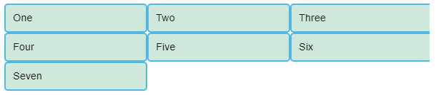
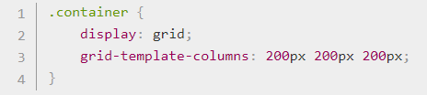
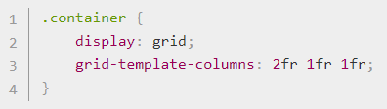
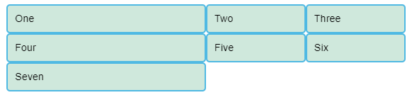
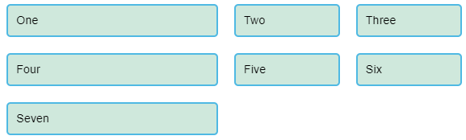
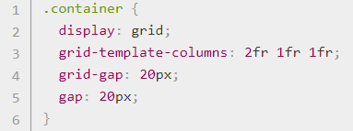
Creating greed in CSS
Defining a grid
Gaps between tracks

Slide 12
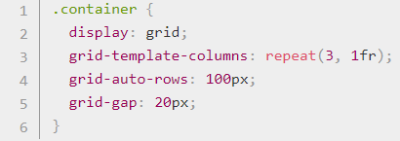
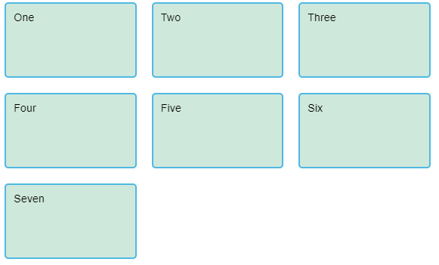
The implicit and explicit grid

Slide 13
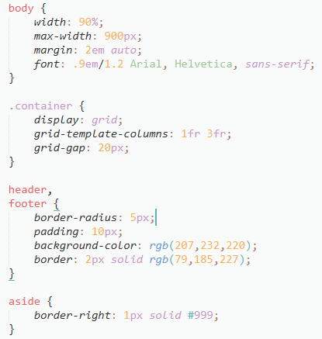
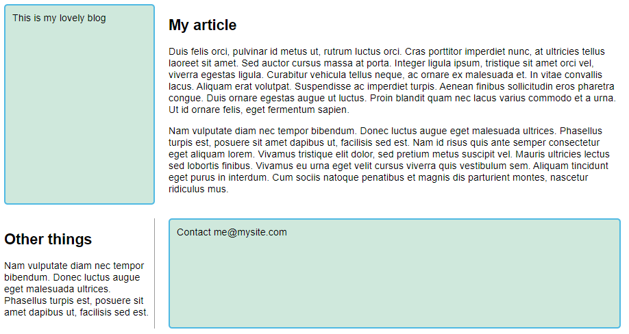
Line-based placement

Slide 14
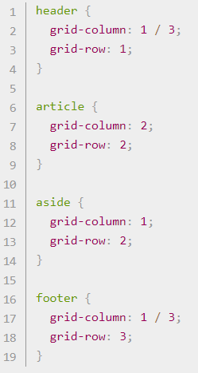
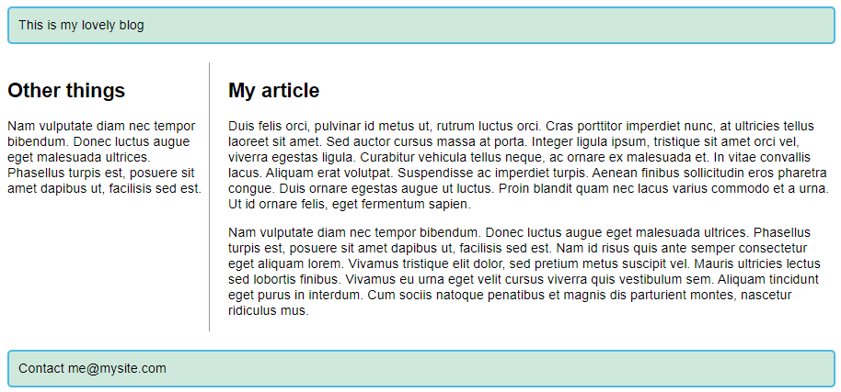
Line-based placement

Slide 15
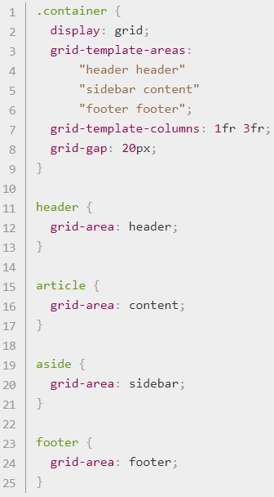
Positioning with grid-template-areas

Slide 16
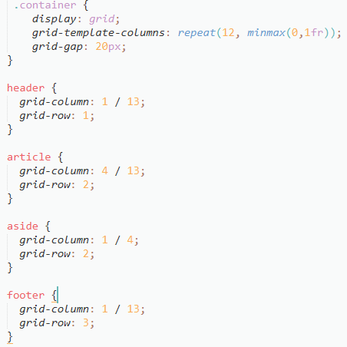
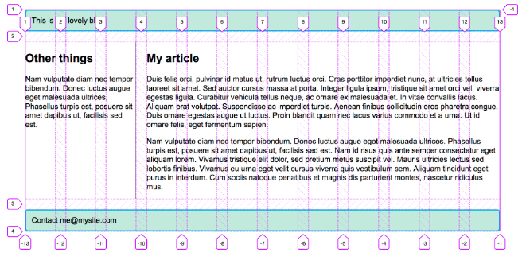
A CSS Grid, grid framework

Slide 17
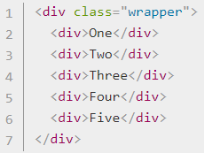
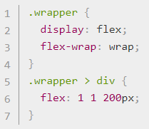
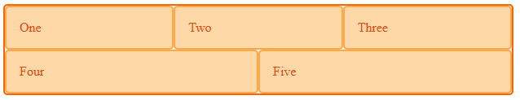
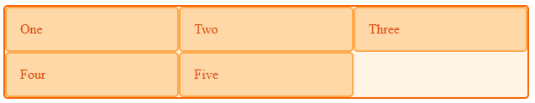
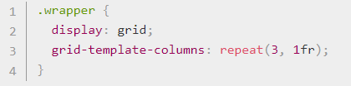
Grid and flexbox
when you wrap flex items, each new row (or column when working by column) becomes a new flex container.
Space distribution happens across the row.
HTML
CSS flex
CSS grid

Slide 18
Floats
Originally for floating images inside blocks of text, the float property became one of the most commonly used tools for creating multiple column layouts on webpages. With the advent of flexbox and grid it has now returned to its original purpose.
Floats have commonly been used to create entire web site layouts featuring multiple columns of information floated so they sit alongside one another (the default behavior would be for the columns to sit below one another, in the same order as they appear in the source). There are newer, better layout techniques available and so use of floats in this way should be regarded as a legacy technique.

Slide 19
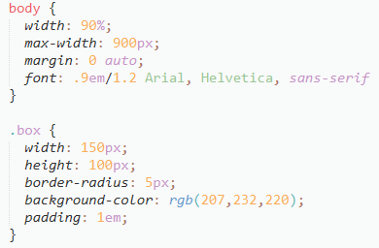
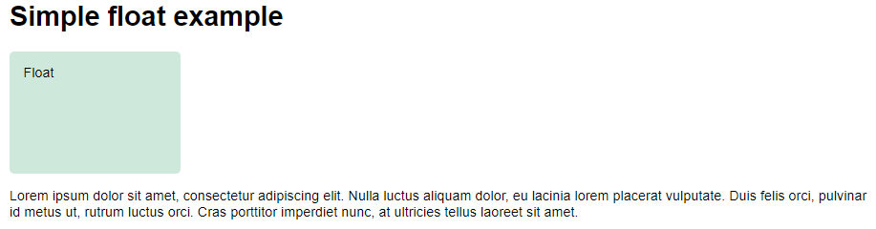
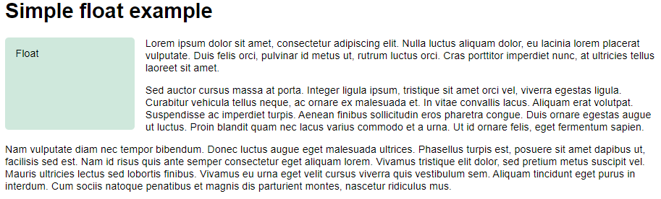
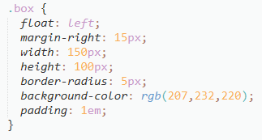
Simple float example

Slide 20
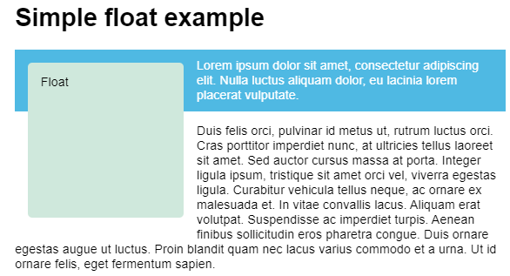
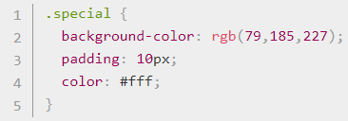
Simple float example

Slide 21
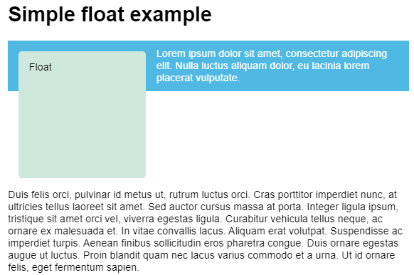

Clearing floats
The clear property accepts the following values:
left: Clear items floated to the left.
right: Clear items floated to the right.
both: Clear any floated items, left or right.

Slide 22
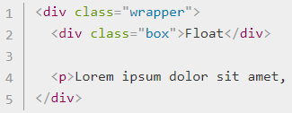
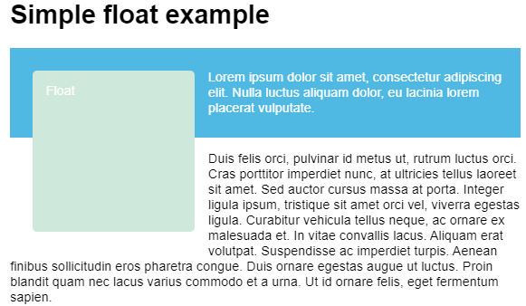
Clearing boxes wrapped around a float

Slide 23
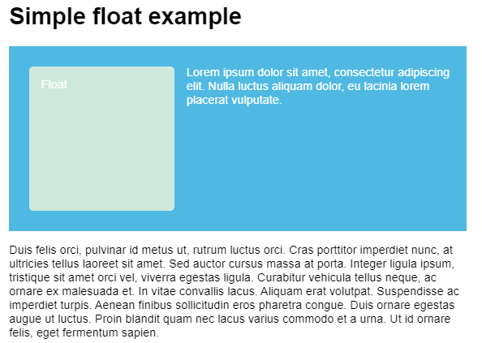
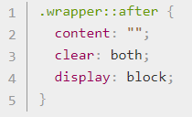
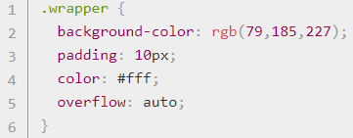
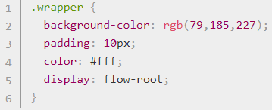
Solution
The clearfix huck
Using overflow
display: flow-root

Slide 24
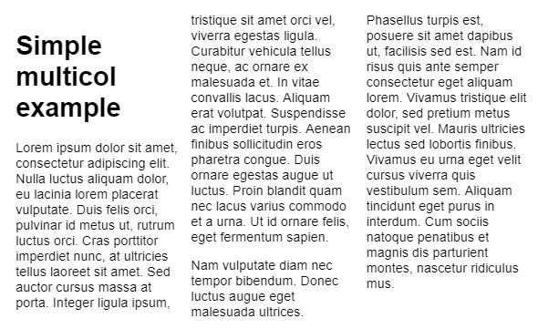


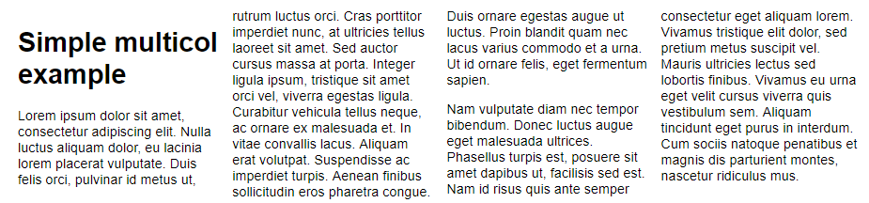
Multiple-column layout

Slide 25
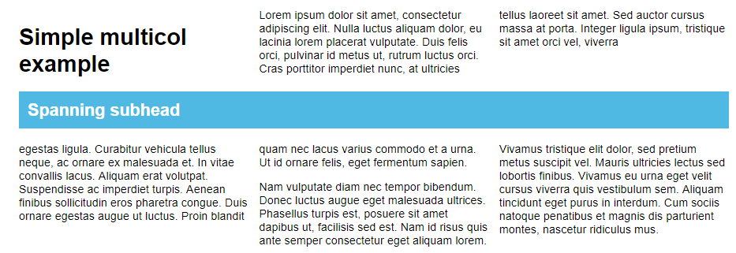
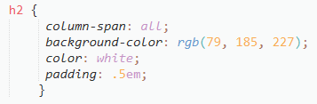
Spanning columns

Slide 26
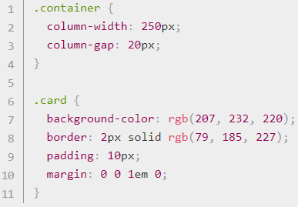



Columns and fragmentation

Slide 27
Cross browser implementation
find out the number of visitors coming to your site using older browsers (Statcounter)
consider the type of devices and the way people use your site
find out about how well a feature is supported (Can I Use)

Slide 28



Creating fallbacks in CSS
CSS
HTML

Slide 29

Feature queries
CSS
HTML

Slide 30


