Slide 1
Node.js Express. Examples of usage
Notes:
<number>

Slide 2
What is Express?
Express is a relatively small framework that sits on top of Node.js’s web server functionality to simplify its API s and add helpful new features.
It makes it easier to organize your application’s functionality with middleware and routing
It adds helpful utilities to Node.js’s HTTP objects
It facilitates the rendering of dynamic HTML views
It defines an easily implemented extensibility standard.

Slide 3
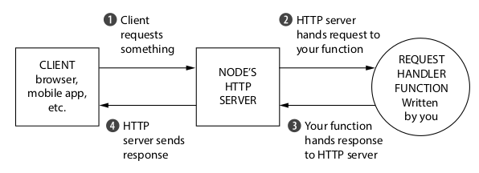
A request through a Node.js web application
The JavaScript function that processes browser requests in your application is called a request handler. it’s a JavaScript function that takes the request, figures out what to do, and responds. Node.js’s HTTP server handles the connection between the client and your JavaScript function so that you don’t have to handle tricky network protocols.

Slide 4
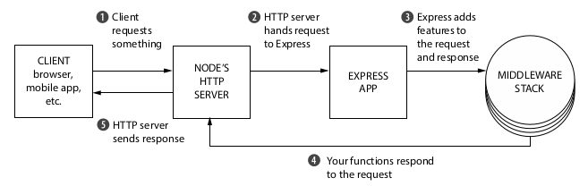
What Express adds to Node.js
It adds a number of helpful conveniences to Node.js’s HTTP server, abstracting away a lot of its complexity. For example, sending a single JPEG file is fairly complex in raw Node.js; Express reduces it to one line.
It lets you refactor one monolithic request handler function into many smaller request handlers that handle only specific bits and pieces. This is more maintainable and more modular.

Slide 5
Express’s minimal philosophy
It’s very rare to build an Express app of any size that uses only Express. Express by
itself probably doesn’t do everything you need, and you’ll likely find yourself with a
large number of other libraries that you integrate into your Express applications.
connect-ratelimit—Lets you throttle connections to a certain number of requests per hour. If someone is sending numerous requests to your server, you can start giving them errors to stop them from bringing your site down.
Helmet—Helps you add HTTP headers to make your app safer against certain kinds of attacks.
cookie-parser—Parses browser cookies.
morgan — HTTP request logger middleware

Slide 6
The core parts of Express
Middleware—In contrast to vanilla Node, where your requests flow through only one function, Express has a middleware stack, which is effectively an array of functions.
Routing—Routing is a lot like middleware, but the functions are called only when you visit a specific URL with a specific HTTP method. For example, you could only run a request handler when the browser visits yourwebsite.com/about.
Extensions to request and response objects—Express extends the request and response objects with extra methods and properties for developer convenience.
Views—Views allow you to dynamically render HTML. This both allows you to change the HTML on the fly and to write the HTML in other languages.

Slide 7
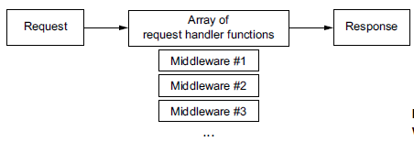
Middleware and the middleware stack
Web servers listen for requests, parse those requests, and send responses. The Node runtime will get these requests first and turn them from raw bytes into two JavaScript objects that you can handle: one object for the request ( req ) and one object for the response ( res) . In Node, these two objects are passed through just one function. But in Express, these objects are passed through an array of functions, called the middleware stack.

Slide 8
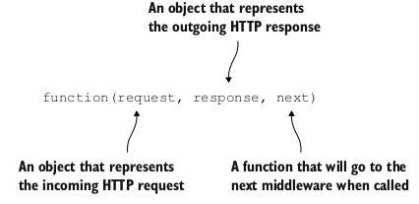
Middleware and the middleware stack
Every function in this stack takes three arguments. The first two are req and res from before. They’re given to you by Node, although Express decorates them with a few convenience features
The third argument to each of these functions is itself a function, conventionally called next. When next is called, Express will go on to the next function in the stack.
Eventually, one of these functions in the stack must call res.end, which will end the request. (In Express, you can also call some other methods like res.send or res.sendFile, but these call res.end internally.) You can call res.end in any of the functions in the middleware stack, but you must only do it once or you’ll get an error.

Slide 9
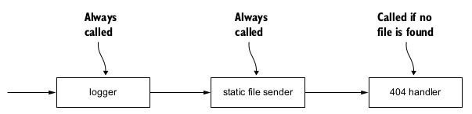
Example app: a static file server
The logger—This will output the requested URL and the time it was requested to the console. It’ll always continue on to the next middleware. (In terms of code, it’ll always call next .)
The static file sender—This will check if the file exists in the folder. If it does, it’ll send that file over the internet. If the requested file doesn’t exist, it’ll continue on to the final middleware (once again, calling next ).
The 404 handler—If this middleware is hit, it means that the previous one didn’t find a file, and you should return a 404 message and finish up the request.

Slide 10
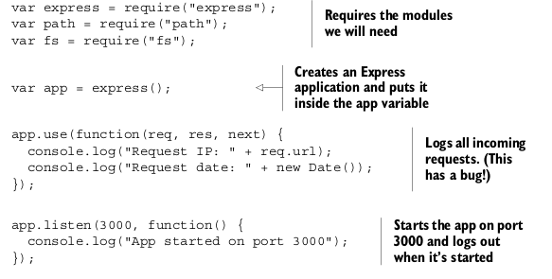

A logger function
Your browser will hang—the loading spinner will spin and spin and spin, until the request eventually times out and you get an error in your browser.
It needs to finish responding to the request (with res.end or one of Express’s convenience methods like res.send or res.sendFile).
It needs to call next to continue on to the next function in the middleware stack.

Slide 11
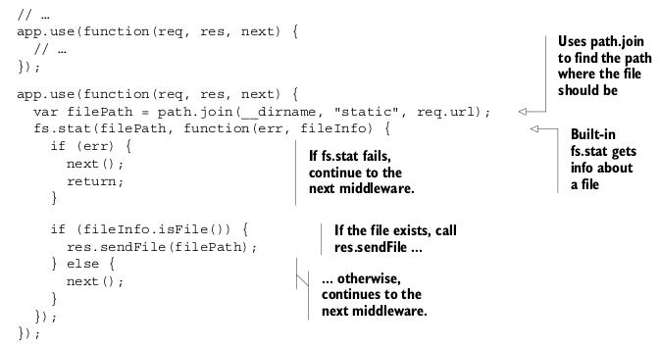
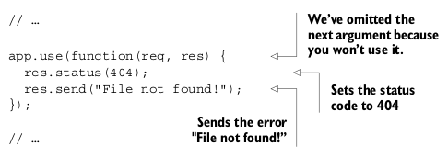
Static file middleware
Express applications have asynchronous behavior like this all the time. That’s why we must have next in the first place! If everything were synchronous, Express would know exactly where every middleware ended: when the function finished (either by calling return or hitting the end). You wouldn’t need to have next anywhere. But because things are asynchronous, you need to manually tell Express when to continue on to the next middleware in the stack.

Slide 12
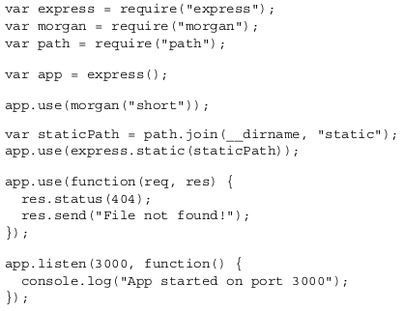
Alternative using third party modules

Slide 13
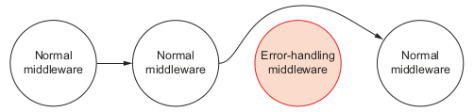
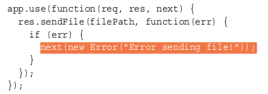
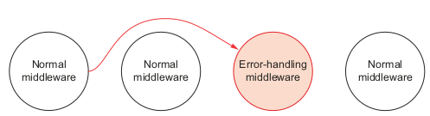
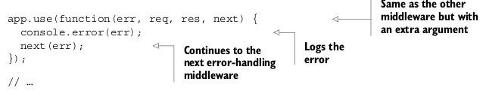
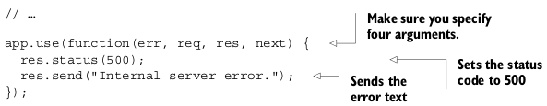
Error-handling middleware
There’s a second kind of middleware that’s much less-used: error-handling middleware. When your app is in error mode, all regular middleware is ignored and Express will execute only error-handling middleware functions. To enter error mode, simply call next with an argument. It’s convention to call it with an error object, as in next(new Error ("Something bad happened!")) .

Slide 14
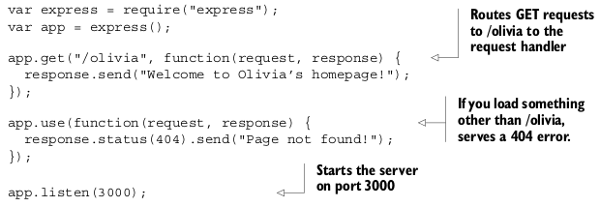
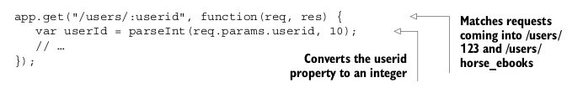
Routing
Routing is a way to map requests to specific handlers depending on their URL and HTTP verb. Conceptually, it’s not too crazy: it maps an HTTP verb + URI combo to a request handler. This lets you map things like GET /about or POST /user/log_in to a specific bit of code.

Slide 15
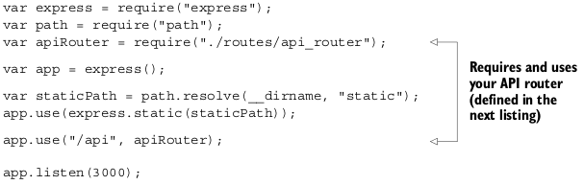
Using routers to split up your app
A router is an isolated instance of middleware and routes. Routers can be thought of as “mini” applications only capable of performing middleware and routing. Every express application has a built-in app router.
Routers allow you to chunk your big app into numerous mini-apps that you can later put together. For small apps, this might be overkill, but as soon as you think, “This app.js file is getting big,” it’s time to think about breaking down your app with routers.

Slide 16

Extending request and response
Express augments the request and response objects that you’re passed in every request handler. The old stuff is still there, but Express adds some new stuff too! The API docs (http://expressjs.com/api.html) explain everything.

Slide 17
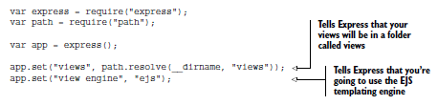
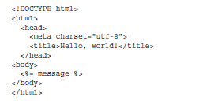

Views
A number of different view engines are available. There’s EJS (which stands for Embedded JavaScript), Handlebars, Pug, and more.

Slide 18
Modifying Express for MVC
Firstly, what is MVC architecture? MVC architecture separates the data (model), the display (view) and the application logic (controller).
At a simple level, this loop in an MVC architecture works like this:
A request comes into the application.
The request gets routed to a controller.
The controller, if necessary, makes a request to the model.
The model responds to the controller.
The controller merges the view and the data to form a response.
The controller sends the generated response to the original requester.

Slide 19
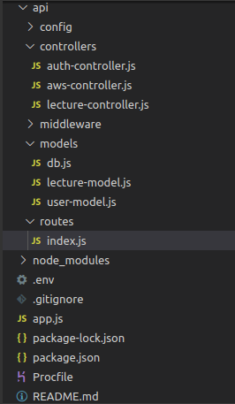
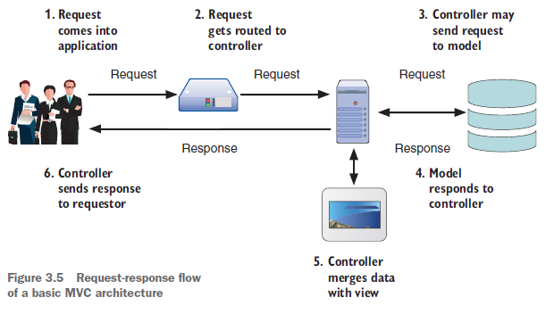
Modifying Express for MVC

Slide 20


