Slide 1
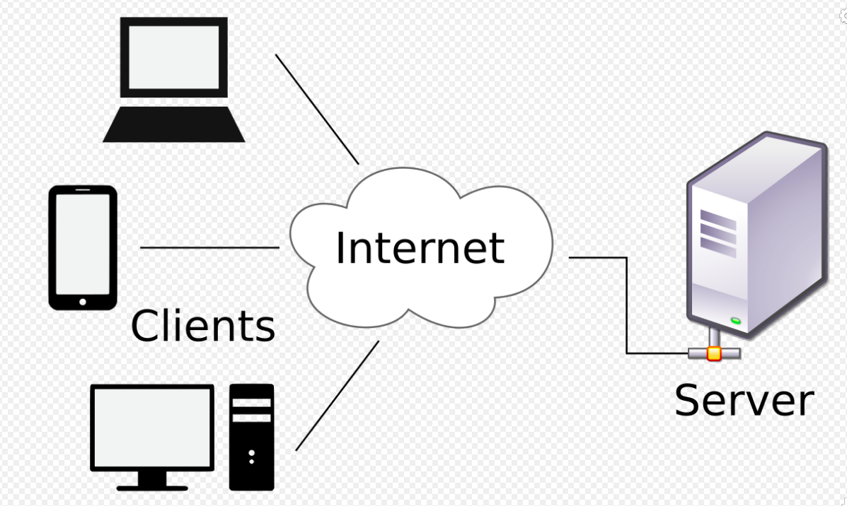
Web Application Architecture, HTTP protocol, REST
Notes:
<number>

Slide 2
The Client Side
URL (Uniform Resource Locator)
http://www.cs.washington.edu/index.html
URLs have three parts: the protocol (also known as the scheme), the DNS name of the machine on which the page is located, and the path uniquely indicating the specific page (a file to read or program to run on the machine).

Slide 3
1. The browser determines the URL (by seeing what was selected).
2. The browser asks DNS for the IP address of the server www.cs.washington.edu.
3. DNS replies with 128.208.3.88.
4. The browser makes a TCP connection to 128.208.3.88 on port 80, the well-known port for the HTTP protocol.
5. It sends over an HTTP request asking for the page /index.html.
6. The www.cs.washington.edu server sends the page as an HTTP response, for example, by sending the file /index.html.
7. If the page includes URLs that are needed for display, the browser fetches the other URLs using the same process. In this case, the URLs include multiple embedded images also fetched from www.cs.washington.edu, an embedded video from youtube.com, and a script from google analytics.com.
8. The browser displays the page /index.html as it appears.
9. The TCP connections are released if there are no other requests to the same servers for a short period.

Slide 4
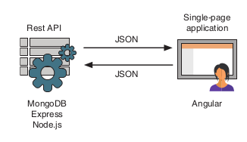
What is a REST API?
REST stands for Representational State Transfer, which is an architectural style rather than a strict protocol. REST is stateless; it has no idea of any current user state or history.
API is an abbreviation for application program interface, which enables applications to talk to one another. In the case of the web, an API is normally a set of URLs that respond with data when called in the correct manner with the correct information.
A REST API is a stateless interface to your application. In the case of the MEAN stack, the REST API is used to create a stateless interface to your database, enabling a way for other applications, such as an Angular SPA, to work with the data. In other words, you create a collection of structured URLs that return specific data when called

Slide 5
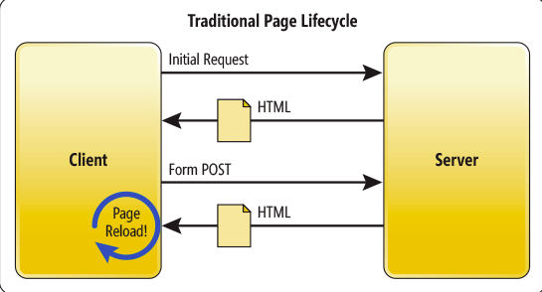
Traditional Page Lifecycle
MPA has a classical architecture, which means that each page of a website has to be completely reloaded upon the request to the server when updating data.

Slide 6
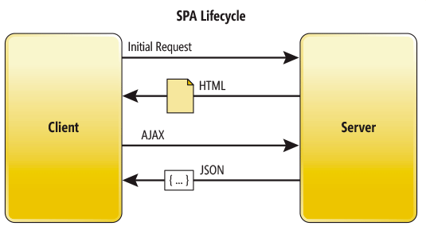
SPA Lifecycle
SPA is created in the way to update only a portion of a content, which allows avoiding the full page reload.

Slide 7
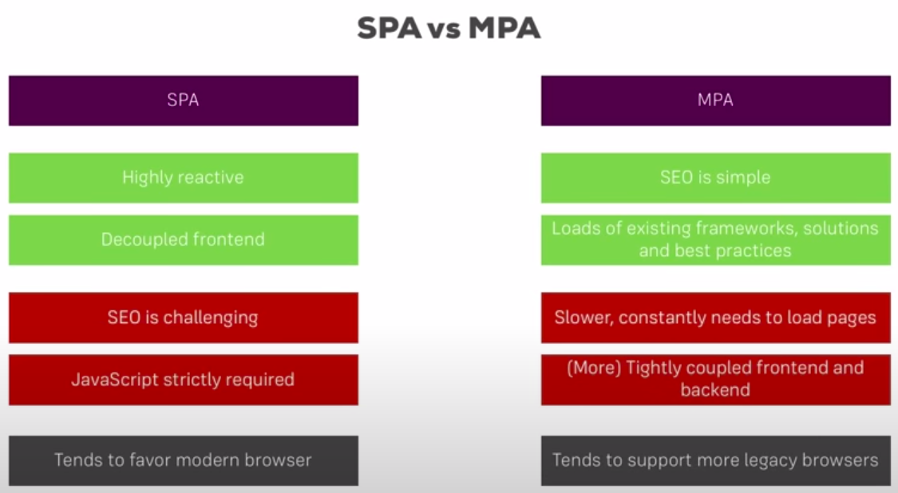
SPA vs MPA

Slide 8
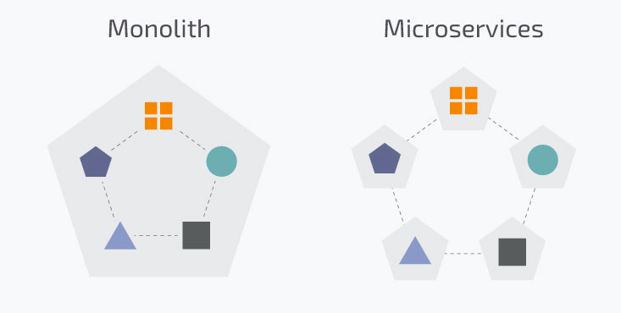
The server side
The monolithic architecture is considered to be a traditional way of building applications. A monolithic application is built as a single and indivisible unit. Usually, such a solution comprises a client-side user interface, a server side-application, and a database. It is unified and all the functions are managed and served in one place.
Normally, monolithic applications have one large code base and lack modularity. If developers want to update or change something, they access the same code base. So, they make changes in the whole stack at once.

Slide 9
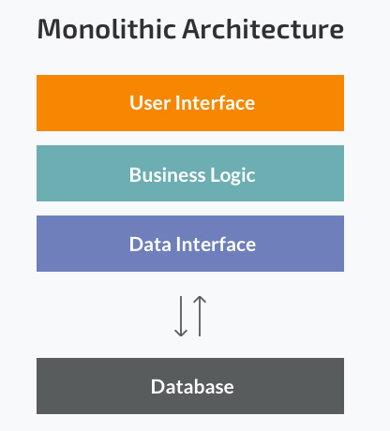
The monolithic Architecture
Less cross-cutting concerns. Cross-cutting concerns are the concerns that affect the whole application such as logging, handling, caching, and performance monitoring. In a monolithic application, this area of functionality concerns only one application so it is easier to handle it.
Easier debugging and testing. In contrast to the microservices architecture, monolithic applications are much easier to debug and test. Since a monolithic app is a single indivisible unit, you can run end-to-end testing much faster.
Simple to deploy. Another advantage associated with the simplicity of monolithic apps is easier deployment. When it comes to monolithic applications, you do not have to handle many deployments – just one file or directory.

Slide 10
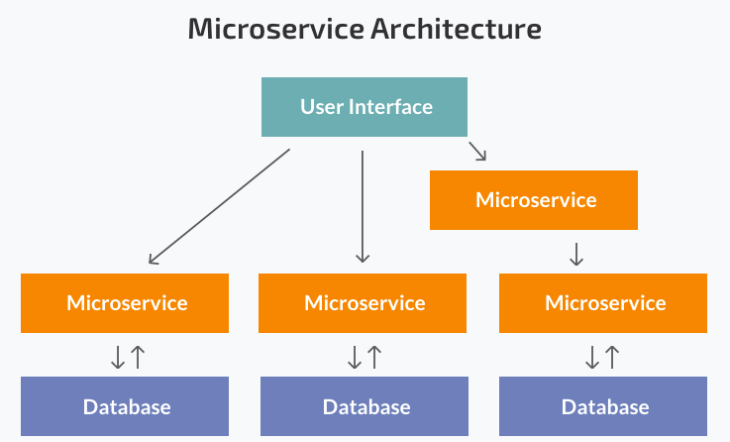
Microservice Architecture
In short, the microservice architectural style is an approach to developing a single application as a suite of small services, each running in its own process and communicating with lightweight mechanisms, often an HTTP resource API.
Notes:
While a monolithic application is a single unified unit, a microservices architecture breaks it down into a collection of smaller independent units. These units carry out every application process as a separate service. So all the services have their own logic and the database as well as perform the specific functions.
Within a microservices architecture, the entire functionality is split up into independently deployable modules which communicate with each other through defined methods called APIs (Application Programming Interfaces). Each service covers its own scope and can be updated, deployed, and scaled independently.
<number>

Slide 11
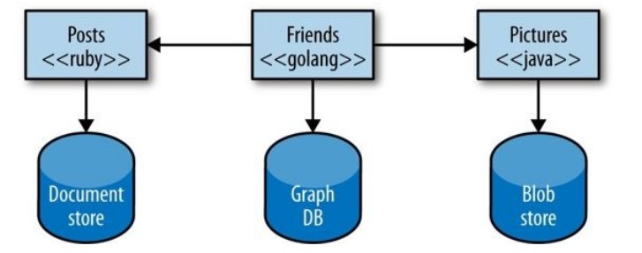
Key Benefits
With a system composed of multiple, collaborating services, we can decide to use different technologies inside each one. This allows us to pick the right tool for each job, rather than having to select a more standardized, one-size-fits-all approach that often ends up being the lowest common denominator.
Notes:
With microservices, we are also able to adopt technology more quickly, and understand
how new advancements may help us. One of the biggest barriers to trying out and
adopting new technology is the risks associated with it. With a monolithic application, if I
want to try a new programming language, database, or framework, any change will impact
a large amount of my system. With a system consisting of multiple services, I have
multiple new places in which to try out a new piece of technology. I can pick a service that
is perhaps lowest risk and use the technology there, knowing that I can limit any potential
negative impact. Many organizations find this ability to more quickly absorb new
technologies to be a real advantage for them.

Slide 12
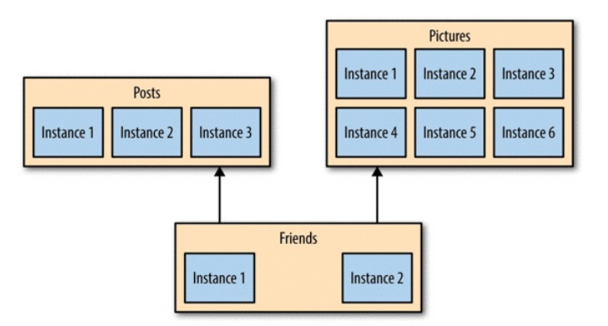
Key Benefits
Resilience
If one component of a system fails, but that failure doesn’t cascade, you can isolate the problem and the rest of the system can carry on working.
Scaling
With a large, monolithic service, we have to scale everything together. One small part of our overall system is constrained in performance, but if that behavior is locked up in a giant monolithic application, we have to handle scaling everything as a piece. With smaller services, we can just scale those services that need scaling, allowing us to run other parts of the system on smaller, less powerful hardware

Slide 13
Key Benefits
Ease of Deployment
A one-line change to a million-line-long monolithic application requires the whole application to be deployed in order to release the change.
Organizational Alignment
Microservices allow us to better align our architecture to our organization, helping us minimize the number of people working on any one codebase to hit the sweet spot of team size and productivity.
Optimizing for Replaceability
Teams using microservice approaches are comfortable with completely rewriting services when required, and just killing a service when it is no longer needed. When a codebase is just a few hundred lines long, it is difficult for people to become emotionally attached to it, and the cost of replacing it is pretty small.
Notes:
With microservices, we can make a change to a single service and deploy it independently of the rest of the system. This allows us to get our code deployed faster. If a problem does occur, it can be isolated quickly to an individual service, making fast rollback easy to achieve.
<number>

Slide 14
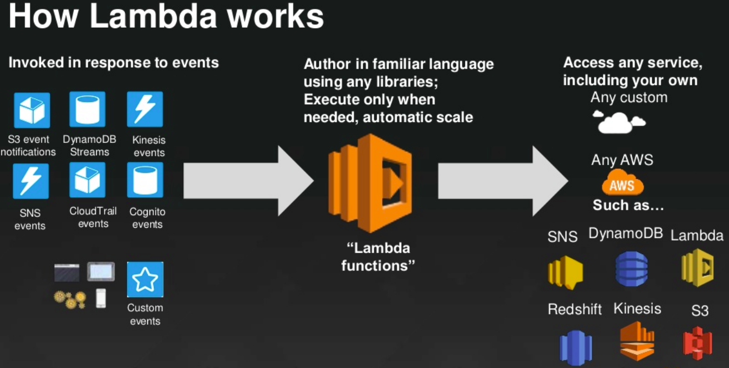
But the main benefit of serverless is that you don’t do any server configuration, balancing, scaling basically, any kind of server management. The serverless provider manages all of that for you while also guaranteeing that if a large number of calls to your application occur at the same time, it will clone enough containers to handle all the calls, and each clone will be an exact copy of the first. If necessary, the provider will create thousands of clones.
The compute container is event-driven, so it’s activated only when a certain event triggers.
Notes:
Rather than renting a server for your application, setting up the environment, and deploying it, you upload your application to your serverless provider, which takes care of assigning servers, storage, application handling, setup, and execution.
More precisely, the provider stores your application inside a certain container. The container represents an isolated environment that contains everything your application needs to run.
Finally, serverless providers offer various triggers that can run your functions. The list of triggers depends on the provider and implementation, but some of the most common triggers are HTTP requests, file uploads to file storage, database updates, and Internet of Things (IoT) events. There are
many more.
<number>

Slide 15
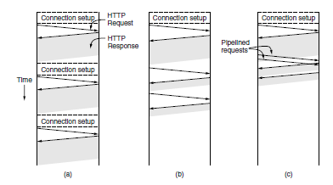
HTTP—The HyperText Transfer Protocol
HTTP is a simple request-response protocol that normally runs over TCP. It specifies what messages clients may send to servers and what responses they get back in return.
Connections
The usual way for a browser to contact a server is to establish a TCP connection to port 80 on the server’s machine, although this procedure is not formally required. The value of using TCP is that neither browsers nor servers have to worry about how to handle long messages, reliability, or congestion control. All of these matters are handled by the TCP implementation.

Slide 16
Methods
HTTP defines a set of request methods to indicate the desired action to be performed for a given resource.
  The GET method requests a representation of the specified resource. Requests using GET should only retrieve data.
  The HEAD method asks for a response identical to that of a GET request, but without the response body.
  The POST method is used to submit an entity to the specified resource, often causing a change in state or side effects on the server
  The PUT method replaces all current representations of the target resource with the request payload.
  The DELETE method deletes the specified resource.
  The CONNECT method establishes a tunnel to the server identified by the target resource.
  The OPTIONS method is used to describe the communication options for the target resource.
  The TRACE method performs a message loop-back test along the path to the target resource.
  The PATCH method is used to apply partial modifications to a resource

Slide 17
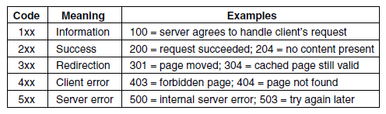
Status codes
The status line contains a three-digit status code telling whether the request was satisfied and, if not, why not.
The 1xx codes are rarely used in practice. The 2xx codes mean that the request was handled successfully and the content (if any) is being returned. The 3xx codes tell the client to look elsewhere, either using a different URL or in its own cache (discussed later). The 4xx codes mean the request failed due to a client error such an invalid request or a nonexistent page. Finally, the 5xx errors mean the server itself has an internal problem, either due to an error in its code or to a temporary overload

Slide 18
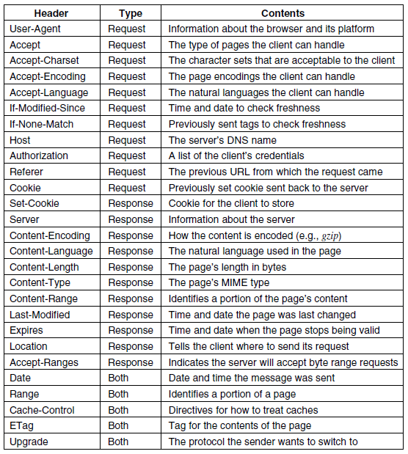
Message Headers

Slide 19
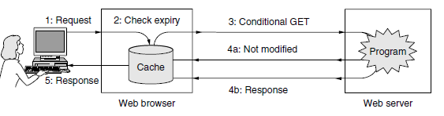
Caching
Notes:
HTTP has built-in support to help clients identify when they can safely reuse pages. This support improves performance by reducing both network traffic and latency.
The difficult issue with HTTP caching is how to determine that a previously cached copy of a page is the same as the
HTTP uses two strategies to tackle this problem. They are shown in Fig. 7-40 as forms of processing between the request (step 1) and the response (step 5). The first strategy is page validation (step 2). The cache is consulted, and if it has a copy of a page for the requested URL that is known to be fresh (i.e., still valid), there is no need to fetch it anew from the server. Instead, the cached page can be returned directly. The Expires header returned when the cached page was originally fetched and the current date and time can be used to make this determination.page would be if it was fetched again.
In this case, the browser may use heuristics. For example, if the page has not been modified in the past year (as told by the Last-Modified header) it is a fairly safe bet that it will not change in the next hour.
The second strategy is used in this case. It is to ask the server if the cached copy is still valid. This request is a conditional GET, and it is shown in Fig. 7-40 as step 3. If the server knows that the cached copy is still valid, it can send a short reply to say so (step 4a). Otherwise, it must send the full response (step 4b).
<number>

Slide 20
Hypertext Transfer Protocol Secure (HTTPS)
Hypertext Transfer Protocol communication Secure (HTTPS) is an extension of the Hypertext Transfer Protocol (HTTP). It is used for secure over a computer network, and is widely used on the Internet. In HTTPS, the communication protocol is encrypted using Transport Layer Security (TLS) or, formerly, its predecessor, Secure Sockets Layer (SSL). The protocol is therefore also often referred to as HTTP over TLS, or HTTP over SSL.

Slide 21


