Slide 1
Node.js Testing.
Notes:
<number>

Slide 2
What is Testing?
Automated testing lets you codify (literally!) how you want your software to behave and lets you say, “My code works!” with much more confidence. It lets you refactor code.
Without tests, you’ll have to manually verify that your old code behaves like the new code. With good automated tests, you can be confident that this refactoring doesn’t break anything.
Notes:
<number>

Slide 3
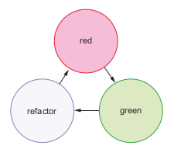
Test-driven development
The red step. Because it’s TDD , you write your tests first. When you write these tests before you write any of the real code, none of your tests green refactor will pass. During the red step, you write all of your tests and run them to watch them all fail.
The green step. Now that you’ve written all of your tests, you begin to fill in the real code to satisfy all the tests. As you make progress, your tests will slowly go from red (failing) to green (passing).
The refactor step. If all of your tests are green, that means all of your code works, but it might not be perfect. Perhaps one of your functions is slow or you’ve chosen bad variable names. Because you have all of your tests, you can refactor without worrying that you’re breaking some unforeseen part of your code.
Repeat the process.

Slide 4
Code coverage
Code coverage tools see how much of your code is covered by your tests. You could imagine writing 10 passing tests for your code but completely ignoring one of your functions, which is totally broken! Code coverage tools tell you what parts of your code are untouched by tests and therefore untested. In the Node world, the prevailing code coverage tool seems to be Istanbul (https://istanbul.js.org/).

Slide 5
Introducing the Mocha testing framework
Mocha (https://mochajs.org/) is a testing framework which gives you a nice syntax for organizing your tests and has several other features like asynchronous test support and easy to-read output. It’s not specifically tied to Express, so you can use it to test Express applications, JavaScript functions, database models, and anything else that runs inside the Node runtime.

Slide 6
How does Node.js testing work?
The real code is whatever you want to test. This might be a function, or a database model, or an Express server. In a Node.js context, this is anything that assigns something to module.exports . The test code tests your real code. This will require whatever you want to test and then start asking questions about it. Does the function return what it should return? Do your objects behave as they should? The test runner is an executable that runs on your computer. It looks at your test code and runs it. Test runners commonly print out things like “These tests succeeded, these tests failed, and here’s how” or “The tests took 100 milliseconds to run.”

Slide 7
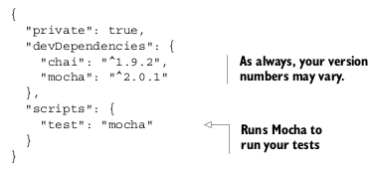
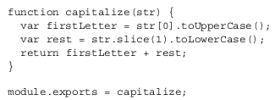
Setting up Mocha and the Chai assertion library
Mocha waits for an assertion library to throw an error. If no error is thrown, the test passes. If an error is thrown, the test fails. That’s why you use Chai—it’s a nice way to throw errors when your tests fail.

Slide 8
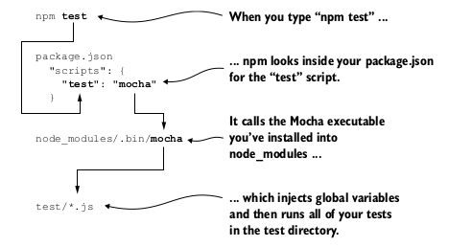
What happens when you run your tests

Slide 9
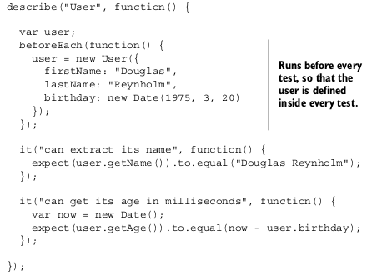


More features of Mocha and Chai
RUNNING CODE BEFORE EACH TEST
TESTING FOR ERRORS
REVERSING TESTS

Slide 10
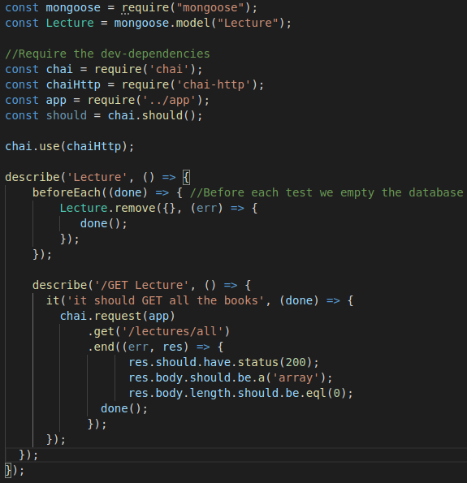
Testing a simple API

Slide 11
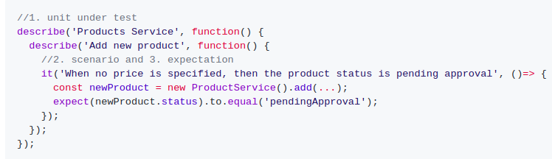
Node.js Testing Best Practices
Include 3 parts in each test name
(1) What is being tested? For example, the ProductsService.addNewProduct method
(2) Under what circumstances and scenario? For example, no price is passed to the method
(3) What is the expected result? For example, the new product is not approved

Slide 12
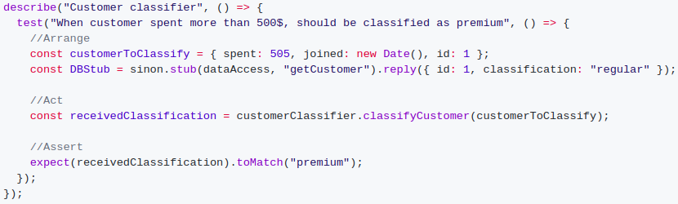
Node.js Testing Best Practices
Structure tests by the AAA pattern
1st A - Arrange: All the setup code to bring the system to the scenario the test aims to simulate. This might include instantiating the unit under test constructor, adding DB records, mocking/stubbing on objects and any other preparation code
2nd A - Act: Execute the unit under test. Usually 1 line of code
3rd A - Assert: Ensure that the received value satisfies the expectation. Usually 1 line of code

Slide 13
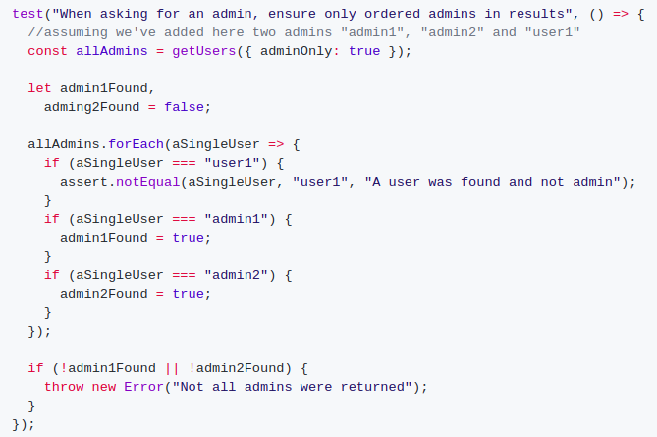
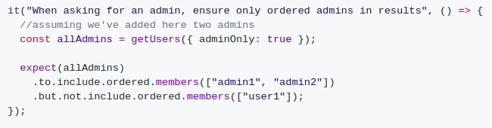
Node.js Testing Best Practices
Describe expectations in a product language: use BDD-style assertions
When you write imperative code that is packed with conditional logic, the reader is forced to exert more brain-CPU cycles. In that case, code the expectation in a human-like language, declarative BDD style using expect or should and not using custom code. If Chai & Jest doesn't include the desired assertion and it’s highly repeatable, consider extending Jest matcher (Jest) or writing a custom Chai plugin

Slide 14
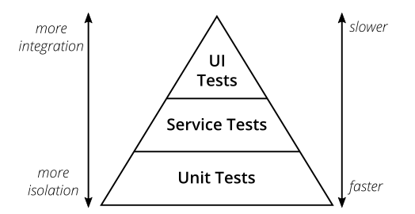
The Test Pyramid

Slide 15
Useful links
https://github.com/goldbergyoni/javascript-testing-best-practices/
https://martinfowler.com/articles/practical-test-pyramid.html

Slide 16


