Slide 1

Team up – cubetris Innovative game mechanics
Students:
Vladimir Lando – 319267852
Yaroslab Svirsky – 313847501
Academic supervisor:
Dr. Hanan Gazith

Slide 2
Agenda
Motivation – Why this project?
Existing similar products.
Innovations over existing projects.
Concept.
Software Engineering solutions used in the project.
Current Progress.

Slide 3
Motivation
Creating a unique game mechanics by combining multiple tested mechanics from commercially successful games.
Allowing users across different gaming platforms to play together and offer unique rewarding experience for each platform.
Stretching the limits of existing Natural User Interface controllers.
Notes:
קרוספלאטפורם וטאבלטים ביחד עם קינקט
קונספט חדש

Slide 4
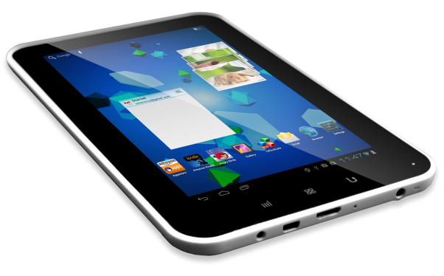
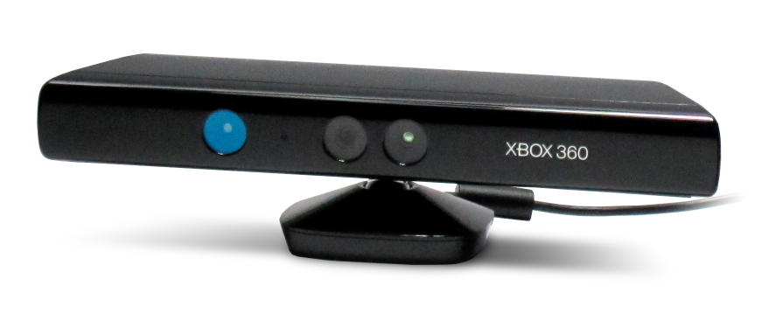
First TIME EVER
VS

Slide 5
Existing Products
Our game is based on four proven gameplay mechanics:
Tetris – Building a tower from falling blocks.
Tower Defense – Defending your tower from incoming enemies.
Intuitive touch controls.
NUI controls.
Unfortunately most of the new games in those genres doesn’t offer any new experience over their predecessors.

Slide 6
Innovations
Combining two game genres into single one.
Allowing user input from various I/O devices (Mice, Touch, Kinect) at the same time in ONLINE multiplayer.
First time ever Kinect/iOS/Android multiplayer game!
Offering different experience for various game platforms.

Slide 7

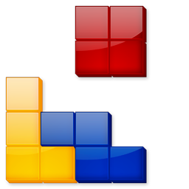
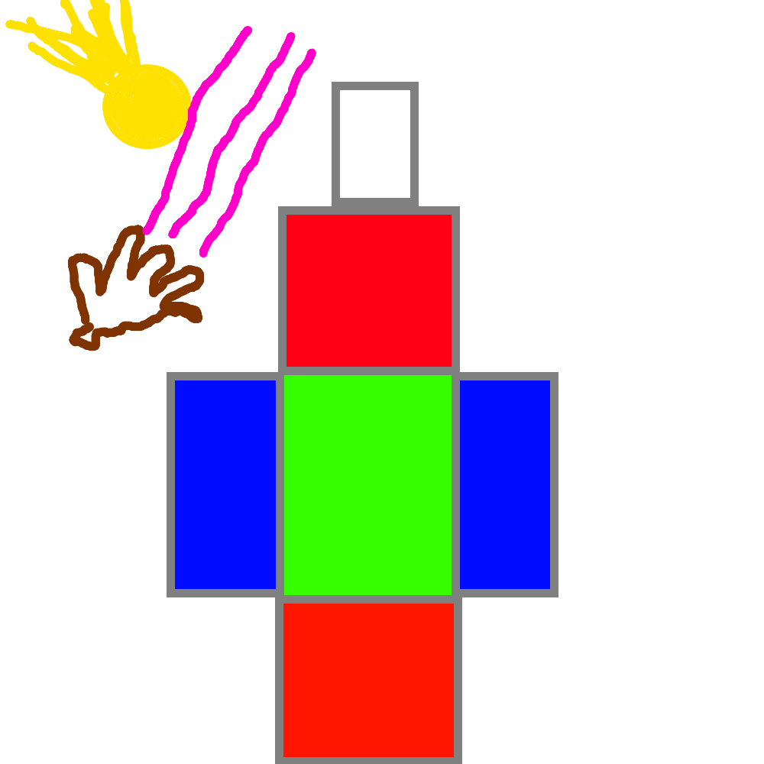
UNIQUE COMBO
+
=
/* First game concept*/
/* TODO: Improve (: */

Slide 8
Concept
Tetris and Tower Defense combination.
One of the players is responsible for building a tower according to level requirements, while his team mate defends it from incoming enemy missiles.
Multiplayer and cross platform compatibility:
PC – Mice, Kinect controls
IOS – Touch controls
Android – Touch controls
WP8 – Touch controls

Slide 9



Frameworks and SDK’s
Both server and client were written using C# with .NET 2.0 libraries.
The client was made in Unity3D environment, using customized NVidia PhysX engine for game physics.
Server side low level code is based on Player.IO library.

Slide 10
Coding philosophy and standards
OOP design, for example:
BaseShape->BlockShape->CubeShape
Using MVC pattern.
Using interfaces to allow dynamic changing of modules.
3rd party wrappers to illuminate dependencies.
Clear comments.
Decreasing code complexity using code complexity measurement tools and reducing single functions complexity.

Slide 11


Slide 12
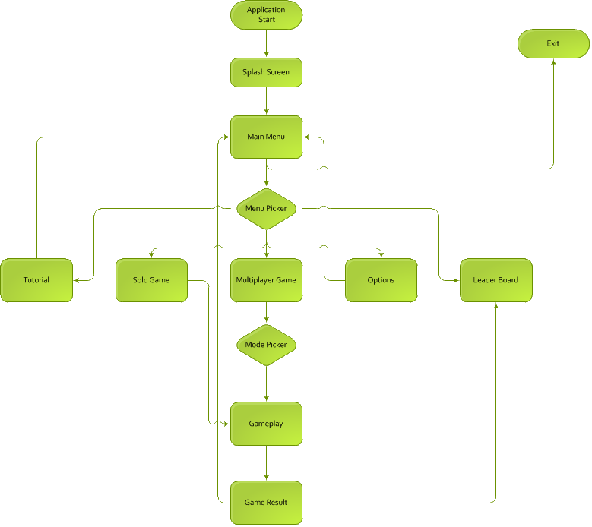
Client Sequence Diagram

Slide 13
Basic Client-Server Diagram

Slide 14
Project Progress
Done:
Basic game engine and physics tuning.
Dynamic levels from XML system is fully implemented.
Basic mode of Multiplayer game.
Server side logic and implementation.
Server side storing stats in DB.
Touch and mouse controls.
Not in the game yet:
Kinect integration.
Expanded gameplay(Stats, level based matchmaking, leaderboards and achievements).
Professional graphics.

Slide 15
Programming Challenges
Creation of previously missing Kinect grip gesture.
Complex software system with over 18K of code and 7K of comments.
Real-time server-client side performance issues.
Converting from 3D space to 2D space.
Modifying real-time physics engine for multiplayer compatibility.
Graphical design.
Increasing the “FUN” factor.
Level design and creation.

Slide 16
Future Development
Mode for people with physical disabilities.
Player profile.
Tutorial mode.
Tournaments and special events.
Game consoles support.
IAP

Slide 17

Thanks for watching

