Slide 1
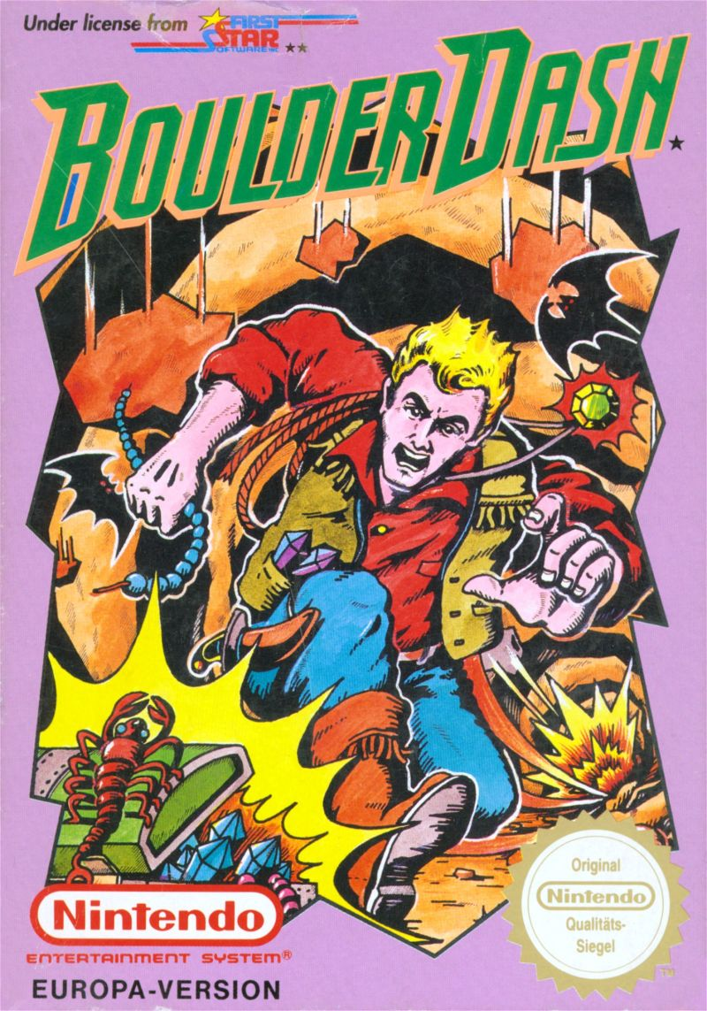

Boulder Dash
Object-oriented programing project

Slide 2
Table of contents
Project actors
Game presentation
Demonstration
Possible upgrades
Question
Emmanuel – Gautier – Hugo – Julien

Slide 3



Project actors
Jean-Aymeric DIET
Consultant
Gautier VUILLAUME
Project Manager
Emmanuel BOUSSER
Developer
Julien HENROTIN
Developer
Hugo ROUTY
Developer
Emmanuel – Gautier – Hugo – Julien

Slide 4
Game presentation
Player
Rock
Enemy
Diamond
Enemy
Door
Emmanuel – Gautier – Hugo – Julien

Slide 5
Maps presentation
Emmanuel – Gautier – Hugo – Julien

Slide 6

Demonstration
Emmanuel – Gautier – Hugo – Julien

Slide 7
Possible upgrades
Add a map to select the level
Add a dual player mode
Emmanuel – Gautier – Hugo – Julien

Slide 8

Questions
Emmanuel – Gautier – Hugo – Julien

Slide 9
Resources
Emmanuel – Gautier – Hugo – Julien

