Slide 1






What is Personalizer ?
Rodrigo Kumpera
rokumper@Microsoft.com
@kumpera

Slide 2






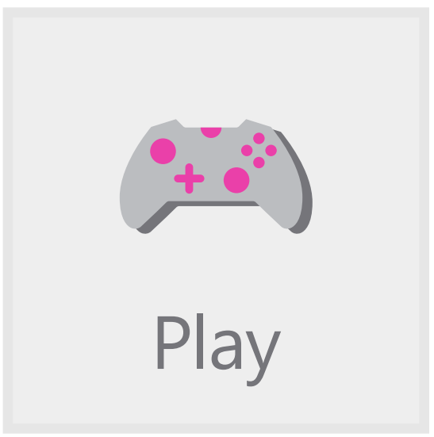

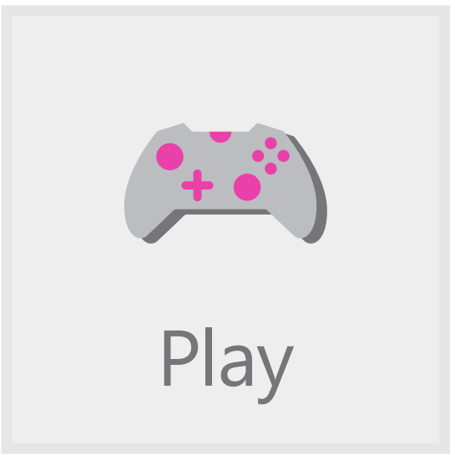
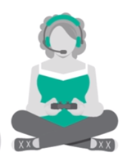








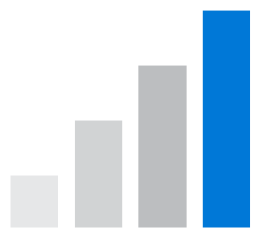
Example…
Your App
User & Context Info
Have Fun!
We think you’ll like…
Action 1 info
?
Action 2 Info
Rank(..)
Personalizer Service
Reward(r)
Your Users
Action 3 Info
Your business logic observing & evaluating user behavior
Reward Score
Notes:
Use icons from EB animation

Slide 3

Show me some code

Slide 4
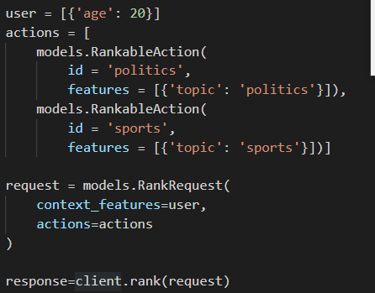
Rank(..)
User& Context info
Actions
Rank it!

Slide 5

Now, the reward
Yes, that’s it.

Slide 6
How does it look inside?
Personalizer Service
User interacts with application /site
User Information
Actions to Choose from
Chosen action
User chooses an action.
{your code}
Reward

Slide 7

It’s a complicated box…
Personalizer Service
Inference & Exploration
Train & Evaluate
User interacts with application /site
User Information, Context, + Features
Model
Inference Model
bestAction = Rank(context,actions) .rewardActionId
Actions to Choose from + Features
Exploration Policy
Training Service
Async via Event Hub
Action Ranking
Joining
Logs
User chooses an action.
Async via Event Hub
{your code}
[0.8]
Reward Score
Reward( 0.8 );
Evaluation
Personalizer Container

Slide 8
The brains
Personalizer Service
Inference & Exploration
Inference Model
Exploration Policy

Slide 9
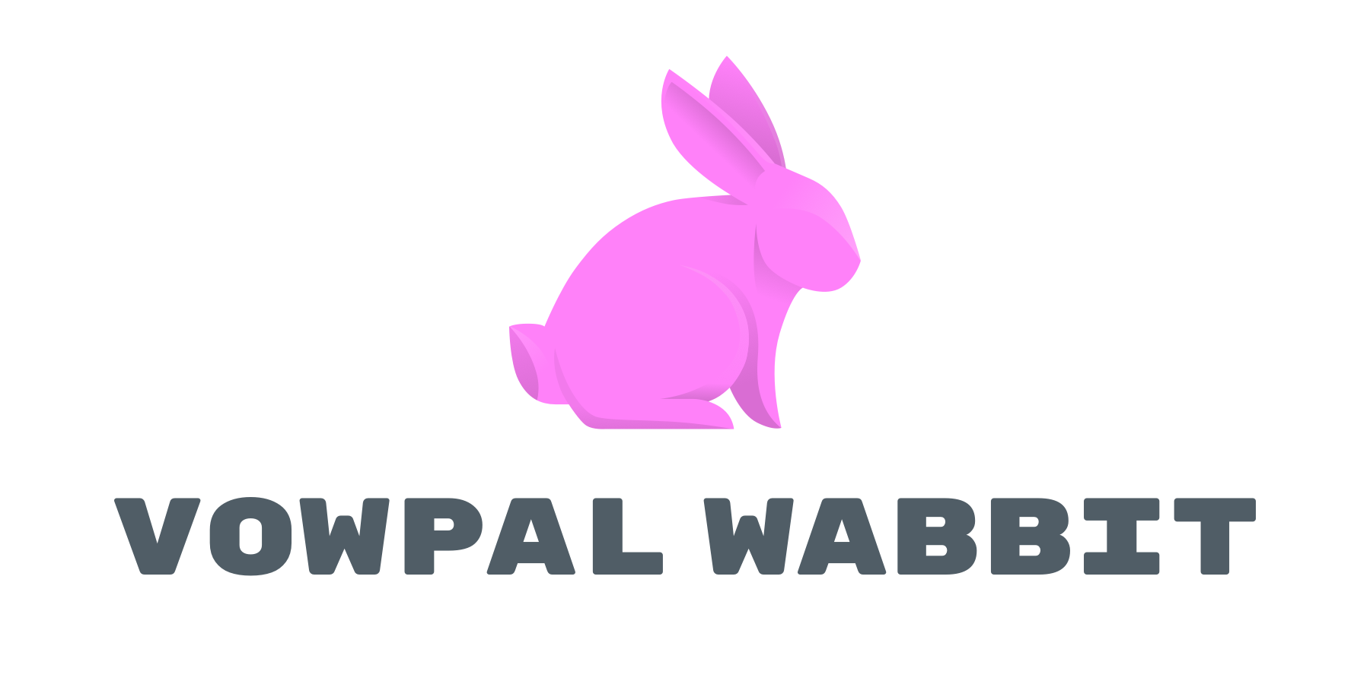
www.vowpalwabbit.org

Slide 10
Vowpal Wabbit
Open Source library
Online, Active or Interactive Learning
Contextual Bandits, Learn2Search, Extreme Classification

Slide 11

Http service wrapped in a container

Slide 12
Logs & Joining
Personalizer Service
Inference & Exploration
Train & Evaluate
User interacts with application /site
User Information, Context, + Features
Model
Inference Model
bestAction = Rank(context,actions) .rewardActionId
Actions to Choose from + Features
Exploration Policy
Training Service
Async via Event Hub
Action Ranking
Joining
Logs
User chooses an action.
Async via Event Hub
{your code}
[0.8]
Reward Score
Reward( 0.8 );
Evaluation
Personalizer Container

Slide 13
Logs & Joining
Personalizer Service
Joining
Logs
Evaluation

Slide 14
Logs & Joining
Joiner
{EventId,Context,Action}
{Event,Context,Action,Reward}
{EventId,Reward}

Slide 15
Trainer
Personalizer Service
Inference & Exploration
Train & Evaluate
User interacts with application /site
User Information, Context, + Features
Model
Inference Model
bestAction = Rank(context,actions) .rewardActionId
Actions to Choose from + Features
Exploration Policy
Training Service
Async via Event Hub
Action Ranking
Joining
Logs
User chooses an action.
Async via Event Hub
{your code}
[0.8]
Reward Score
Reward( 0.8 );
Evaluation
Personalizer Container

Slide 16
Trainer
Personalizer Service
Train & Evaluate
Model
Training Service
Logs

Slide 17
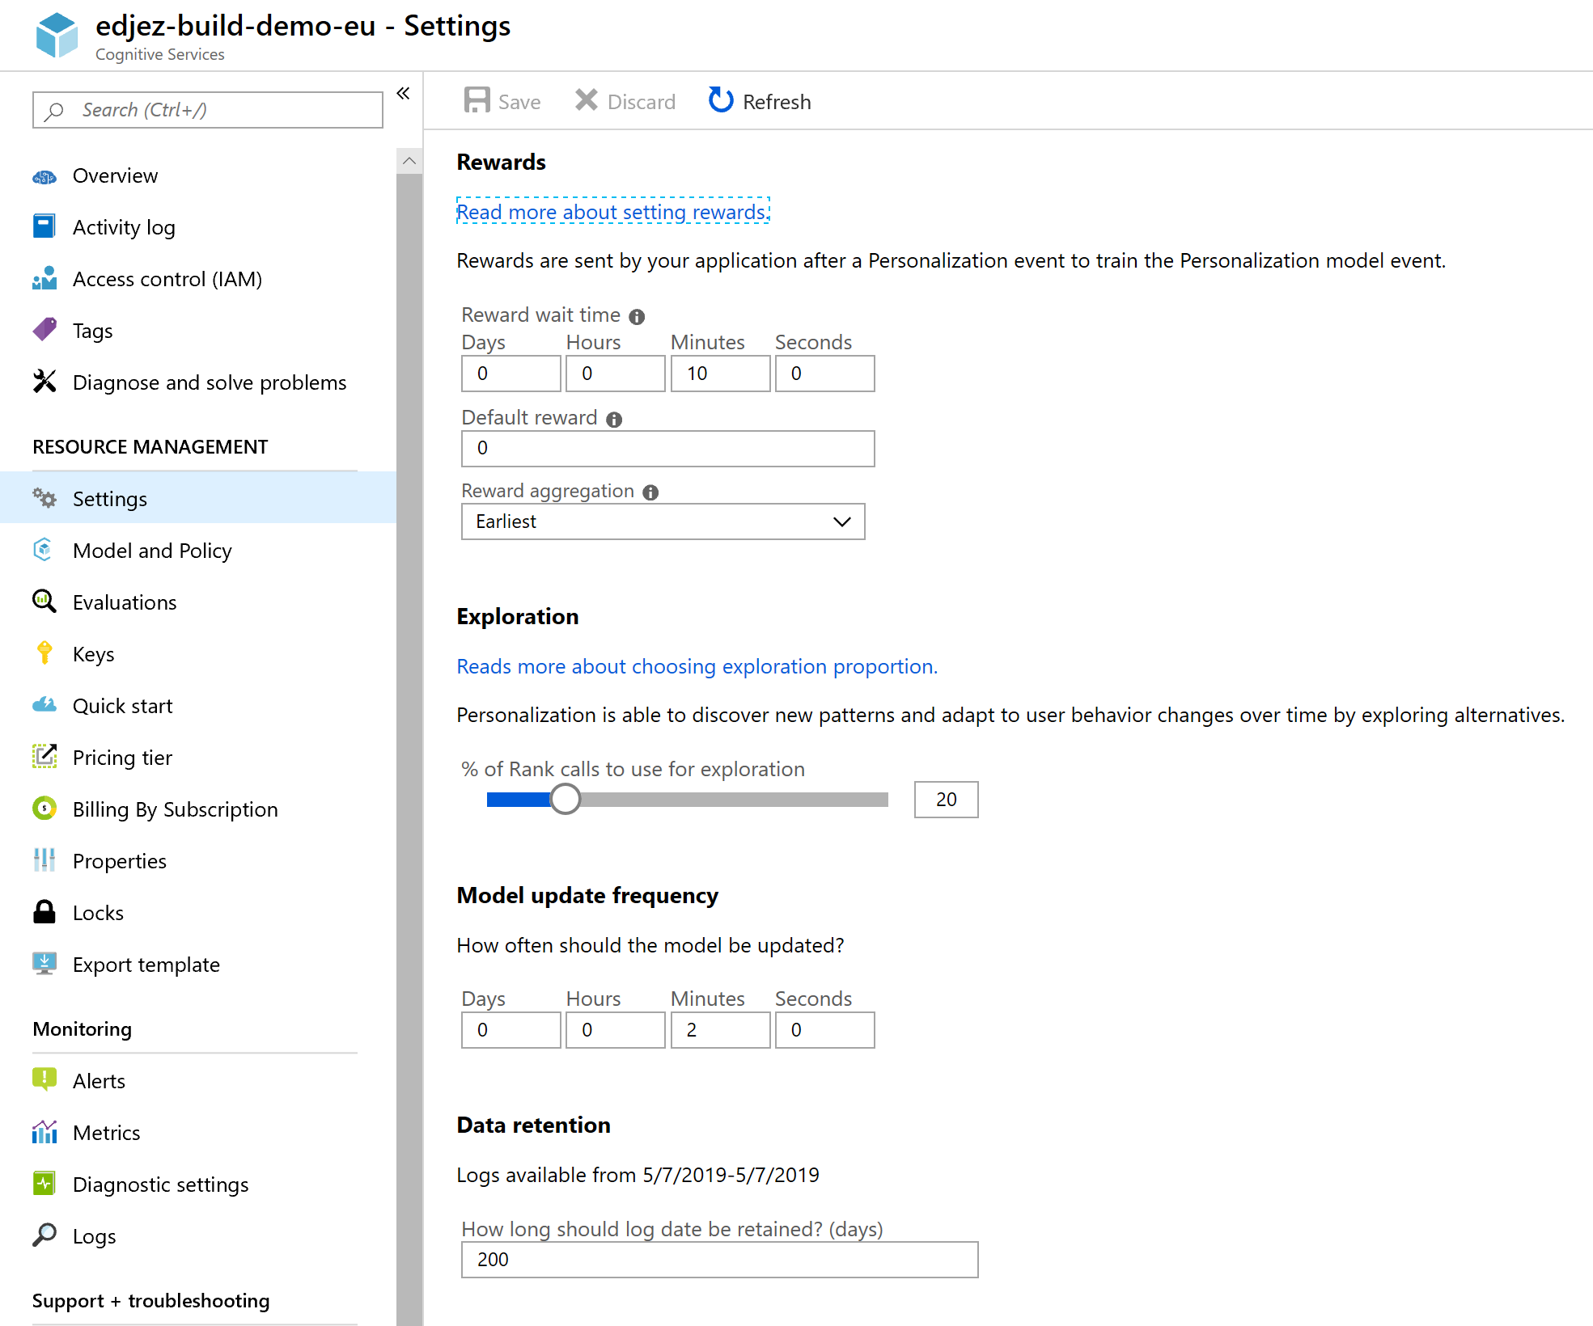
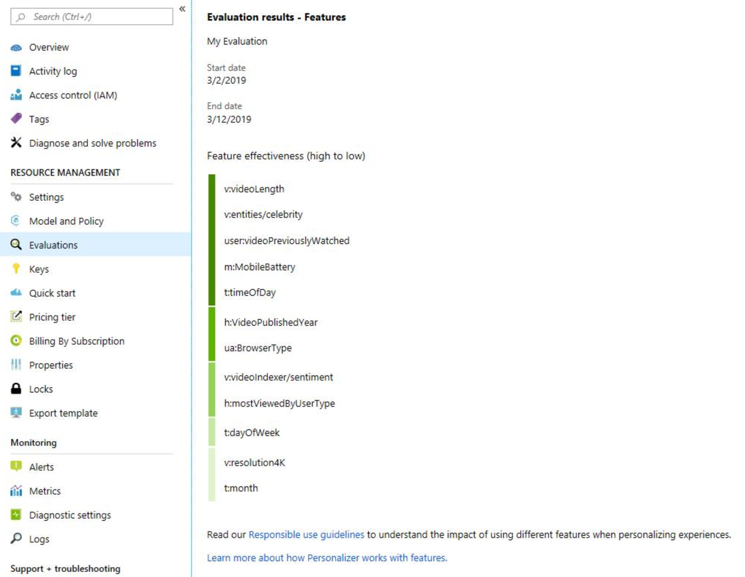
Azure Portal

Slide 18
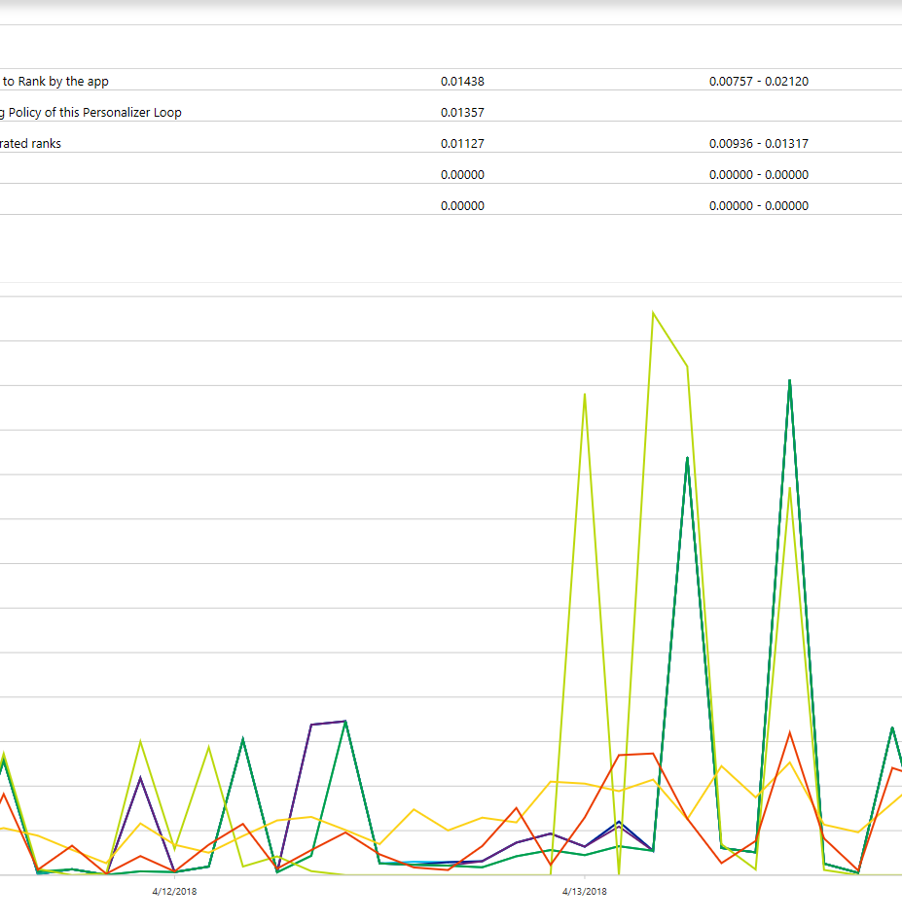
Counter factual evaluation and optimization

Slide 19
Do you have a Bandits problem?
You’re picking one choice from many options.
You don’t know what would happen if you picked the other options.
Your options change over time.
The world keeps changing around you.

Slide 20

You gave me pizza You don’t know my preference to tacos
Notes:
Partial feedback
Why exploration helps

Slide 21





The menu changed!
Notes:
We describe actions by features.

Slide 22






Non stationarity
Notes:
Non stationarity

Slide 23
Questions? Thank you! rokumper@Microsoft.com @kumpera
Azure Portal http://aka.ms/personalizer
Feedback in UserVoice http://aka.ms/personalizer-uservoice
Research Tutorial http://hunch.net/~rwil
ML underpinning: Vowpal Wabbit
ML innovations : conditional contextual bandits,

